Slide 1
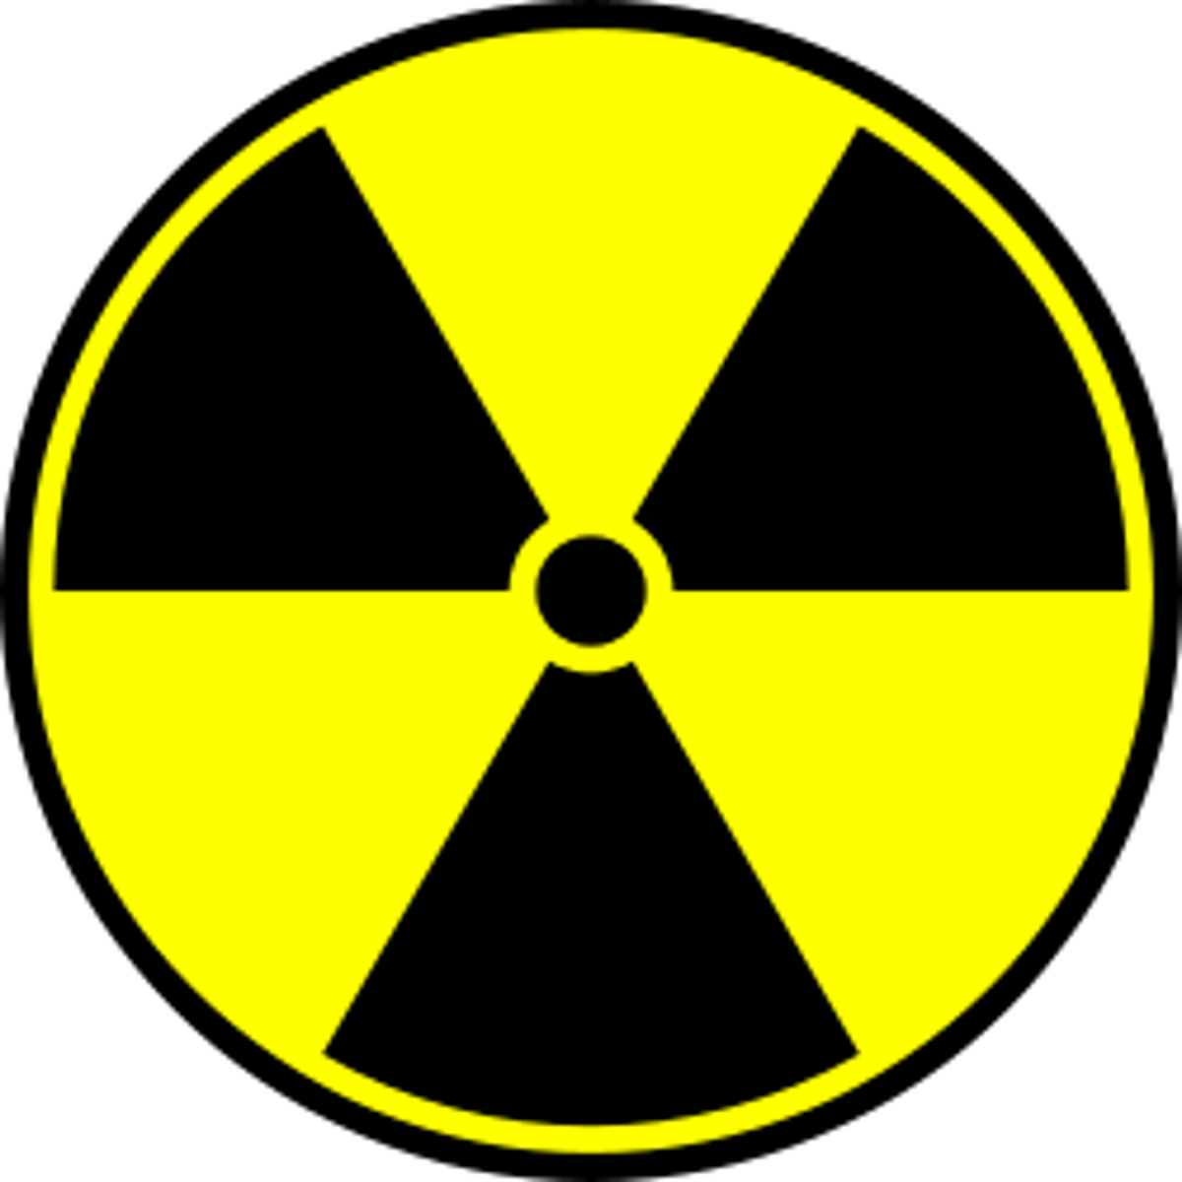
Developing Experts All rights reserved © 2021

Slide 2
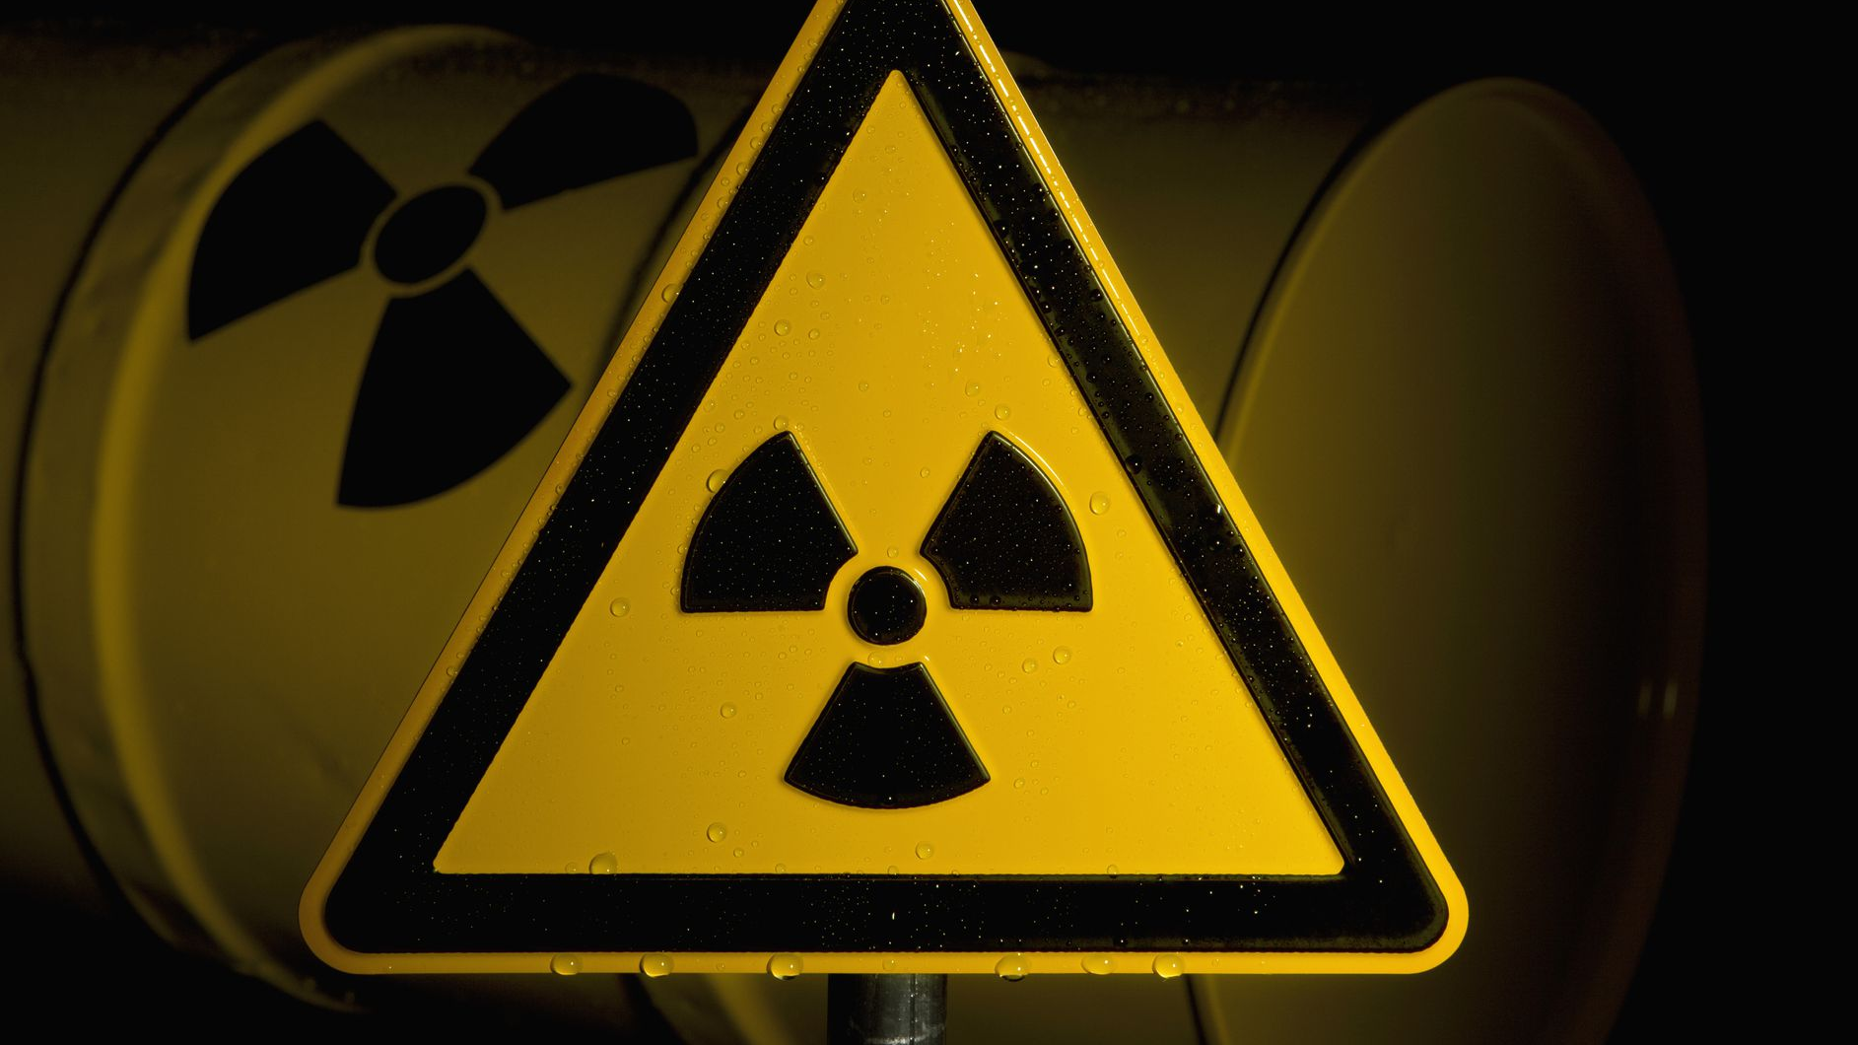
Exposure to very high levels of radiation, such as being close to an atomic blast, can cause acute health effects such as skin burns and acute radiation syndrome (“radiation sickness"). It can also result in long-term health effects such as cancer and cardiovascular disease.

Slide 3
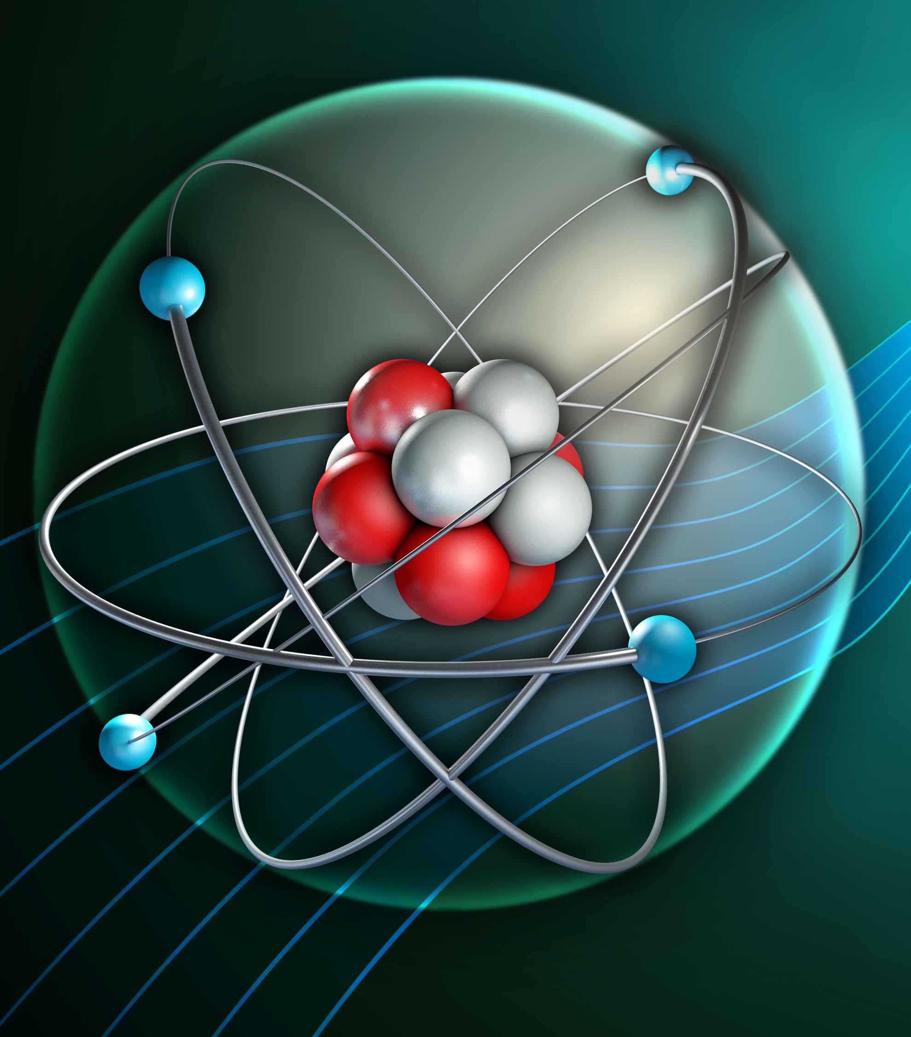
Hazards of radiation
Define the terms radiation and radioactive contamination
Compare the hazards associated with radiation and contamination
Explain the precautions to take against radioactive hazards
Discuss why it is important for the findings of studies into the effects of radiation on humans to be published by scientists and peer reviewed

Slide 4
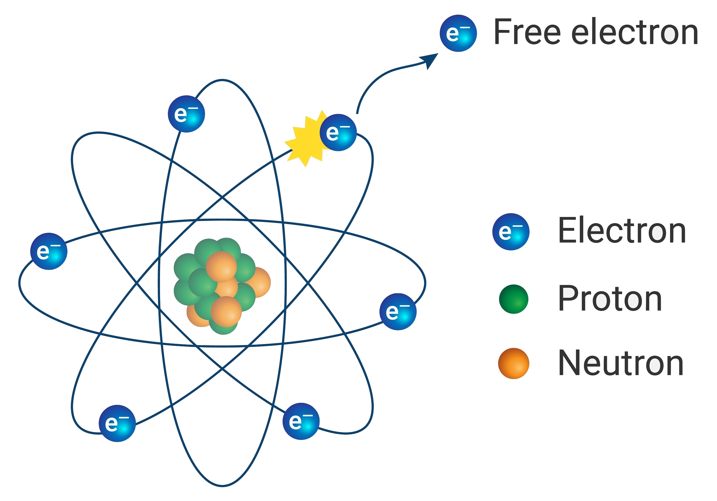

Slide 5


Slide 6
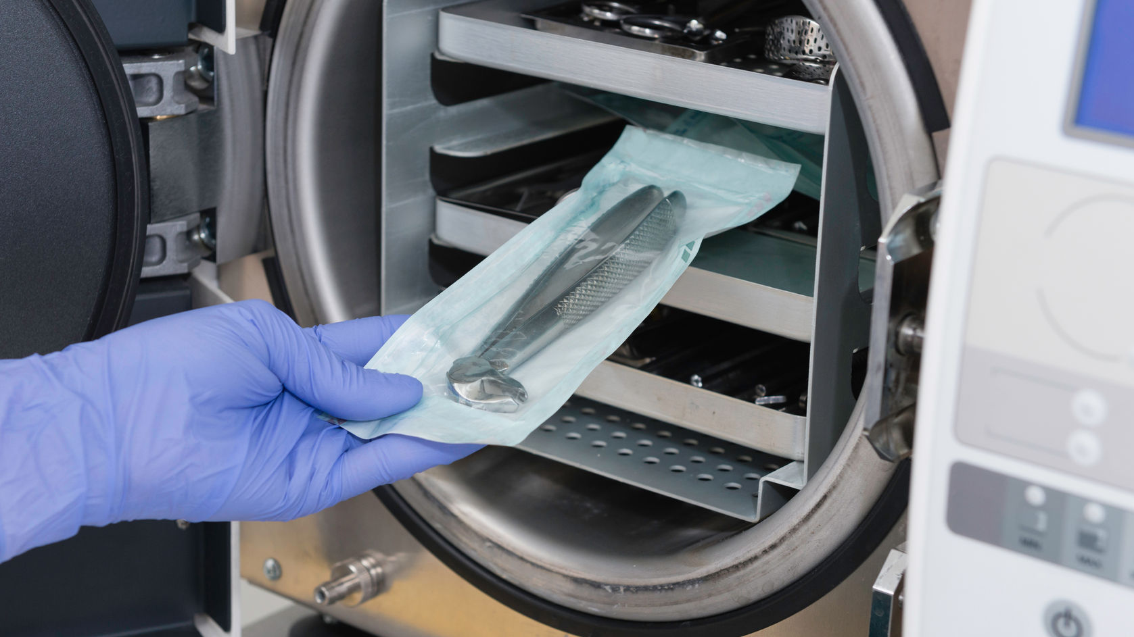

Slide 7


Slide 8


Slide 9
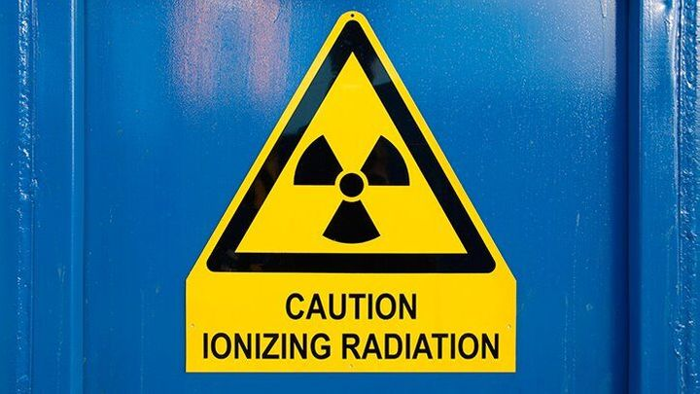

Slide 10
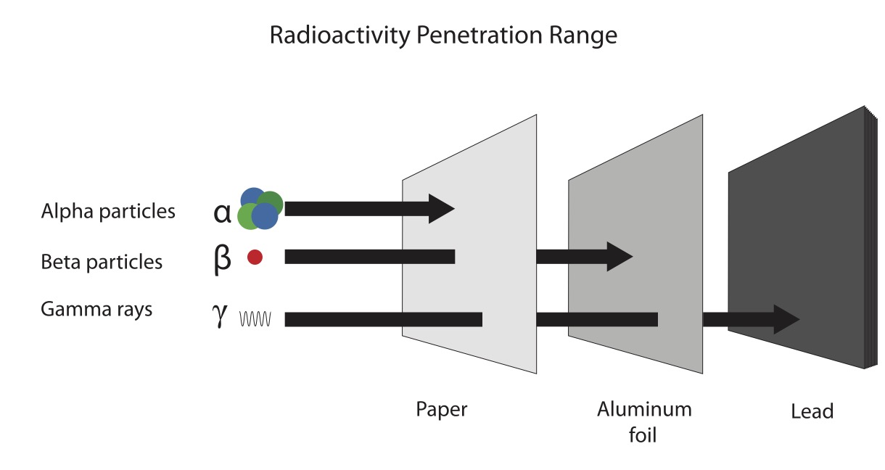

Slide 11
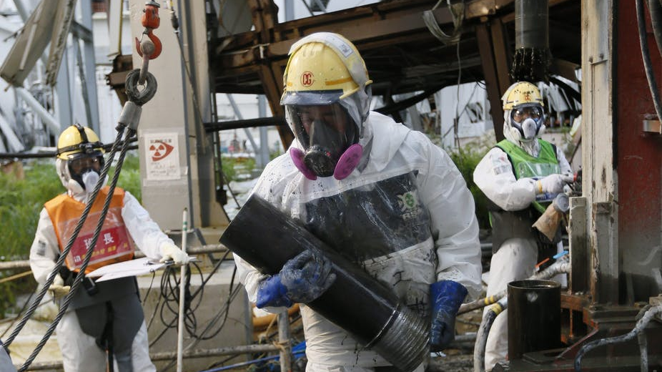

Slide 12
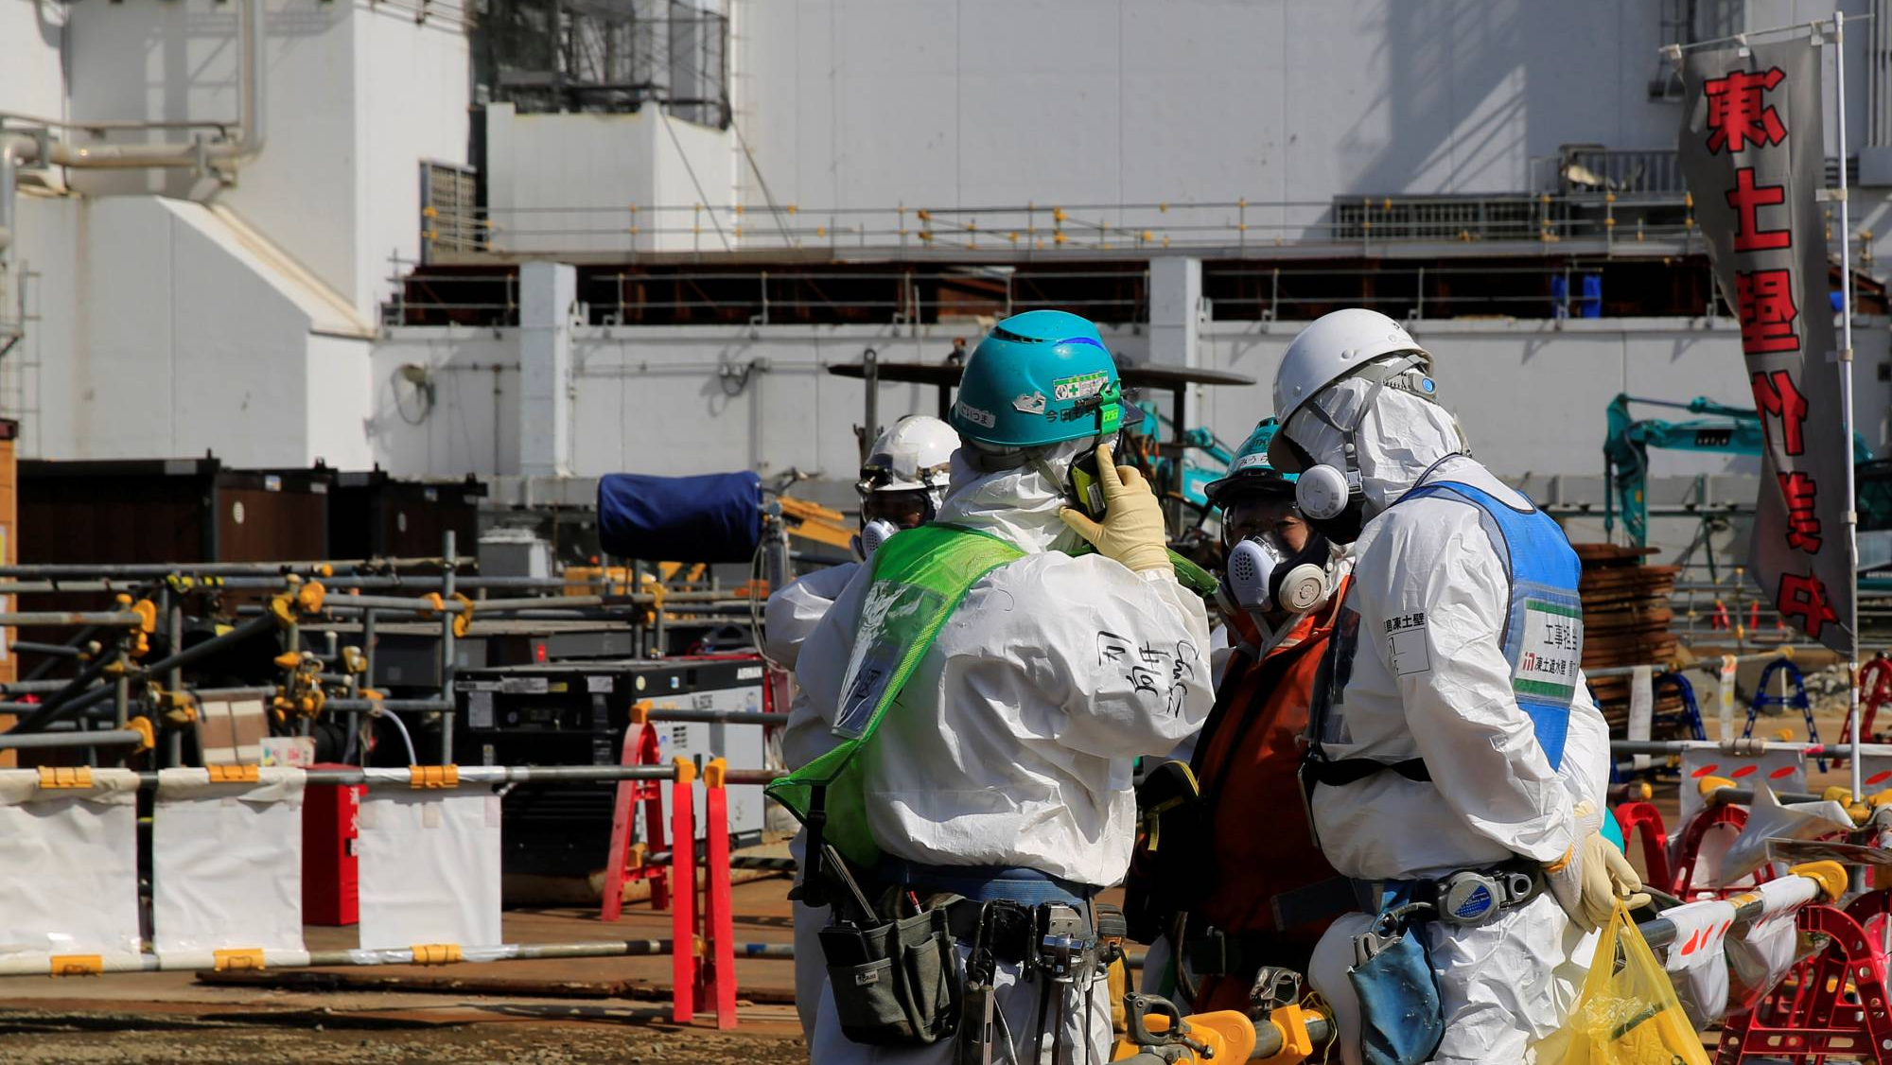

Slide 13
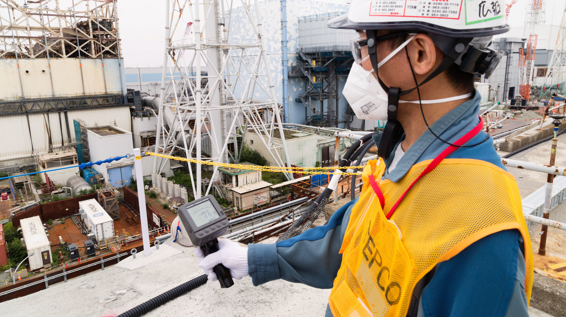

Slide 14
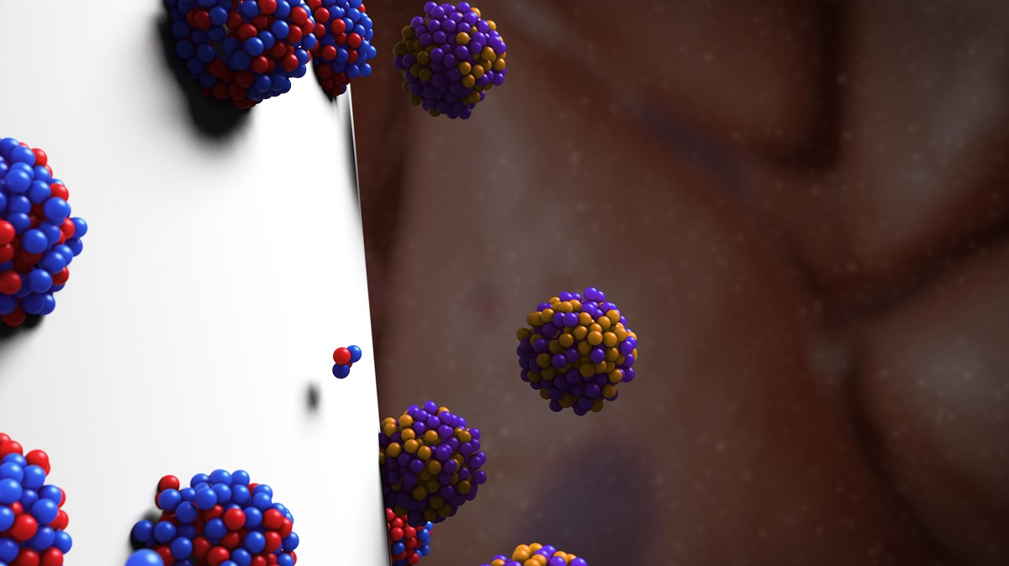

Slide 15
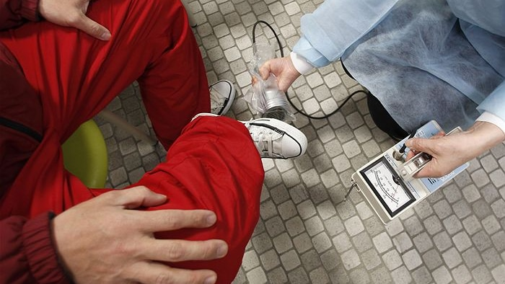

Slide 16
