Slide 1



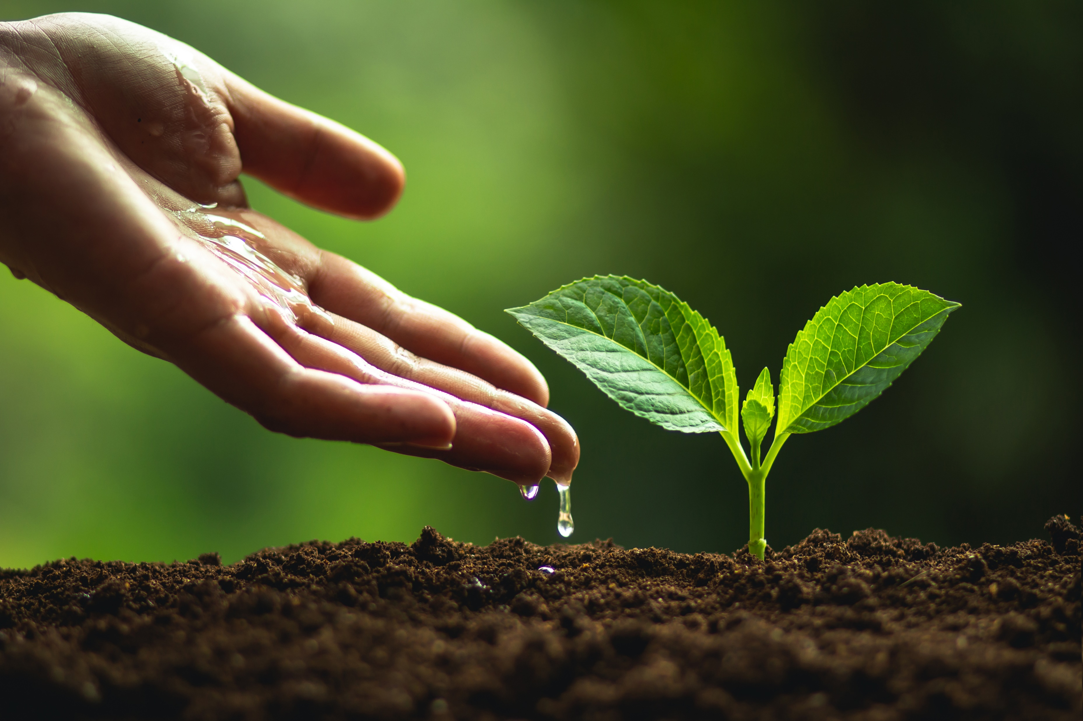
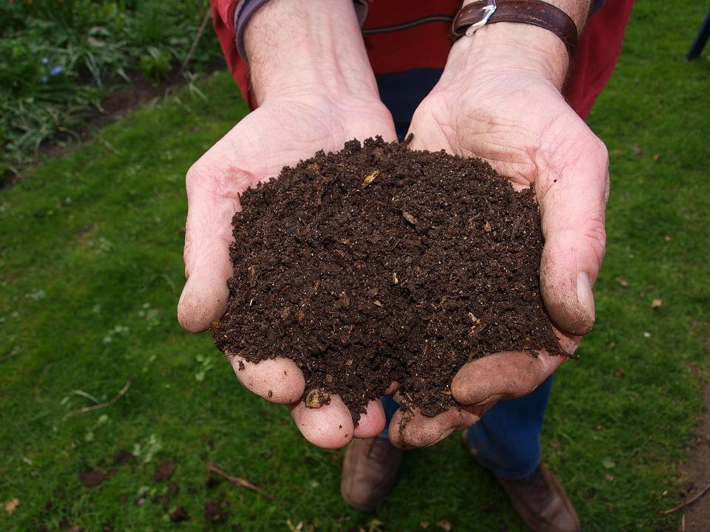
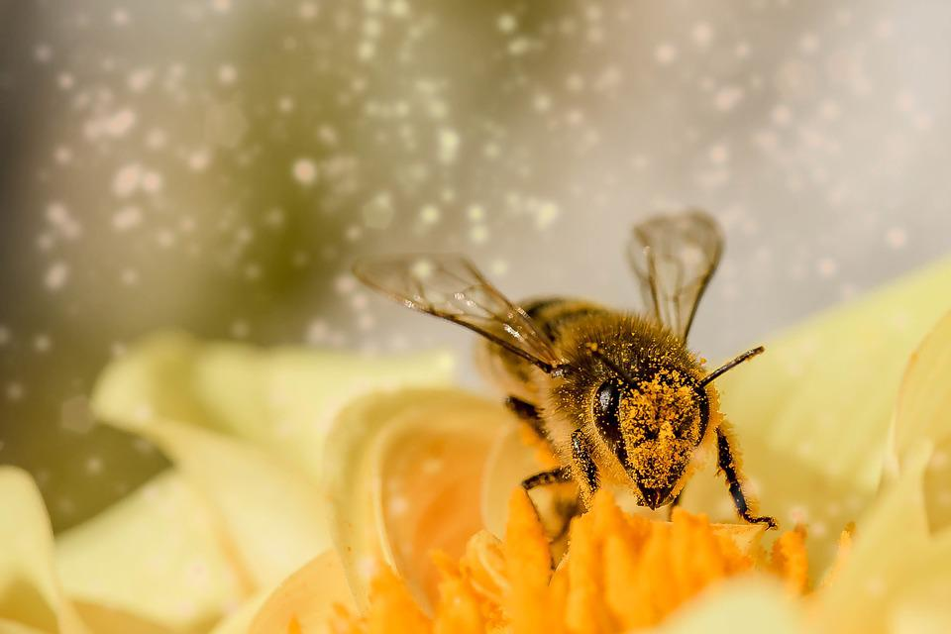





Mission Assignment: Explore what we can do to protect natural habitats
Code: COP26_02_02
Cut out the images and match with the correct eco-friendly action.
Cut out the eco-friendly action and match with the correct picture.
Stick them onto a sheet of paper in their pairs.
Plant trees, flowers and bushes.
Use environmentally friendly compost.
Build bee hotels, bird boxes and ponds for nature.
Repair items instead of throwing them out and buying new ones.
Reduce, reuse and recycle.
Save water.
2
Developing Experts Copyright 2022 All Rights Reserved

Slide 2
Mission Assignment: Explore what we can do to protect natural habitats
Code: COP26_02_02
Challenge Task: Think about how you could do these actions at home or in school. Fill the table with your answers and suggestions.
Plant trees, flowers and bushes.
Use environmentally friendly compost.
Build bee hotels, bird boxes and ponds for nature.
Reduce, reuse and recycle.
Repair items instead of throwing them out and buying new ones.
Save water.
4
2
Developing Experts Copyright 2022 All Rights Reserved
Developing Experts Copyright 2022 All Rights Reserved

