Slide 1
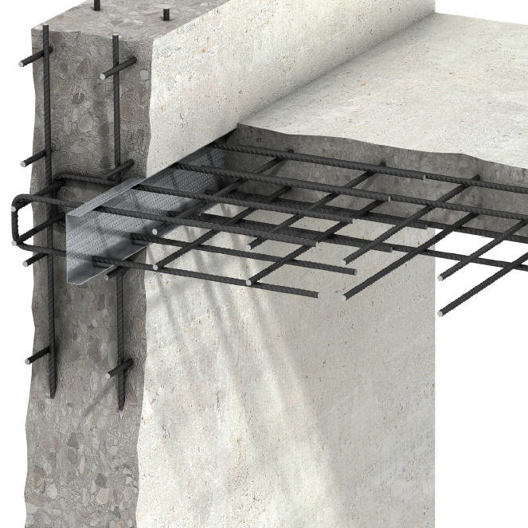
KS4-17-08: Using Resources - Explore glass, ceramics and composites
● Describe how we make soda lime glass and borosilicate glass
● Describe how clay ceramics are formed
● Describe what's meant by a composite and give examples of composites
Key Facts:
Ceramics
Due to their high melting points and resistance to stains, ceramics are used in kitchen and dinnerware.
Glass Ceramics
Transparent and strong, glass ceramics insulate against heat and allow light to pass through, making glass the ideal material for making windows.
Glass ceramics are also more durable than other materials hence they are better suited for use in windows than plastic.
Most of the glass produced is soda-lime glass which is made by heating a mixture of limestone, sand and sodium carbonate (soda) until it melts.
On cooling it crystallises to form glass.
A variation is borosilicate glass which is made using sand and boron trioxide and has a higher melting point than soda-lime glass.
Clay Ceramics
These are hardened materials that resist compressive forces.
Clay is a soft material dug up from the earth which hardens at high temperatures.
Allows bricks to be used to build walls which withstand the weight and pressure of the material bearing downwards on itself.
Composites
These are made from two components: reinforcement and matrix.
The reinforcement material is embedded in the matrix material which acts as a binder..
Common examples include fibreglass and steel reinforced concrete.
Wood is an example of a natural composite as it consists of cellulose fibres held together by an organic polymer mix.
Composite | Reinforcement | Matrix
Concrete | Steel | Concrete
Fibreglass | Glass fibres | Polymer resin
Carbon fibre / tubes | Carbon fibres / nanotubes | Polymer resin
The properties of composites depend on the reinforcement and matrix used so composites can be tailor engineered to meet specific needs.
Carbon fibres for example are extremely strong and low weight, hence they are used in aviation, aeronautics and for making professional racing bicycles.
The picture to the right shows steel reinforced concrete has immense tensile and compressive strength allowing it to be used as columns and supporting structures in construction.
Developing Experts All rights reserved © 2021

Slide 2
KS4-17-08: Using Resources - Explore glass, ceramics and composites
● Describe how we make soda lime glass and borosilicate glass
● Describe how clay ceramics are formed
● Describe what's meant by a composite and give examples of composites
Describe how the following are produced and give uses for each:
soda-lime glass
borosilicate glass
clay ceramics
composites
soda-lime glass
borosilicate glass
Developing Experts All rights reserved © 2021

Slide 3
KS4-17-08: Using Resources - Explore glass, ceramics and composites
● Describe how we make soda lime glass and borosilicate glass
● Describe how clay ceramics are formed
● Describe what's meant by a composite and give examples of composites
Research the physical properties of:
soda-lime glass
borosilicate glass
clay ceramics
composites
soda-lime glass
borosilicate glass
clay ceramics
composites
Developing Experts All rights reserved © 2021

