Slide 1
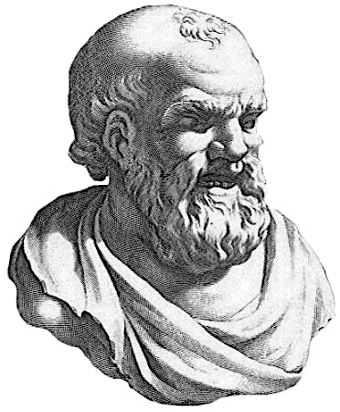
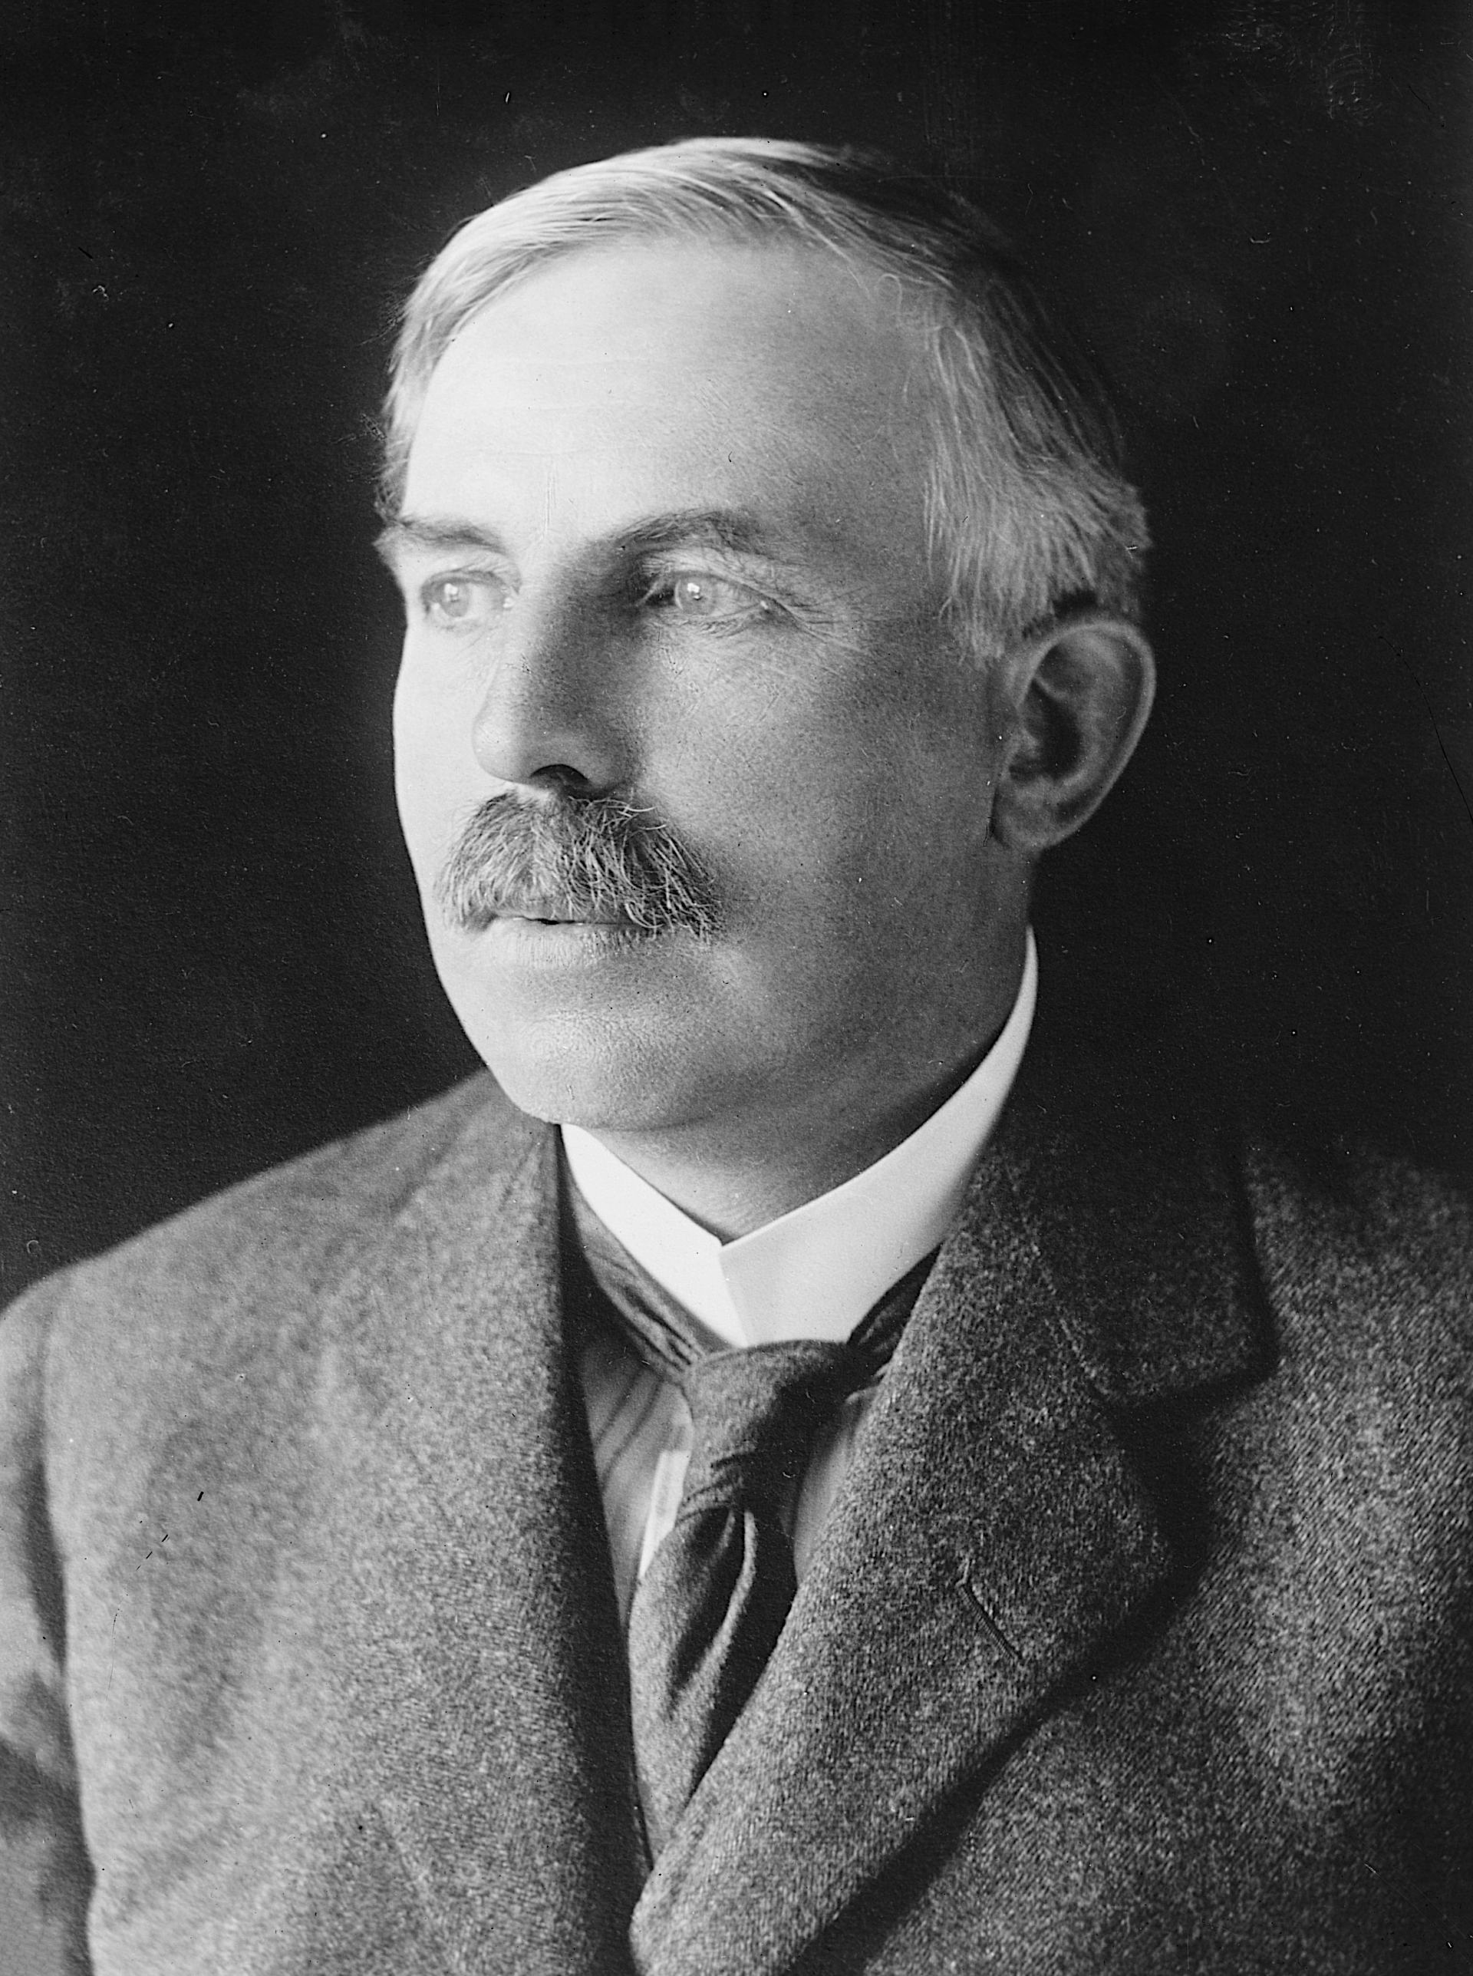
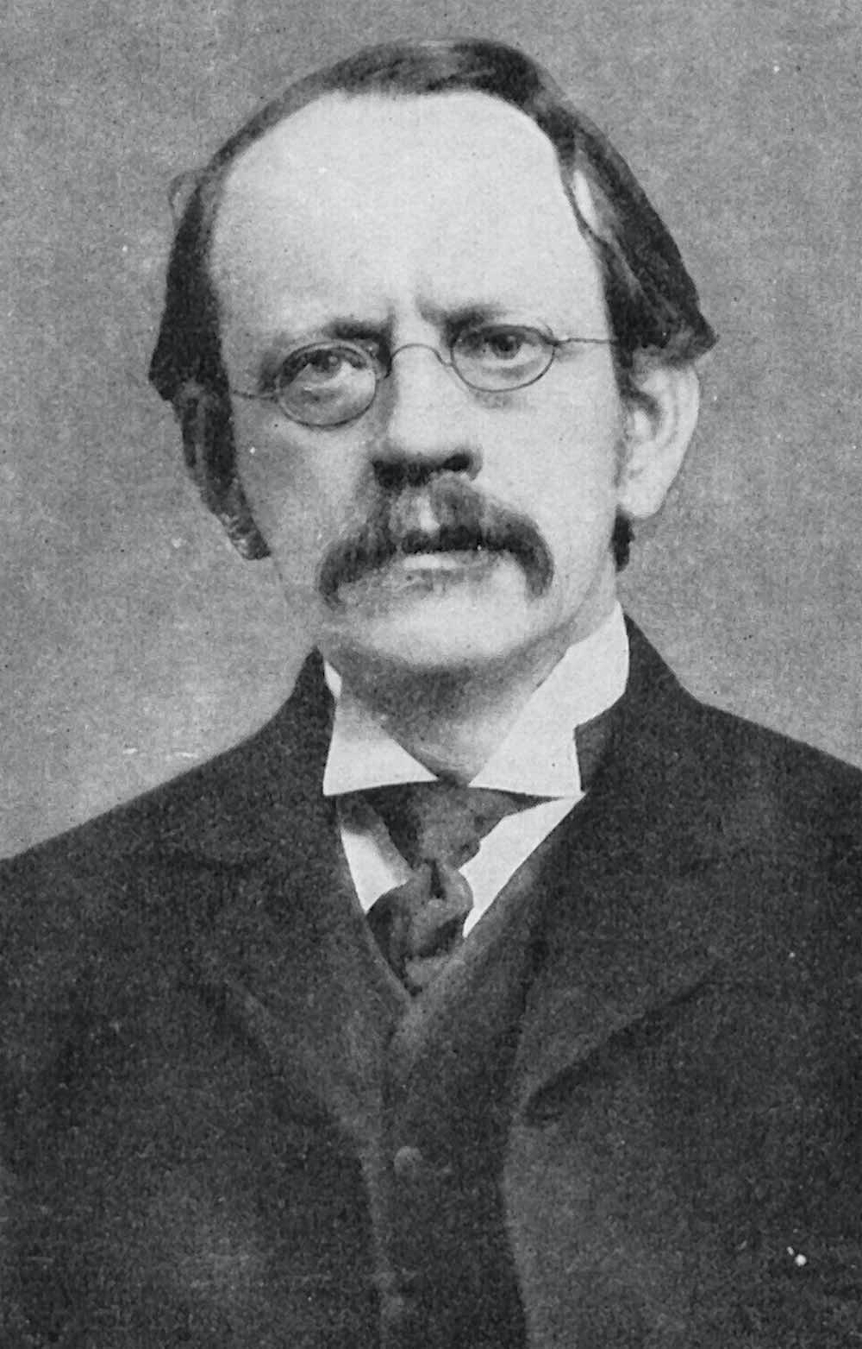
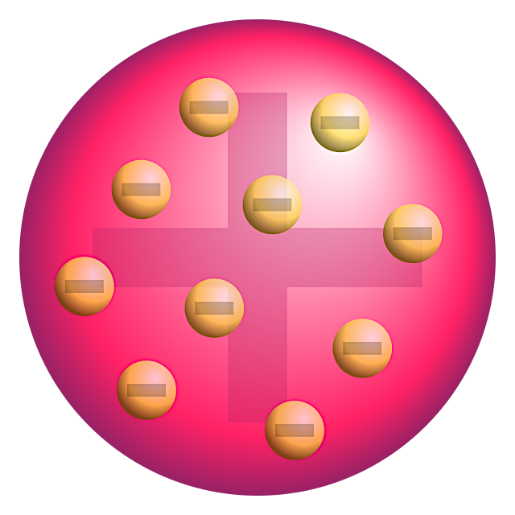
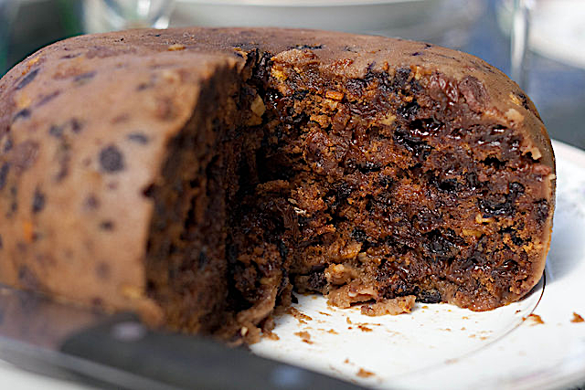
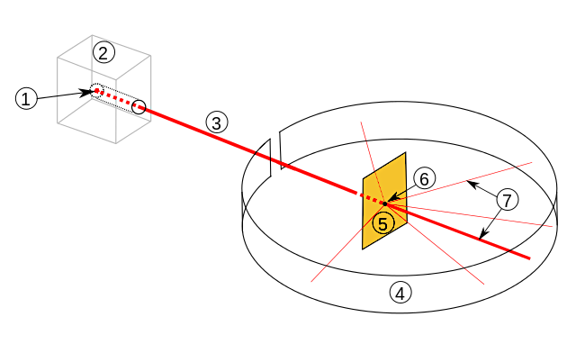
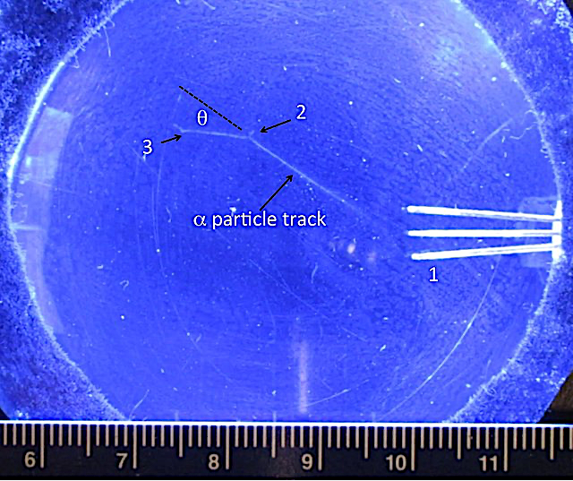
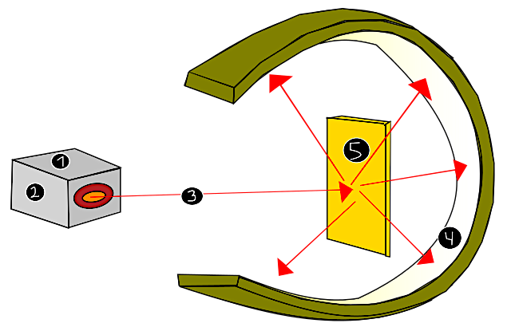
The atomic model
Sometime around 400BC, the Ancient Greek philosopher Democritus proposed that all matter was made up of tiny particles, or atoms. It was not until 200 years ago that John Dalton developed a theory of these particles having a different mass through his experiments of the combination of elements in gases. In the early 1900s, following Fredrick Soddy’s theory of isotopes, JJ Thompson discovered negatively charged particles that he called corpuscles during his cathode tube experiments. Today, we call these particles electrons. Thompson proposed the ‘plum pudding’ model for an atom. It was Ernest Rutherford - from New Zealand - who developed the atomic model to the one we understand today through the alpha scattering experiment.
The ‘plum pudding’ model
Thompson proposed that an atom was sphere of positively charged matter with small negatively charged electrons embedded within. In other words, the atom was almost a solid mass of matter with no spaces. The amount of positive and negative masses was the same, so the atom is neutral.
The alpha scattering experiment
In 1909, Rutherford devised an experiment using an extremely thin sheet of gold foil coated with zinc sulfide. He used gold foil because it could be hammered very thinly. He bombarded the foil with very small positive alpha particles from decaying radium, expecting them all to pass through the foil. Most did, but some were deflected at angles to the foil.
Gravitational
field strength
10N/kg
Question:
Why did the alpha scattering experiment lead Rutherford to think that there were empty spaces in the model of an atom? Discuss as a group and formulate an explanation to write as a succinct answer.

Slide 2
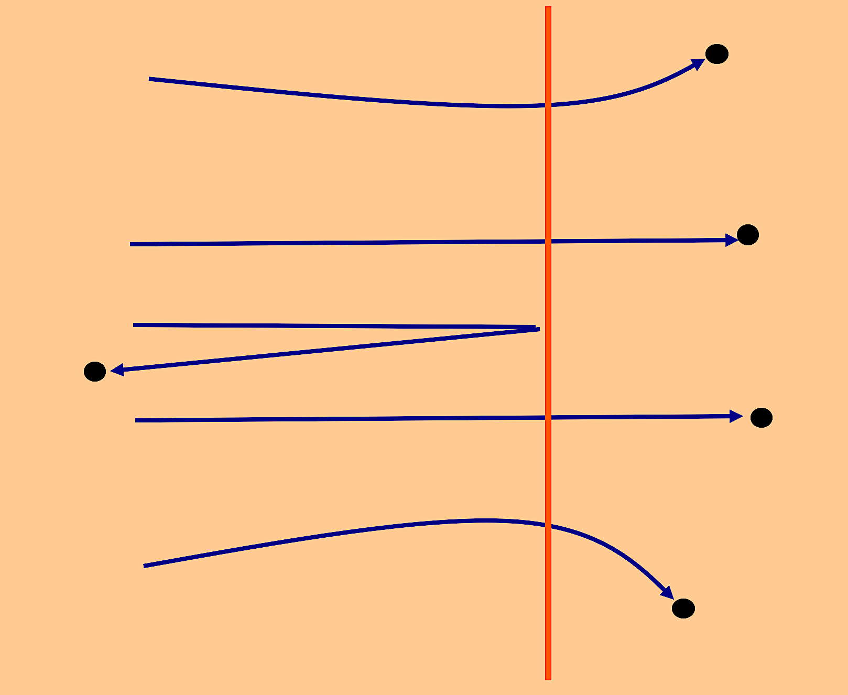
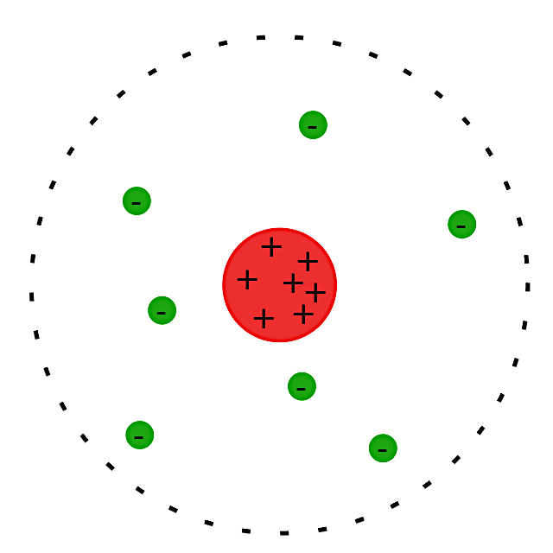
Practice
Read these 4 statements. Assign the right statement to each path shown:-
The alpha particle has a head on collision so
that it bounces straight back.
Alpha particles is far from the nucleus, experience little or no deflection as they are
not close enough to the small positive nucleus.
This particle is close to the nucleus,
experiences a large deflection, so they are
scattered through large angles.
A
B
C
Read the fact given. Relate that to your responses to question 1. Describe why the alpha particles take pathways A, B, and C. ____________________________________________________________________________________________________________________________________________________________________________________
The diameter of a gold atom is 0.3X10⁻⁹which is 0.3 nanometres (0.3nm).
The diameter of the nucleus is less than 1X10⁻¹⁴.
If an atom was the size of this screen, the nucleus would be a full stop.
What conclusion did Rutherford make about how an atom is structured? Explain why. _____________________________________________________________________________________________________________________________________________________________________________________________________________________________________________________
What would the changes be to the deflection angle if the particles were travelling faster or if they had more electrical charge? __________________________________________________________________________________________________________________ _. ___________________________________

Slide 3
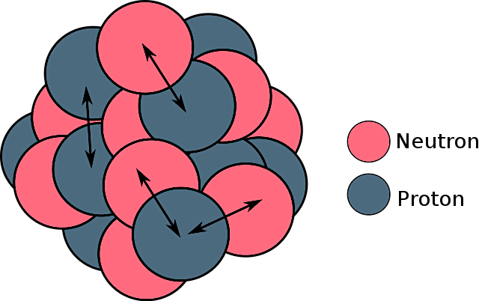
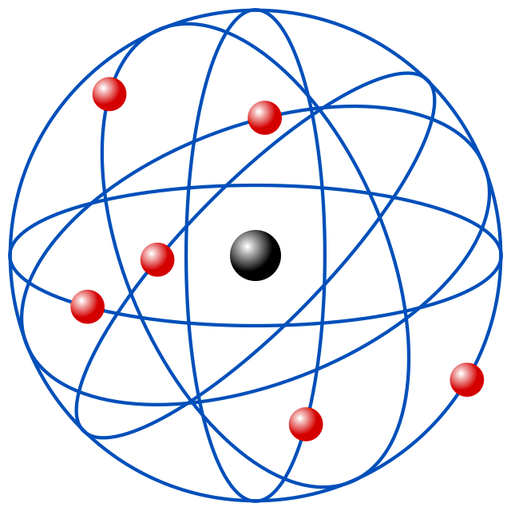
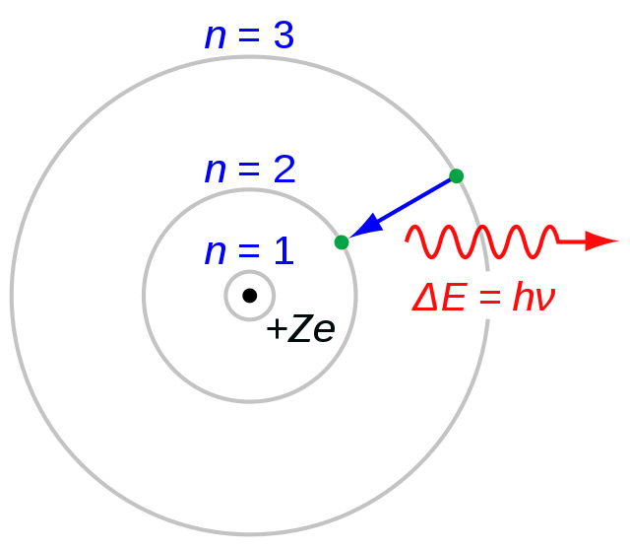
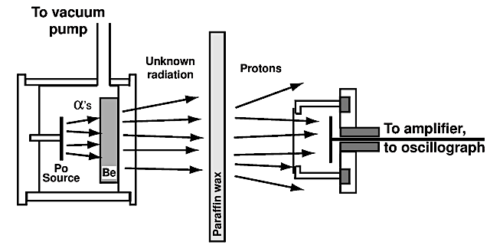
The alpha scattering experiment led to the discovery that the nucleus of the atom was made up of positive protons. The protons should repel one another, but do not because the nucleus is held together by which force?
Electromagnetic force
Gravity
The strong nuclear force
The development of the model
Rutherford proposed that there were a cloud of electrons circulating around the nucleus. In 1913, Niels Bohr developed this theory by suggesting what?
_______________________________________________________________________________________________________________________________________________________________________________________________________________________________________________________________________________________________
In 1932, James Chadwick used the following experiment to discover the existence of which particle? Explain how the experiment was set up. What were the insights gained from observations? __________________________________________________________________________________________________________________________________________________________________________________________ _______________________________

