Slide 1
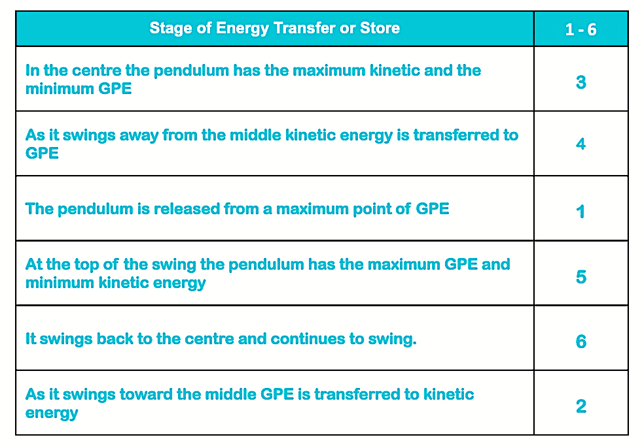
Teacher answers
Electrical – Kinetic – Sound – Thermal – GPE - Kinetic
Thermal – Sound
Completed Table
Friction
Dissipation
Explain that it starts within the use of perfectly machined ball bearings made of stainless steel which are set in a machined channel (a race). The ball bearings move smoothly with the addition of silicon spray or lubrication. The use of a bearing cuts down the friction substantially.

