Slide 1
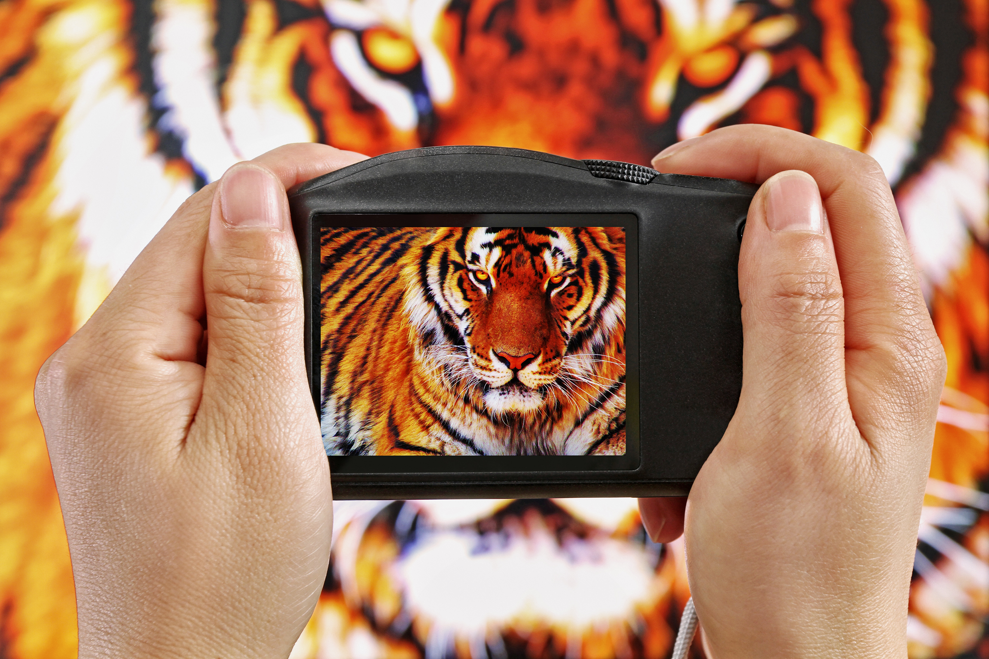
Mission Assignment: Describe how lenses focus light – Mission to Write!
KS3-19-05
Explain how the two lenses in this image work – the lens of the camera and the lens in the tiger’s eyes!
The lens in the tiger’s eyes: ________________________________________________________________________________________________________________________________________________________________________________________________________________________________________________________________________________________________________________________________________________________________________________________________________________________________________________________________________________________________________________________________________________________________________________________________________________________________________________________________________________________
The lens in the camera: _____________________________________________________________________________________________________________________________________________________________________________________________________________________________________________________________________________________________________________________________________________________________________________________________________________________________________________________________________________________________________________________________________________________________________________________________________
Word bank:
convex concave refraction focal point bi
Developing Experts Copyright 2023 All Rights Reserved

Slide 2
Mission Assignment: Describe how lenses focus light – Mission to Write!
ANSWERS
KS3-19-05
Explain how the two lenses in this image work – the lens of the camera and the lens in the tiger’s eyes!
The lens in the tiger’s eyes: ________________________________________________________________________________________________________________________________________________________________________________________________________________________________________________________________________________________________________________________________________________________________________________________________________________________________________________________________________________________________________________________________________________________________________________________________________________________________________________________________________________________
The lens in the tiger's eye is bi-convex, which means it is curved outward on both sides. It works by refracting light as it enters the eye and focusing it onto a point on the retina, called the focal point. The muscles in the eye change the curvature of the lens, allowing the tiger to adjust the focal length and see objects at different distances with clarity.
The lens in the camera: _____________________________________________________________________________________________________________________________________________________________________________________________________________________________________________________________________________________________________________________________________________________________________________________________________________________________________________________________________________________________________________________________________________________________________________________________________
The lens in a camera is typically also bi-convex. It also works by refracting light as it passes through it forming an image at a specific focal point. This focal point can be adjusted by changing the distance between the lens and the film/sensor. The shape of the lens, as well as the distance between the lens affects the image captured by the camera.
Word bank:
convex concave refraction focal point bi
Developing Experts Copyright 2023 All Rights Reserved

