Slide 1
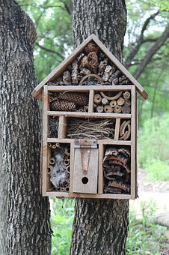
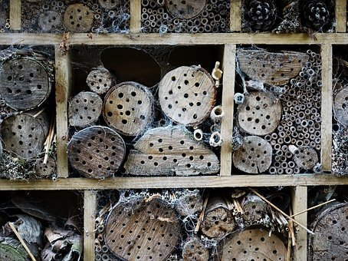
Resource Handout: S04.05.08 Handout
Know about the balance of nature.
Draw and label the features of your bug habitat design.
Stretch:
Identify the key features of a habitat which will help a bug to thrive explaining your reasons why.
Challenge:
Identify the key features of a habitat which will help a bug to thrive.
Developing Experts Ltd. © 2022

