Slide 1
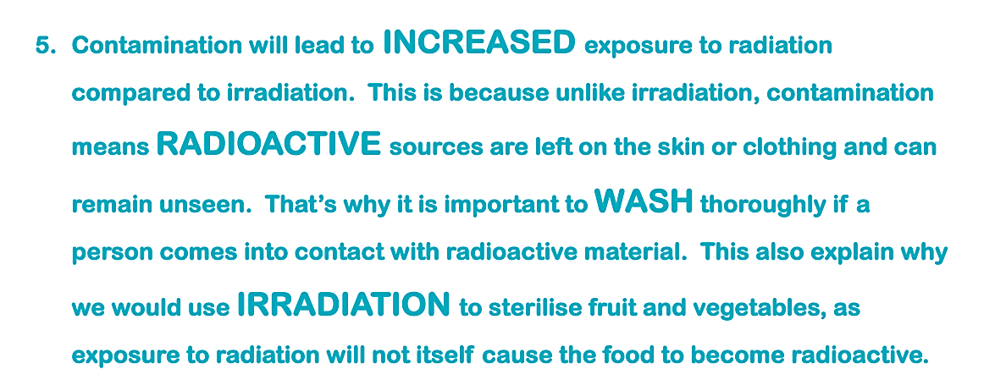
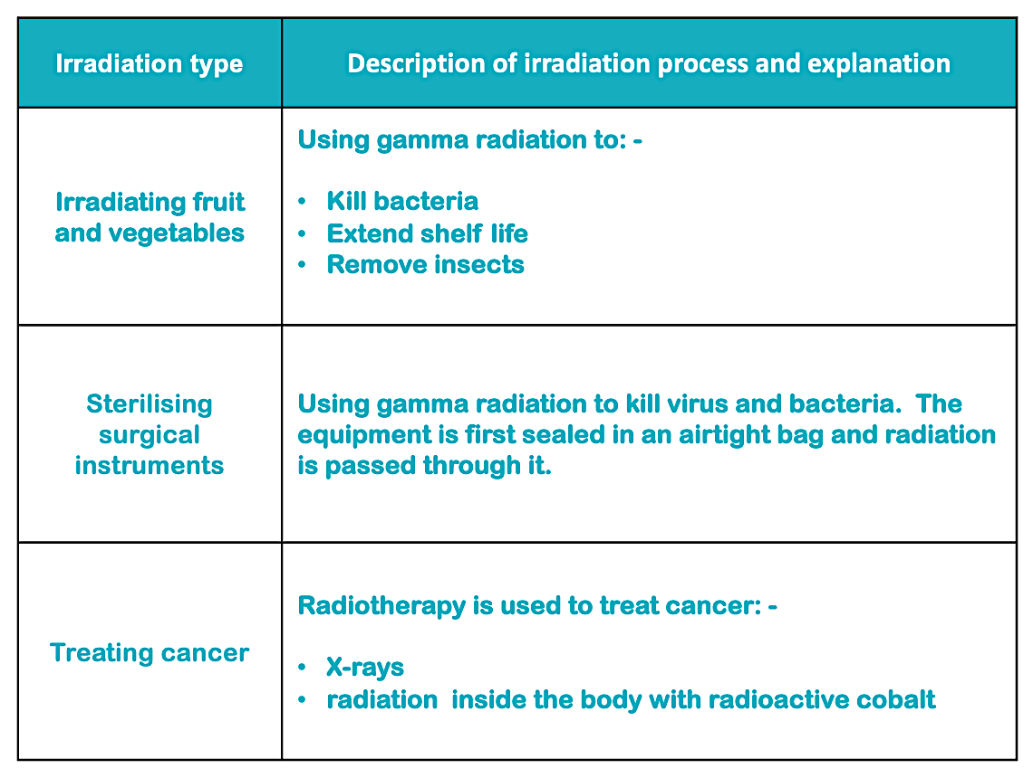
Teacher answers
Radiation can damage cells and cause radiation burns. It can also damage the DNA in cells. This can lead to the cell dividing uncontrollably and forming a tumour It can also lead to changes or mutation in the DNA of gametes (Sperm or egg cells). These mutations are then passed to future generations
Irradiation is when an object exposed to radiation. It does not become radioactive. Contamination is when an object takes in some unwanted radiation either inside or on the surface..
4 half lives = 32 days
Gloves can prevent an alpha emitter from entering the body through cuts. Gloves can also be removed after handling the substance which helps contain the risk and prevents contamination
*
*

