Slide 1
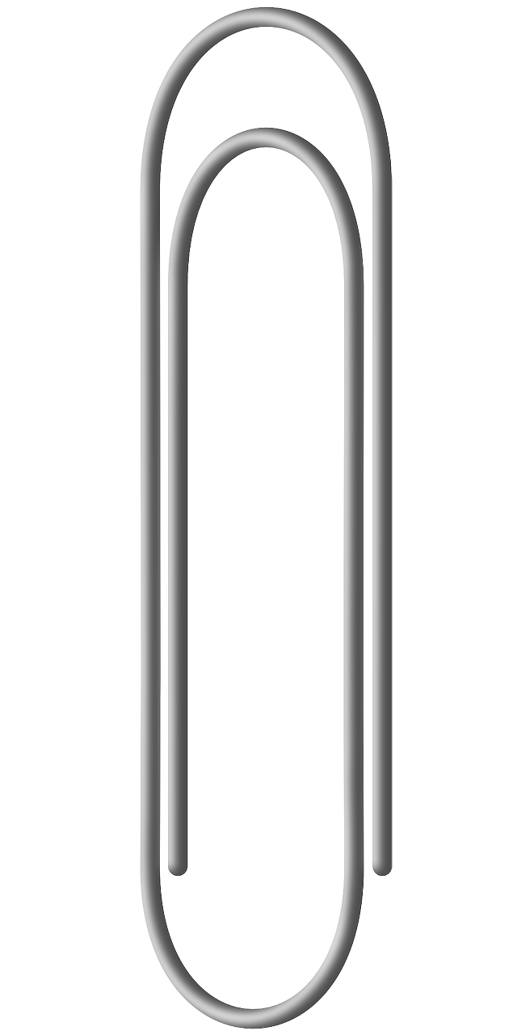
Mission Assignment: Explain how to build an electromagnet
KS3-23-06
Build an electromagnet
You are going to build an electromagnet and investigate how its strength can be varied.
Method:
1. Wrap a piece of insulated wire around an iron nail. Count how many times you wrap the wire around the nail and make a note of it.
2. Connect one end of the wire to a battery and the other to a switch, make sure the switch is open.
Equipment
Iron nail
Insulated wires
Battery cell
Variable resistor
Switch
Paperclips
3. Connect the switch to a variable resistor and put it on its lowest setting - make a note of how much this is in amps.
4. Connect the variable resistor to the battery to complete the circuit.
5. Scatter a few paperclips on the table.
6. Close the switch and see if the nail can pick up any paperclips to check it is working.
To see what effects the strength of the electromagnet, you will be changing two variables. These are:
The current supplied to the electromagnet.
The number of rotations of wire around the magnet.
To test the strength of the electromagnet, you will count the number of paperclips it picks up after a variable has been changed. To vary the current, change the slider on the variable resistor.
You will need to create a results table to record your results.
Challenge!
Test the strength of your electromagnet with greater precision by making the pieces of metal smaller.
Developing Experts Copyright 2023 All Rights Reserved

