Slide 1
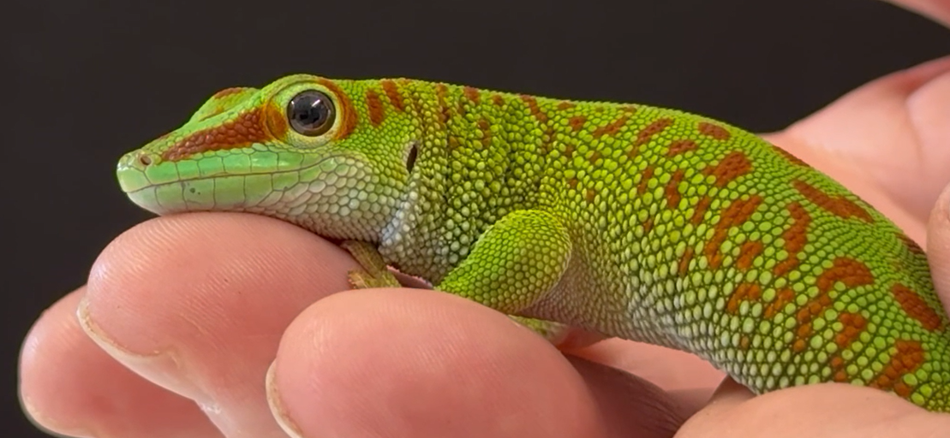
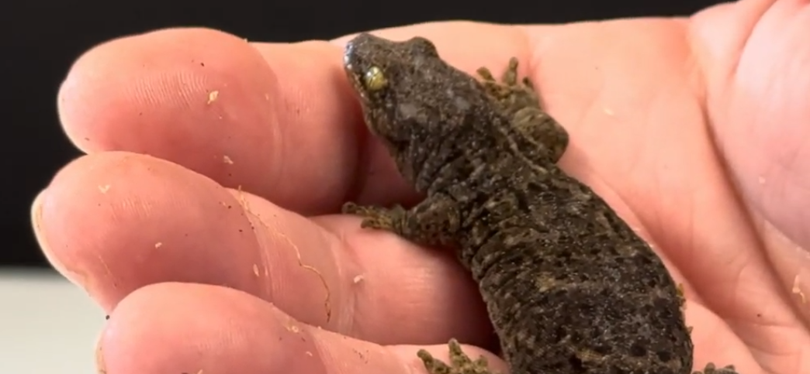
Science Week 2025
LKS2: Reptiles Uncovered: Adaptations, Habitats and Survival – Teacher Pack and Answers
Session 2
Activity 1: Write down the reptiles you know.
✓
Variety of answers, e.g.: snakes (rattlesnake; python; anaconda; boa constrictor; adder), lizards (gecko; chameleon; bearded dragon; skink), tortoise, turtle, crocodile, alligator.
What is a reptile? List their key features.
A reptile is a cold-blooded animal with scaly skin that mostly lays eggs.
Activity 2: Write the habitat underneath each gecko. Include some facts for each one. ✓
Madagascar day gecko
New Zealand gecko
Tropical rainforests. A bright green body, red marks and sticky toe pads.
Forests (New Zealand). Gives birth to live young.
leopard gecko
house gecko
Deserts. Fat reserve stored in tail.
Warm, urban areas. Lays eggs in buildings.
1
Developing Experts Copyright 2025 All Rights Reserved

Slide 2
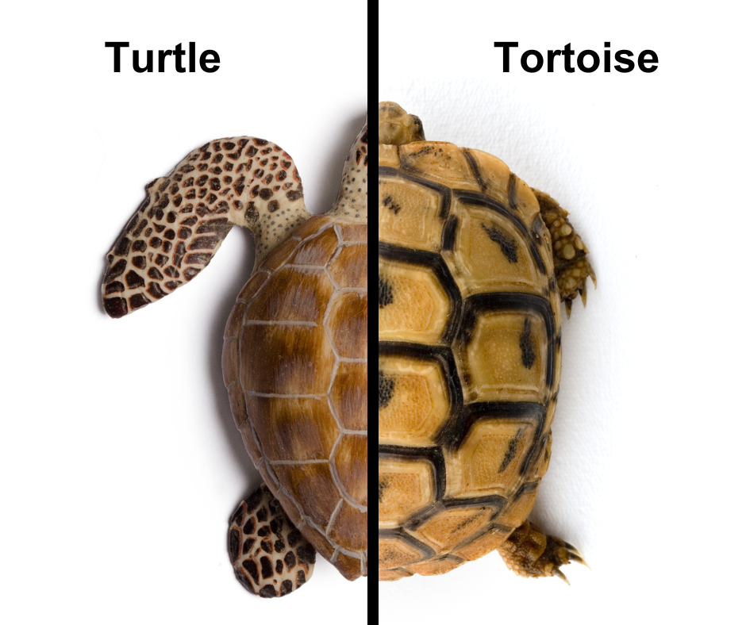
Science Week 2025
LKS2: Reptiles Uncovered: Adaptations, Habitats and Survival – Teacher Pack and Answers
Session 2
Activity 3: Label the features of a turtle and a tortoise. Label the adaptations each one has.
✓
head
flippers for swimming
domed, bumpy shell
smooth, streamlined shell
strong, stumpy legs, with claws
tail
What are the key differences between a tortoise and a turtle? __________________________________________________________________________________________________________________________________________________________________
Challenge: Can you write a fact about the terrapin? __________________________________________________________________________________________________________________________________________________________________
Tortoises live on land; turtles live in water and have flippers or webbed feet for swimming. Tortoises have domed, bumpy shells for protection. Turtles have smooth, streamlined shells.
Found in freshwater environments like ponds and marshes; spend time in water and on land; have webbed feet for swimming and strong claws for climbing.
2
Developing Experts Copyright 2025 All Rights Reserved

Slide 3
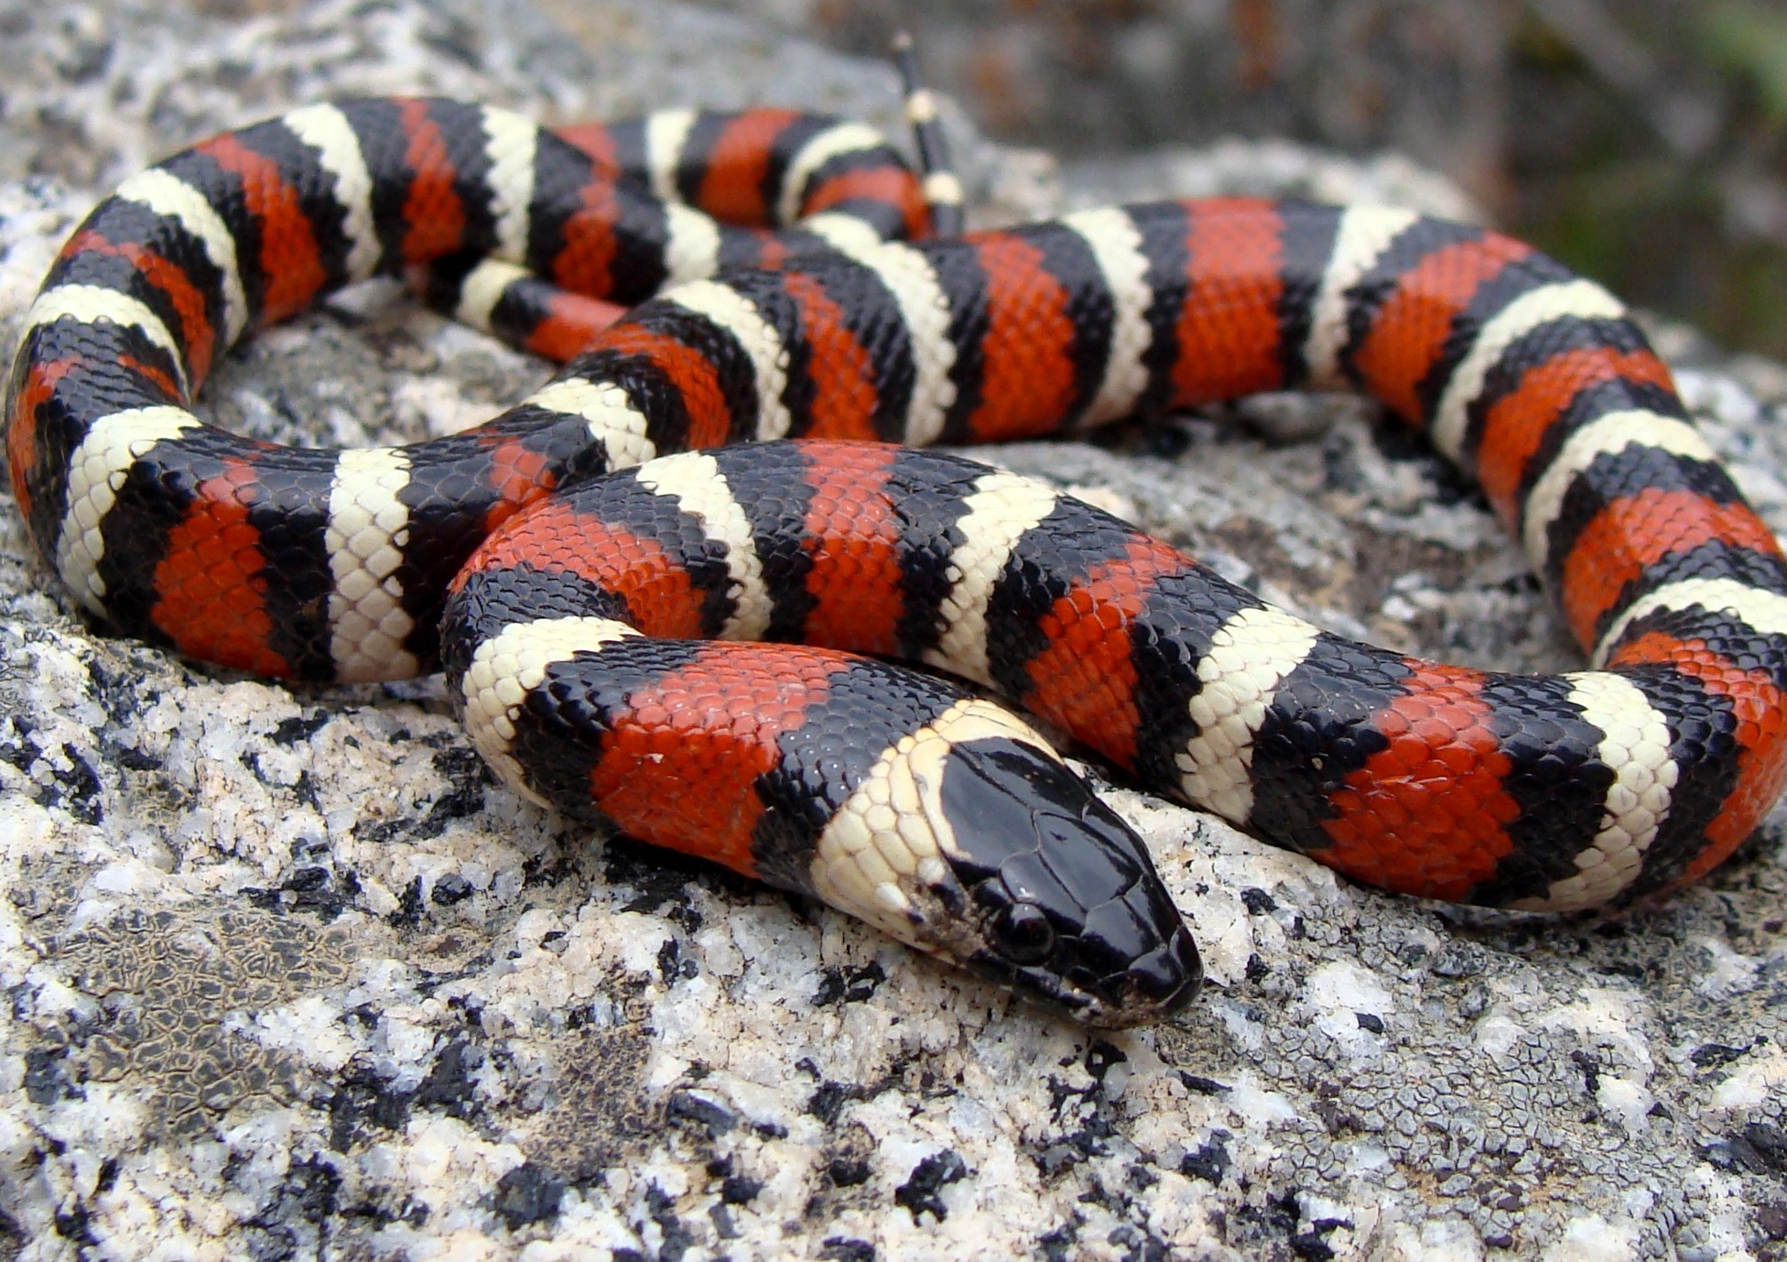
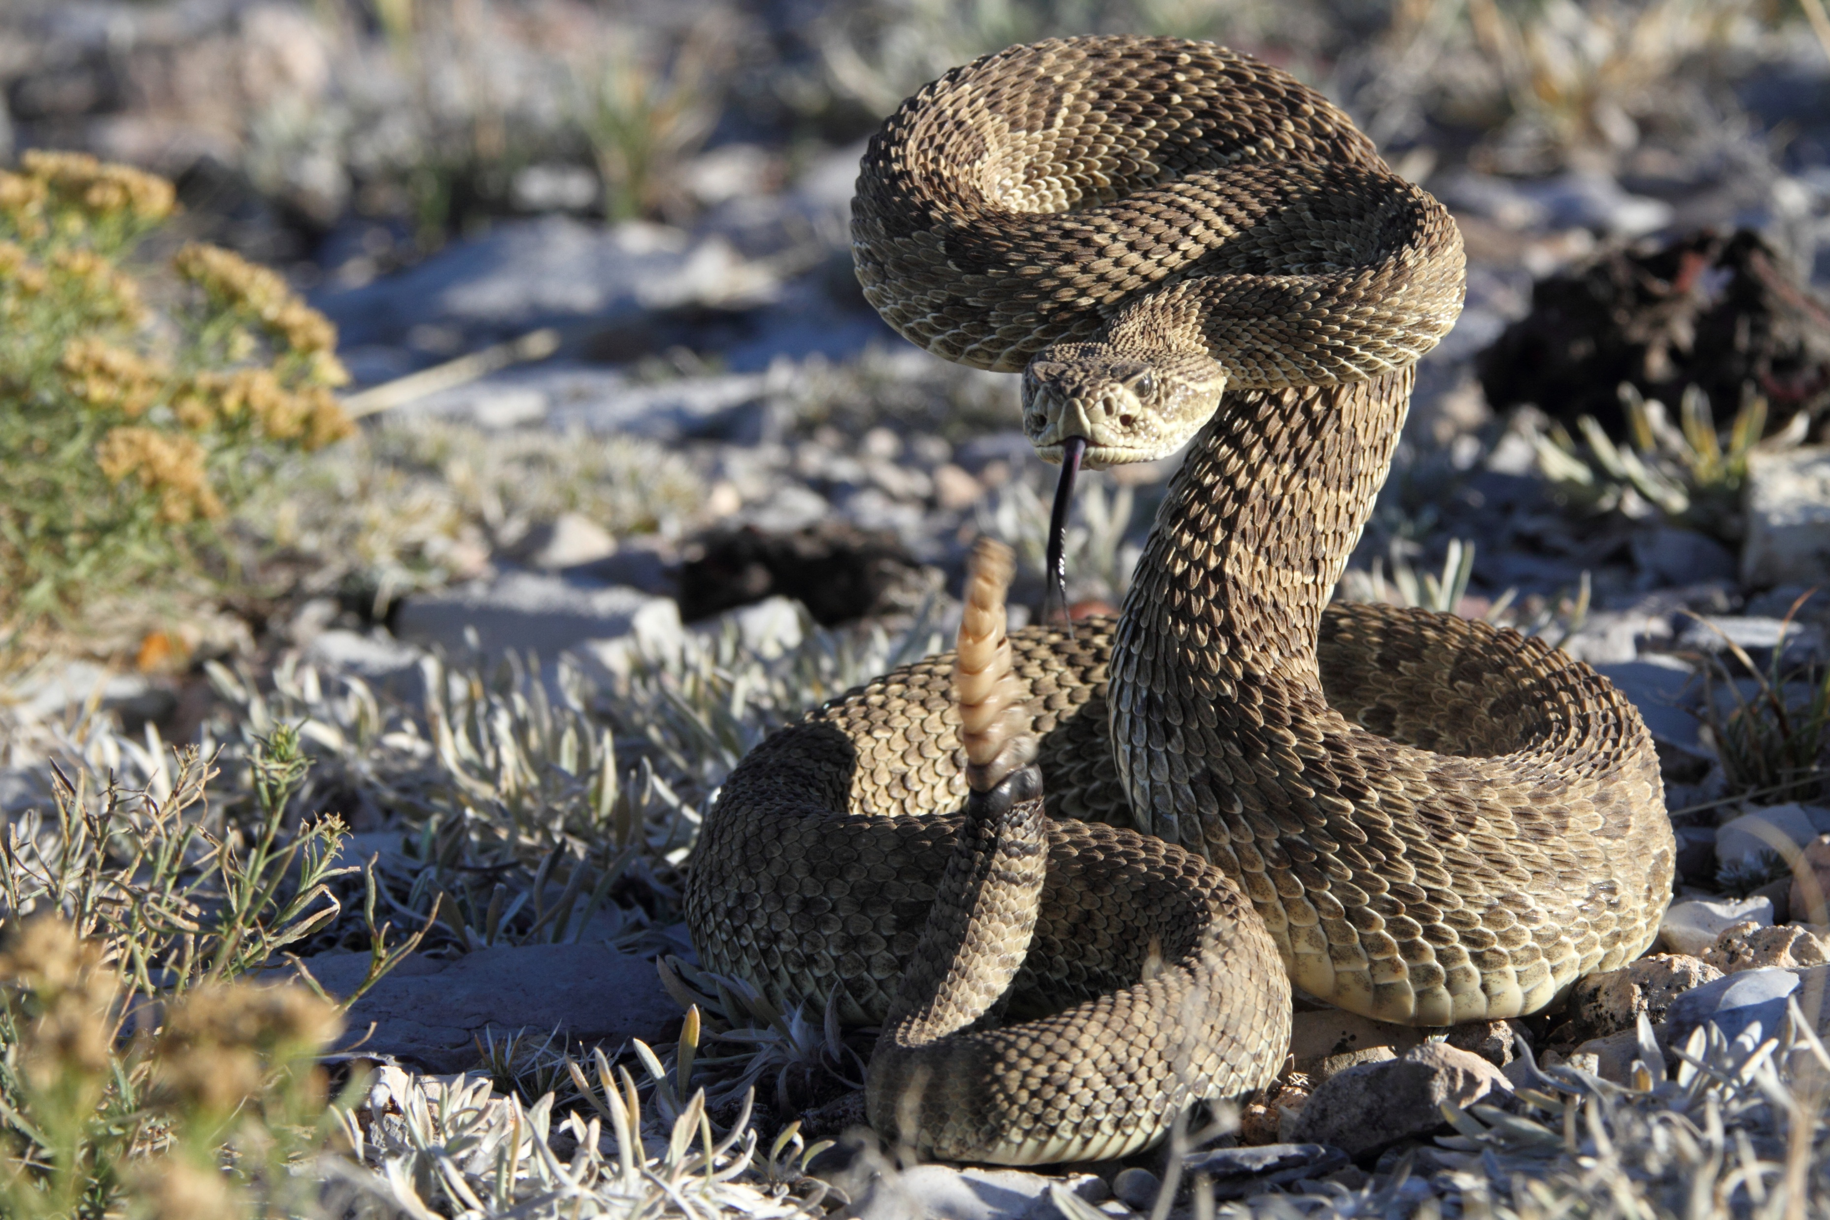
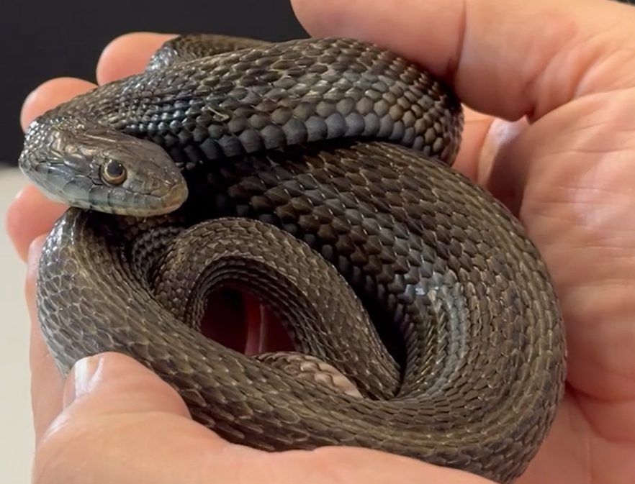
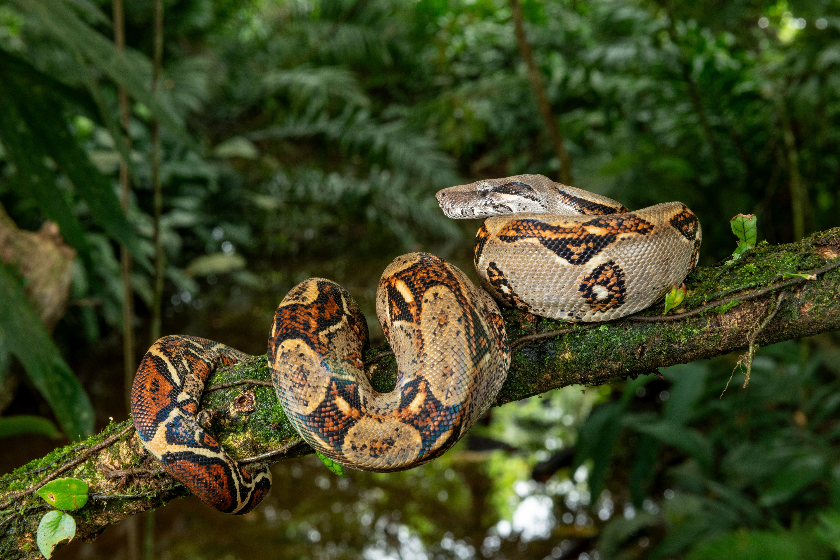
Science Week 2025
LKS2: Reptiles Uncovered: Adaptations, Habitats
and Survival – Teacher Pack and Answers
Session 2
Activity 4: For each snake, write the following: 1. Its habitat; 2. What it eats; 3. How it kills prey (constrictor/venomous); 4. Other facts.
✓
king snake
rattlesnake
Forests, grasslands and deserts (North America)
Rodents, other snakes, eggs, small reptiles
Constrictor
Deserts (North America)
Warm-blooded animals – birds, mice etc.
Venomous
garter snake
boa constrictor
Forests, grasslands, marshes (North America)
Fish, frogs and newts
Constrictor
Rainforests (South America)
Small mammals and other reptiles
Constrictor
3
Developing Experts Copyright 2025 All Rights Reserved

