Slide 1

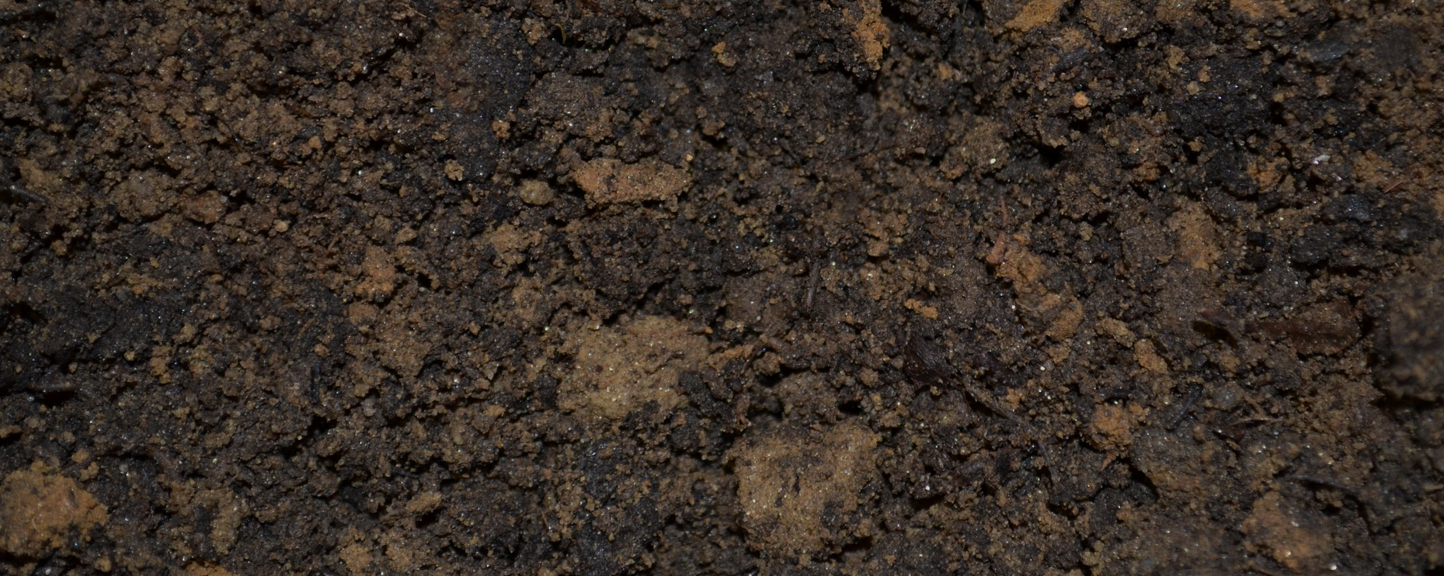
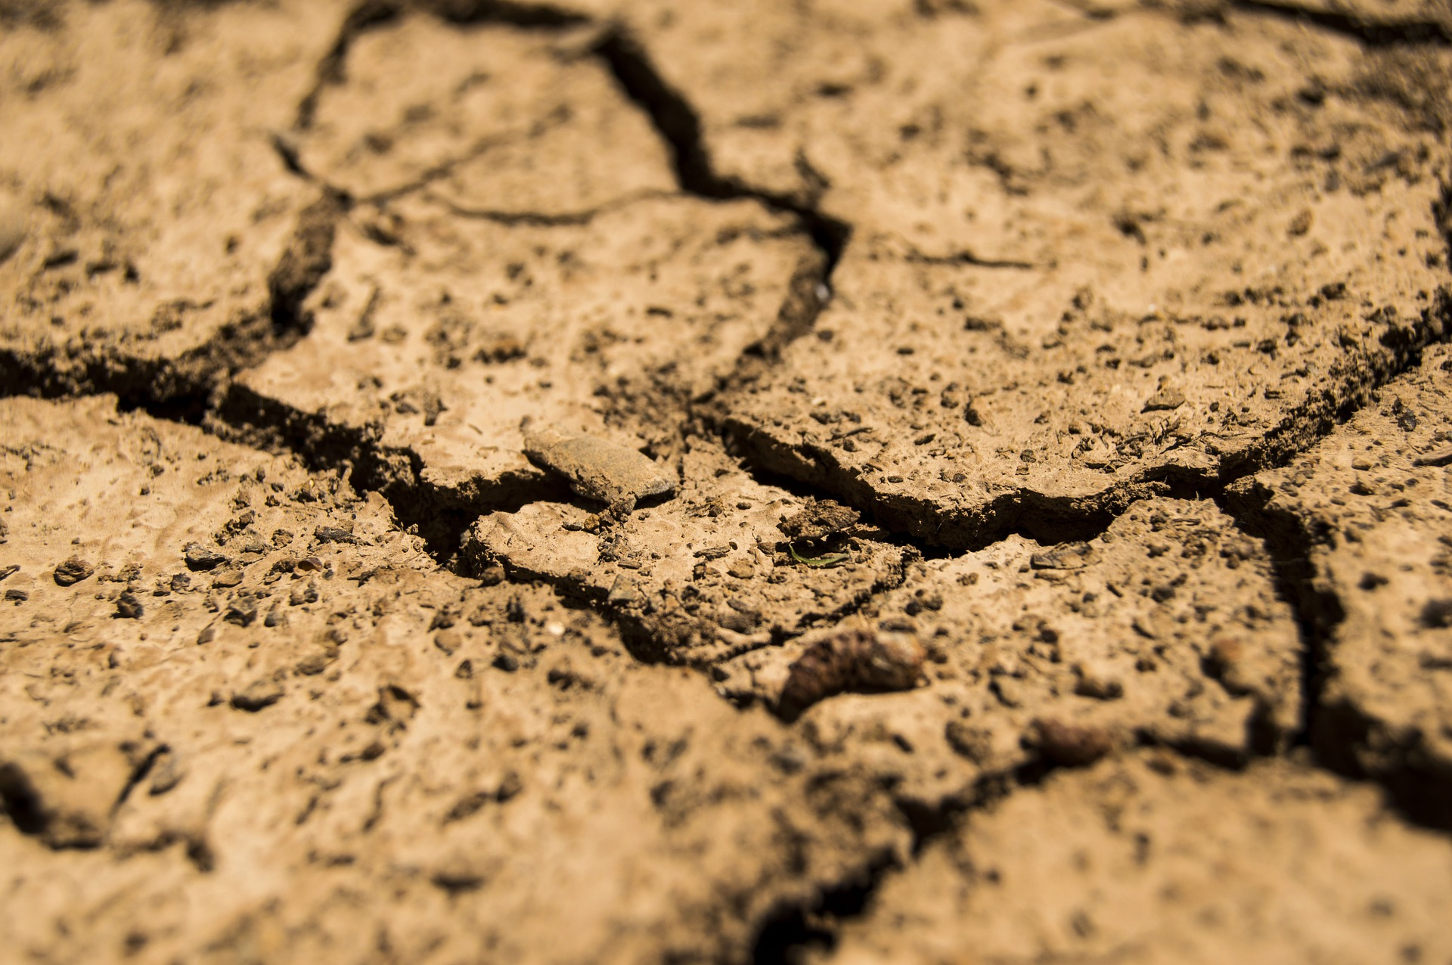
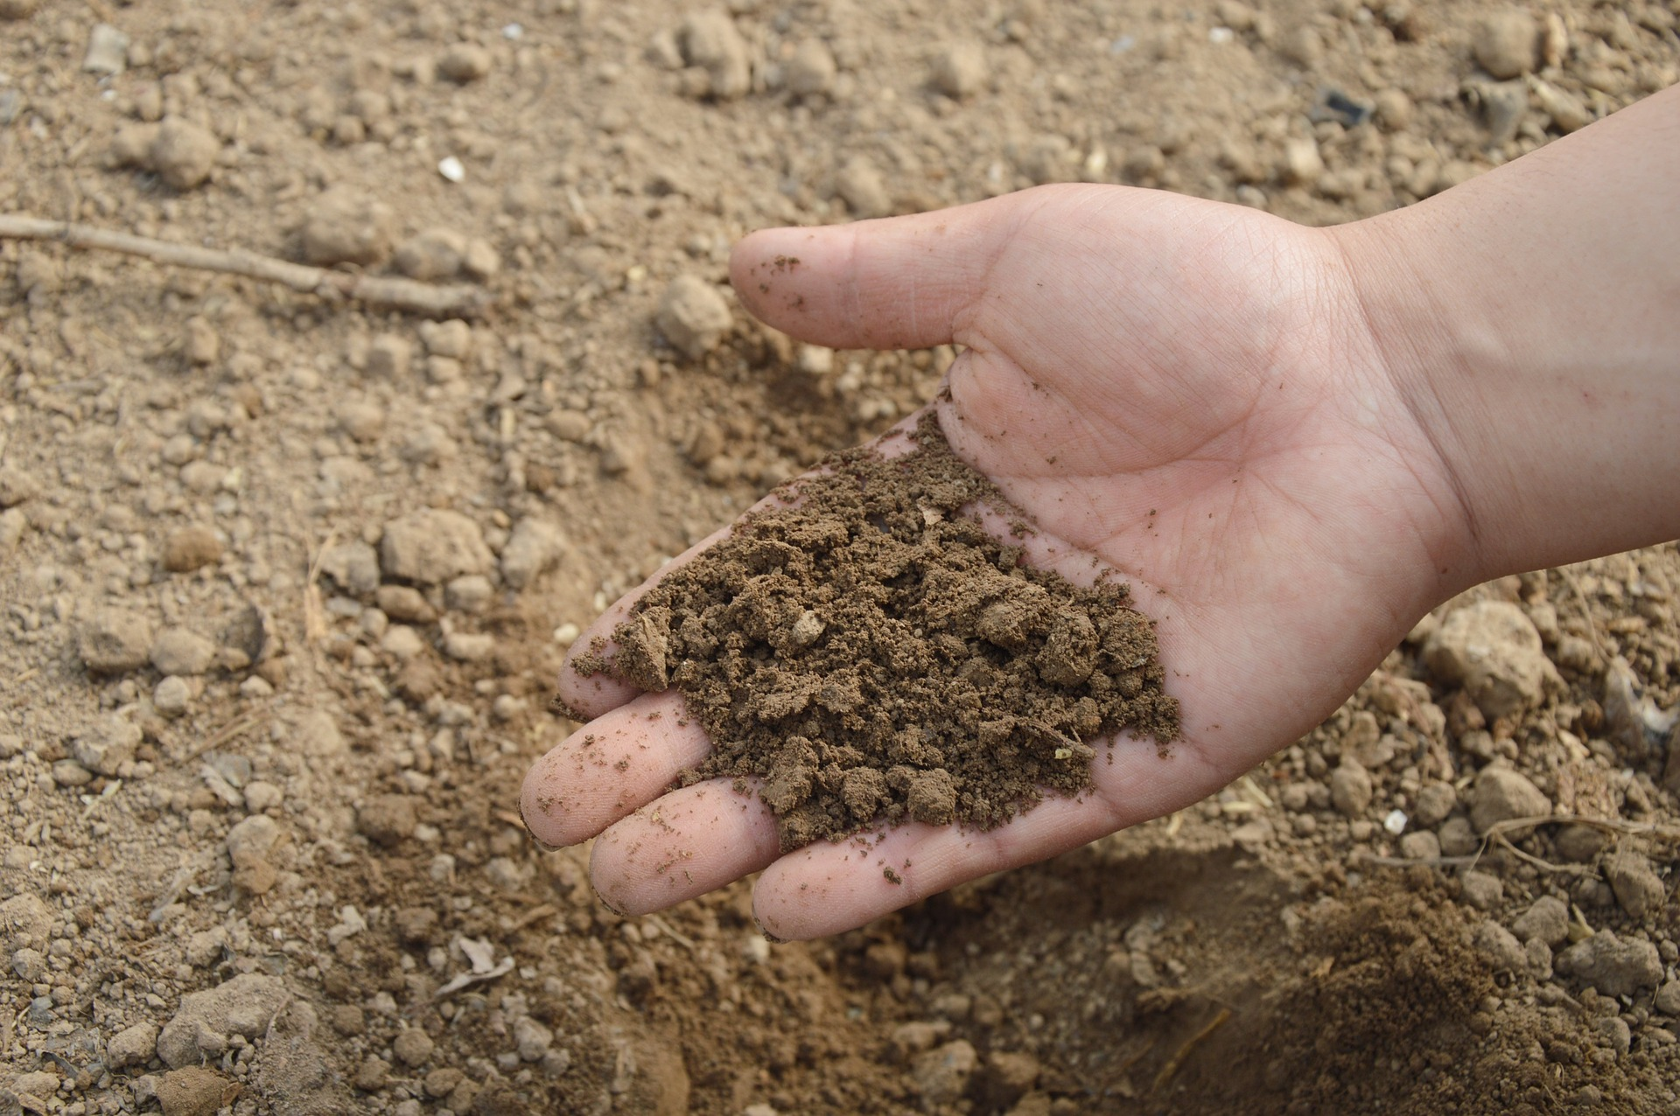
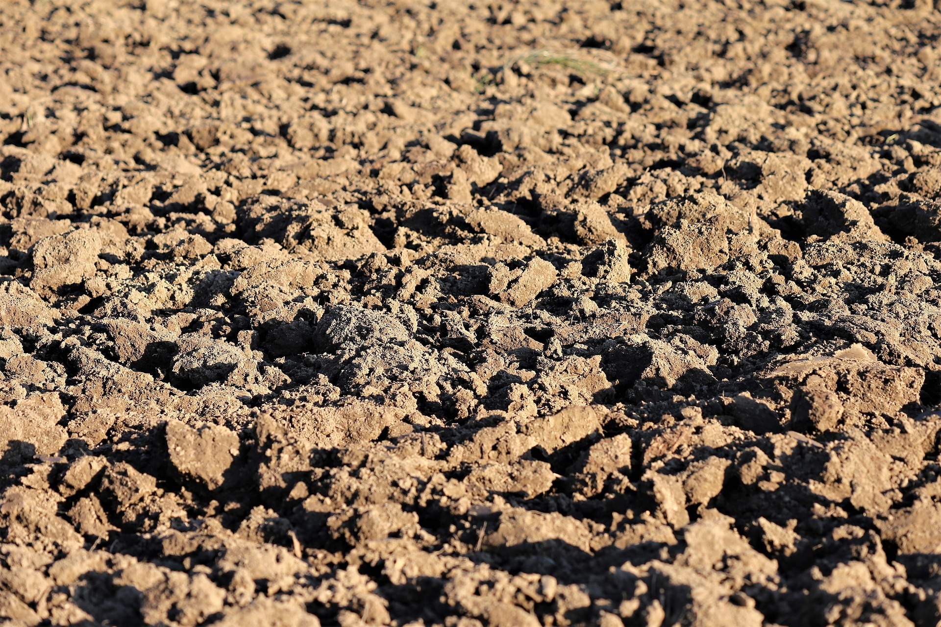
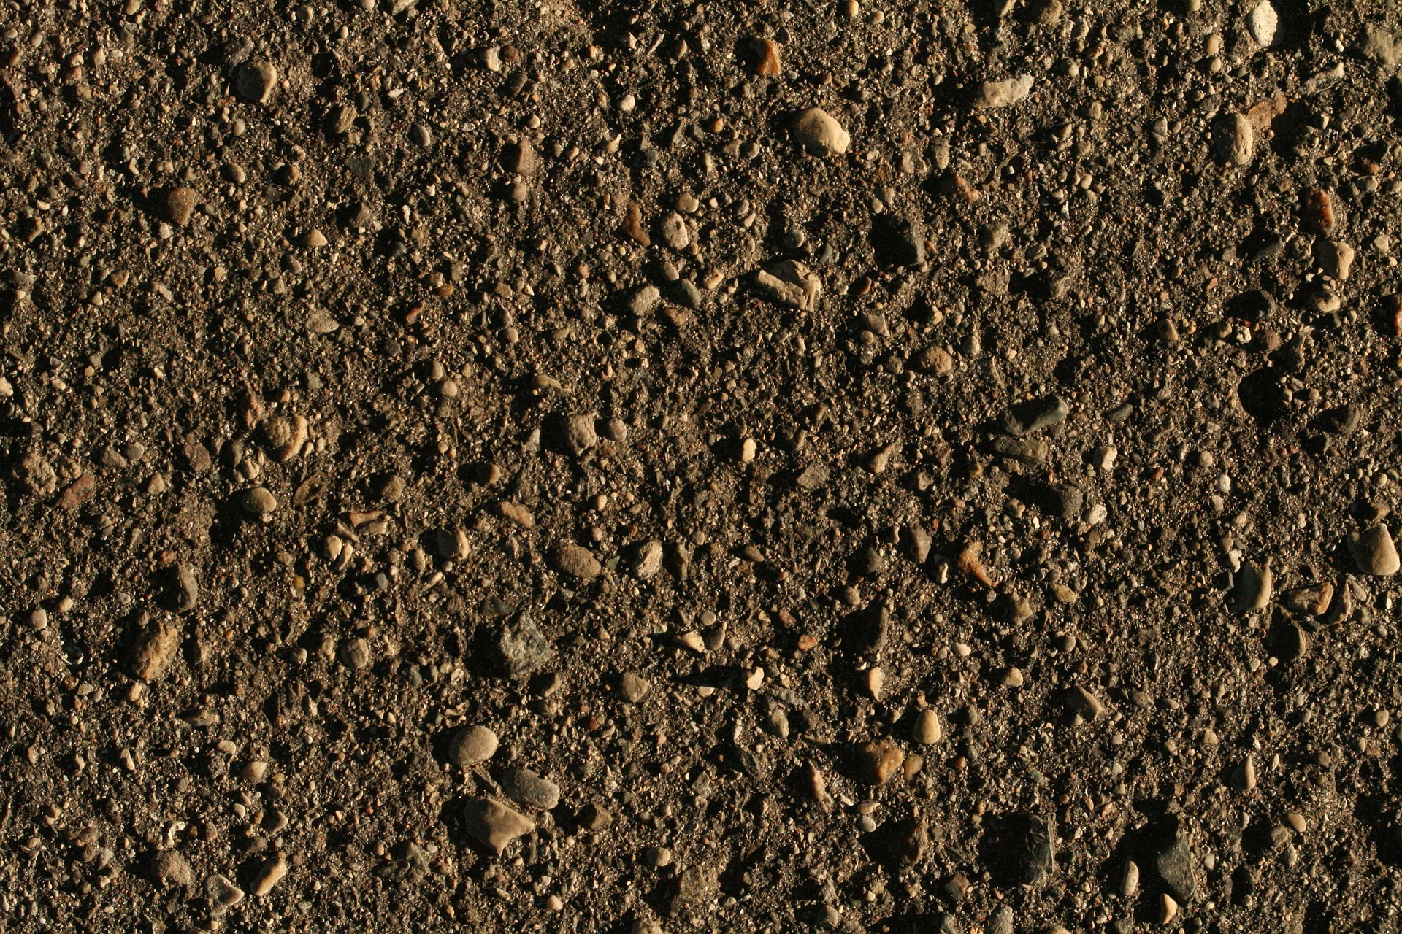
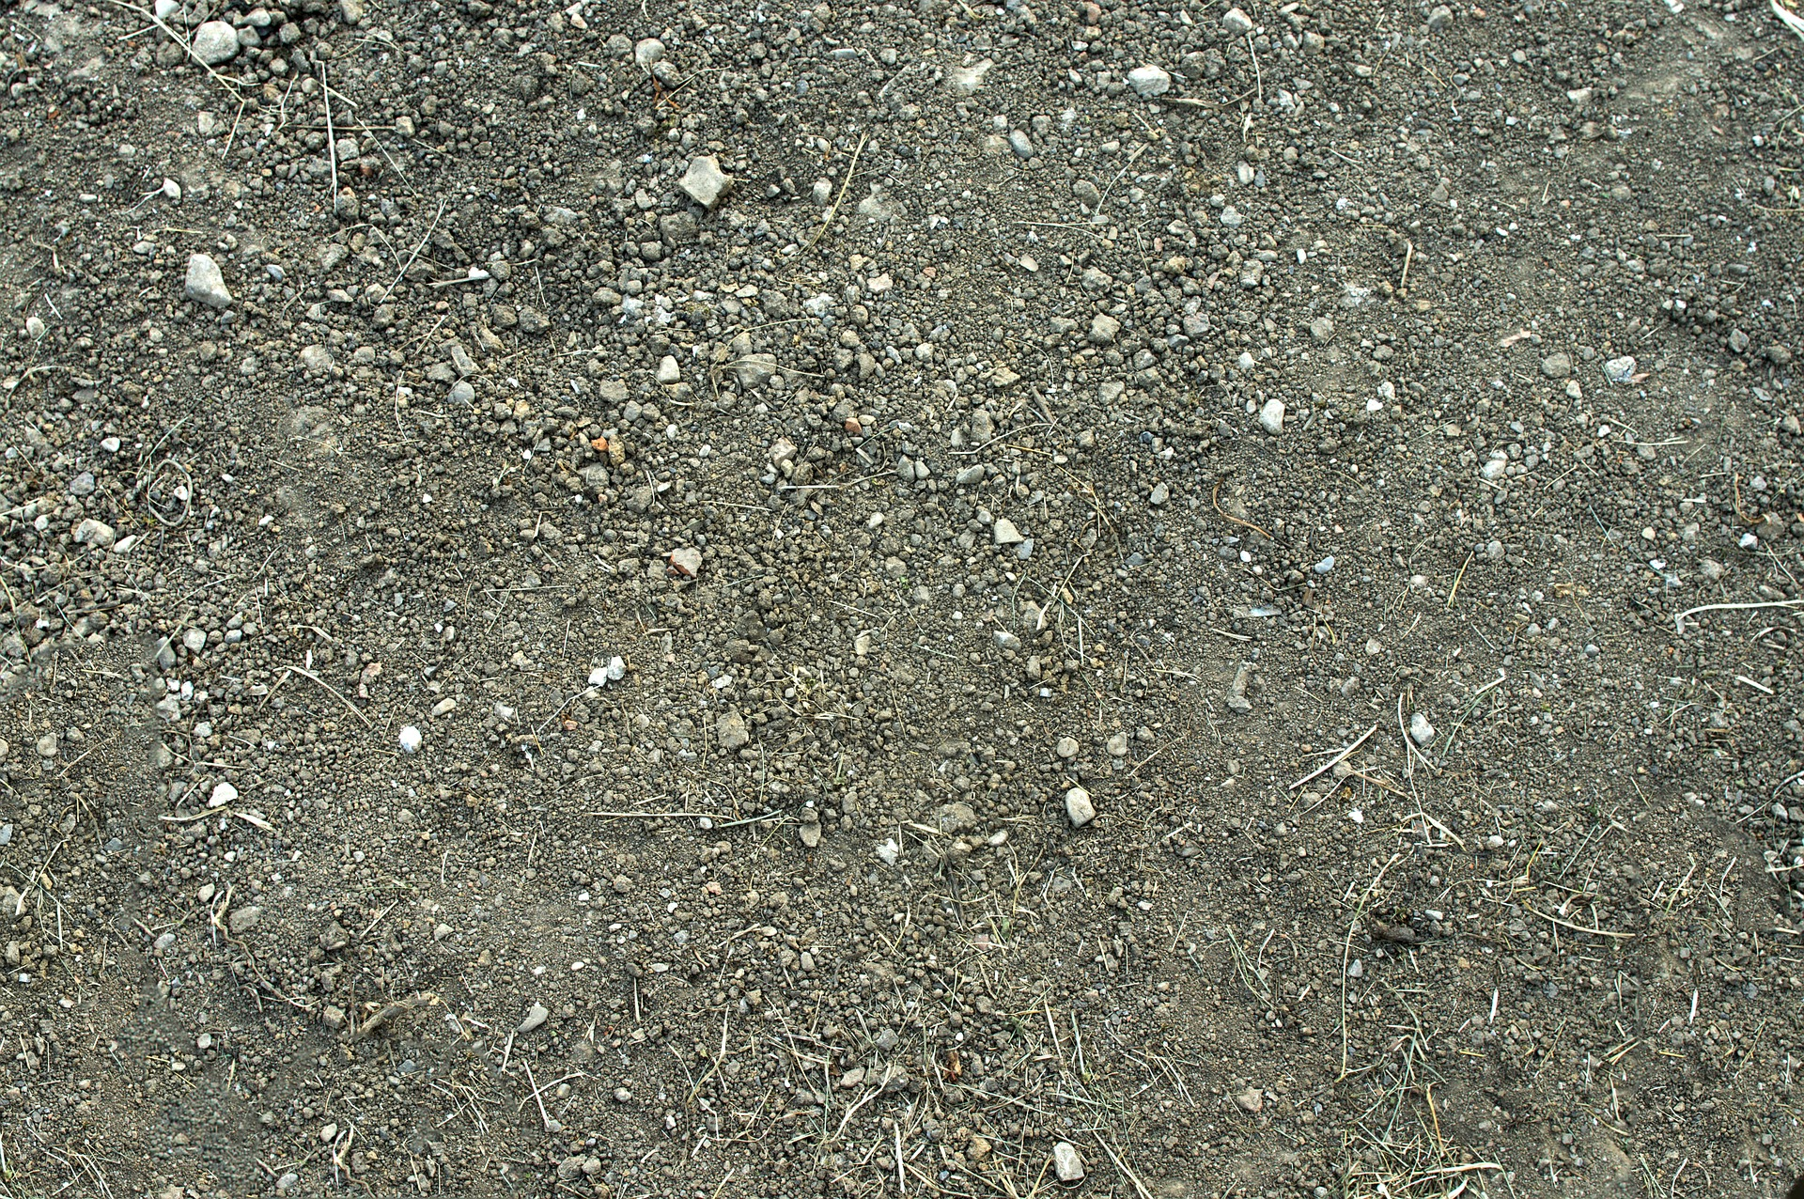
Mission Assignment: Explore different types of soil
Code: N22_34_06
Use this table to help you identify your soil samples.
Soil type | Image | Description
Peat |  | Very dark colour Mostly organic matter Holds a lot of moisture
Clay |  | Slightly orange colour Very fine particles Sticky when wet Holds a lot of water but water may run off it at first
Sandy |  | Light, yellow/brown colour Feels gritty Falls through fingers Does not hold water well
Silt |  | Medium colour Feels slippery and smooth Small particles Holds some water
Loam |  | Dark/medium colour Feels slightly gritty & smooth Holds some water
Chalky |  | Light colour May have lumps of white stone in it Does not hold water well
2
Developing Experts Copyright 2022 All Rights Reserved

Slide 2
Mission Assignment: Explore different types of soil
Code: N22_34_06
Fill in the table with your observations.
 | Soil 1 | Soil 2 | Soil 3 | Soil 4
Colour
Texture
Smell
Other notes about its appearance
Amount of water held (ml)
Soil type
2
Developing Experts Copyright 2022 All Rights Reserved

