Slide 1
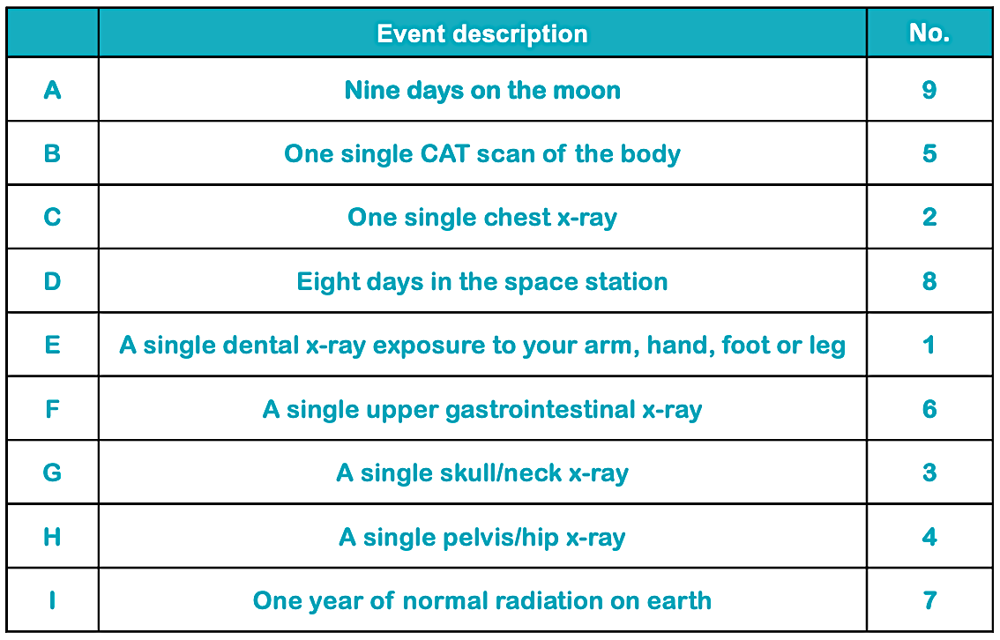
Teacher answers
medical X-rays, radioactive fallout from weapons testing, radioactive waste
Where someone lives or what they do alters their exposure to radiation. Most is absorbed in the environment, from cosmic rays, rocks, building materials and living things. Exposure to elevated levels of radon gas may be of concern. Having medical treatment using radiation or using applications of irradiation in their employment.
Bananas contain a radioactive isotope of potassium-40 in very small quantities. The radioactive decay of the atom gives off a very small fraction of radiation at 0.0001 mSv
The American College of Radiology recommends limiting lifetime diagnostic radiation exposure to 100 mSv, which is the equivalent to about 10,000 chest X-rays.
Radon is everywhere; it is formed from the uranium in all rocks and soils. It is constantly monitored in high-risk areas and maps of the UK show darker areas where there are elevated levels. The amount of radon is measured in becquerels per cubic metre of air (Bq/m³). The average level in UK homes is 20 Bq/m³.
Pilots are restricted to 900 hours a year. A direct flight from to Australia is approximately 20 hours. Assuming that they would have to do return flights (0.2 mSV): 11 return flights at 0.2mSv x 11 = 2.2mSv.
*

