Slide 1
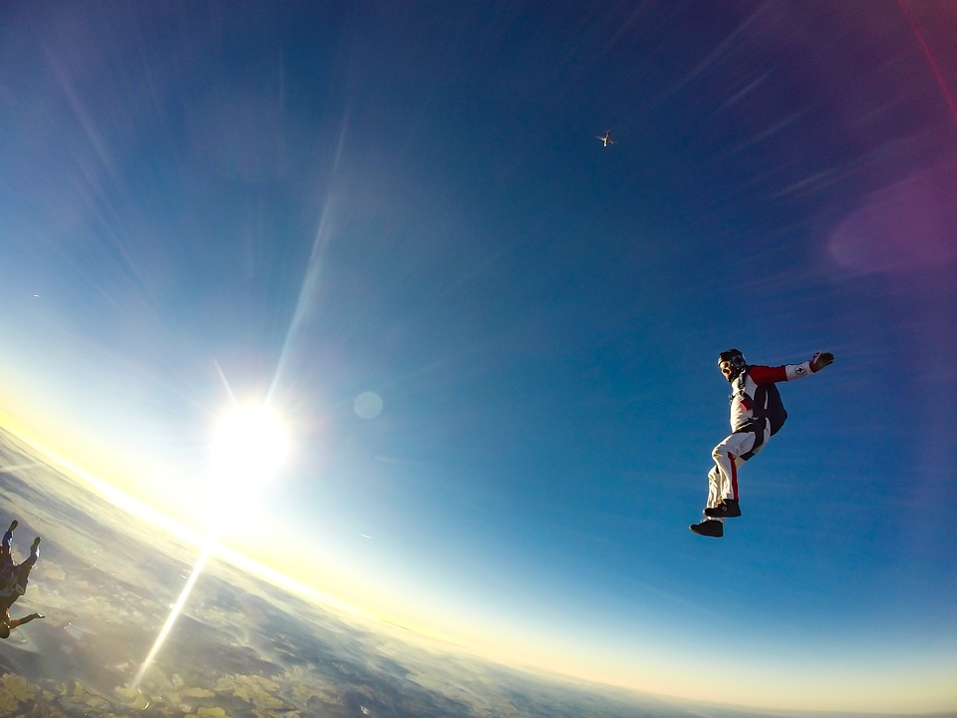
0001.01
Mission Assignment
Task | Research the gravity experiment of Galileo. What did he learn from his experiment at the Tower of Pisa? | Research
Developing skills | Practise calculating GPE; try changing the gravity to that of the Moon or Mars. Rearrange the equation to solve for height or gravitational field strength.
Think about… | Explain why rockets leaving the Earth require so much energy in thrust compared to a rocket leaving the Moon.
KS4-18-02:
Gravitational Potential Energy

