Slide 1
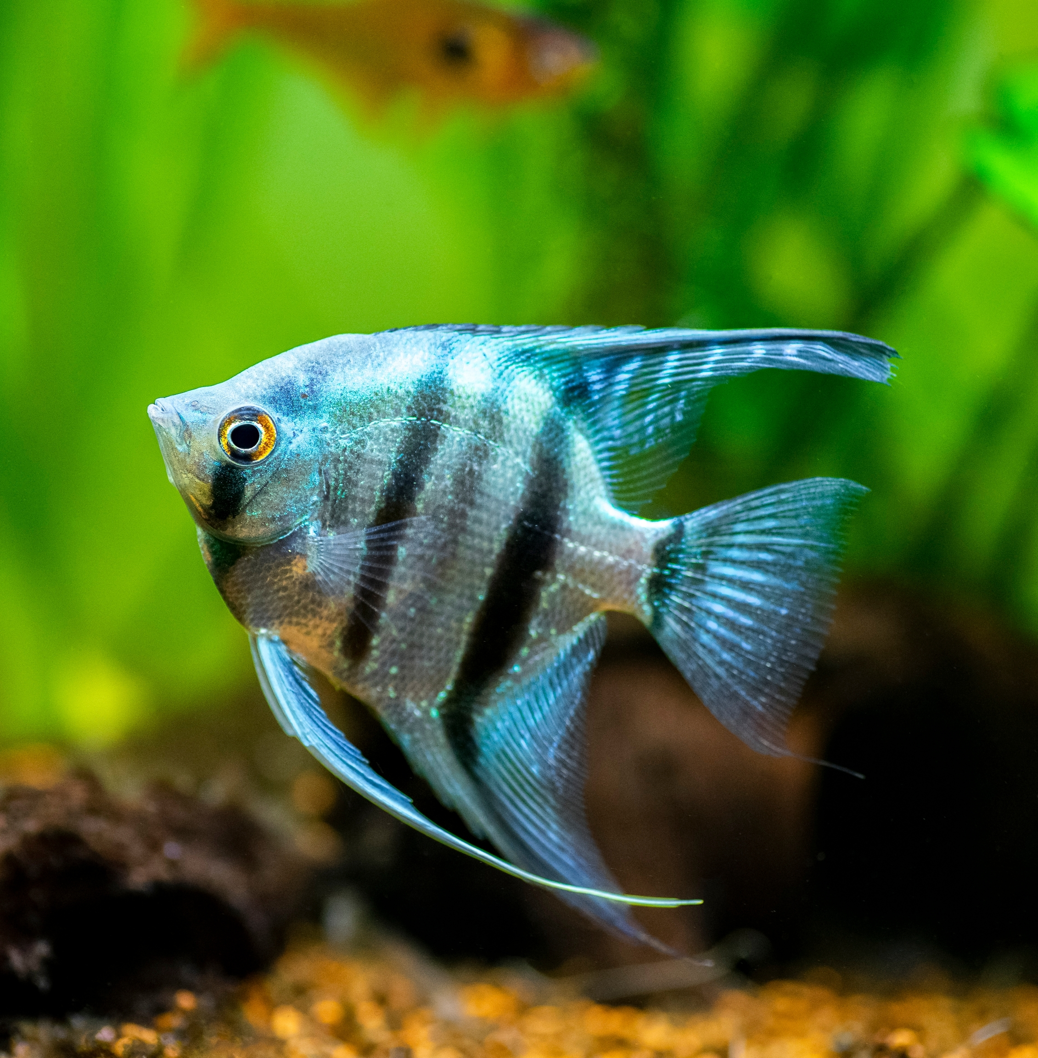
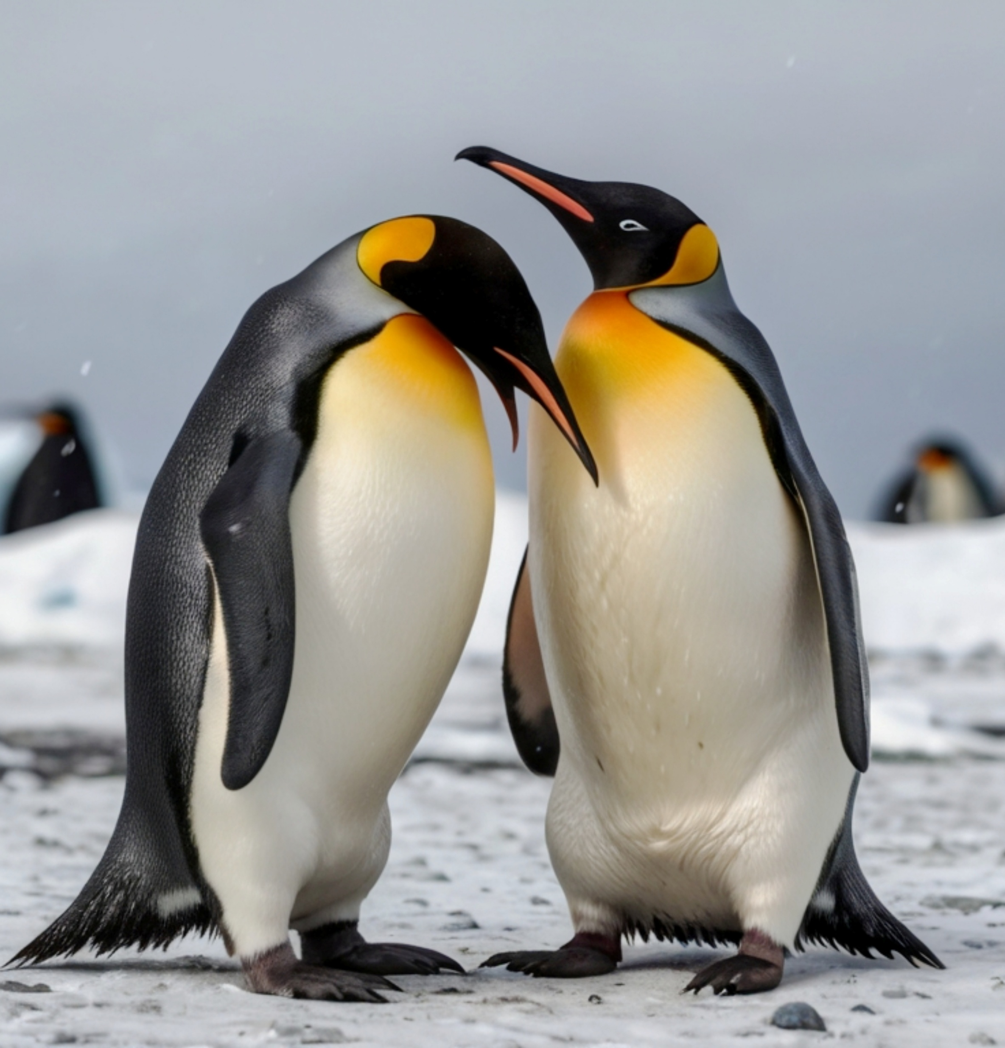
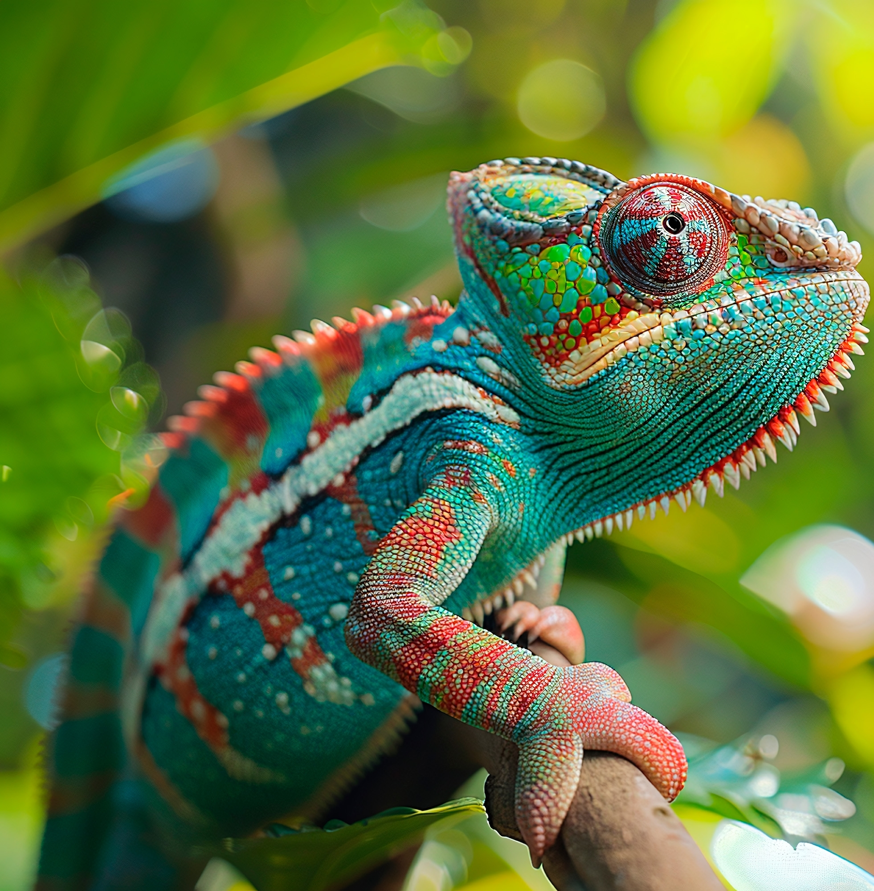
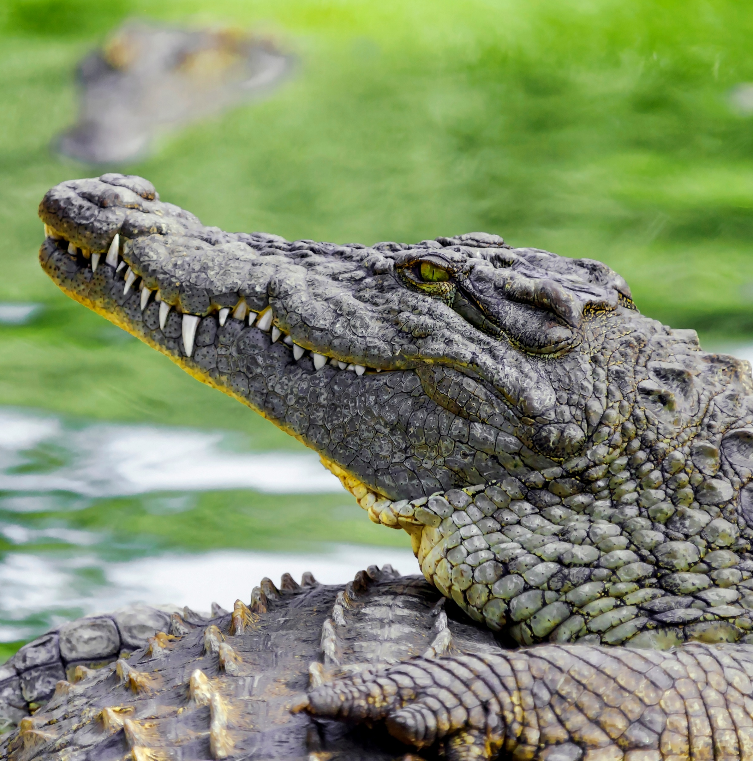
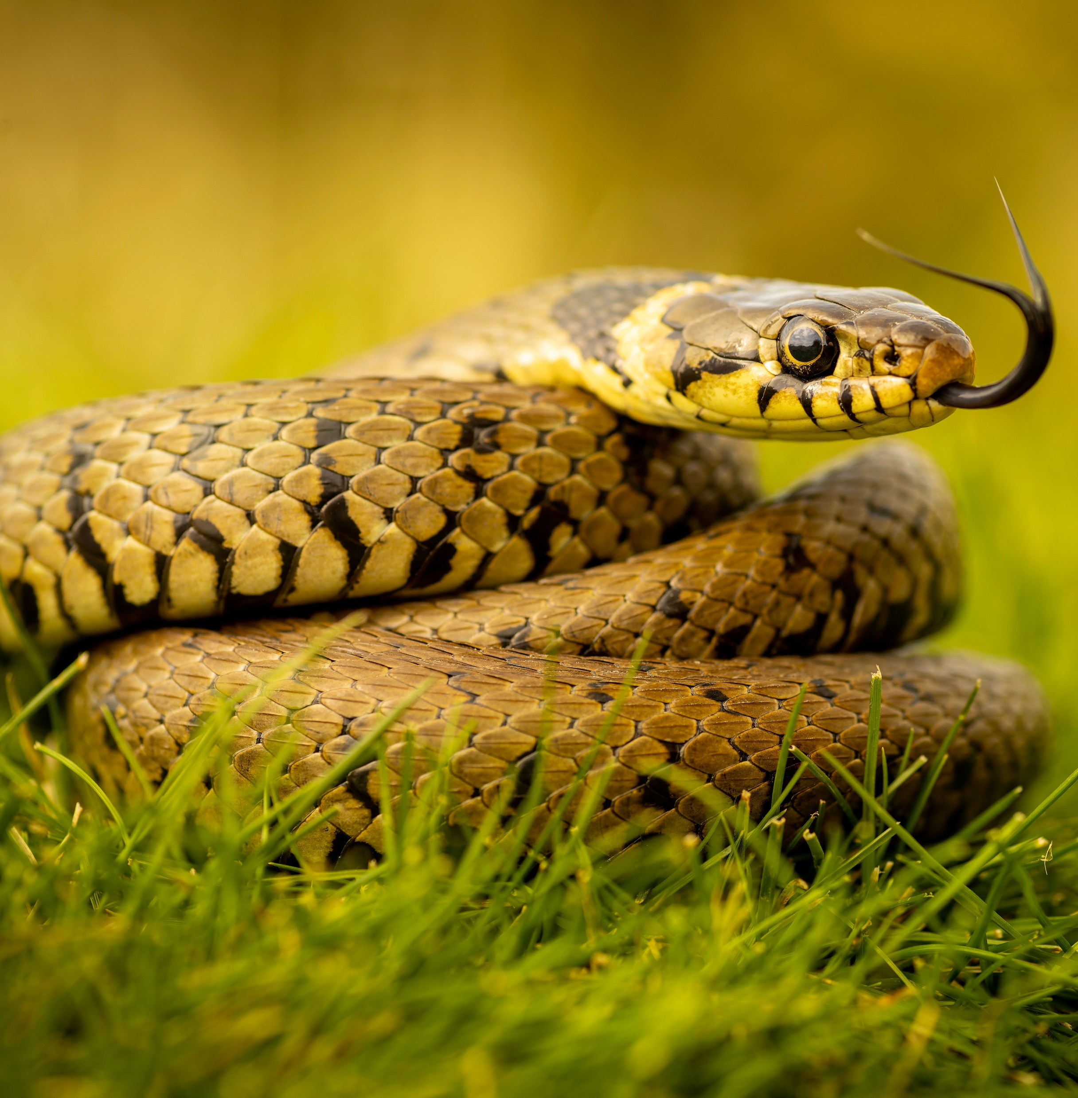
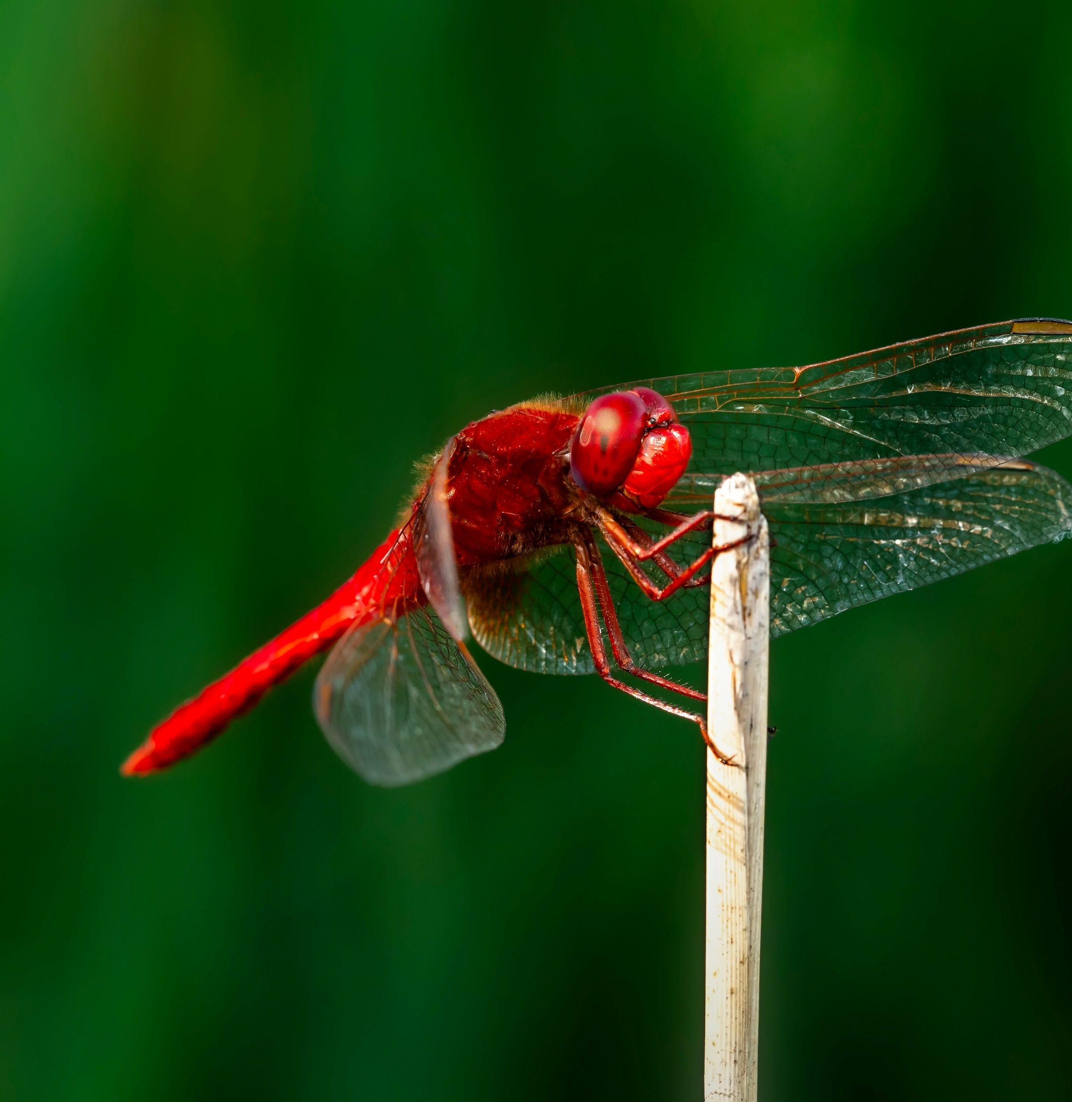
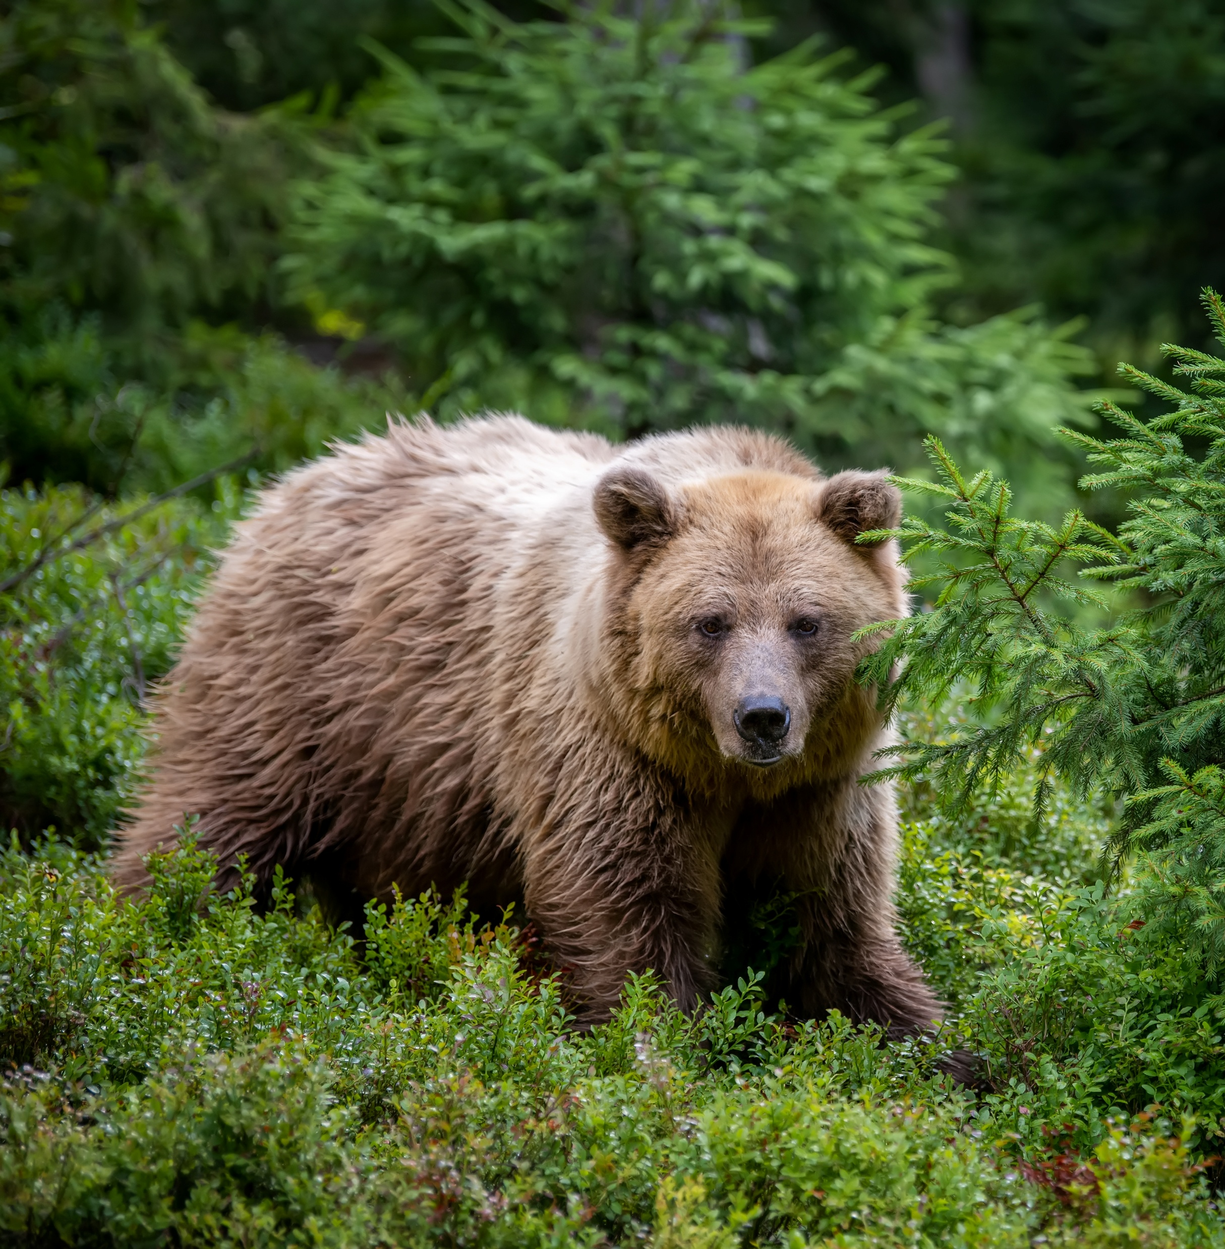
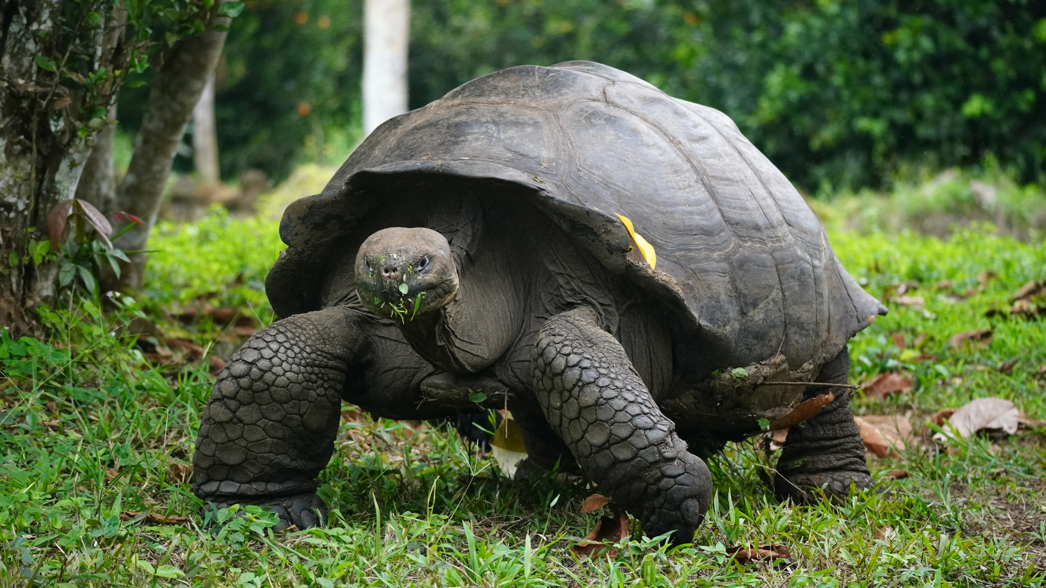
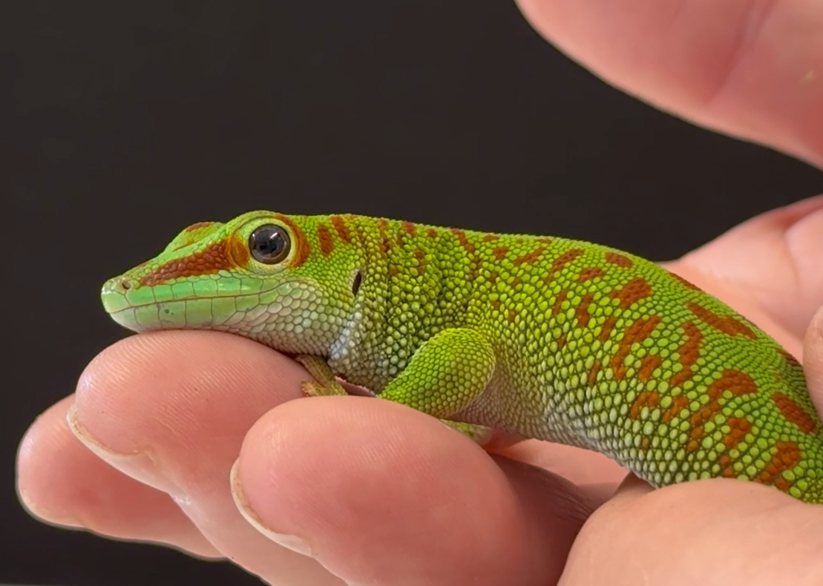
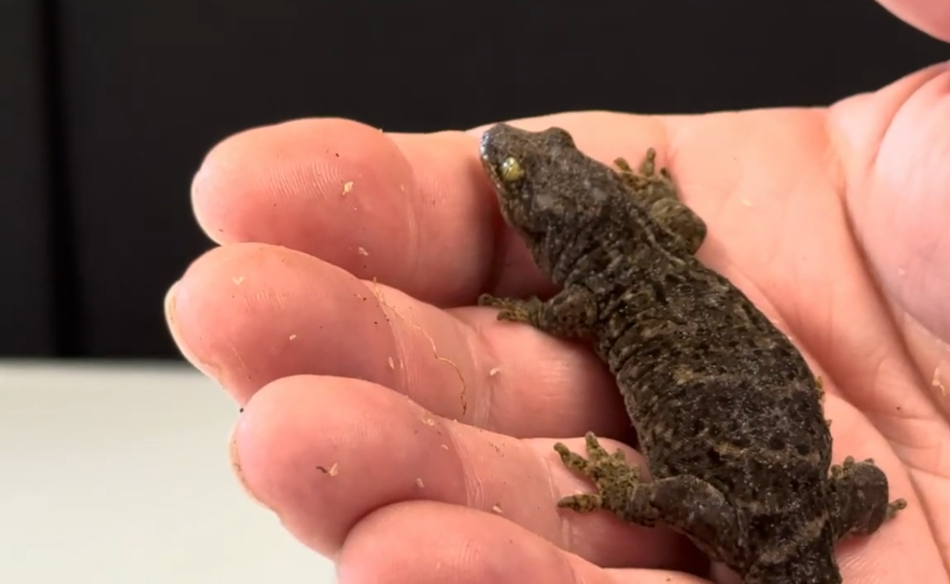
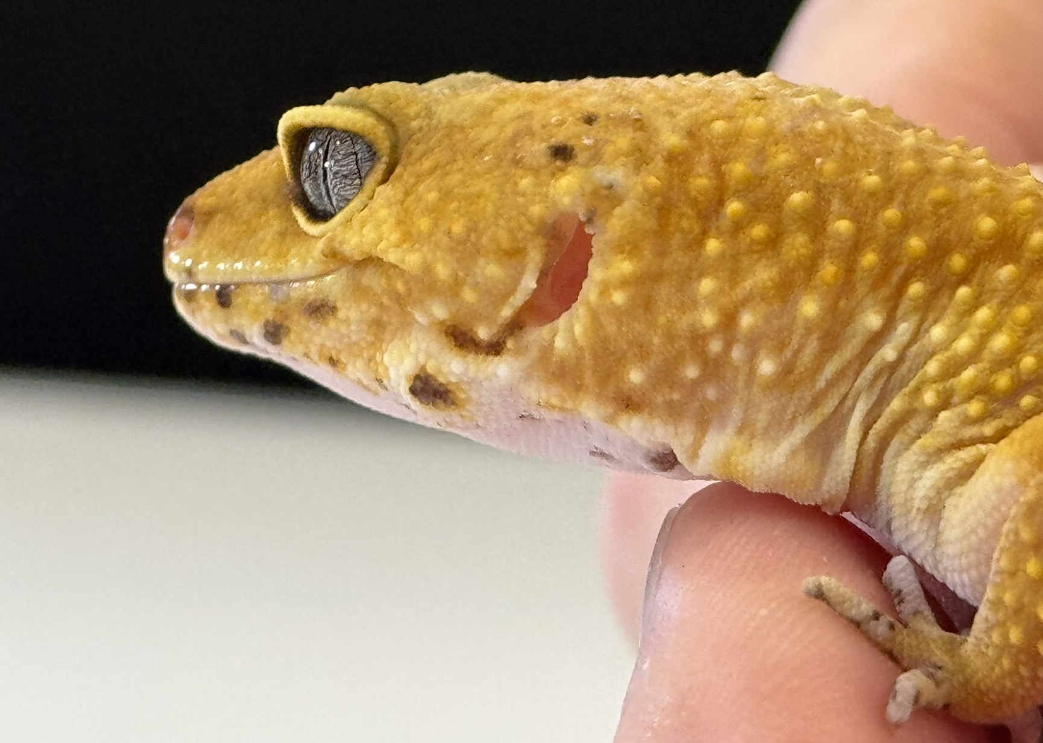
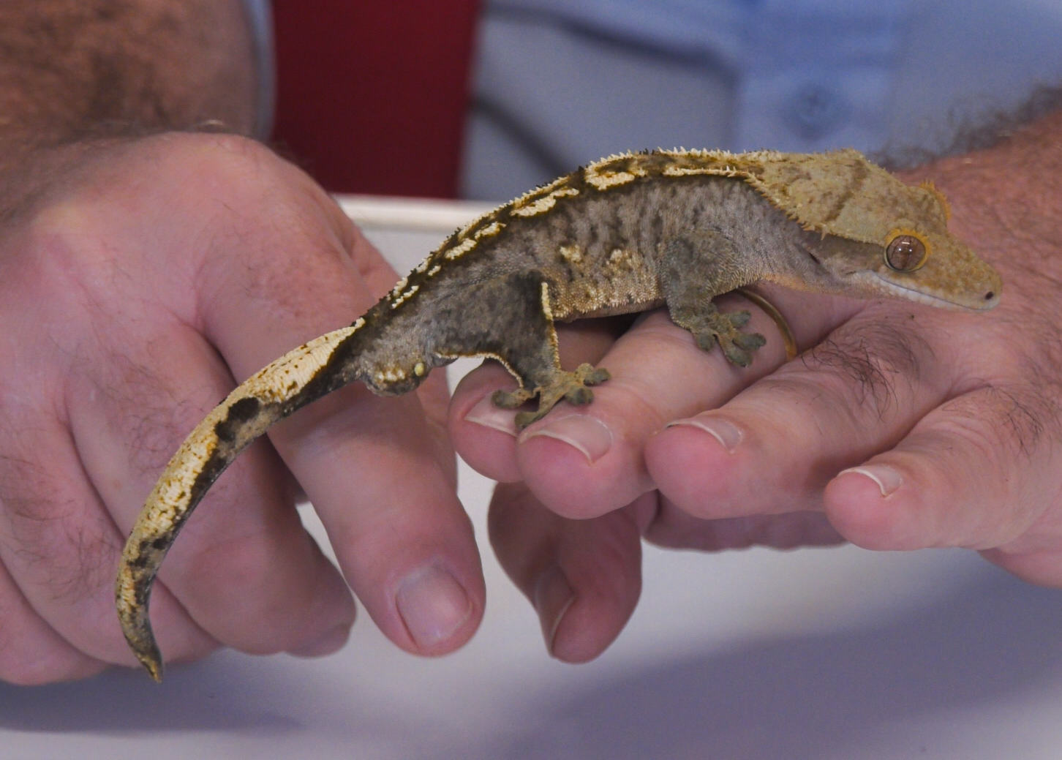
Science Week 2025
Remarkable Reptiles: Their Changes Over Time
KS1 Handout
Session 2
Activity 1: Tick the reptiles. ✓
Activity 2: Write the habitat underneath each gecko. ✓
Madagascar day gecko
New Zealand gecko
leopard gecko
crested gecko
deserts tropical rainforests forests
1
Developing Experts Copyright 2025 All Rights Reserved

Slide 2
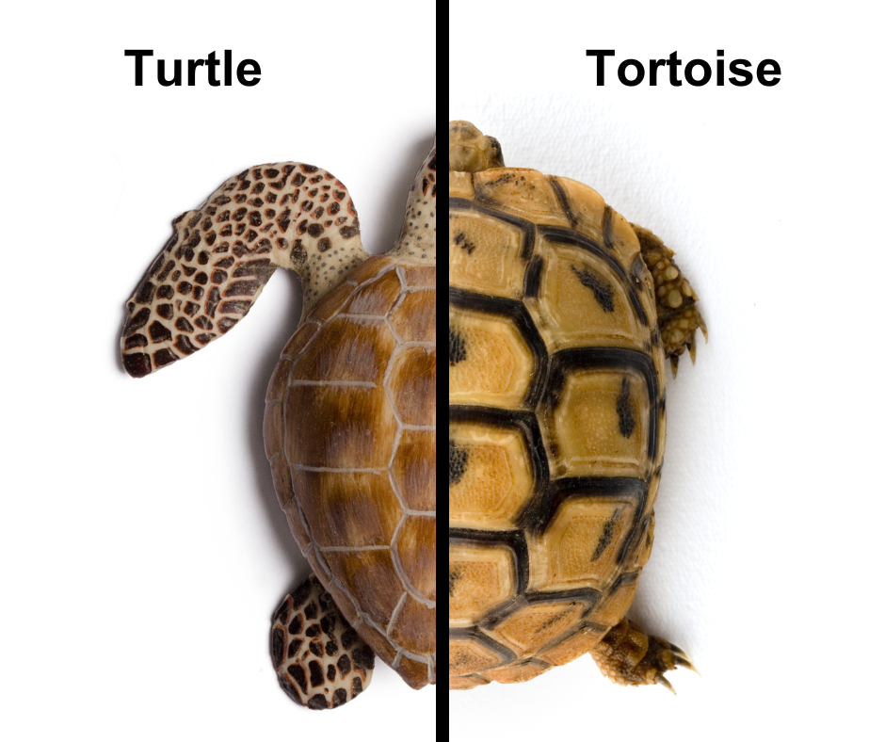
Science Week 2025
Remarkable Reptiles: Their Changes Over Time
KS1 Handout
Session 2
Activity 3: Use the word bank to label the tortoise and turtle. Can you discuss their similarities and differences?
flat shell head tail leg
foot flippers claw dome-shaped shell
2
Developing Experts Copyright 2025 All Rights Reserved

Slide 3
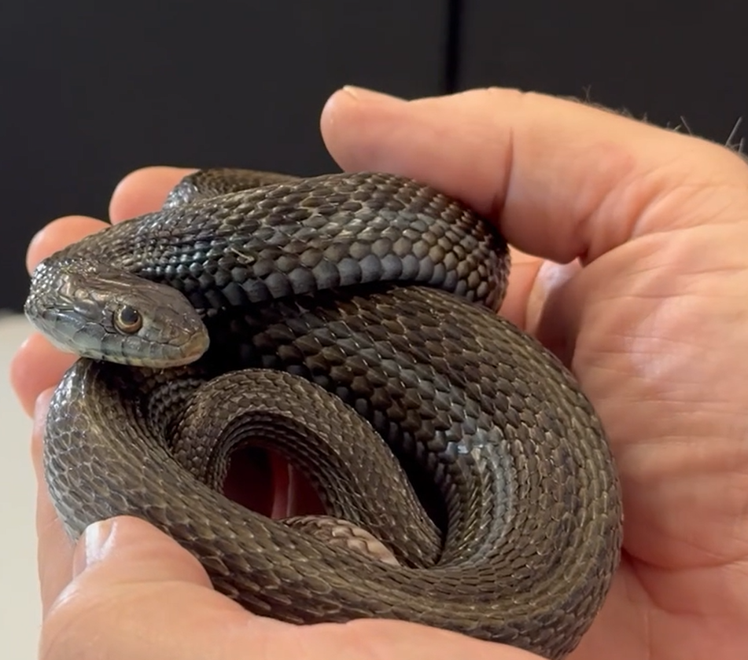
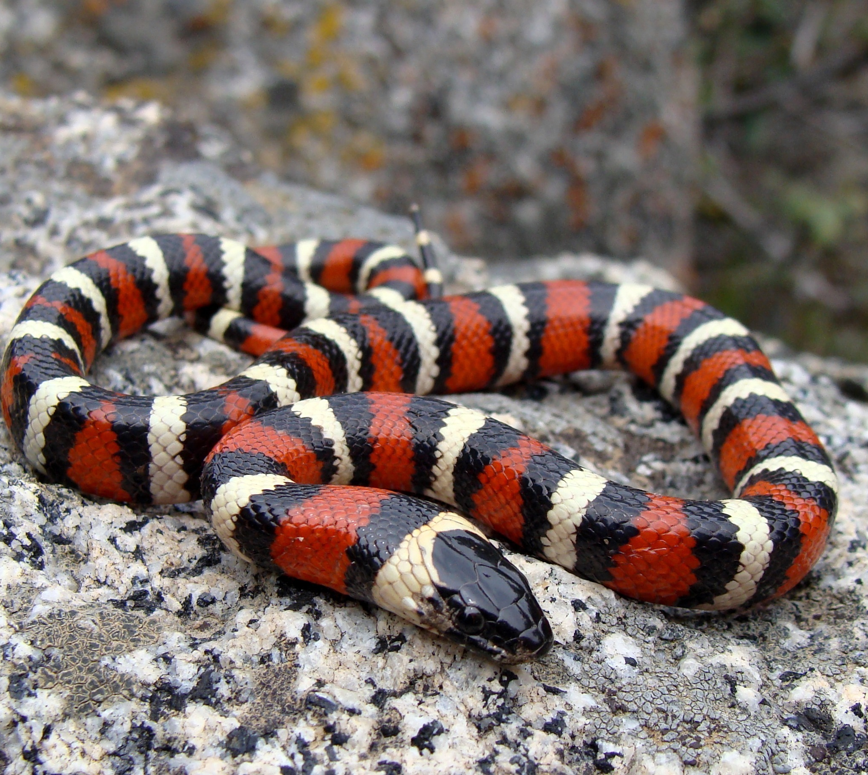
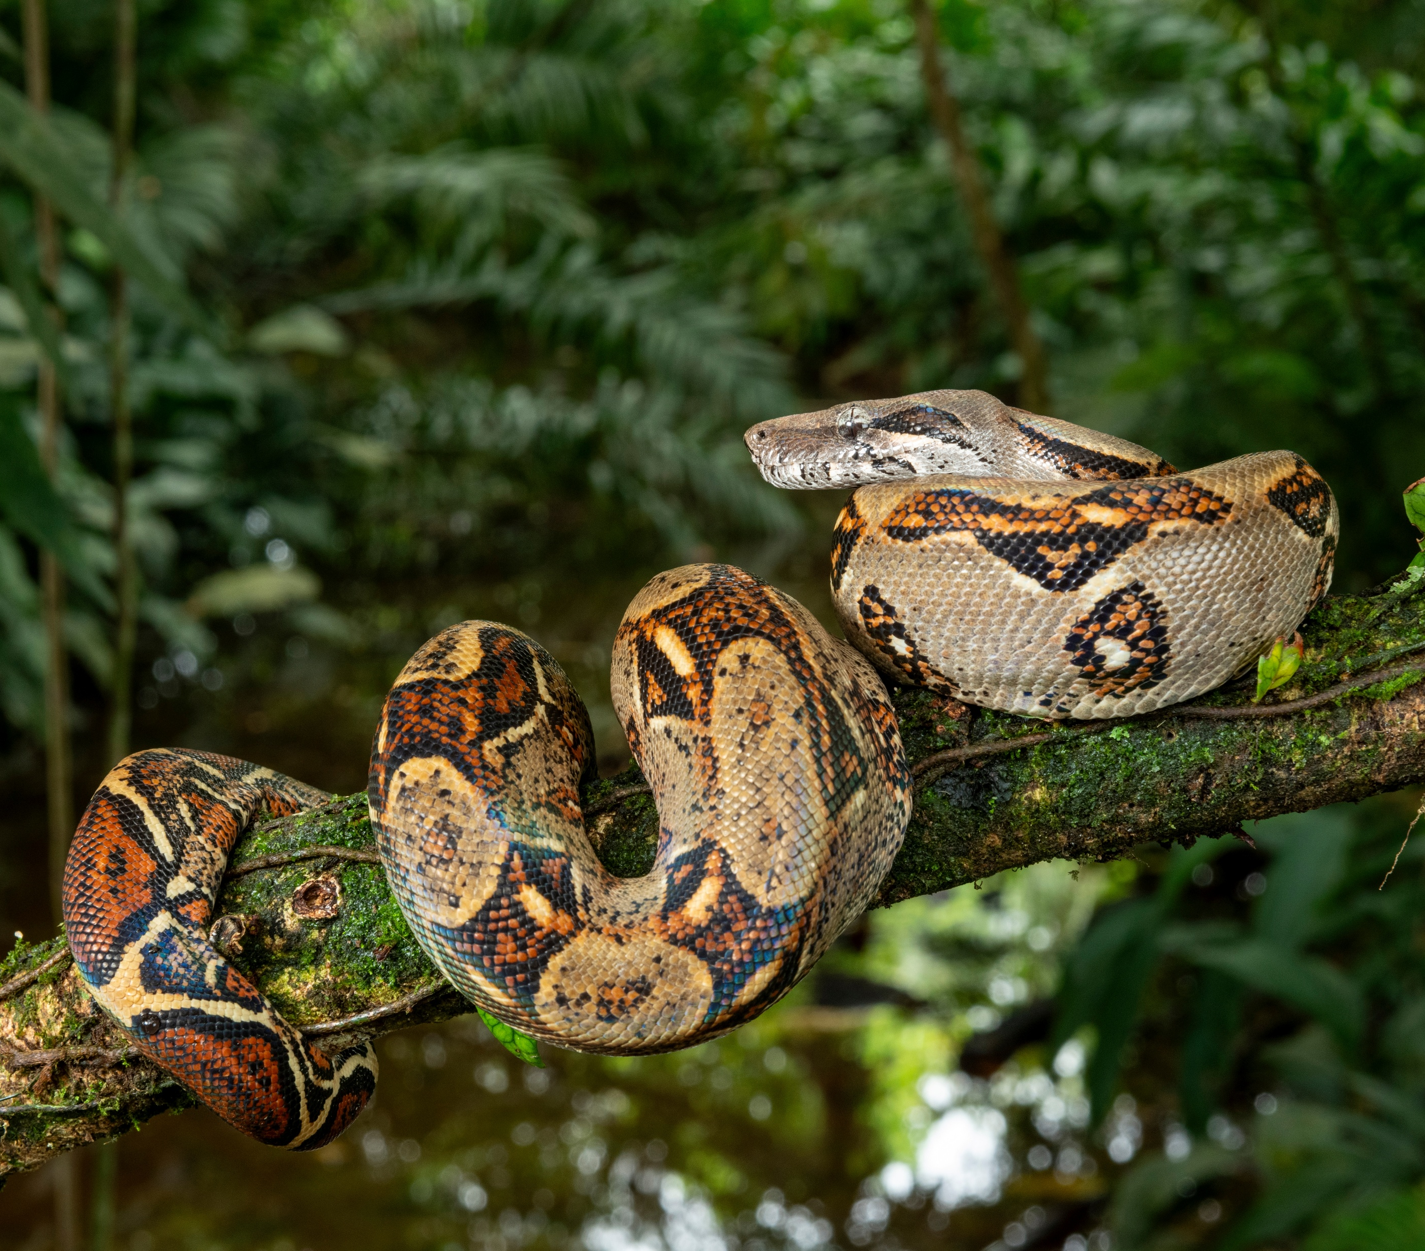
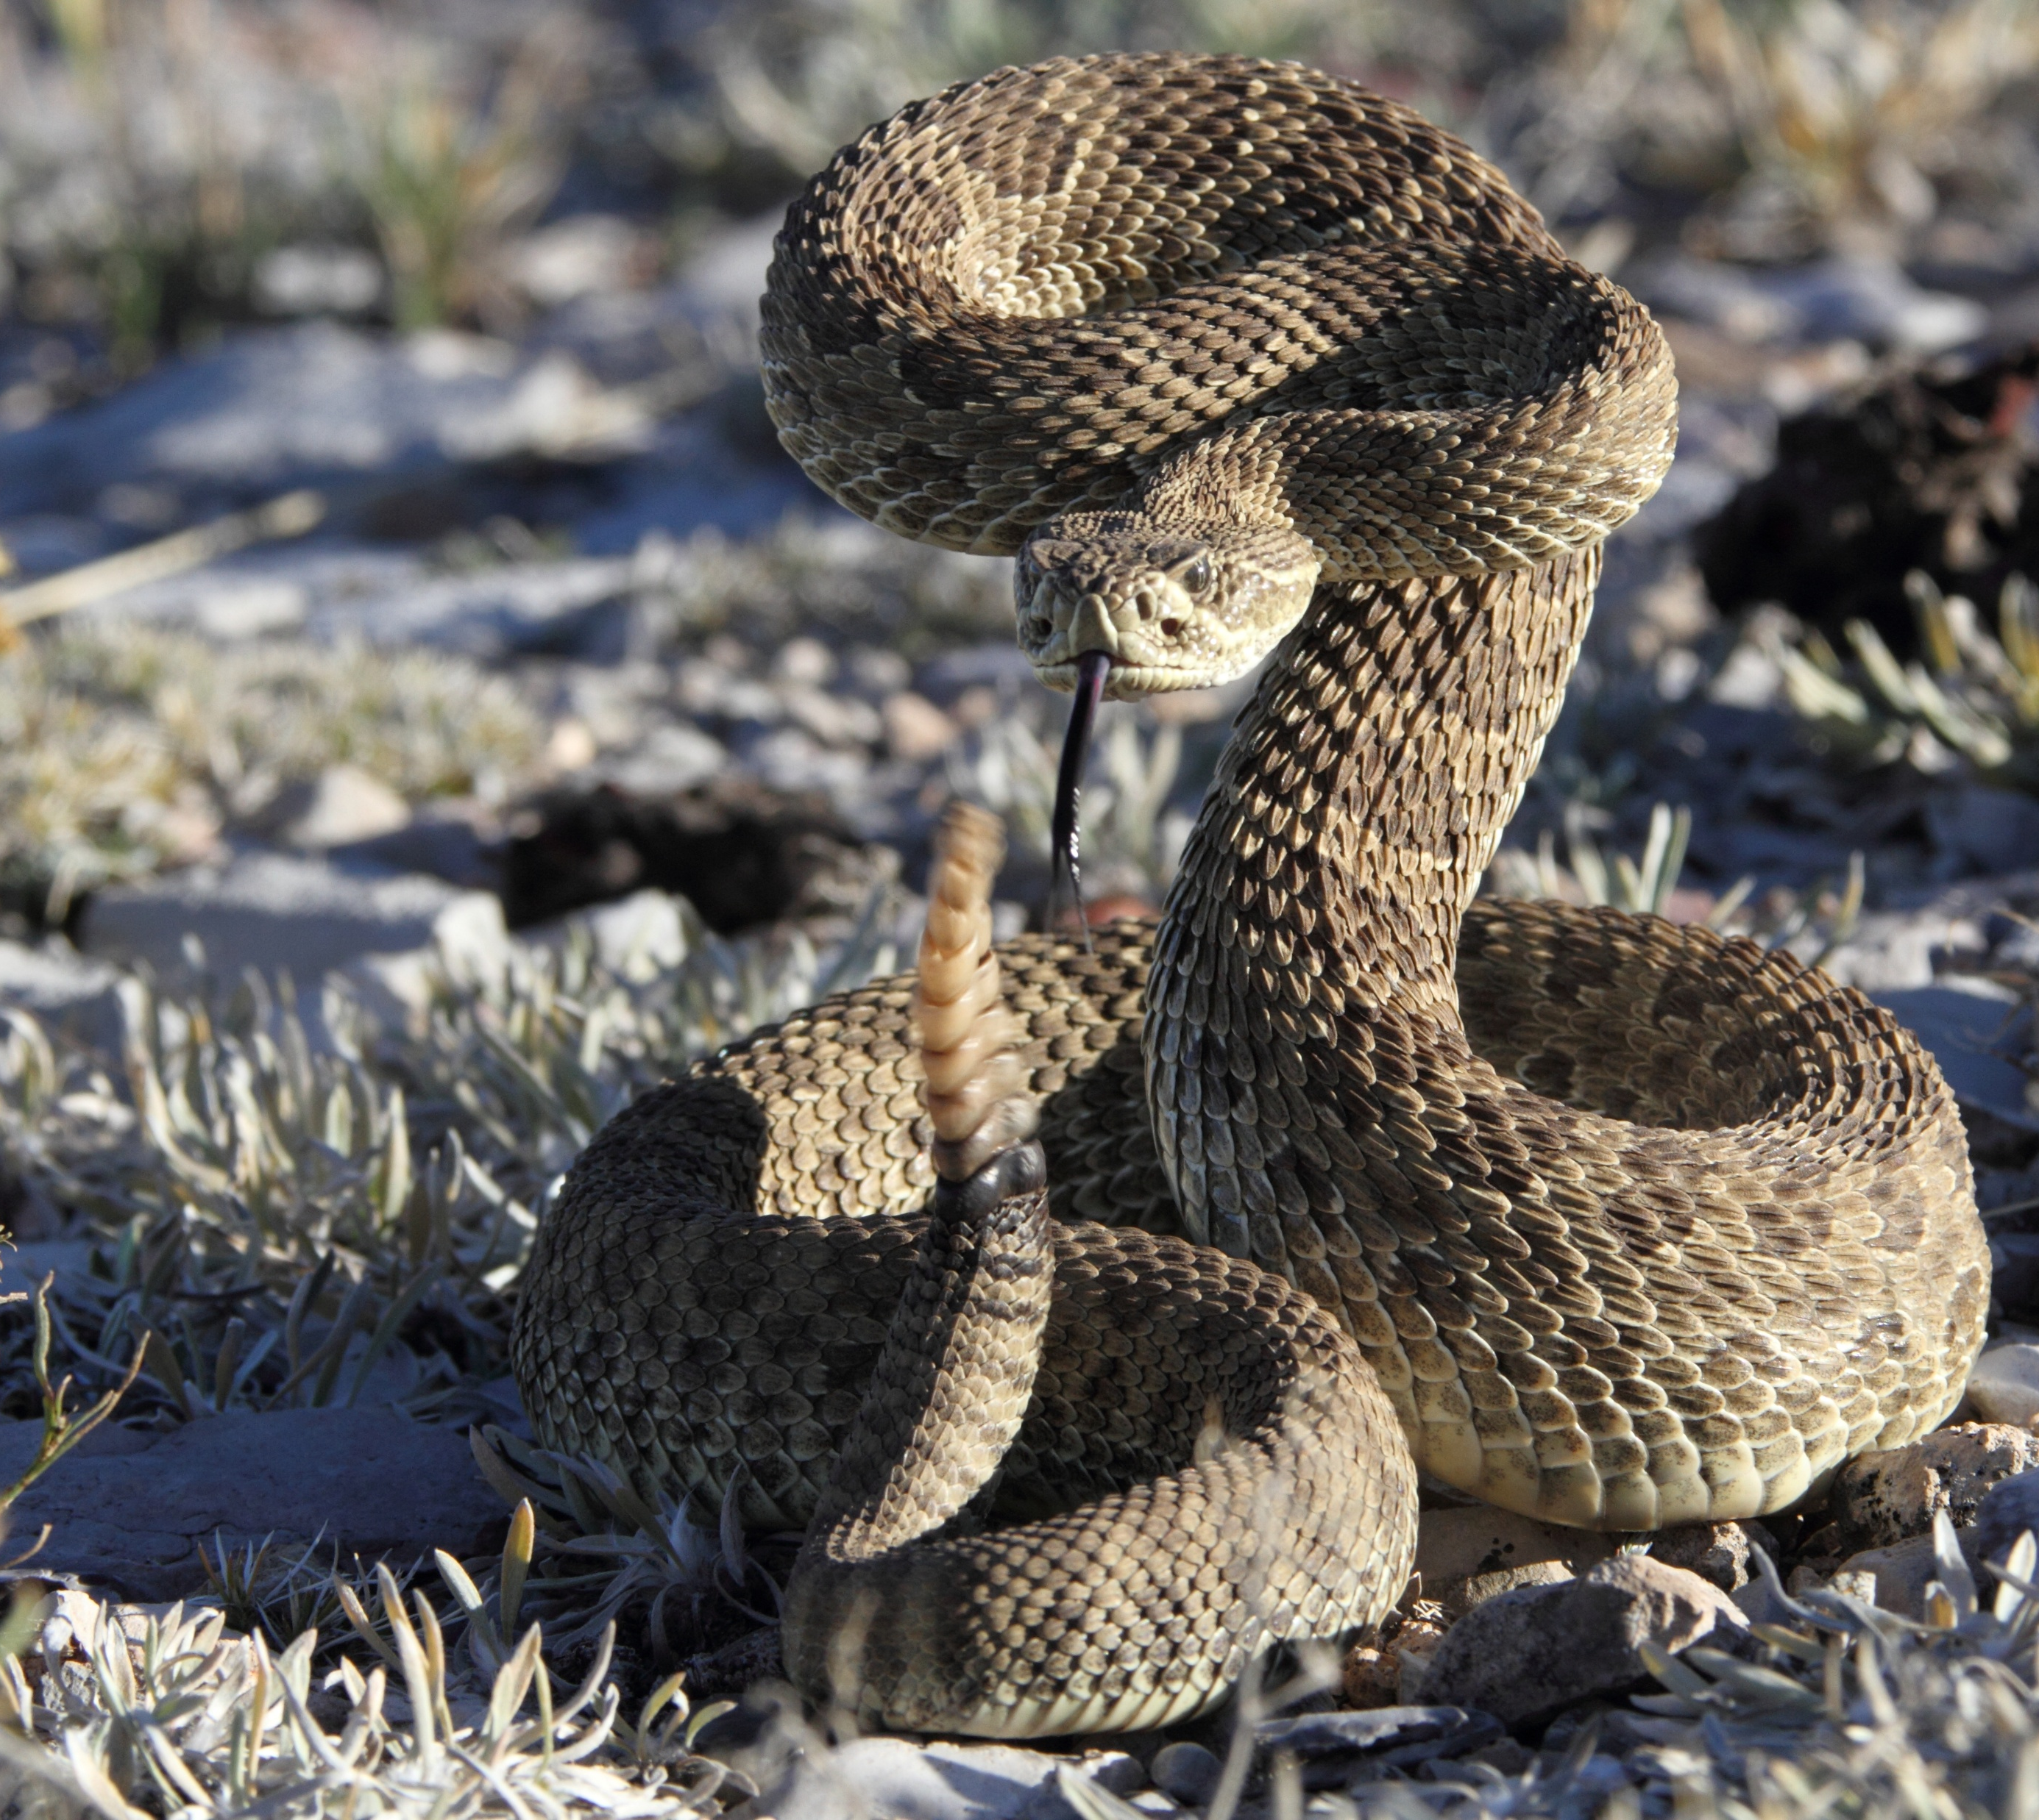
Science Week 2025
Remarkable Reptiles: Their Changes Over Time
KS1 Handout
Session 2
Activity 4: Discuss the facts you remember about these snakes. ✓
Where does each snakes live? What is its habitat?
What does each snake eat?
Is the snake venomous or a constrictor?
garter snake
king snake
boa constrictor
rattlesnake
3
Developing Experts Copyright 2025 All Rights Reserved

