Slide 1
Teacher answers
Students should make reference to the infrastructure for renewable energy in the UK being under development and that renewables such as, wind, solar, and hydro cannot meet our energy demands alone. We need to increase our generation from nuclear to create a consistent supply when there is not enough wind or sun.
The phrase ‘peak demand’ should be in the answer. If that specifically refers to morning and evening during traditional work patterns, then it should have higher marks (reference to home working changing peak demand can merit the highest marks).
Advantages: Reliable- fossil fuels can be used to release energy when we need it
Release a lot of energy from a small amount. This means you only need to carry small amounts for transport
Abundant- There is a relatively large amount available and are relatively cheap
Versatile: Fossil fuels can be used for may energy requirements.
Disadvantages: Burning fossil fuels releases carbon dioxide which is a greenhouse gas. This causing climate change
Non-renewable. It is a finite resource and will run out
Air pollution: Particulate, sulphur dioxide and nitrogen oxides cause breathing problems and acid rain
Carbon capture is the process of separating carbon dioxide that is emitted from manufacturing or energy generation and storing it, generally under ground in deep geological formations. One example could be the storage in empty gas basins in the North Sea, UK. Another example might be using disused mines as the CO₂ molecules attach to the coal.
Acid rain erodes the waxy layer on the leaves of trees, causing damage to the natural environment. In the human-made environment, the rain dissolves stone and metal structures faster than normally weathering.

Slide 2
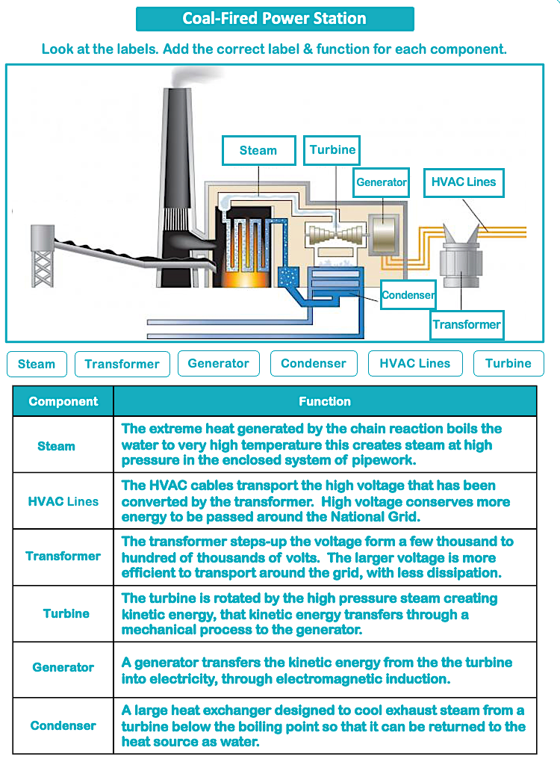
Teacher Answers

