Slide 1
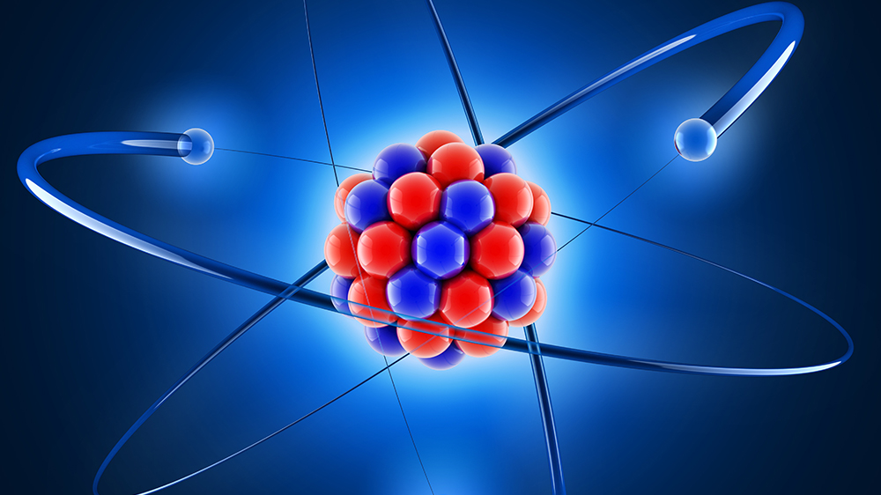
Developing Experts All rights reserved © 2021

Slide 2
What’s the difference between isotopes and ionisation?
Isotopes are atoms of the same element. They have the same number of protons and electrons but different numbers of neutrons.
Ionisation is when a particle (atom or molecule) becomes electrically charged by losing or gaining electrons.
Developing Experts All rights reserved © 2021

Slide 3
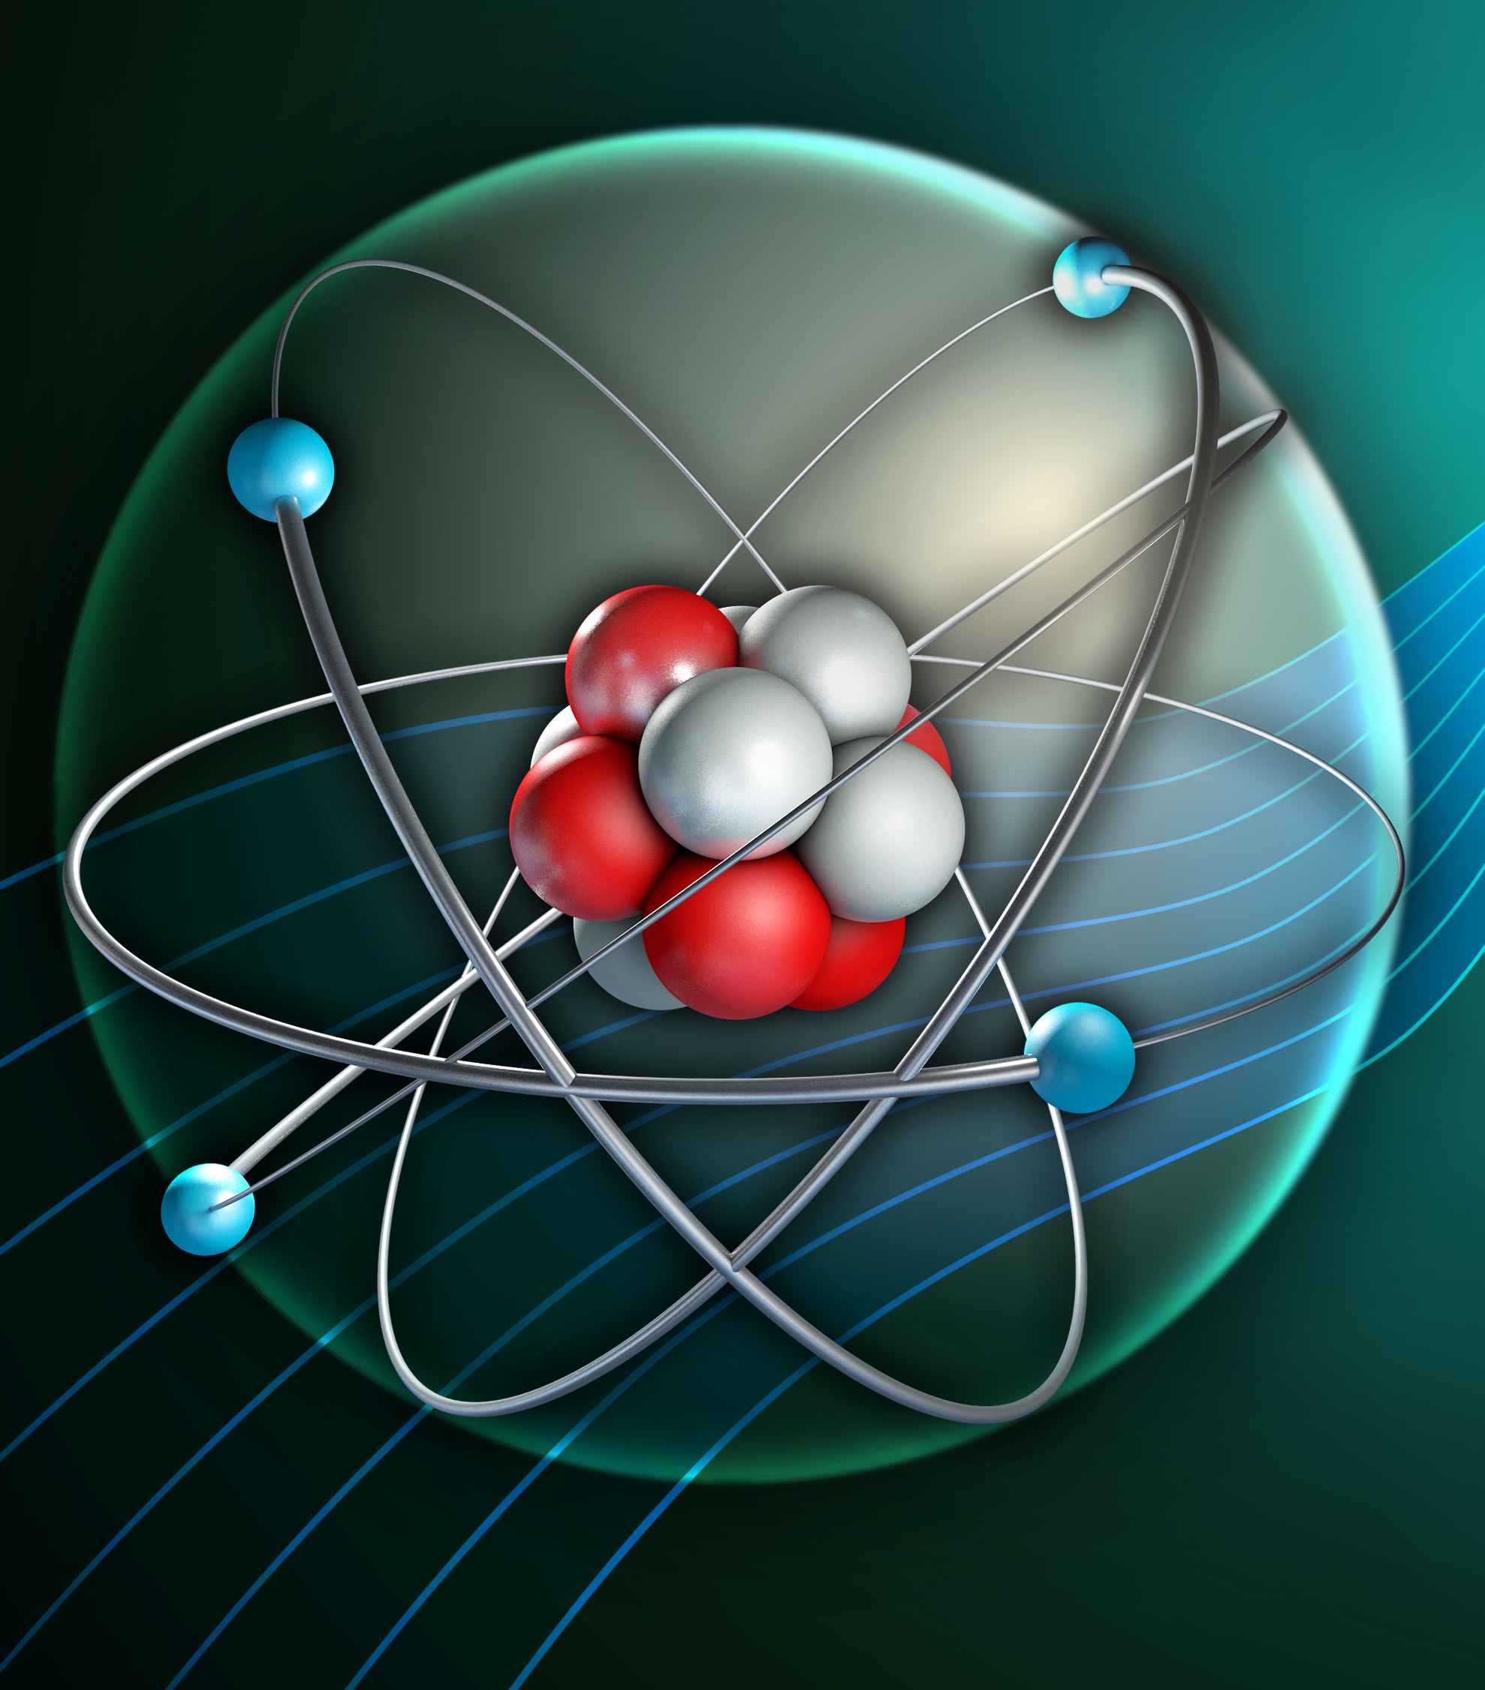
Isotopes and Ionisation
You should be able to use the atomic and the mass numbers to work out the number of protons, neutrons and electrons in atoms.
You should be able to describe what's meant by an isotope and an ion.

Slide 4
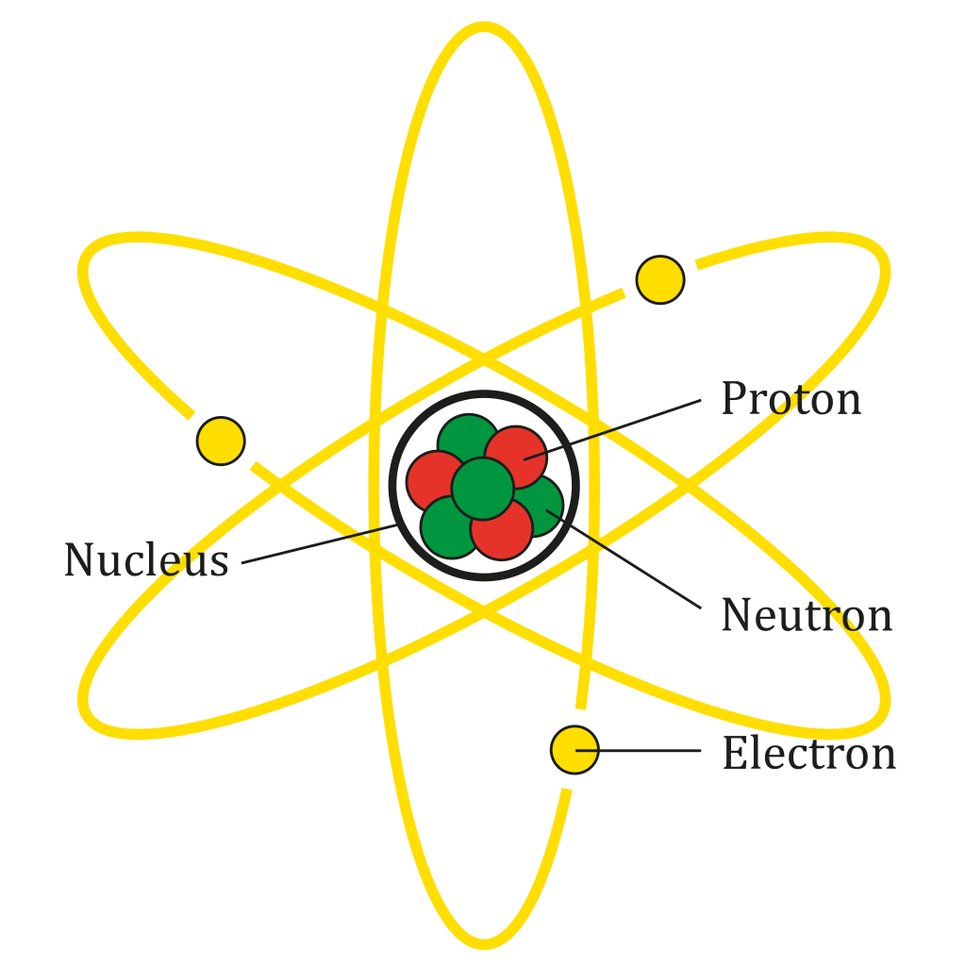

Slide 5
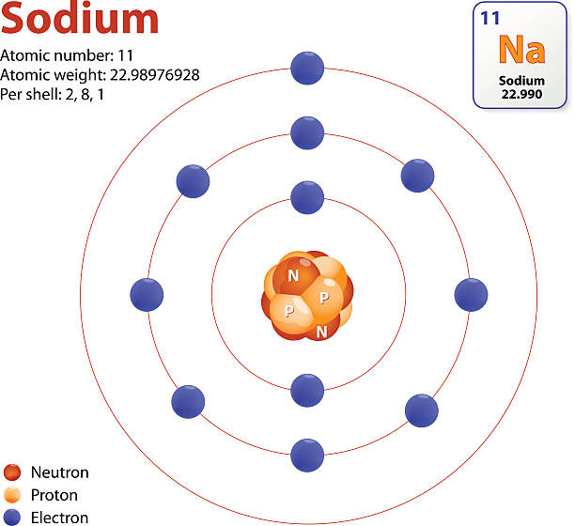
Sodium
23
Na
sodium
11

Slide 6
23
Na
Relative atomic mass
Atomic symbol
Name
Atomic (proton) number
sodium
11
Developing Experts All rights reserved © 2021

Slide 7
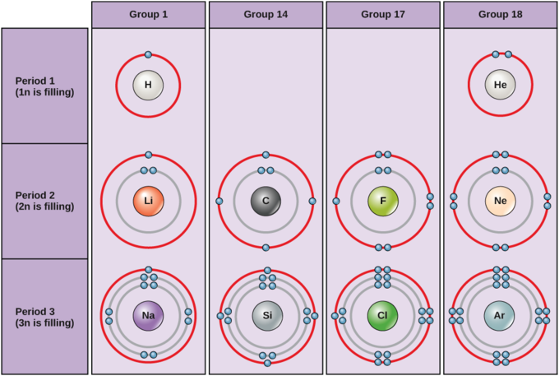

Slide 8
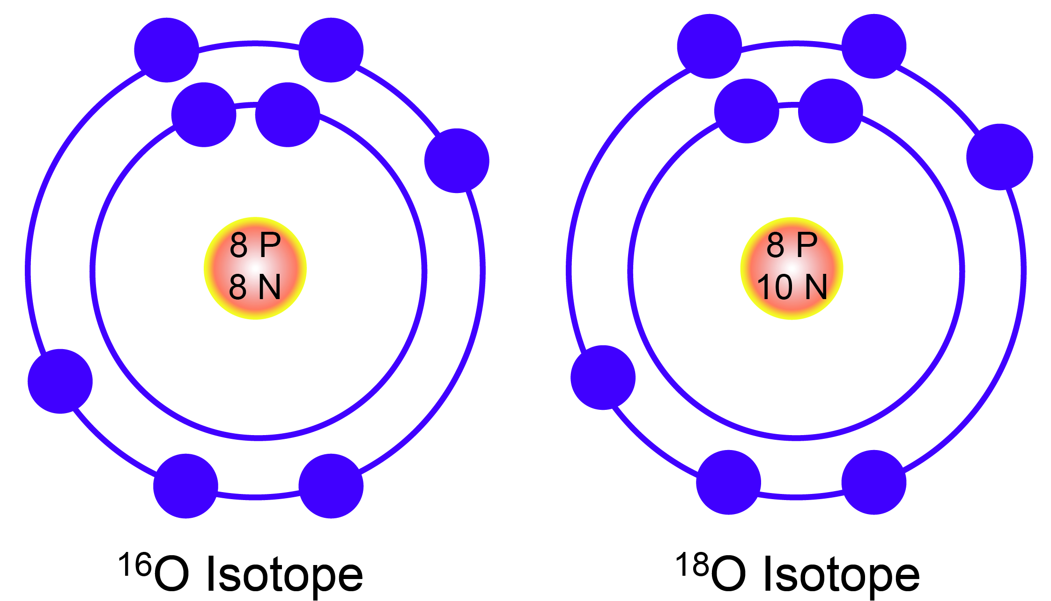

Slide 9
