Slide 1
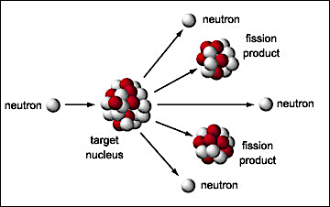
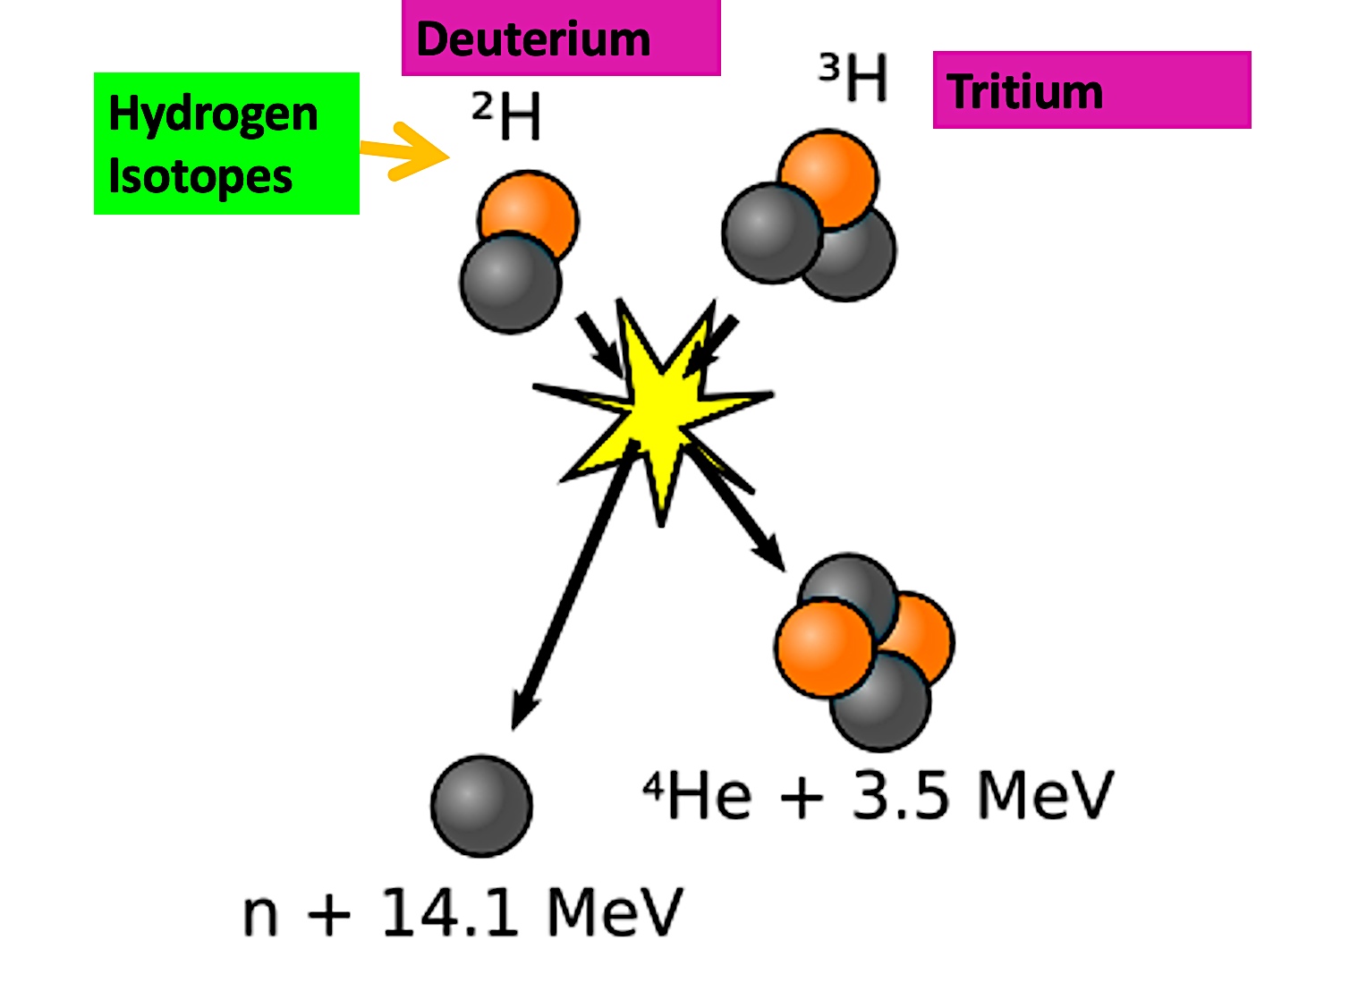
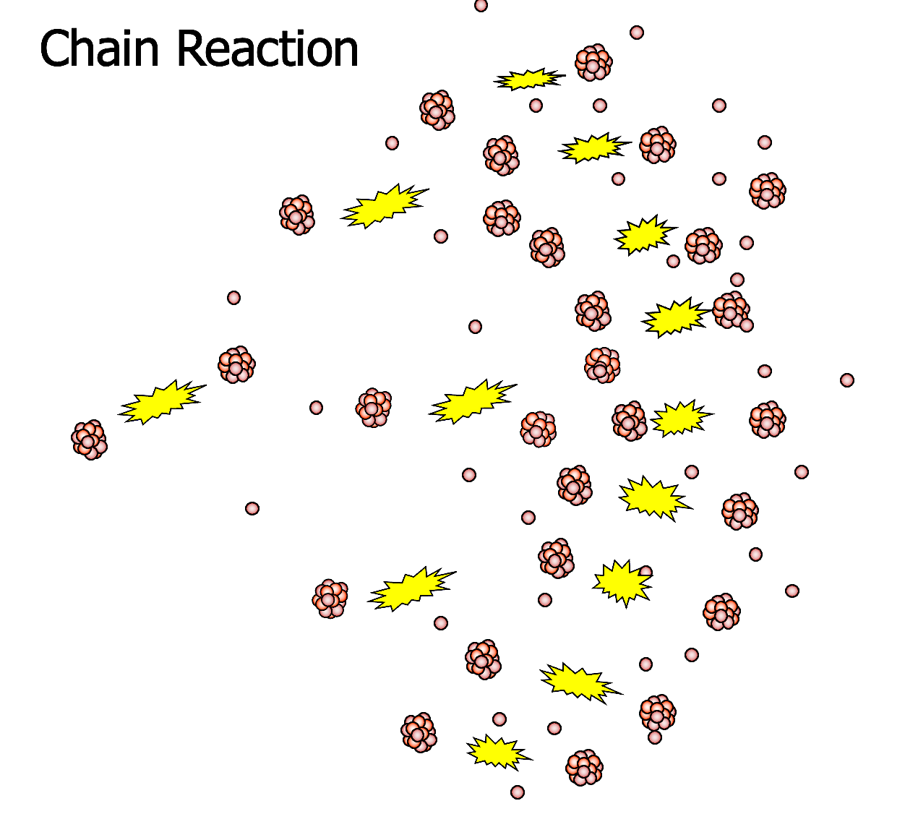
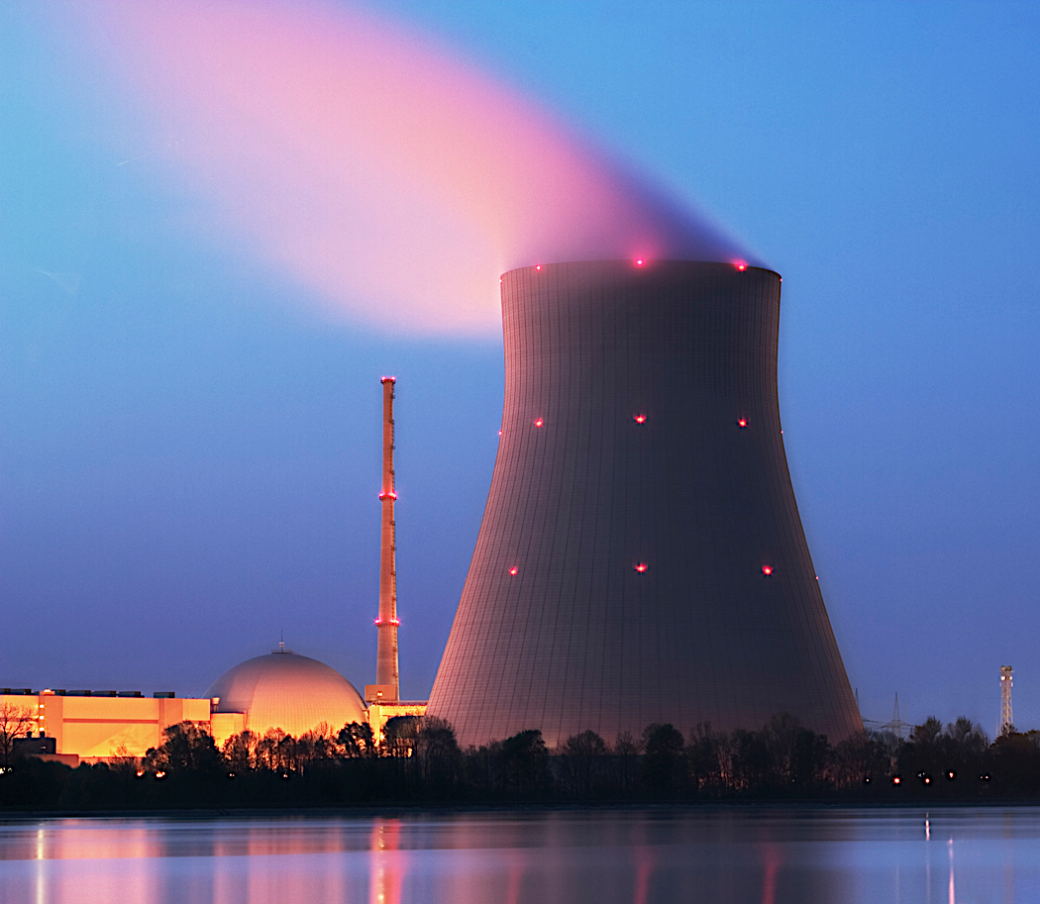
Nuclear fission
Nuclear fission is the splitting of atomic nuclei. There are two fissionable substances in common use in nuclear reactors: uranium 235 and plutonium 239.
For fission to occur, the uranium 235/plutonium 239 nucleus must first absorb a neutron. The nucleus undergoing fission splits into 2 smaller nuclei and 2/3 neutrons and energy are released. The neutrons may go on to start a chain reaction.
Nuclear fusion
Nuclear fusion occurs when nuclei are stuck (or fused) together. Fusion is different to fission. In fusion, two small nuclei join to make a single heavier nucleus.
The process generates heat energy (just like fission). Nuclear fusion is the process by which energy is released in stars. The products of nuclear fusion are not radioactive.
Nuclear fission releases daughter nuclei and neutrons that will continue to bombard neighbour atoms. Within 30 cycles 680000 billion atoms have been spilt. We call this uncontrolled release of energy a chain reaction. It is this power that is utilised in an atomic weapon explosion. In a nuclear fission reactor, the process is slowed by using a moderator and controlled by using control rods that are lowered to absorb excess neutrons in the reactor core. These control rods are usually made of boron.
Gravitational
field strength
10N/kg
Nuclear fission is the current technology that is used to generate energy in nuclear fission reactors. Nuclear fusion is still in the experimental phase at various sites around the world. France has a large-scale fusion reactor in construction called ITER. At JET, in the Culham Centre for Fusion in Oxfordshire in the UK, experimental technology in nuclear fusion is being pioneered.

Slide 2
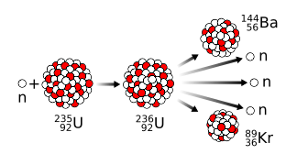
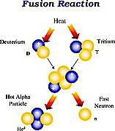
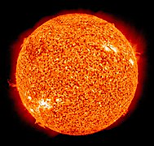
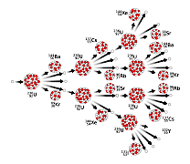
Practice
This diagram shows what happens when a uranium-235 atom absorbs a neutron. a) What name is given to this process? b) Explain how this process leads to a chain reaction? c) How does the mass number of an atom change when its nucleus absorbs a neutron? __________________________________________________________________________________________________________________________________________________________________________________________
How is nuclear fusion different to nuclear fission? ____________________________________________________________________________________________________________________________________________________________________
How is the sun able to produce energy by nuclear fusion? _________________________________________________________________________________________________________________________________
Why do we need to control chain reactions in a nuclear reactor? ____________________________________________________________________________________________________________________________________

Slide 3
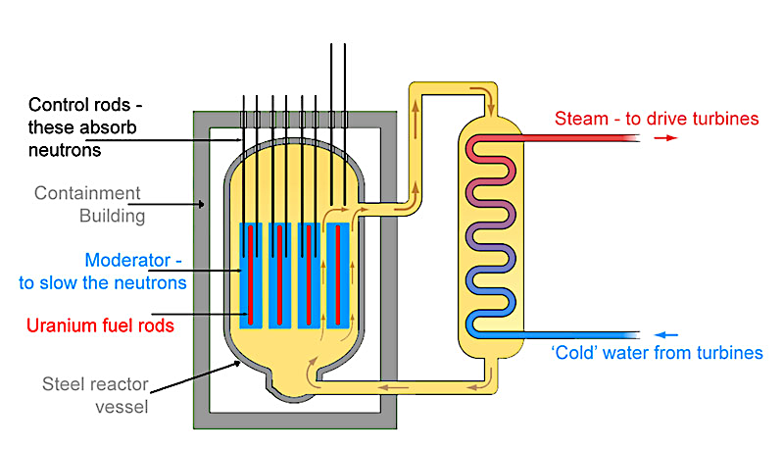
Practice
This diagram shows a nuclear fission reactor.
What is the role of the control rods in the reactor?
________________________________________________________________________________________________________________
b) What is the job of the moderator in the reaction?
________________________________________________________________________________________________________________
 | Fission or fusion?
A | The process by which energy is released in the sun. Energy is released when two nuclei are fused together.
B | The waste product are highly radioactive substances (barium and krypton) which need to be disposed of safely.
C | The waste product is helium which is a harmless gas.
D | Occurs when a uranium-235 nucleus or a plutonium-239 nucleus splits.
E | Releases two or three neutrons which go on to cause further ______ resulting in a chain reaction.
F | Occurs when two small nuclei are forced close enough together, so they join to make large nucleus.

