Slide 1
A Dog’s Needs
Think about what living things need in order to live.
Circle the things that you might use to look after his dog.
Stretch:
Draw one more thing that would be useful.
Challenge:
Would any of these help you care for another animal? Explain your ideas.

Slide 2
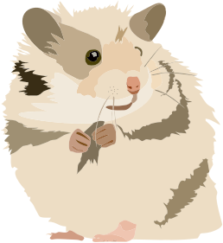
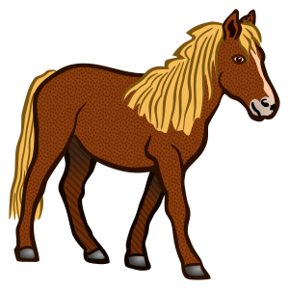
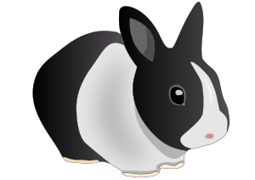
Indoors or Outside?
Which pets are kept indoors and which animals are kept outside? Which can be kept indoors OR out? Put a cross in the box of the one you choose.
Inside Outside Both

Slide 3
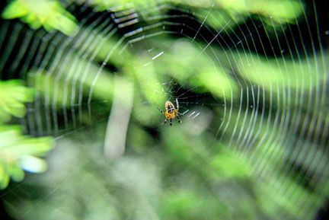
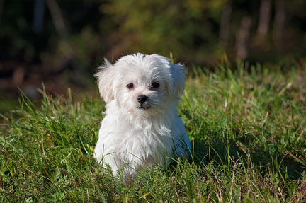
spider
puppy

Slide 4
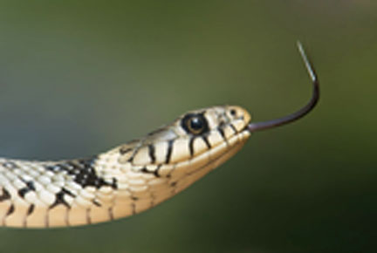
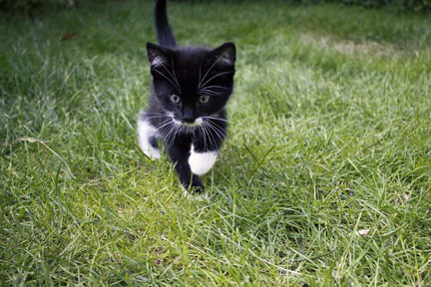
snake
kitten

Slide 5
Animal Adjectives
Write a word to describe these animals.
A
Stretch:
Tell your talk partner which one is your favourite, and why
snake
A
Challenge:
Describe how much bigger these animals could grow.
spider
A
puppy
A
kitten

