Slide 1

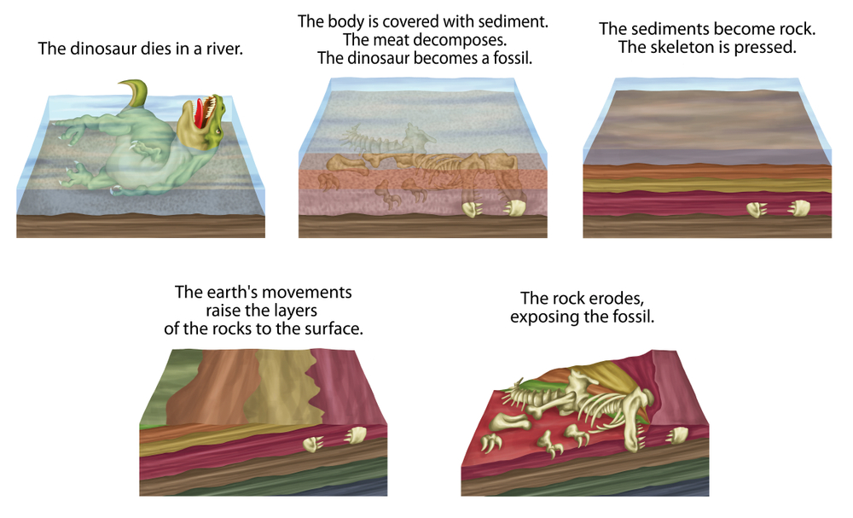
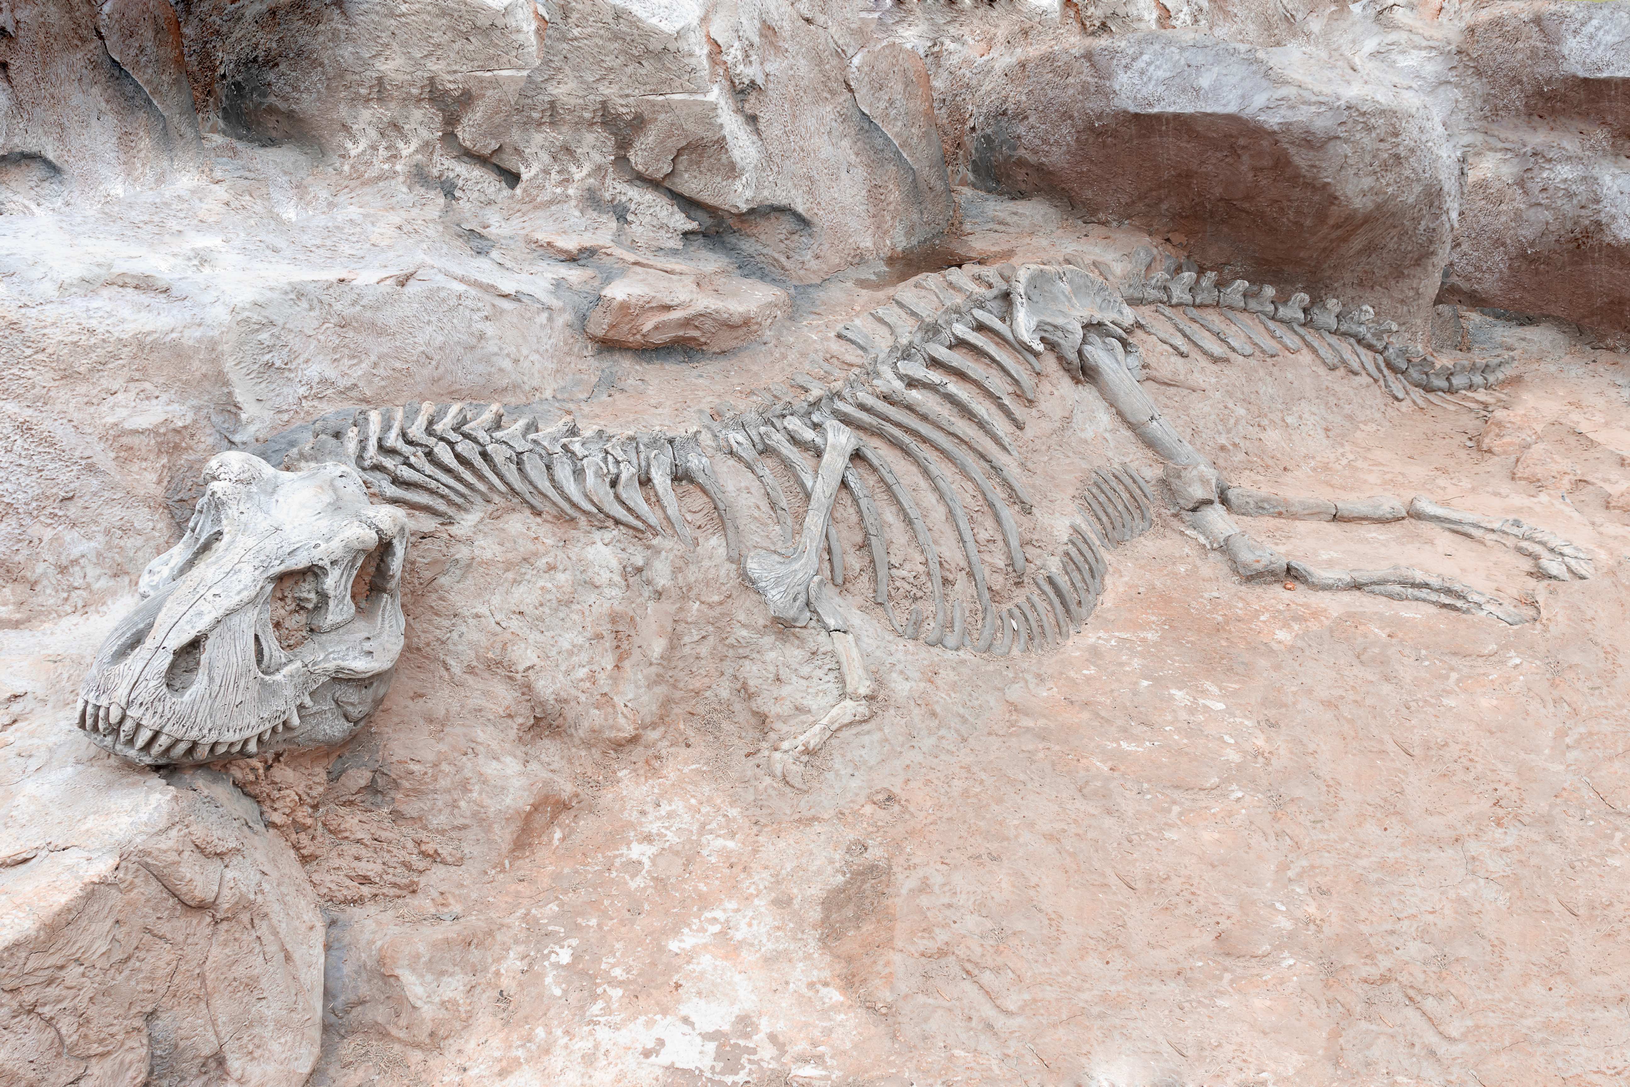
Mission Assignment: Understand how fossils are formed
Code: N22_34_05
Explain how a fossil is created. Use the pictures to
help guide your answer. One box has been completed for you.
____________________________________________
____________________________________________
1
2
____________________________________________
The Earth’s movements bring the fossil layer closer to the surface.
3
4
____________________________________________
5
3
Developing Experts Copyright 2024 All Rights Reserved

Slide 2
Mission Assignment: Understand how fossils are formed
Code: N22_34_05
Teacher answers.
The dinosaur dies in a river.
The body is covered with sediment and decomposes, leaving the bones.
1
2
Sediment builds up and hardens into sedimentary rock.
The skeleton is pressed.
The Earth’s movements bring the fossil layer closer to the surface.
3
4
5
The rock erodes, exposing the fossil.
3
Developing Experts Copyright 2024 All Rights Reserved

Slide 3
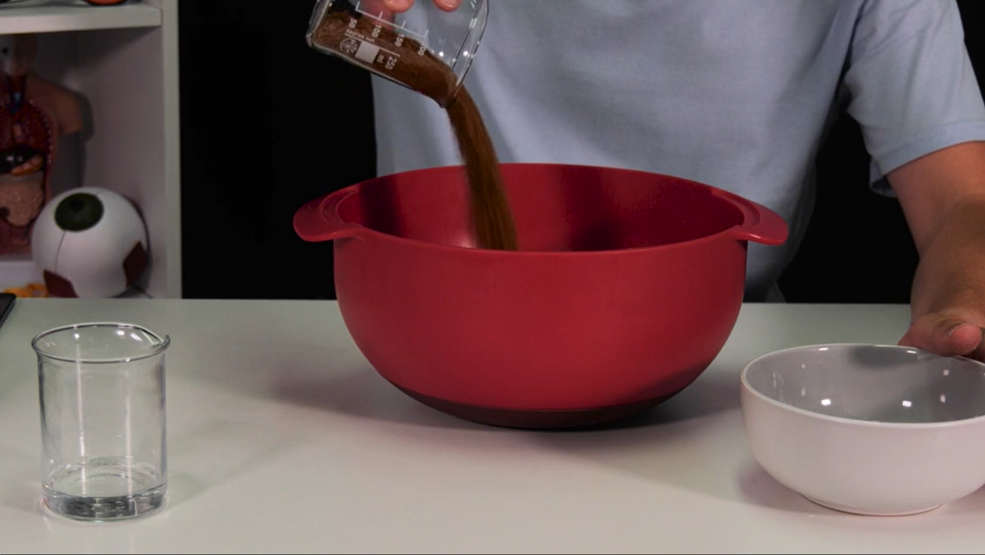
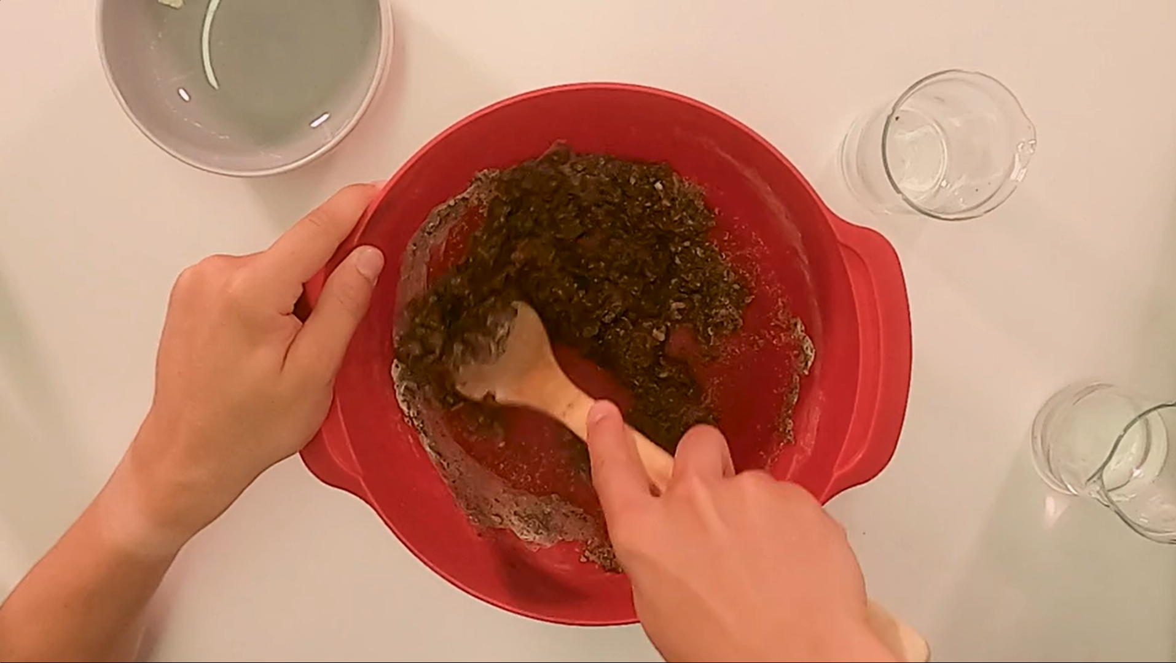
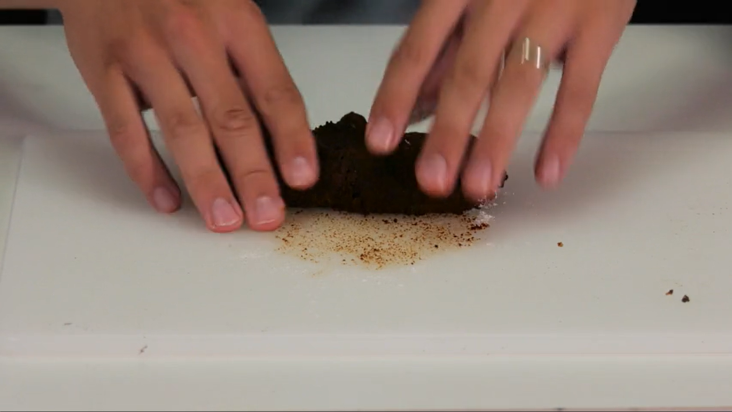
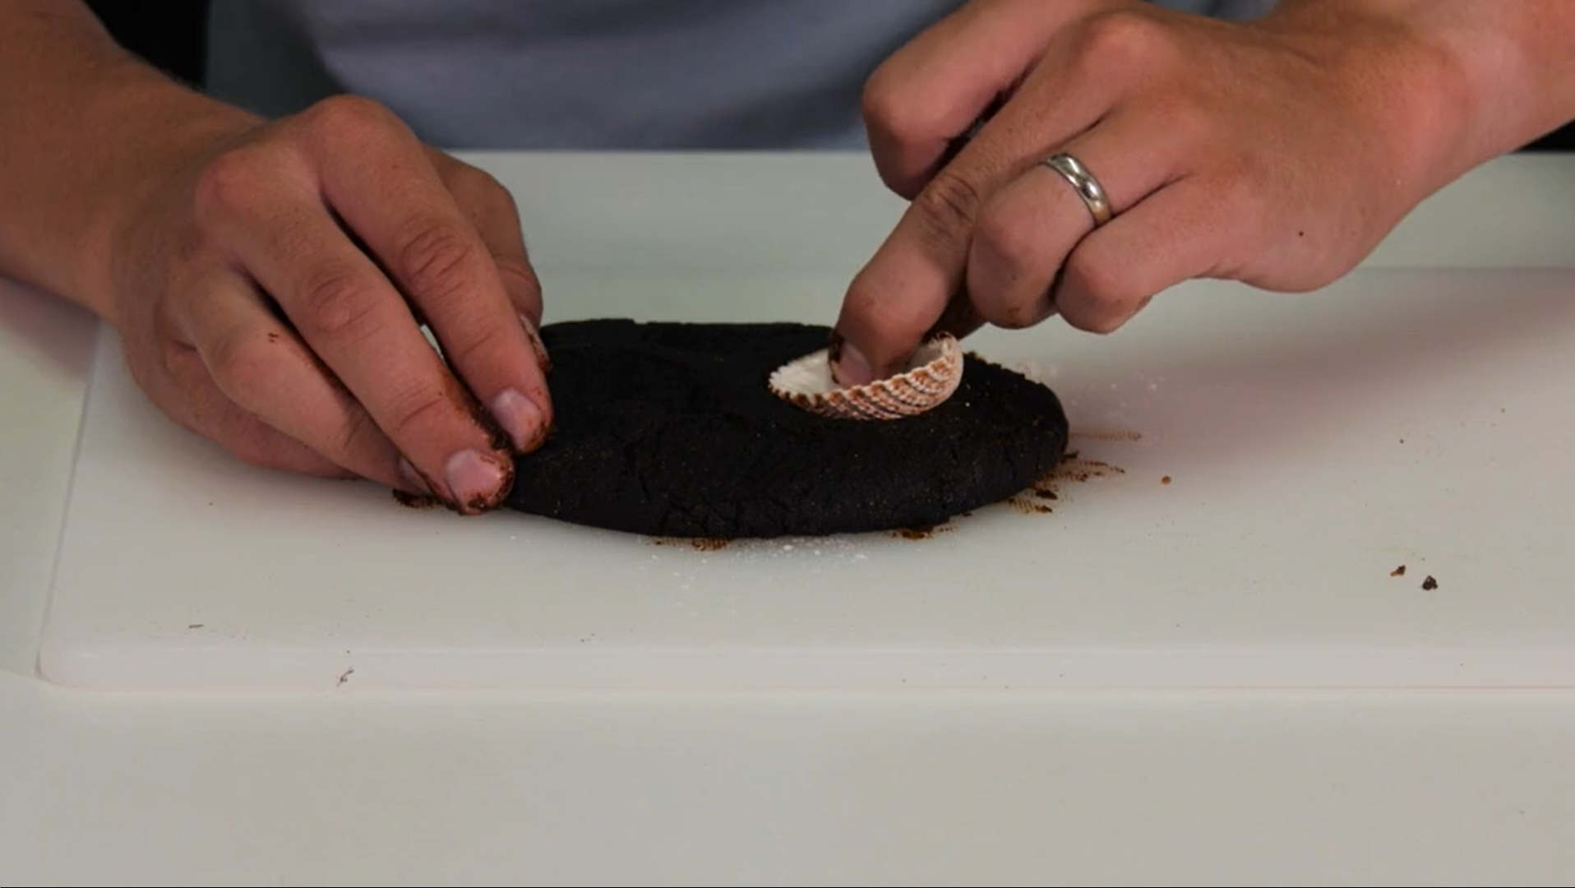
Mission Assignment: Understand how fossils are formed
Code: N22_34_05
Instructions to create a fossil
Mix together 200g salt, 150g flour and 150g coffee grounds.
Add 100ml of cold coffee (you can also use water).
Mix the solution together well until it forms a kneadable dough-like texture. You can add more flour or water if necessary.
Turn out the mixture onto a flat surface and knead it for about 3 to 4 minutes or until the dough no longer sticks to your hands.
Roll out your dough so that it is flat.
Use an object of your choice to make an imprint into the dough. Press it in and then peel it away gently.
Leave the fossil to dry for 1-2 days.
2
Developing Experts Copyright 2024 All Rights Reserved

