Slide 1
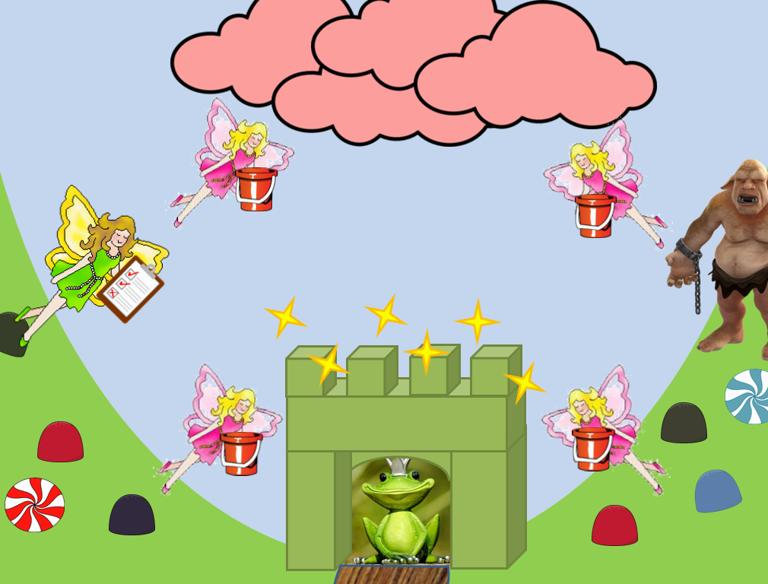
Mission Assignment: Model an electric circuit
KS3-22-06
Read the description of the model then identify which feature represents which electrical idea.
Gumdrop Valley is ruled over by the Toad King. The Toad King relies on the sugar lump fairies to fly up to the candy floss clouds and bring the candy floss to him. They fly in a loop between the clouds and the Toad King.
When the Toad King eats from the candy floss clouds, he fills Gumdrop Valley with happiness.
The sugar lump fairies are overseen by the Boss Fairy - she monitors how quickly the fairies fly around.
Draw lines to match the part of the model to the electrical feature it represents.
Toad King
Candy floss clouds
Candy floss
Sugar lump fairies
Boss Fairy
Ogre
Happiness
Energy output
Component
Energy
Ammeter
Power source
Resistor
Current
Suggest how the model could be adapted to represent a parallel circuit.
___________________________________________________________________________________________________________________________________________________________________________________________________________________________________________________________________________________________________________________________________________________________________
Developing Experts Copyright 2023 All Rights Reserved

Slide 2
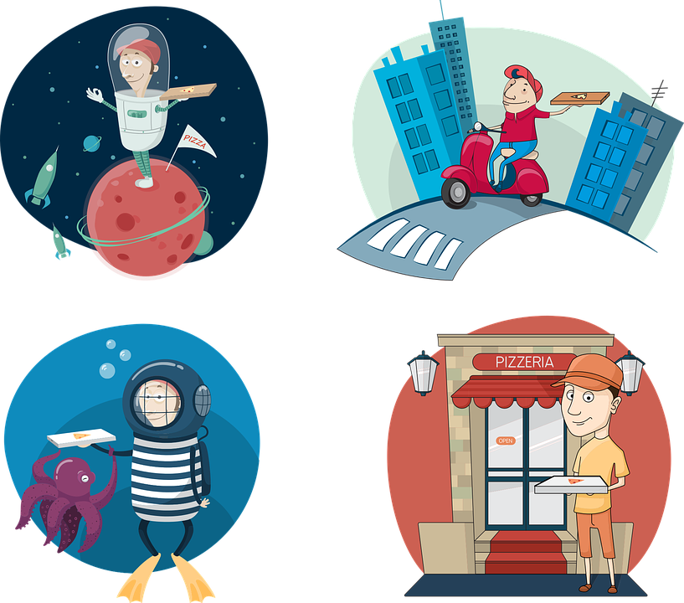
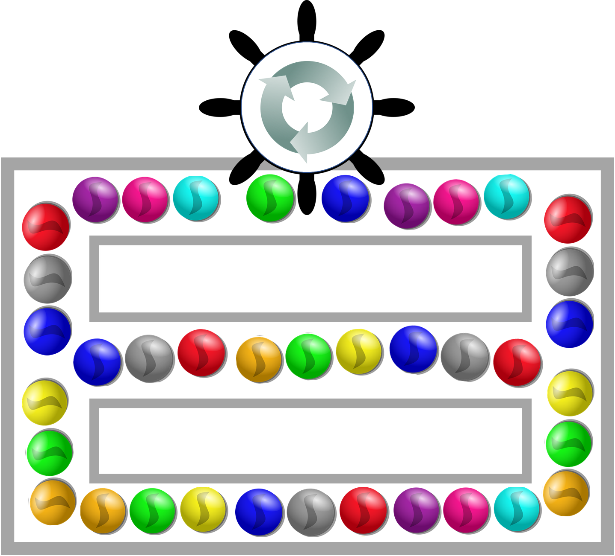
Mission Assignment: Model an electric circuit
KS3-22-06
A scientific model is used to describe, explain or predict a scientific concept. The model can be a theoretical idea or physical product. You are going to design a scientific model to describe how a circuit works. In this model, you will need something to represent a power source, the current and a component.
You can -
Draw it: Design a poster showing your model.
Make it: Use craft materials to build your model.
Here are some examples of circuit models to get you started.
Pizza Delivery Model
A pizzeria makes pizzas, and a delivery driver delivers them to customers. Then he returns to the pizzeria to pick up more pizzas for delivery.
The pizzeria represents the battery.
The driver represents the current.
The pizza represents electrical energy.
The customers represent components.
As the driver must return to the pizzeria, it shows us a complete circuit.
Marble Run Model
Marbles are pushed around a track by hand. Each marble pushes into the one in front. At a junction, the marbles split into two paths. They rejoin together on the other side.
The marbles represent the current.
The hand represents the power source.
The junctions show us how a parallel circuit works.
Challenge: Try to develop your model to represent some other electrical ideas. Can you include a parallel loop, an ammeter, a switch or a resistor?
Developing Experts Copyright 2023 All Rights Reserved

Slide 3
Mission Assignment: Model an electric circuit
ANSWERS
KS3-22-06
Read the description of the model then identify which feature represents which electrical idea.
Gumdrop Valley is ruled over by the Toad King. The Toad King relies on the sugar lump fairies to fly up to the candy floss clouds and bring the candy floss to him. They fly in a loop between the clouds and the Toad King.
When the Toad King eats from the candy floss clouds, he fills Gumdrop Valley with happiness.
The sugar lump fairies are overseen by the Boss Fairy - she monitors how quickly the fairies fly around.
Draw lines to match the part of the model to the electrical feature it represents.
Toad King
Candy floss clouds
Candy floss
Sugar lump fairies
Boss Fairy
Ogre
Happiness
Energy output
Component
Energy
Ammeter
Power source
Resistor
Current
Suggest how the model could be adapted to represent a parallel circuit.
___________________________________________________________________________________________________________________________________________________________________________________________________________________________________________________________________________________________________________________________________________________________________
Developing Experts Copyright 2023 All Rights Reserved

