Slide 1
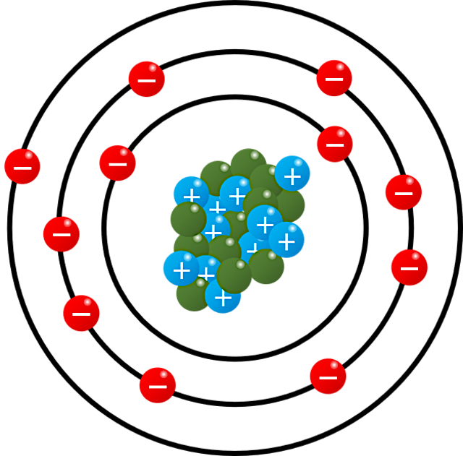
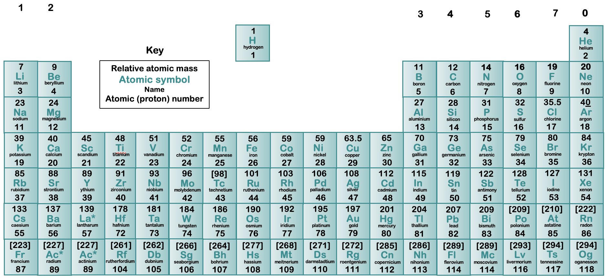
Inside an atom
John Dalton came from a Cumbrian Quaker family. He was a great thinker, philosopher and chemist, and in his time suggested theories for meteorology, colour blindness and gas laws. His most influential work was on atomic theory. In fact, he wanted to prove that elements were made from these unobservable particles. He proposed that these particles combined in ratios with the particles of other elements. Through his experiments with gas, he had reasoned that matter did not divide equally but combined in different atomic weights by ratio, meaning that there had to be particles unobservable to the eye through a microscope that were the building blocks of all matter.
The structure of an atom
An atom is comprised of a nucleus in the centre that has positively charged protons and neutral neutrons, and energy levels or shells, of negatively charged electrons circulating around. If you were to make a comparison in scale, imagine that the atom was the size of Manchester Arena; the nucleus in the centre would be the size of a cricket ball.
Gravitational
field strength
10N/kg
To this date, scientists have discovered 118 different types of atom. That is why there are 118 different elements in the periodic table.
* each element has a unique atomic number

Slide 2
Practice
There are three types of particle in an atom. Complete the following sentence.
There are two particles in the nucleus. The particles in the nucleus of an atom are
_____________________________
electrons and neutrons
electrons and protons
neutrons and protons
Which of the three particles:
Is found outside the nucleus?
__________________________
Has a negative charge?
__________________________
This is a diagram of a lithium atom.
Label the diagram.
Which one of the particles is not charged?
(Draw a ring around the correct answer.)
electron neutron proton
A sodium atom has an atomic mass of 23 and an atomic number of 11. How a many neutrons are in the atom? ________________________________________________________________________________________________________________________

Slide 3
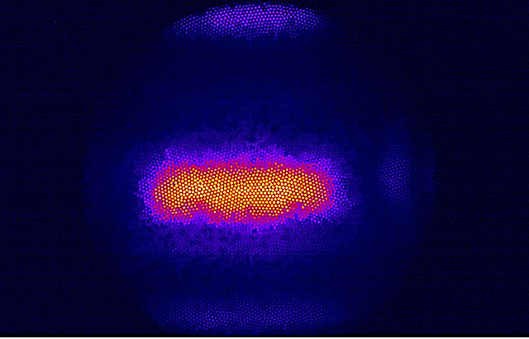
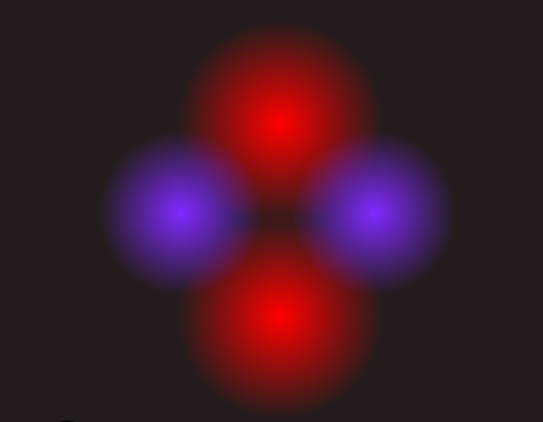
Energy
Complete the sentences:-
Atoms consist of protons, neutrons and ______________________.
Protons and ____________ make up the nucleus.
The nucleus is tiny compared to the rest of the atom but it contains most of the _________________
Neutrons have a mass of ______________and a charge of ____________
Protons have a mass of ______________and a charge of ______________
The rest of the atom is mainly empty space and contains the _____________ in energy levels or shells.
Electrons have a negligible mass and a charge of _______
Complete the table to show the relative charge of each the particles.
Particle | Relative Charge
electron | - 1
neutron
proton

