Slide 1
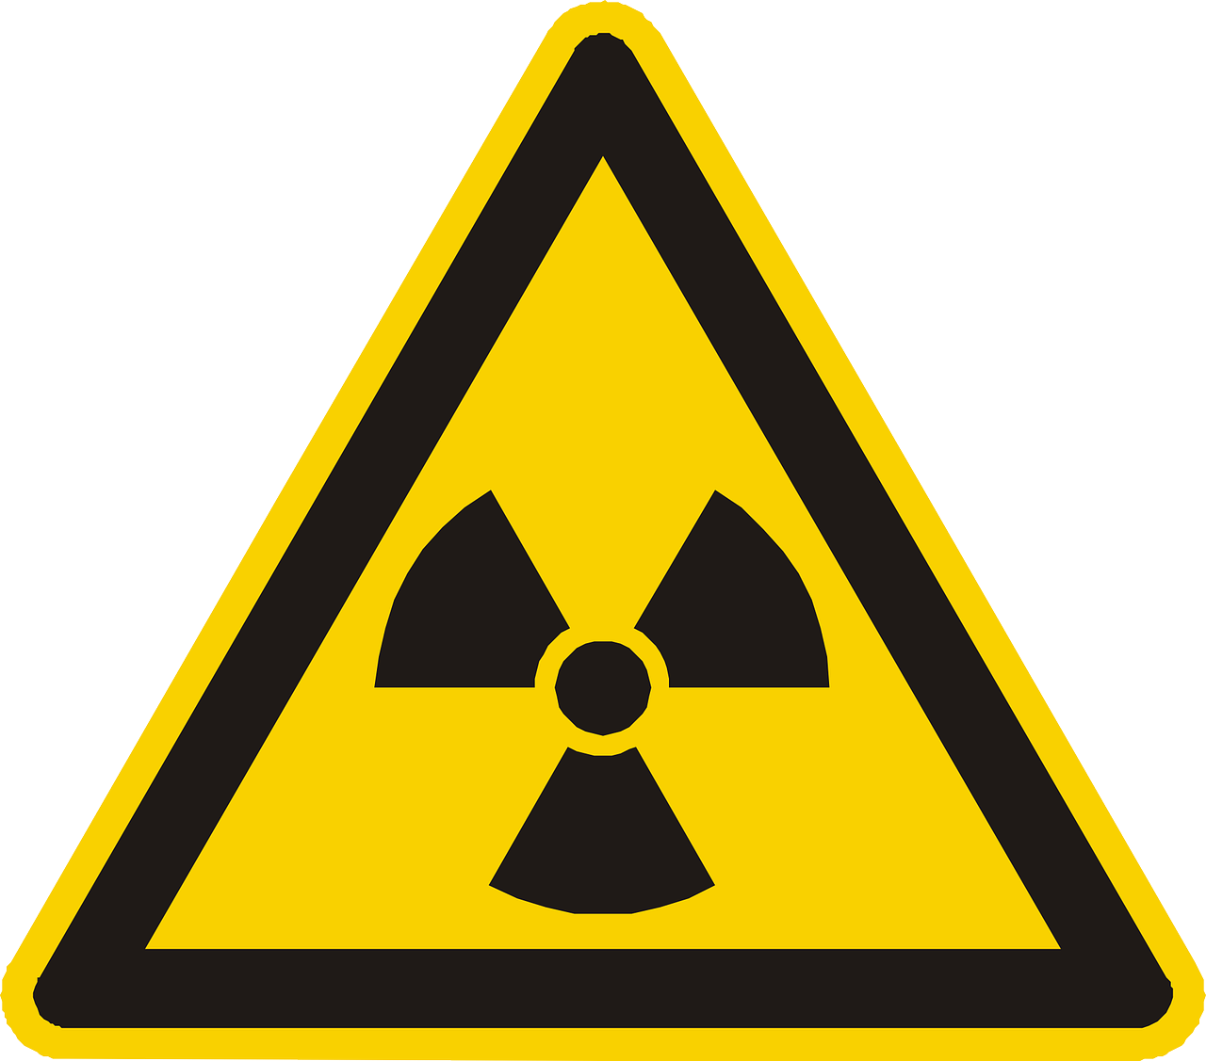
0001.01
Mission Assignment
Task | Produce a set of flash cards covering the properties of each type of radiation. Include distance, ionisation and penetration
Developing skills | Practise writing complete answers to problems that are set, include a recap of the question before you answer with facts or data to prove your answer
Think about… | The applications of radiation in medicine – is it just used for treating cancer, or are there other possible uses?
KS4-21-05:
Explore the properties of the types of radiation

