Slide 1
Teacher answers
⍺ Mass number 4. charge +2. Paper.
β Mass number 1/200th proton (negligible). charge -1. Aluminum
𝜸 It is a wave not a particle and it has no mass. Thick lead
The radioisotope iodine-131 is used in medicine to treat an over-active thyroid. It is also used to see if the thyroid gland in the neck is working properly. Iodine is present in small amounts in the body and up to ¼ of the total amount of iodine can be stored in the thyroid gland. The amount of iodine entering the gland can be seen by detecting the radioactivity emitted from the radioactive iodine. This isotope has a half-life of 8 days and emits γ radiation and β particles. Given orally, it is concentrated in the thyroid, where the β particles destroy the gland.
i) Radiotherapy is the name given to the treatment of cancer using radiation. Although radiation can cause cancer, it is also highly effective at treating it. Radiation can kill living cells. Some cells, such as bacteria and cancer cells, are more susceptible to radiation than others. During external radiotherapy, beams of gamma rays are directed at the cancerous tumour by a gamma knife. Surrounding healthy tissue tends to be shielded to avoid causing any damage. During internal radiotherapy, small pellets of radioactive materials can also be inserted into a tumour, exposing it directly to radiation.
ii) Iodine-131. Strontium-89 and Samarium-153. Radium-223

Slide 2
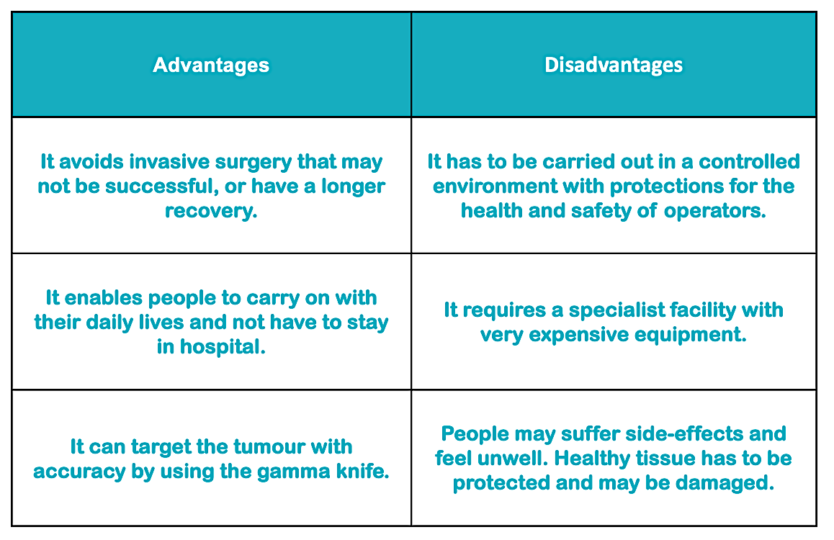
Teacher Answers

