Slide 1
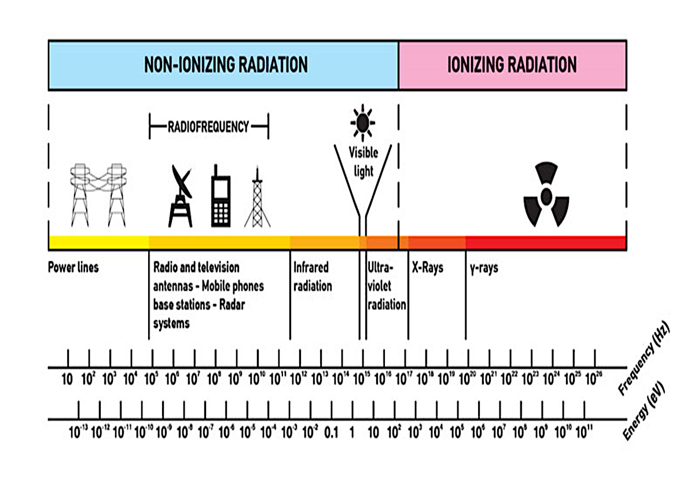
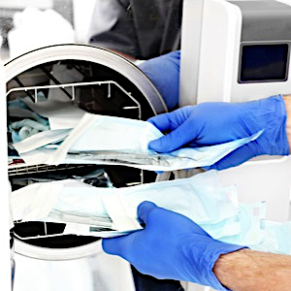
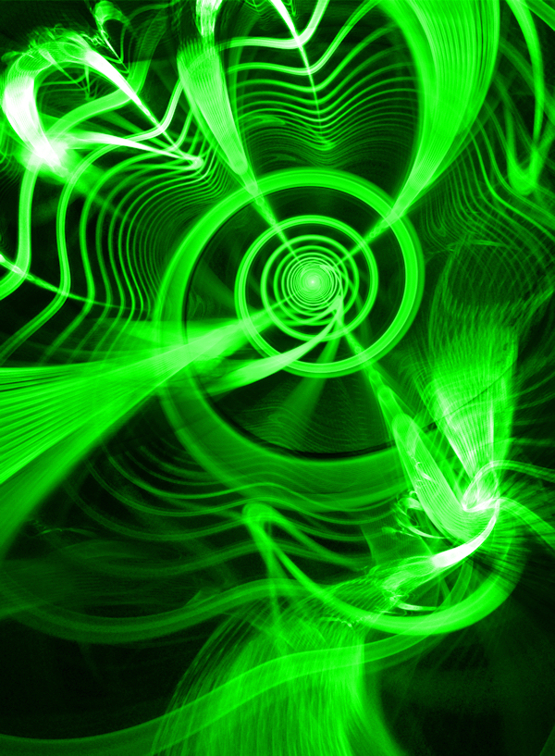
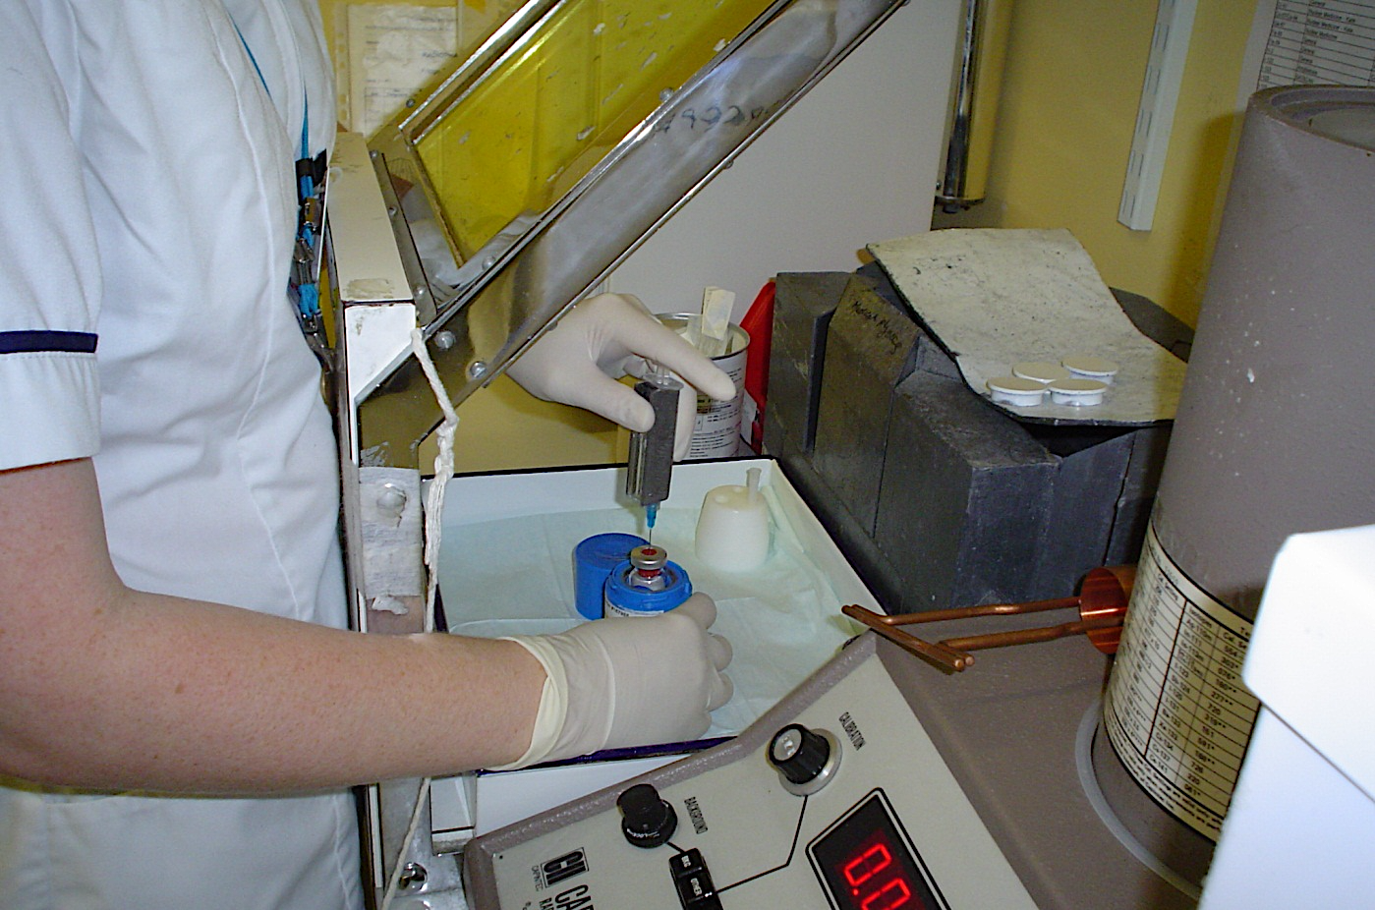
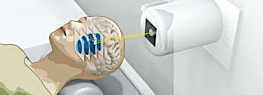
Radiation and medicine
Radiation is extensively used in medicine and medical practices. The use of x-rays was discovered by Roentgen in 1885 by accident. X-rays are not one of the 3 nuclear radiations used in medicine because this is from the electromagnetic spectrum of radiation. X-rays are made by smashing electrons into a tungsten plate and are a main form of diagnosis used by doctors. The three nuclear radiation applications used in medicine are; sterilising, diagnosis by tracing, and treatment - all with gamma radiation.
Sterilising equipment
Gamma sterilisation through irradiation of surgical equipment uses a lot of energy and is efficient at killing bacteria. Metal equipment, such as knives, can be sterilised using heat; however, plastic syringes would melt, which is why gamma irradiation is more efficient.
One form of targeted treatment using radiation is radiotherapy. This is firing an intense beam of gamma waves at the cancer cells to kill them. It must be focused carefully as the gamma rays will also kill healthy cells – this would harm the patient.
Cobalt-60 is a good source of strong gamma rays.
Diagnosis through tracing
We use a ‘tracer’ to find cancer by adding sugar to technetium 99. The tracer is injected into the patient and carried around the body by the blood. Cancer cells divide rapidly so they need energy. They absorb (grab) the sugar to get energy and absorb the technetium, which enters the cancer cells. Technetium is a radioactive isotope which emits gamma rays and can be detected by a gamma camera.
Gravitational
field strength
10N/kg
The radiology lab deals with radioactive material:-
Mainly Beta and gamma emitters
They have half-life of 6-8 hours
The main danger is at medium distances, hence lead and aluminium aprons will be worn when working near radiation
The workers all wear a nuclear badge monitoring the radiation dose received by the person
The radioactive isotope mainly used is Tc-99m – beta emitter

Slide 2
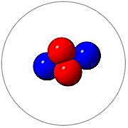
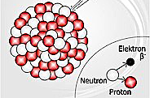
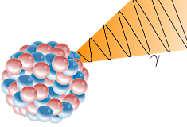
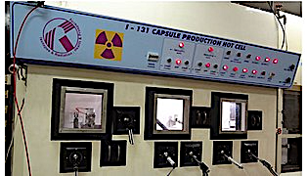
Practice
An alpha article:-
a) What it its symbol?
b) What is its mass?
c) What is its charge?
d) What thickness of material can stop it? _________________________________________________________________________________________________________________________________
A beta particle:-
a) What it its symbol?
b) What is its mass?
c) What is its charge?
d) What thickness of material can stop it? _________________________________________________________________________________________________________________________________
A gamma ray:-
a) What it its symbol?
b) What is its mass?
c) What is its charge?
d) What thickness of material can stop it? _________________________________________________________________________________________________________________________________
Iodine-131 is used to treat thyroid conditions. What type of particles does it emit? How is it used in medicine? ______________________________________________________________________________ ____________________________________

Slide 3
Irradiation and cancer treatment
X-rays and Gamma rays are very similar.
both are ______________waves
both travel at the speed of __________(which is another EM wave)
BUT they have different ___________________
- gamma rays come from the ________ of _______________ atoms.
unstable electromagnetic nuclei light frequencies
How is radiation therapy used to treat cancer? __________________________________________________________________________________________________________
How does it work? ________________________________________________________________________________________________________________________________________________
What radioactive isotope is used? ________________________________________________
Write the advantages and disadvantages of this treatment:-
Advantages | Disadvantages

