Slide 1

Developing Experts All rights reserved © 2021

Slide 2
From cosmic rays
The air we breath
From the rocks and soil
From the food we eat and even our own bodies
From plants
Developing Experts All rights reserved © 2021

Slide 3
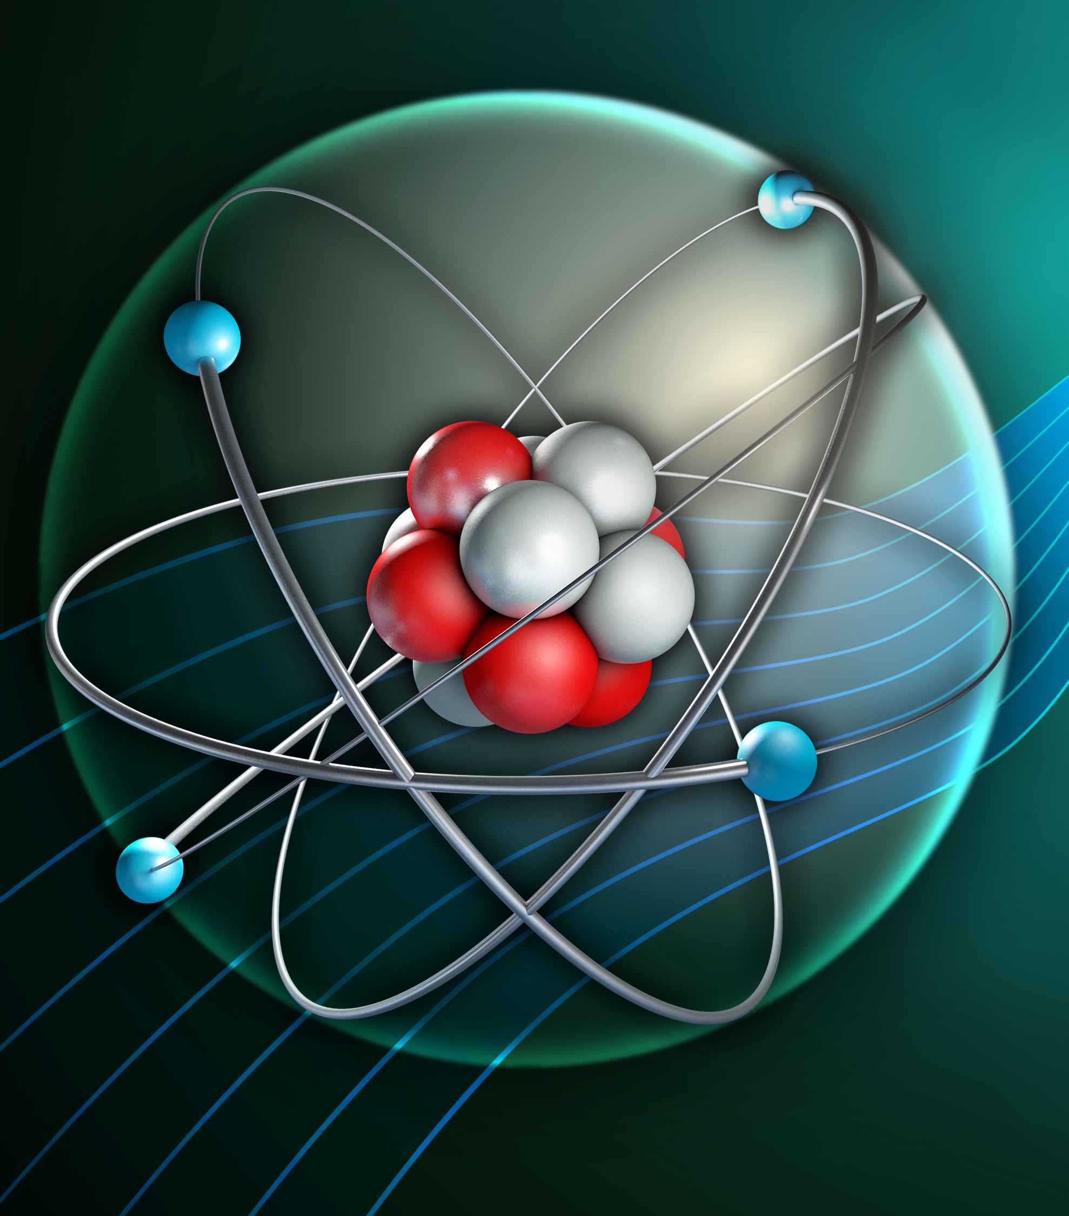
Uses of radiation
Define background radiation
Describe the main sources of natural and man-made background radiation
Explain how exposure the background radiation may vary based on job or location

Slide 4
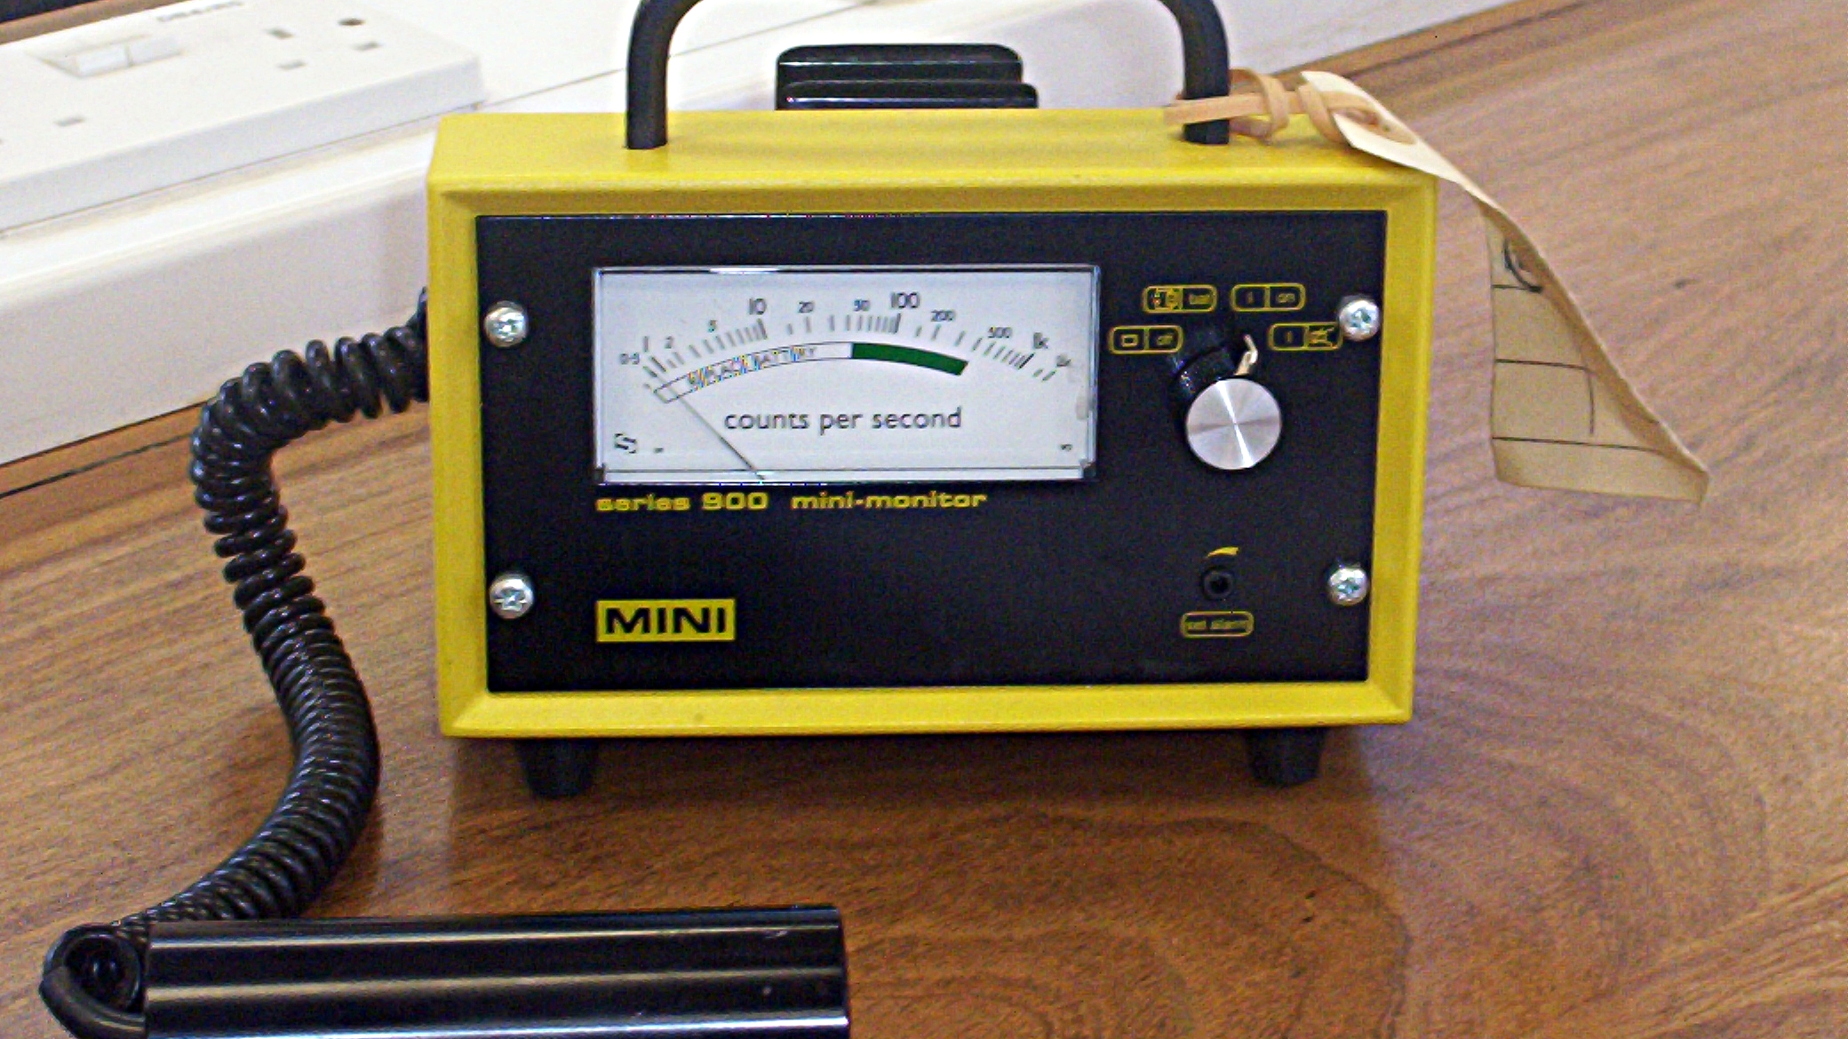
Developing Experts All rights reserved © 2021

Slide 5
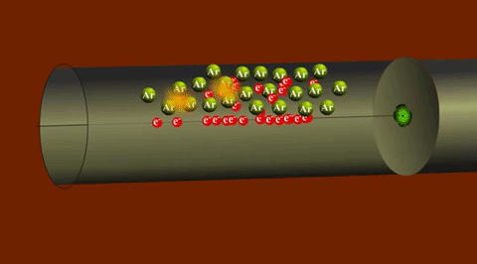
Developing Experts All rights reserved © 2021

Slide 6
From cosmic rays
The air we breath
From the rocks and soil
From the food we eat and even our own bodies
From plants
Developing Experts All rights reserved © 2021

Slide 7
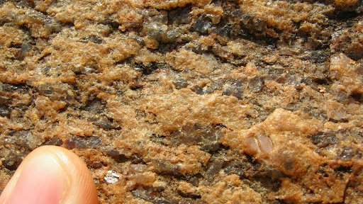

Slide 8
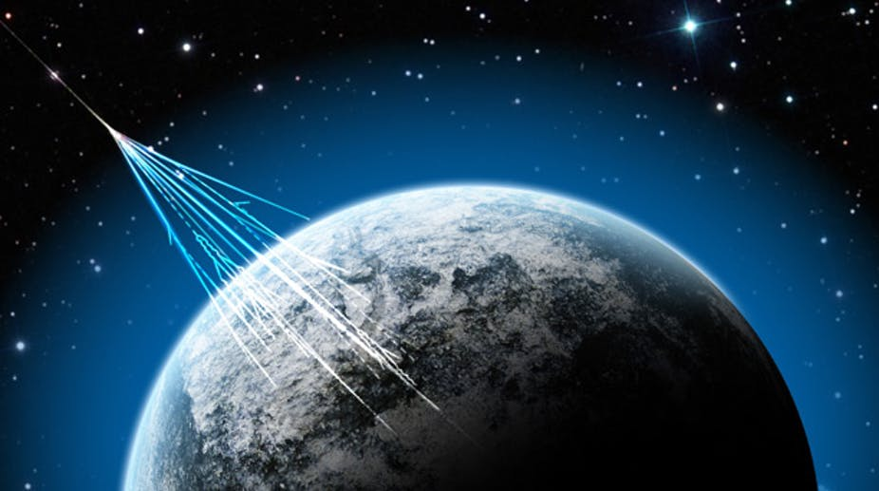

Slide 9
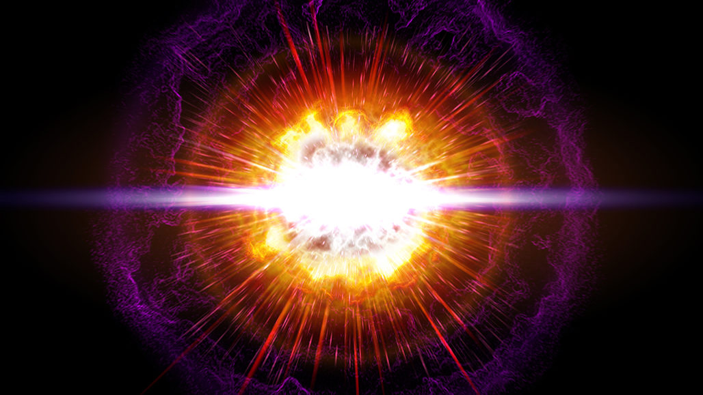

Slide 10
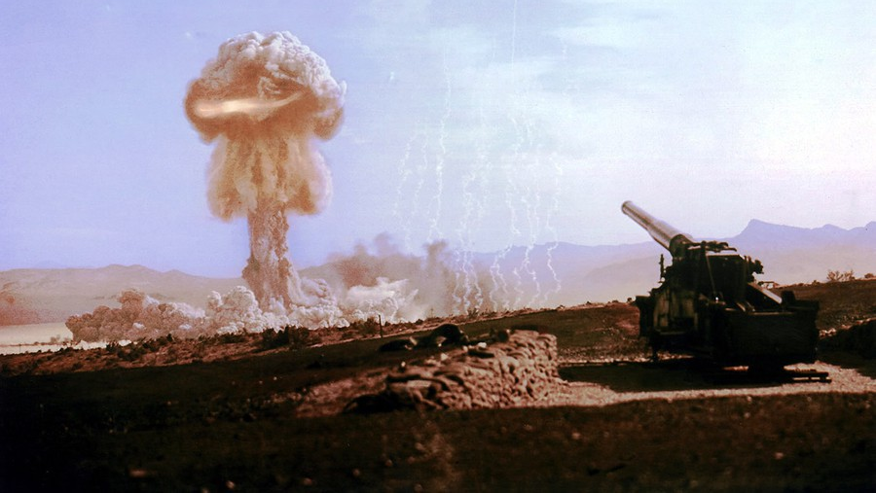

Slide 11


Slide 13


Slide 14
