Slide 1
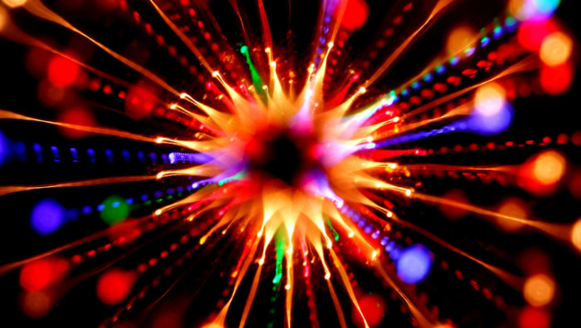
The frequency
The half-life
The activity
Developing Experts All rights reserved © 2021

Slide 2
The frequency
The half-life
The activity
Developing Experts All rights reserved © 2021

Slide 3
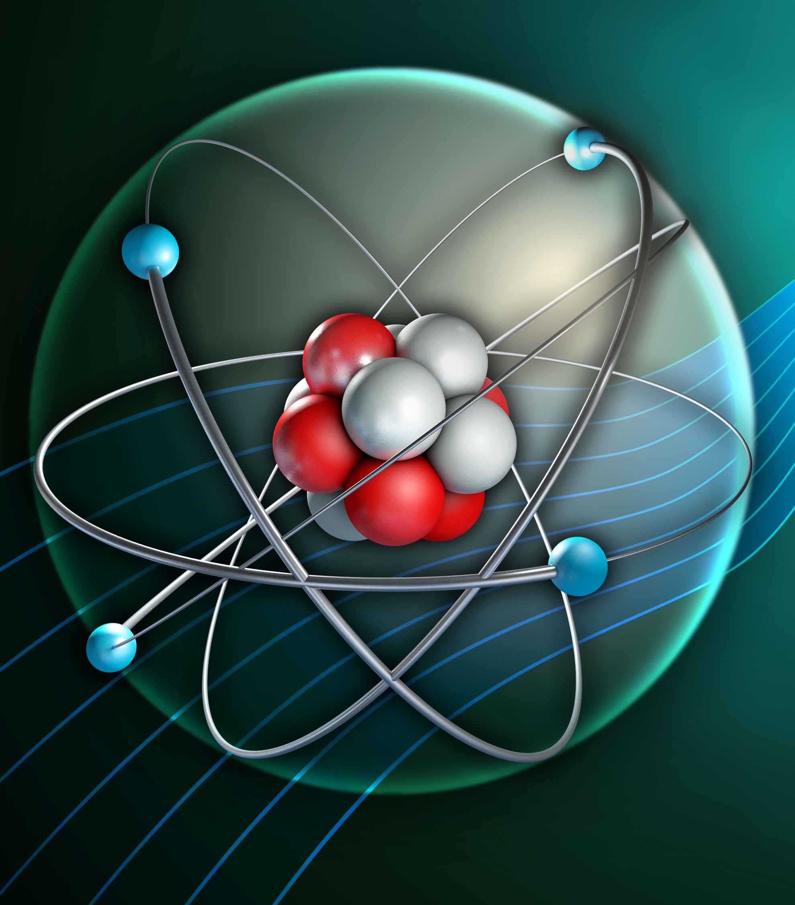
Half-life of a radioactive isotope
Describe what's meant by the half-life of a radioactive isotope.
Determine the half-life of a radioactive isotope.
Calculate the decrease in radioactive count rate after a given number of half-lives (applies only to higher-tier).

Slide 4


Slide 5
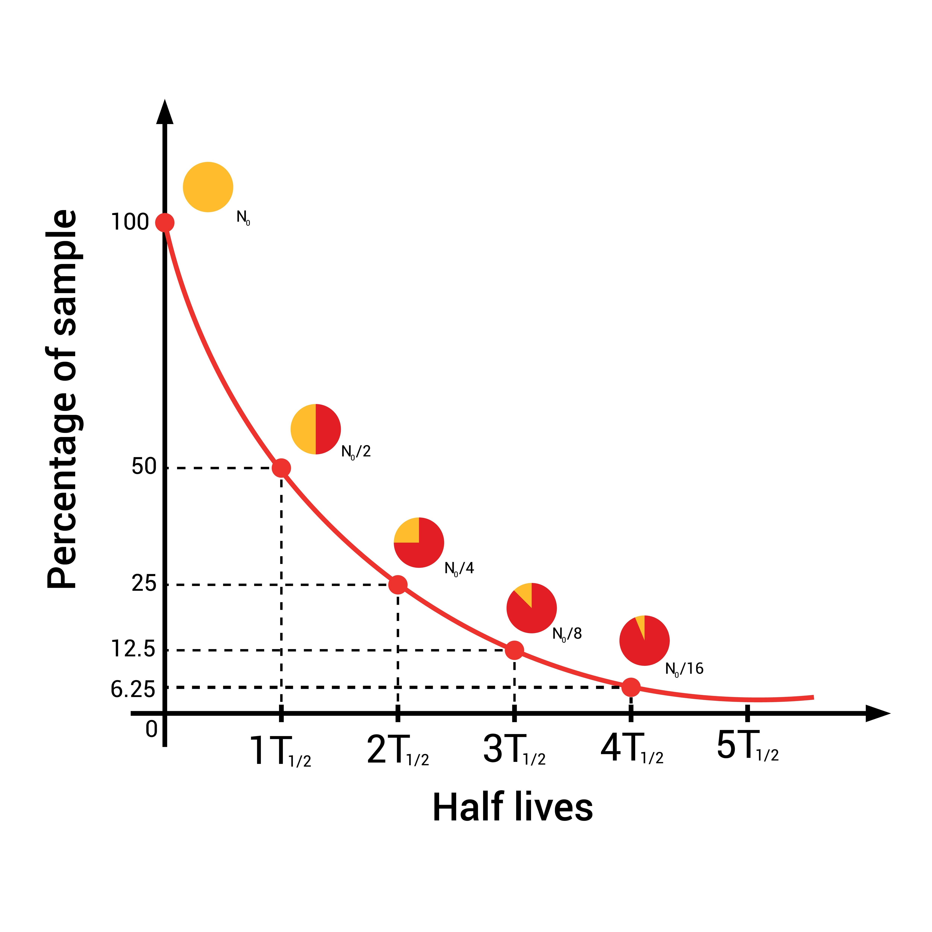

Slide 6
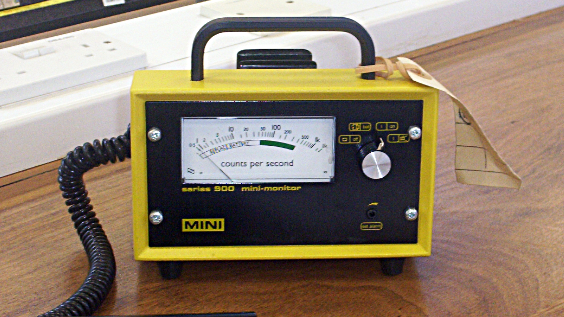

Slide 7
1000
500
Number of undecayed nuclei
0
20
Time (minutes)
Developing Experts All rights reserved © 2021

Slide 8
1000
500
Number of undecayed nuclei
0
20
Time (minutes)
Developing Experts All rights reserved © 2021

Slide 9
1000
500
Number of undecayed nuclei
250
0
20
40
Time (minutes)
Developing Experts All rights reserved © 2021

Slide 10
A radioactive isotope has a half-life of 15 days and an initial count rate of 200 counts per second. Determine the count rate after 45 days.
Developing Experts All rights reserved © 2021

Slide 11
A radioactive isotope has a half-life of 15 days and an initial count rate of 200 counts per second. Determine the count rate after 45 days.
Start Count rate = 200 counts per second
15 days Count rate = 100 counts per second
30 days Count rate = 50 counts per second
45 days Count rate = 25 counts per second
Developing Experts All rights reserved © 2021

