Slide 1
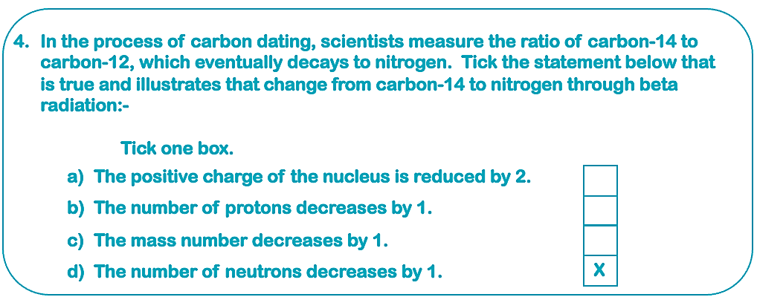
Hydrogen (H-1 Isotope)
Gamma rays can be directed in a gamma knife and targeted at cancerous cells to destroy or alter them. This is because they are ionizing and can damage the DNA and kill a cell.
Alpha radiation. It has the most ionisation but can only travel a short distance and has very low penetration
*
In a smoke detector an isotope of americium is used, which emits alpha particles. This ionisation of the air allows a small current to flow between two electrodes. As alpha radiation has limited penetration ability, when smoke is created during a house fire that is enough to block the alpha radiation, the circuit of electricity is broken, and the alarm goes off.
a) There is no change in the atomic mass.
b) A beta particle β is an electron that has been emitted from the nucleus. A neutron decays into a proton and releases an electron. This means that Caesium 137 undergoes β-decay by a neutron decaying into a proton and releasing an electron.
c) Beta particles β are relatively less ionising than alpha particles and have much less effect; however, beta particles β have a greater range at a metre and they have a good penetration power - being stopped by aluminium 5mm thick.
Teacher answers

Slide 2
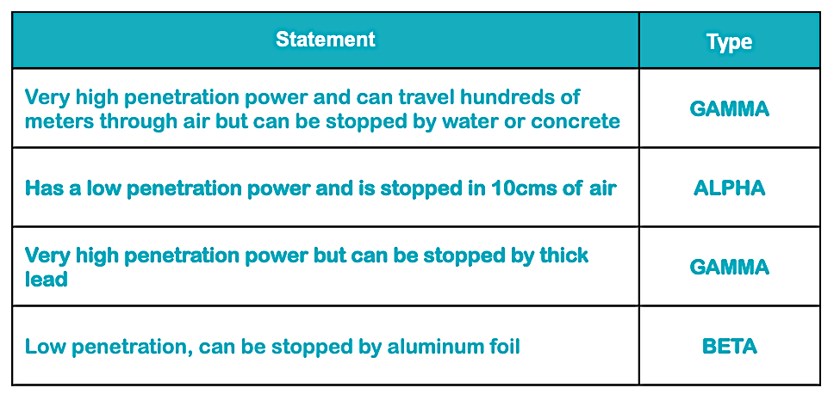
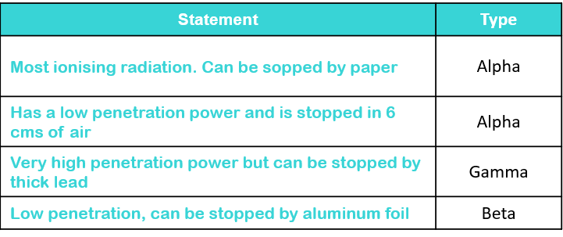
Teacher answers
A nucleon is the combination of protons and neutrons in the nucleus of an atom.

