Slide 1
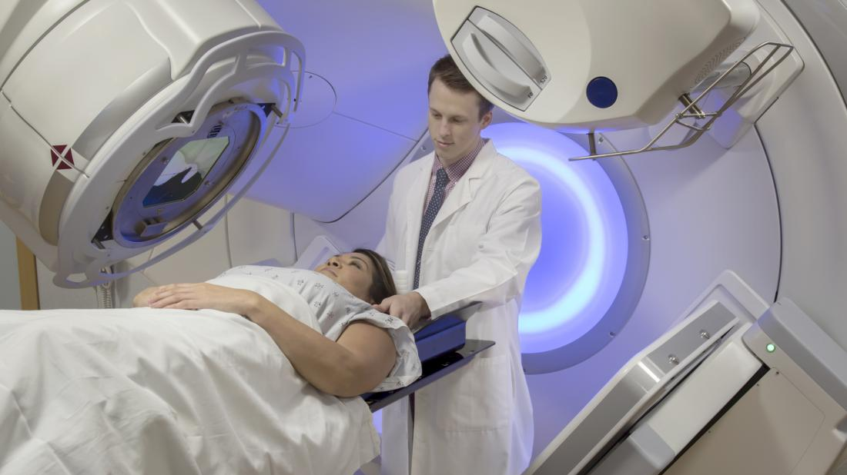
Developing Experts All rights reserved © 2021

Slide 2
Nuclear medicine uses radiation to provide diagnostic information about the functioning of or recommend treatments for specific organs. Diagnostic procedures using radioisotopes are now routine.
Radiotherapy can be used to treat some medical conditions - especially cancer. It uses radiation to weaken or destroy particular targeted cells.
Over 40 million nuclear medicine procedures are performed each year and the demand for radioisotopes increases by up to 5% annually.
Sterilisation of medical equipment is another important use of radioisotopes.
Developing Experts All rights reserved © 2021

Slide 3
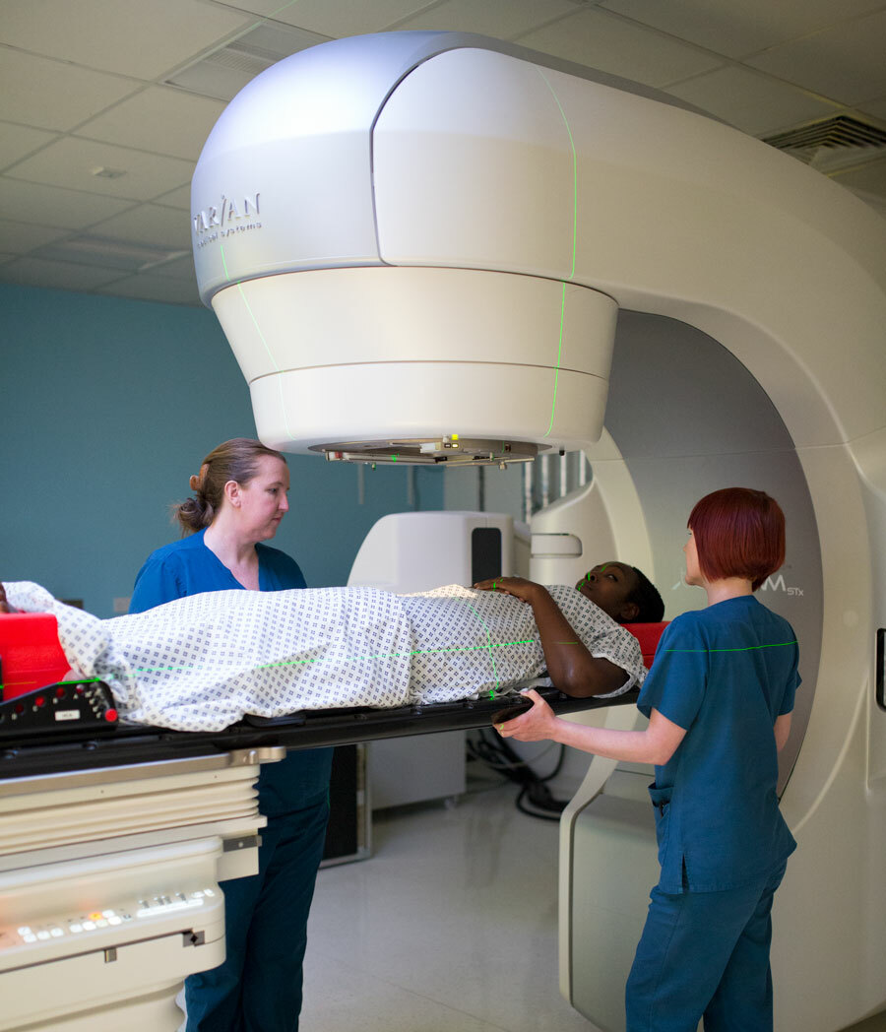
How radiation is used in medicine
Describe how nuclear radiation is used in medicine
Explain the risks and benefits of using nuclear radiation in medicine
Use data to evaluate the risks and consequences of using nuclear radiation
Developing Experts All rights reserved © 2021

Slide 4
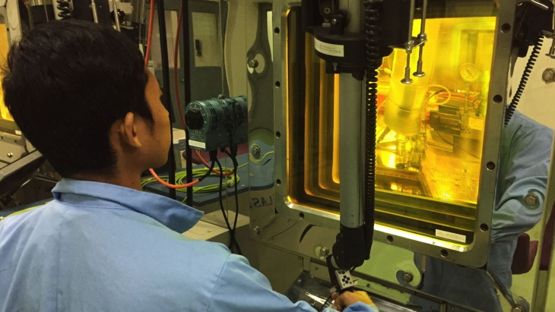
Developing Experts All rights reserved © 2021

Slide 5
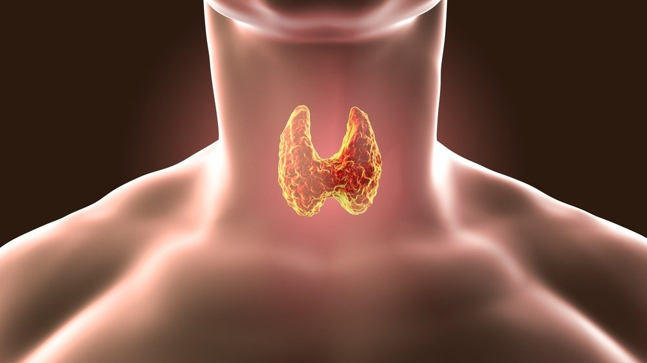

Slide 6


Slide 7
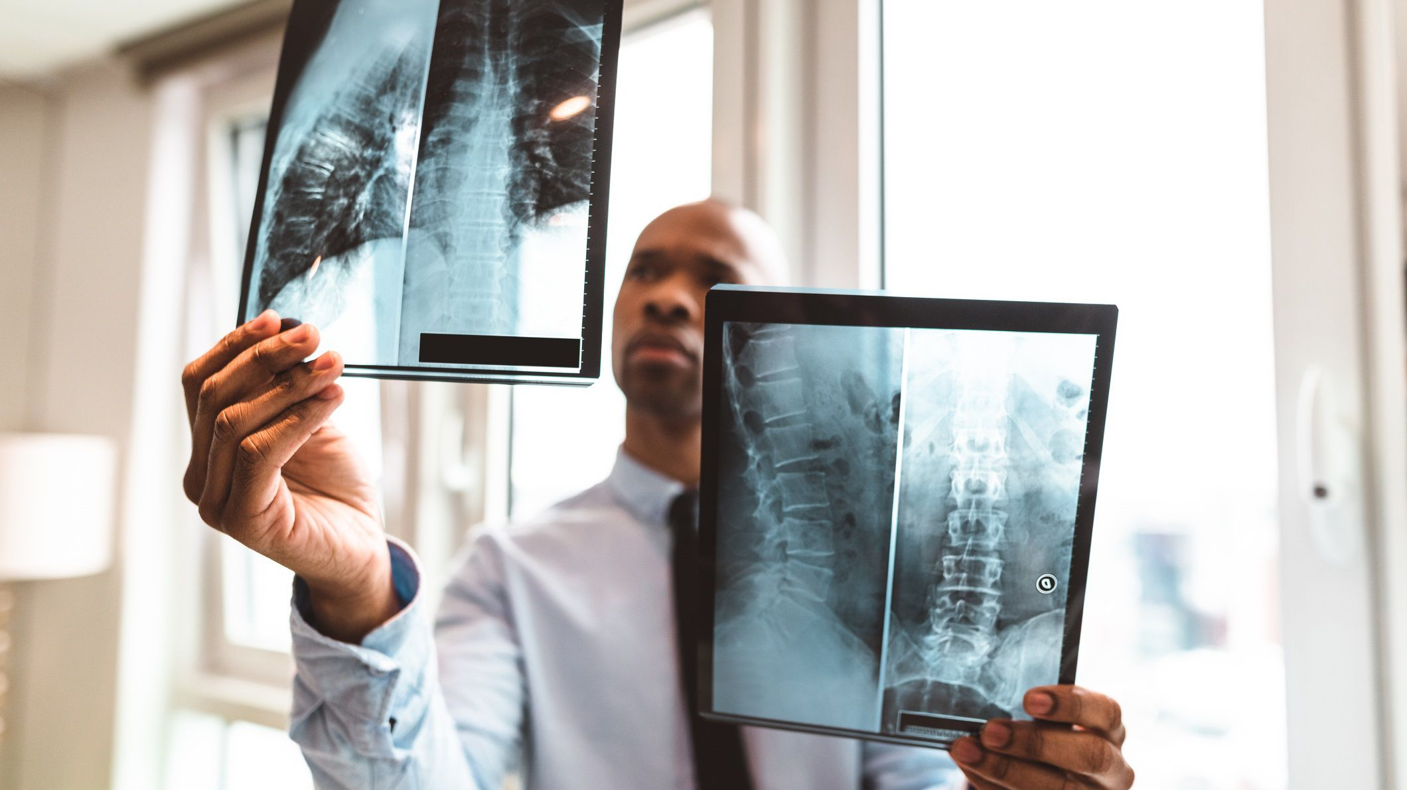

Slide 8
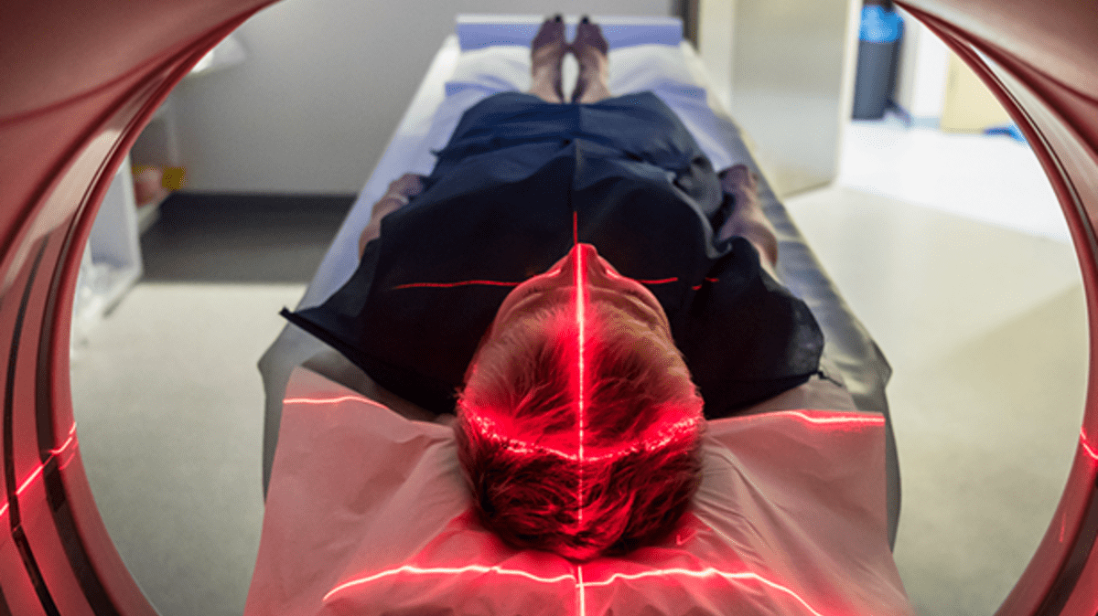

Slide 9
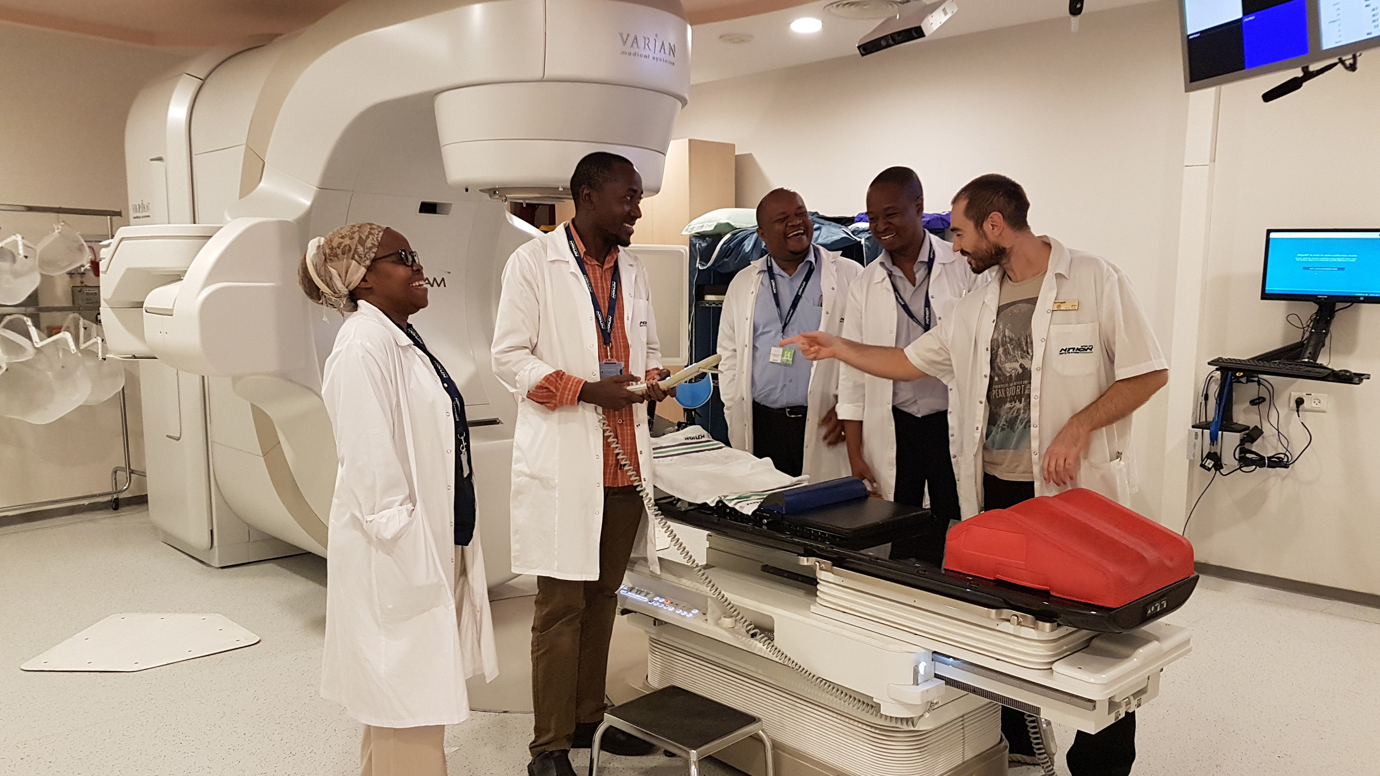

Slide 10
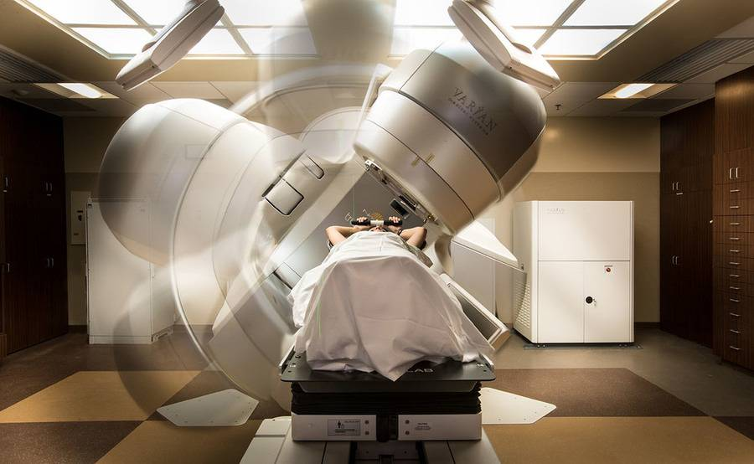

Slide 11
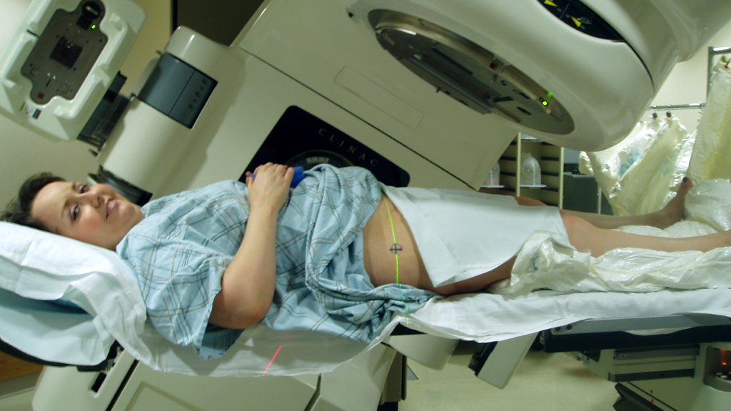

Slide 12
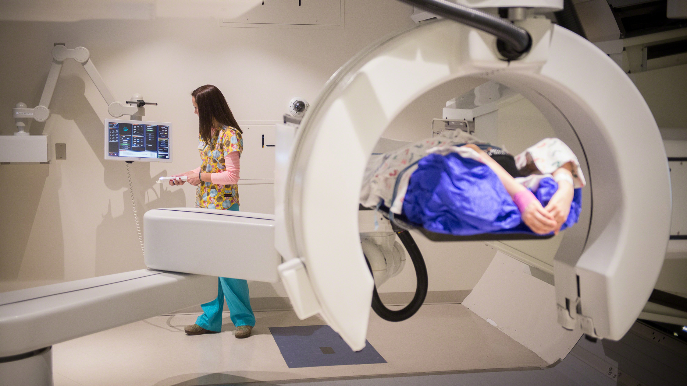

Slide 13
