Slide 1
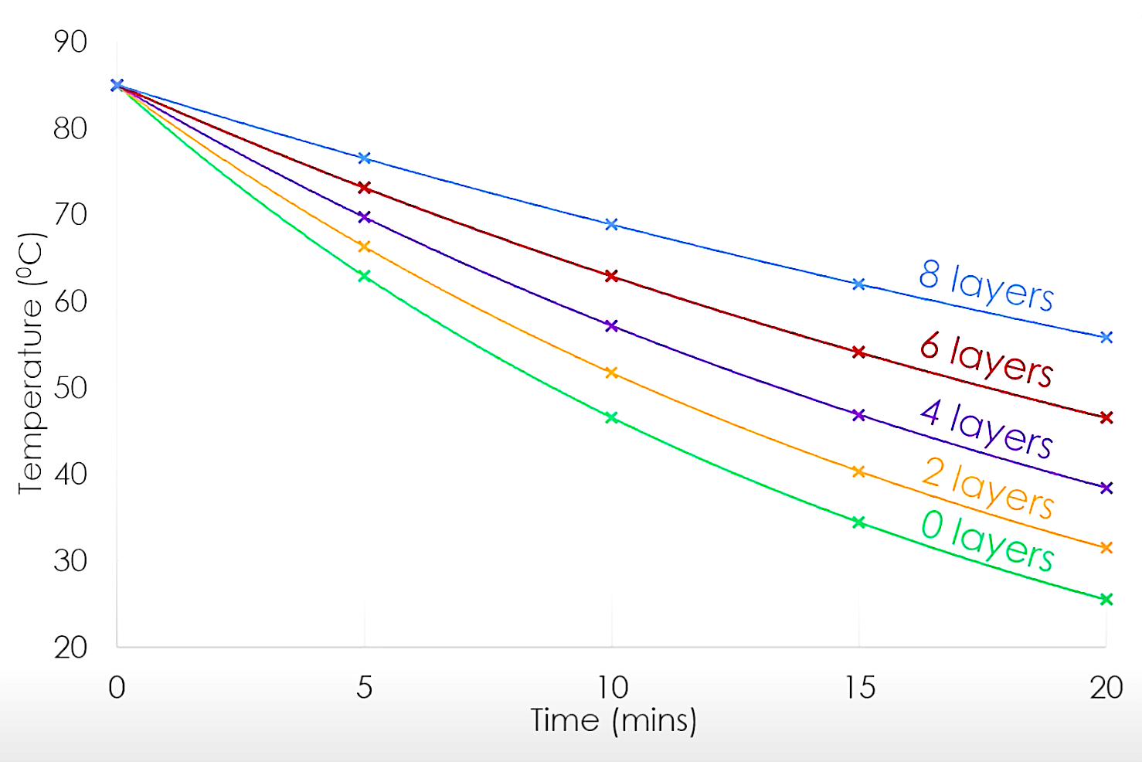
Explore insulating material – required practical
Objective:
Investigate the effectiveness of different materials as thermal insulators and the factors that may
affect the thermal insulation properties of a material.
Planning:
Consider the hypothesis:-
What are we investigating?
How might we find the answers?
What do you predict might happen?
Make a risk assessment:-
What are the hazards?
What measures will you take to manage risk?
Variables:-
What controls do we need?
What are the dependent variables?
What are the independent variables?
Determine for accuracy and for error:-
What is the calibration of the thermometer?
What is the resolution of the thermometer?
What is the time interval between reading the data? Can data be misread?
Is there material variability?
Can energy be lost?
Investigate the effectiveness of different materials as thermal insulators.
Measure the rate of cooling (change of temperature (independent variable) over time (dependent variable) of a beaker insulated with different materials.
Investigate the factors that may affect the thermal insulation properties of a material.
Measure the rate of cooling (change of temperature (independent variable) over time (dependent variable) of different thicknesses of the same material.
Remember:
A steeper line of best fit means that the beaker or the can cooled down faster.
All cans and beakers will cool to the same temperature.
Gravitational
field strength
10N/kg
Analysis:
A comparison of factors that determine how effective a thickness of thermal insulation is.
This can be done by plotting a graph of the data and drawing a line of best fit of temperature versus time.
Gradients and lines of best fit can provide the information of what is the optimum thickness of material.

Slide 2
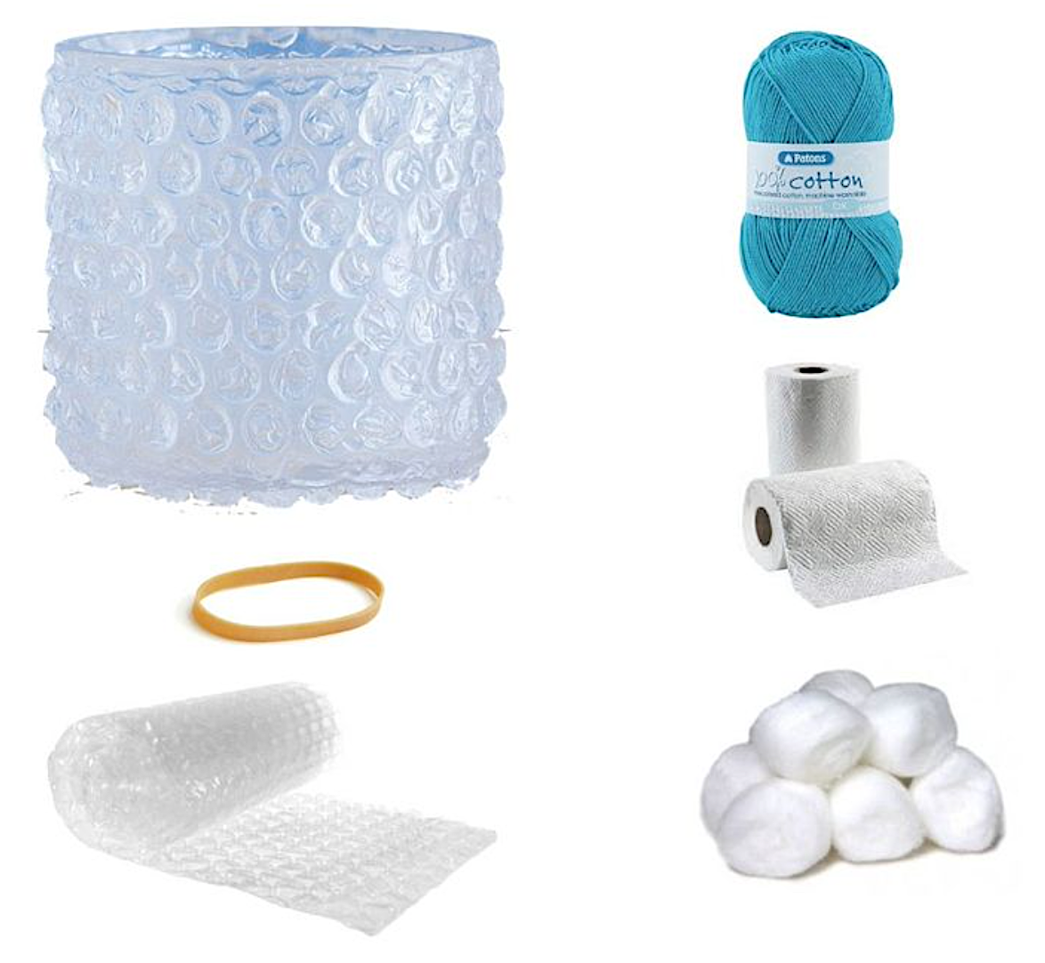
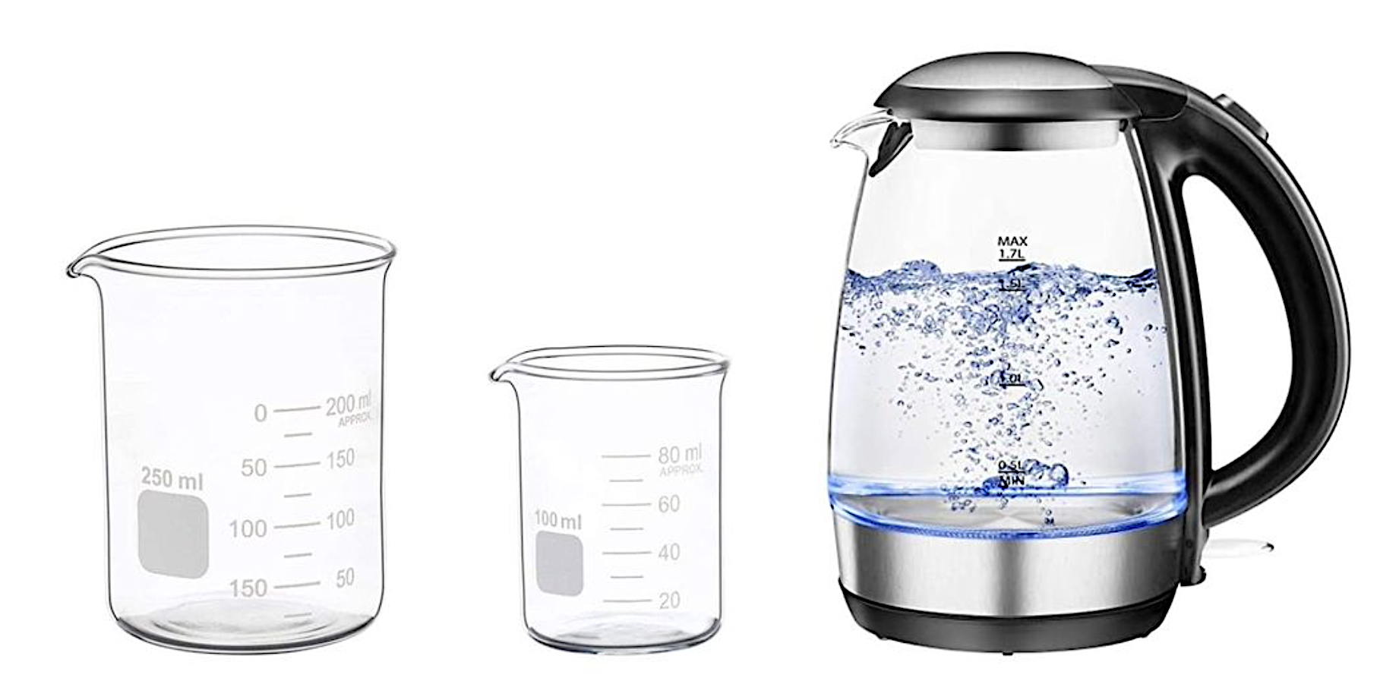
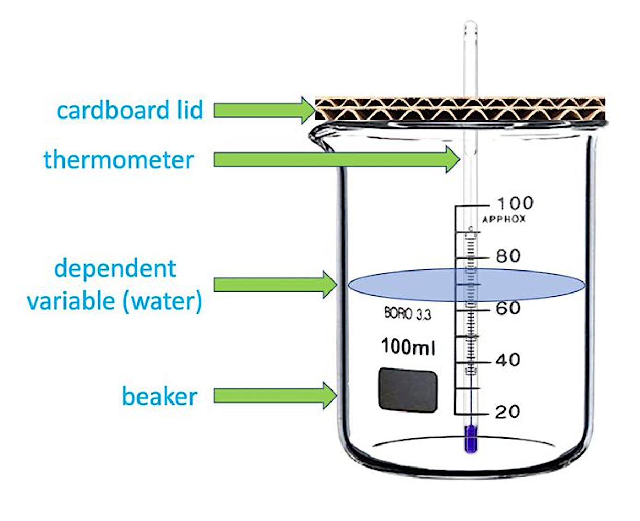
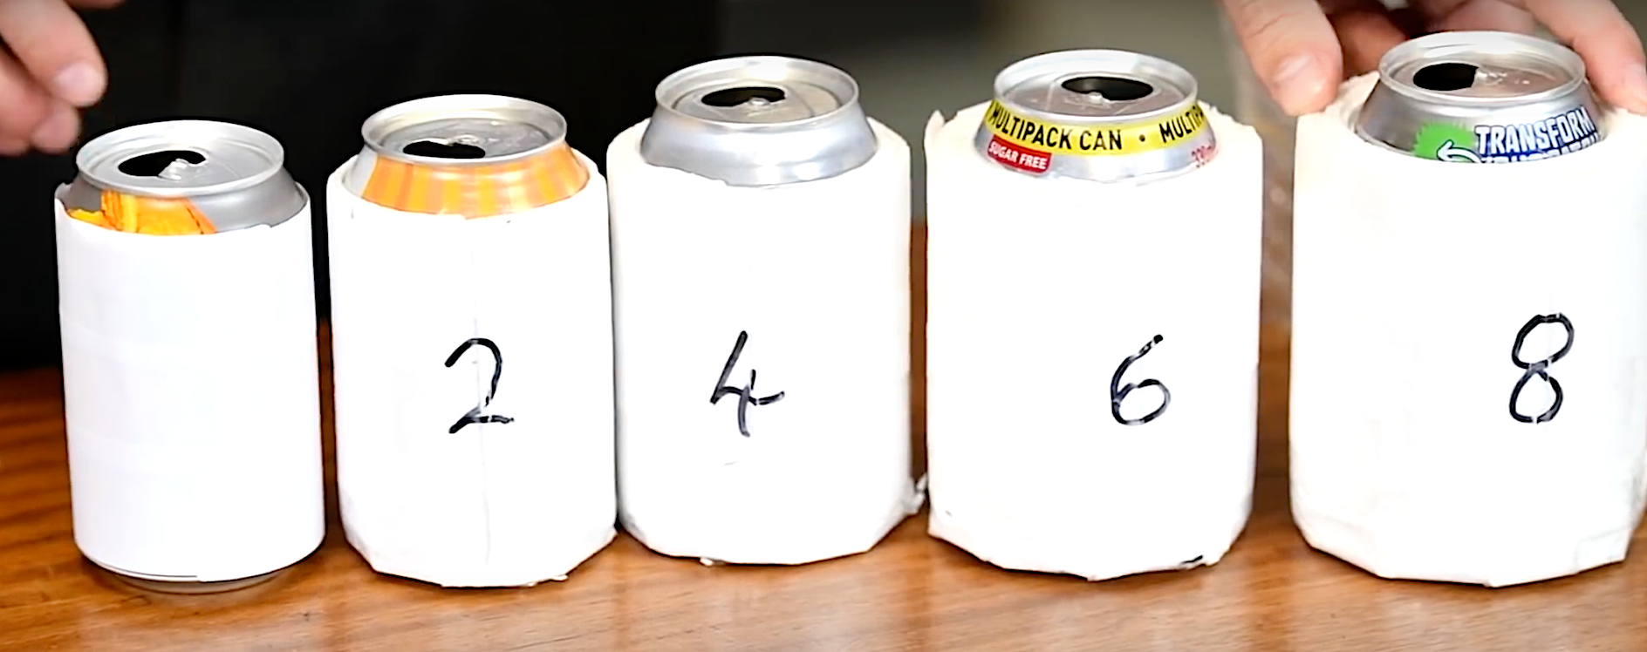
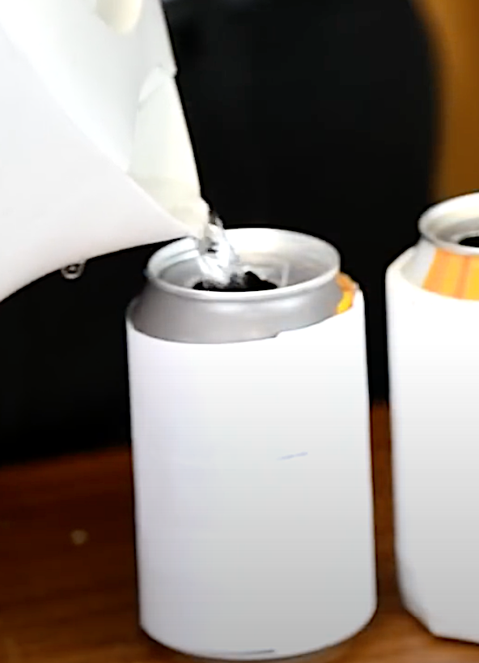
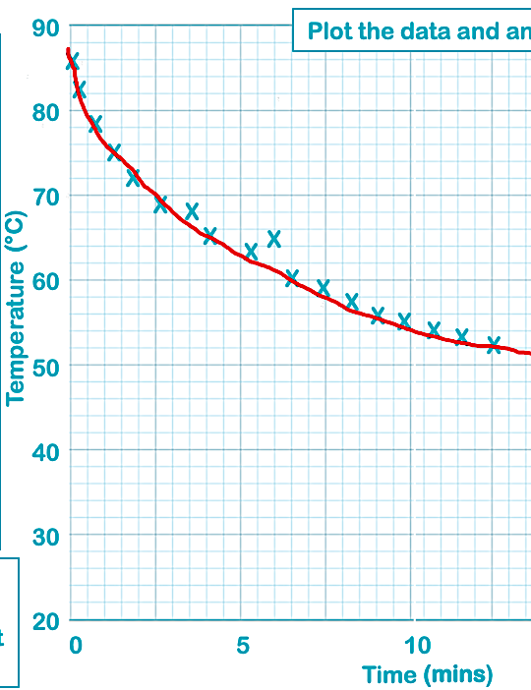
Methods
Method 1: for different material type
Prepare several sets of small beakers inside larger beakers. Fill the space between the beakers with different types of insulating materials.
Put 60ml of hot water from a boiled kettle in the small beaker.
Use a piece of cardboard for the lid. Make a small hole for the thermometer.
Insert the thermometer through the hole in the lid so that the bulb of the thermometer is in the water.
Record the temperature of the water in each beaker and start the timer.
Record the temperature of the water in each beaker every 53minutes for 15 minutes.
Method 2: for different layers of insulation
Set up a series of aluminum cans, with increasing layers of insulation material.
Ensure that the first can is the control with no insulation.
Cut a cardboard lid and make a hole for the thermometer. Ensure that the thermometer bulb will be immersed in the water.
Boil a kettle and fill can 1. Start the timer.
Record the temperature of the water in each beaker every 3 minutes for 15 minutes.
Repeat with the remaining 4 cans.
Consider all the sources of error carefully.
Lines of best fit should be smooth. They can be curved or straight.
Think of all of the hazards of this experiment. Write your risk assessment having listed each hazard.
The line of best fit does not have to pass through each plotted point; some points are anomalous.

Slide 3
Planning sheet
Plan an experiment for measuring the effectiveness of a range of different insulation materials.
Organise __________________________________________________________________________________________________________________________________________________________________________________________________________________________________________________________________________________________________________________________________________________________________________________________________________________________________
Equipment
1___________
Use_____________________
2___________
Use_____________________3___________
Use_____________________
4___________
Use_____________________
5___________
Use_____________________
Risk assessment ________________________________________________________________________________________________________________________________________________________________________________________________________
Notes
Control & variables ____________________________________________________________________________________________________________________________________________________________________________________________________________
Sources of error ________________________________________________________________________________________________________________ _____________________________________

Slide 4
Record the data.
Data analysis
Time (mins) | Material 1 | Material 2 | Material 3 | Material 4 | Material 5
0
3
6
9
12
15
Notes
Plot the data and analyse the results.
Temperature
(°C)
Dependent variable on the y axis, independent variable on the x.
(mins)

Slide 5
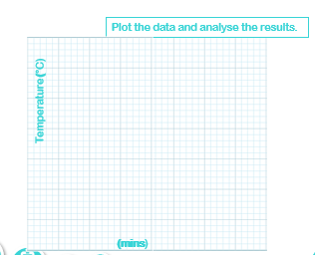
Record the data.
Data analysis
 | Number of layers of insulation
Time (mins) | 0 | 2 | 4 | 6 | 8
0
3
6
9
12
15
Notes
Dependent variable on the y axis, independent variable on the x.

Slide 6
Questions
Should each set of apparatus start with the same temperature? Explain your answer. ____________________________________________________________________________________________________________________________________________________________________________________________________________________________________________________________________________________________________________________________________________________________________________________________________________________________________________________________________________________________________________________________________________________________
What changes could you make to the experiment to improve the validity of the data? ____________________________________________________________________________________________________________________________________________________________________________________________________________________________________________________________________________________________________________________________________________________________________________________________________________________________________________________________________________________________________________________________________________________________

