Slide 1


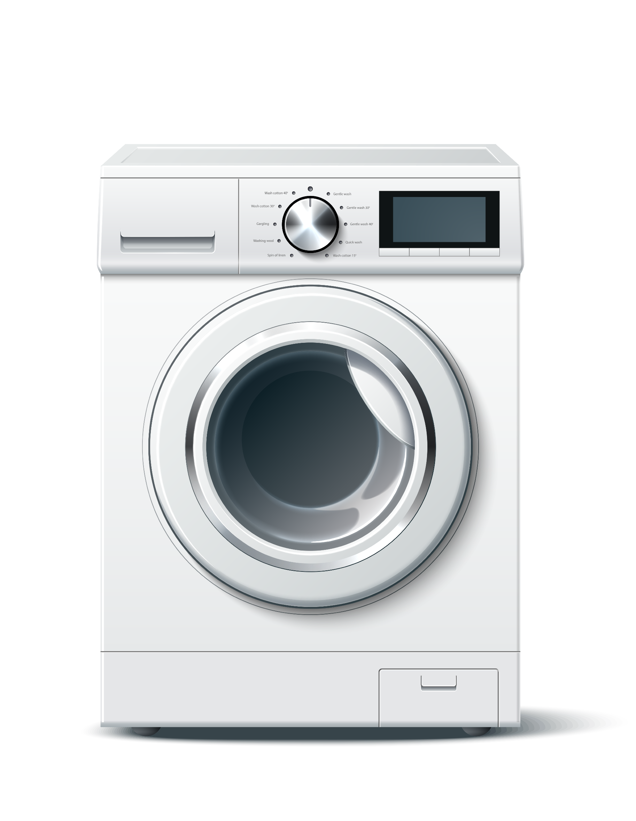
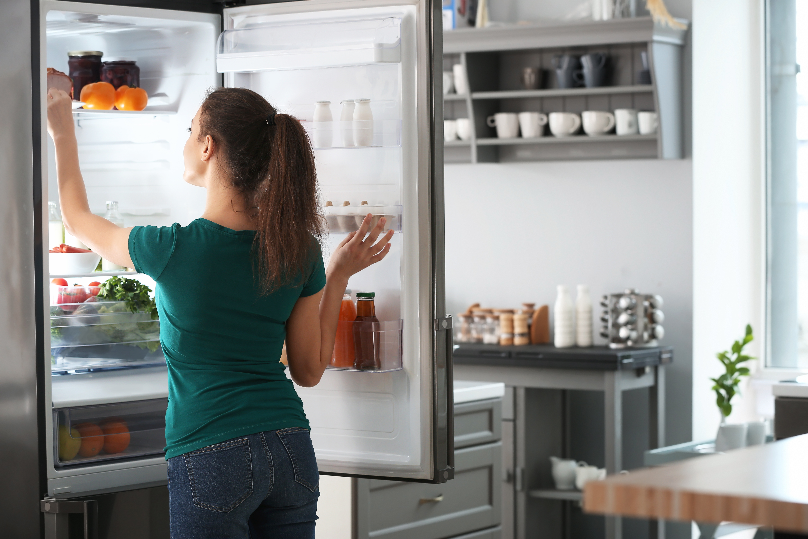
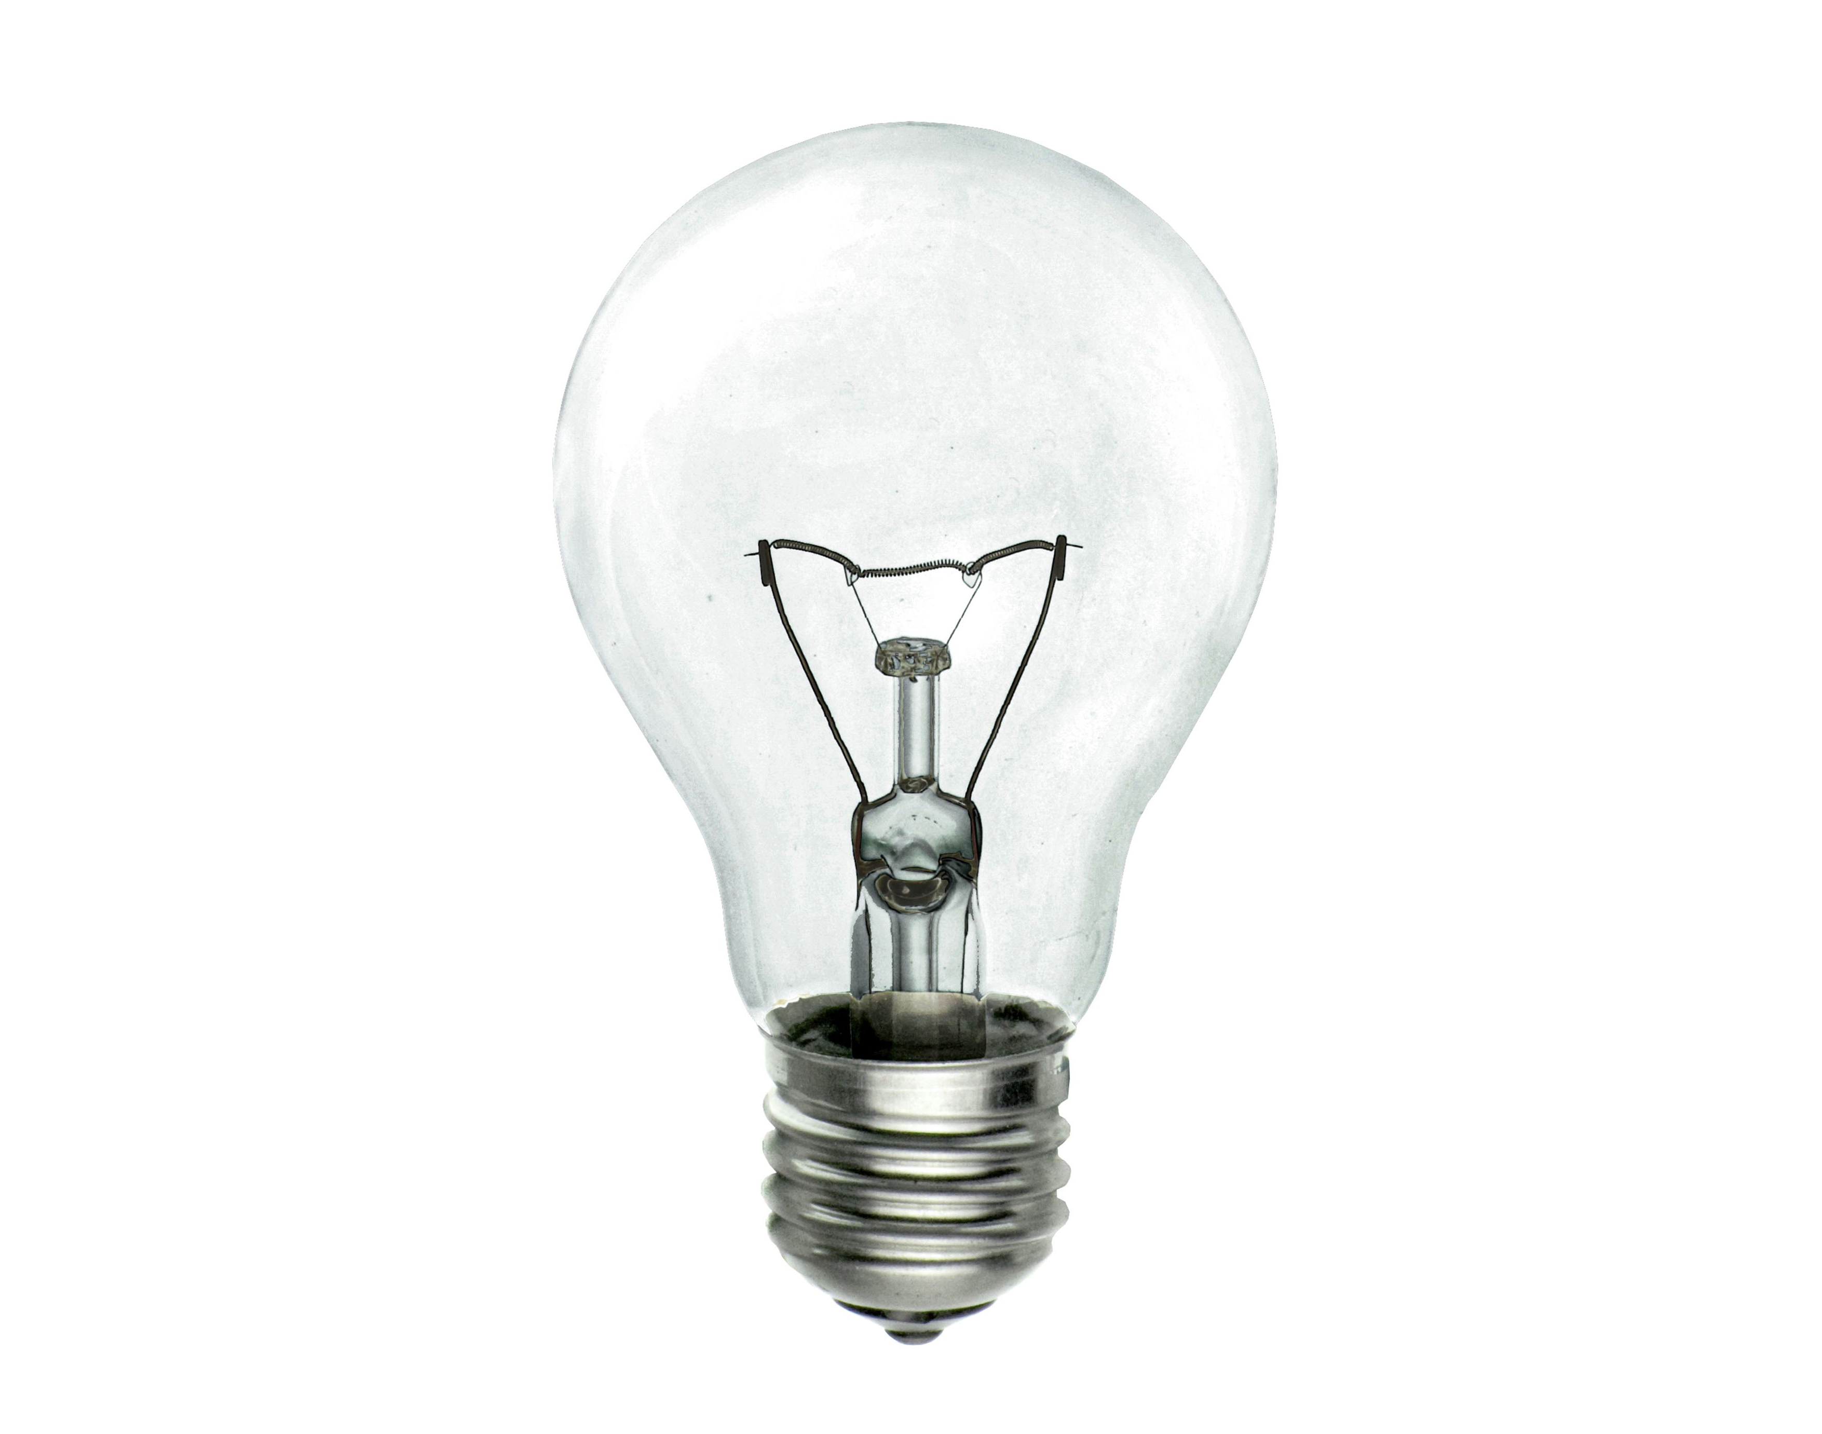
Developing Experts All rights reserved © 2021

Slide 2
Cooking= 4%
Consumer electronics such as laptops, TV’s and game consoles= 6%
Wet appliances like washing machines and dishwashers = 14%
Cold appliances such as fridge freezers = 13%
Lighting= 5%
Developing Experts All rights reserved © 2021

Slide 3
Explaining Power
Recall the two equations for calculating power and units involved
Describe, using examples, what is meant by power
Calculate power using energy transferred or work done
Compare the power of different appliances or machines
Developing Experts All rights reserved © 2021

Slide 4
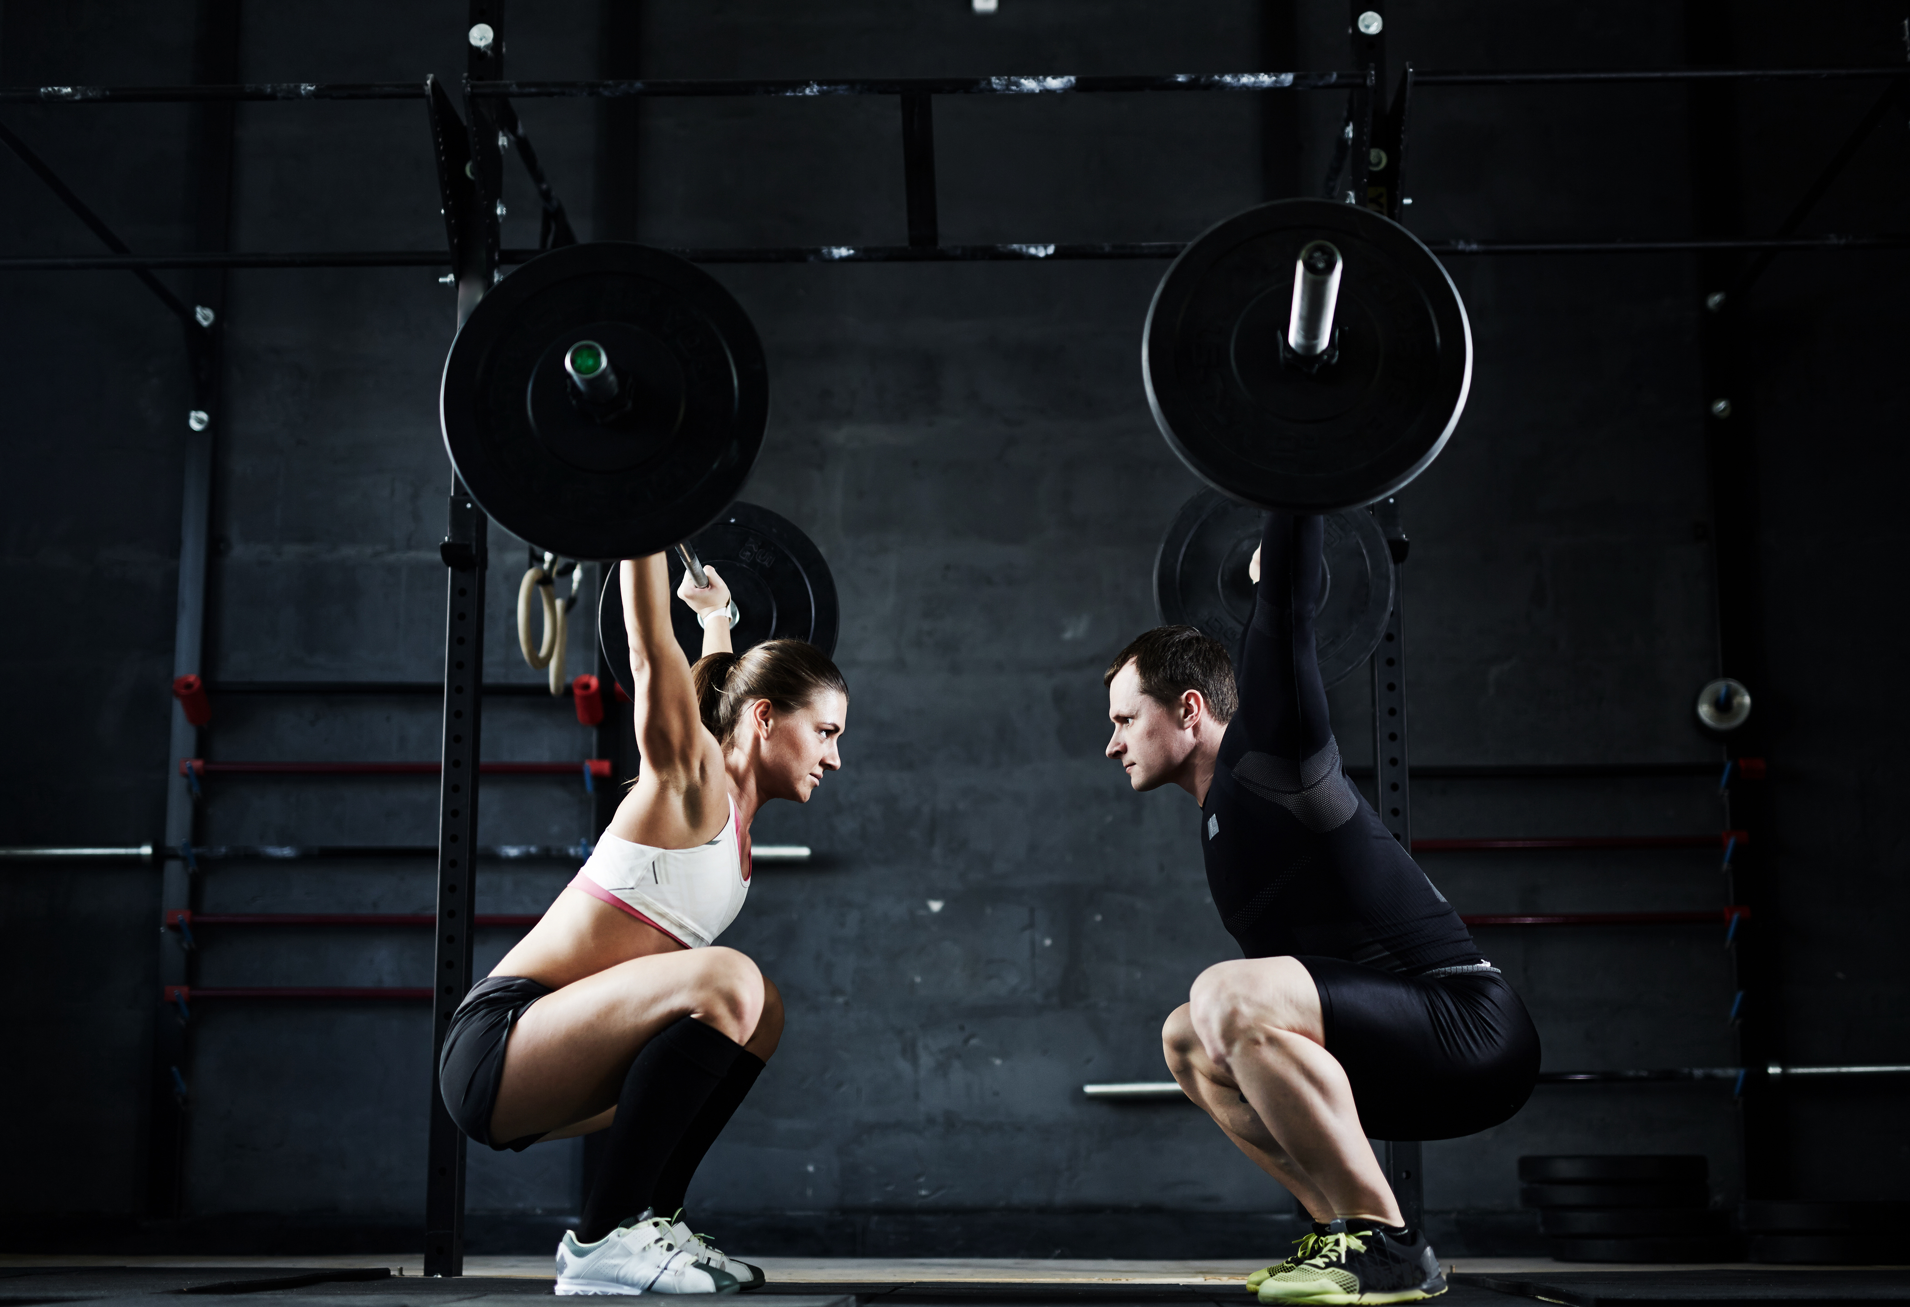
Power is the rate at which you do work or transfer energy
If you do more work, in a short time, your power will be greater
Developing Experts All rights reserved © 2021

Slide 5
Power (P) is the rate at which you do work or transfer energy
Power = energy transferred
time
P = E
t
joules
seconds
Watts
Developing Experts All rights reserved © 2021

Slide 6
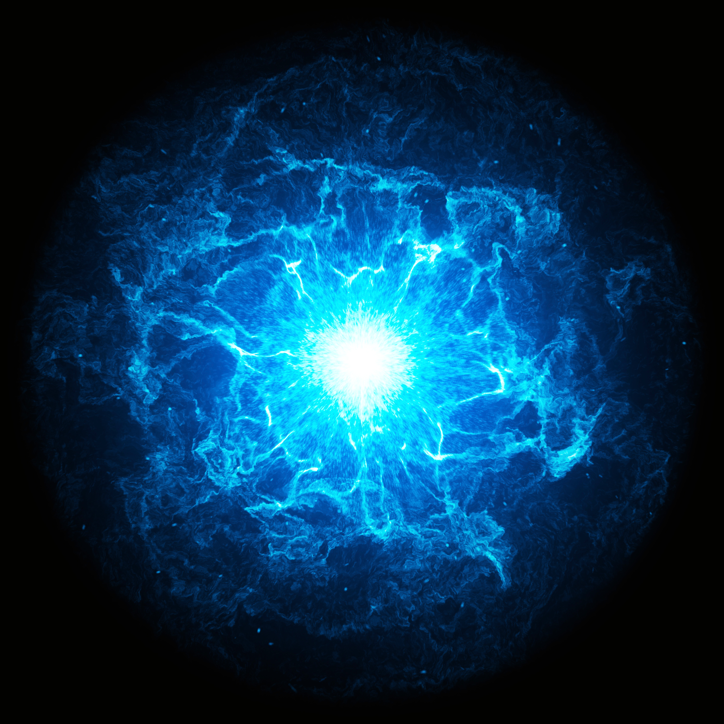
Power (P) is the rate at which you do work or transfer energy
Power = work done
time
P = W
t
Joules (J)
Seconds (s)
Watts (W)
Developing Experts All rights reserved © 2021

Slide 7
One watt (W) is the power when
1 joule of work (or energy) is transferred in 1 second
1 watt = 1 joule per second
1 W = 1 J/s
James Watt
Developing Experts All rights reserved © 2021

Slide 8
Energy is the capacity to do work.
It is measured in joules.
Power is the rate at which energy is transferred or work is done. It is measured in joules per second, or watts.
Developing Experts All rights reserved © 2021

Slide 9
One thousand watts = 1000 W = 1 kW (kilowatt)
One million watts = 1000000 W = 1 MW (megawatt)
× 1000
× 1000
watt (W)
kilowatt (kW)
megawatt (MW)
÷ 1000
÷ 1000
Developing Experts All rights reserved © 2021

Slide 10

A hair dryer transfers 42 000 joules of energy in 60 seconds. What is the power rating of the hair dryer?
Developing Experts All rights reserved © 2021

Slide 11
A hair dryer transfers 42 000 joules of energy in 60 seconds. What is the power rating of the hair dryer?
Power (W) = energy transferred (J)
time (s)
Power = 42000
60
Power = 700 W
Developing Experts All rights reserved © 2021

Slide 12
A hair dryer transfers 78 kilojoules of energy in 2 minutes. What is the power rating of the hair dryer?
Developing Experts All rights reserved © 2021

Slide 13
A hair dryer transfers 78 kilojoules of energy in 2 minutes. What is the power rating of the hair dryer?
Power (W) = energy transferred (J)
time (s)
Power = 78000
120
Power = 650 W
Developing Experts All rights reserved © 2021

Slide 14
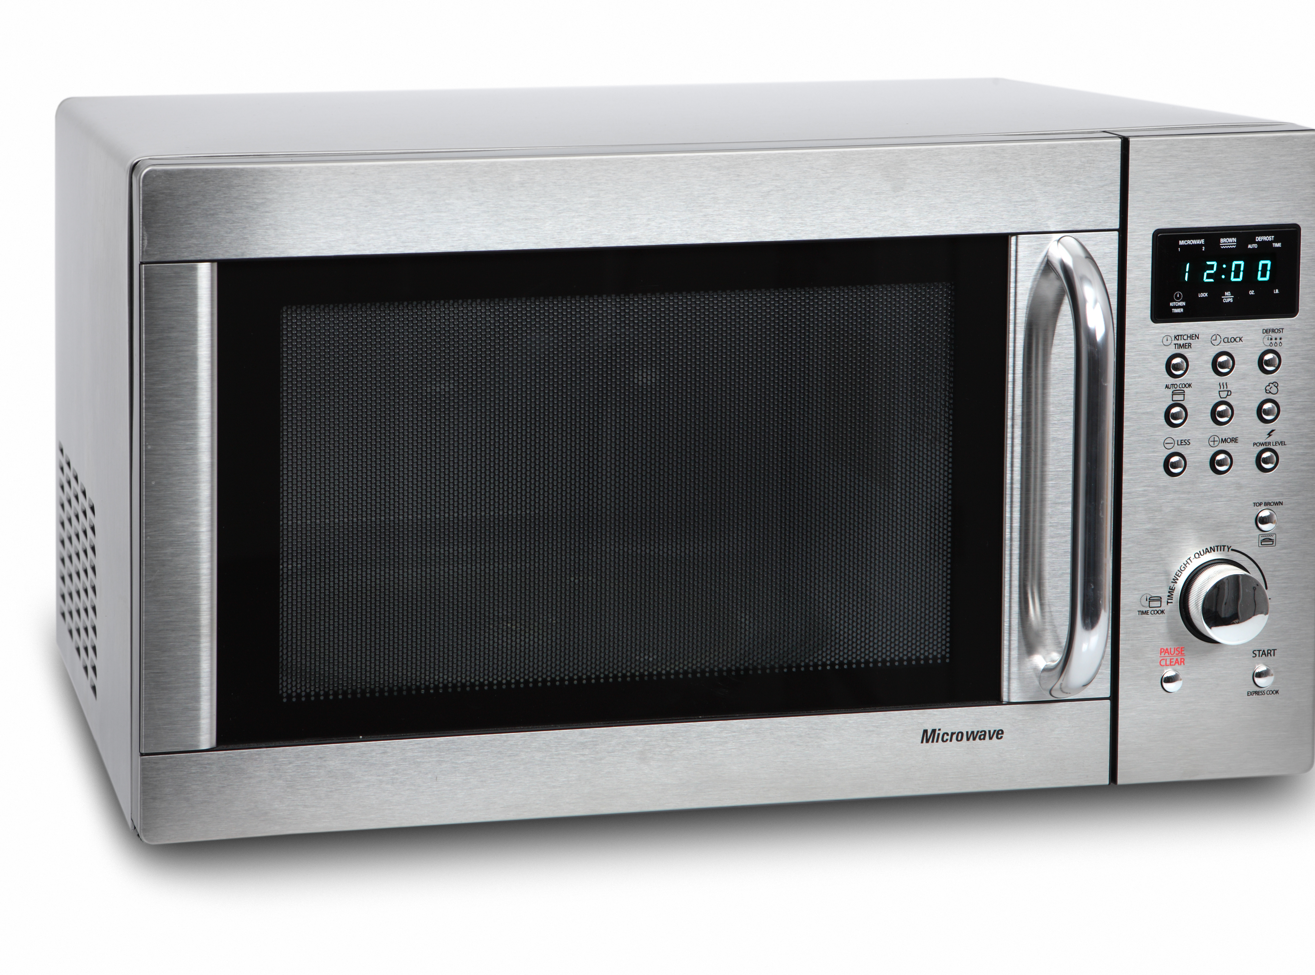
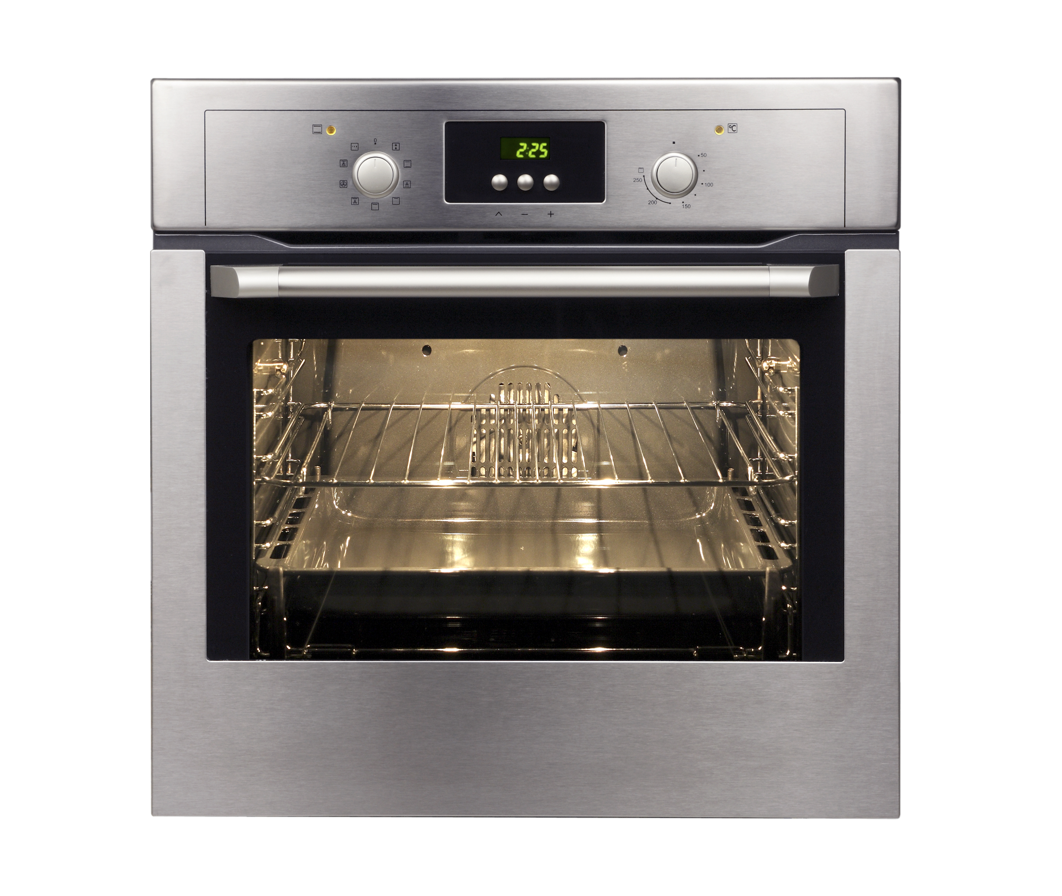
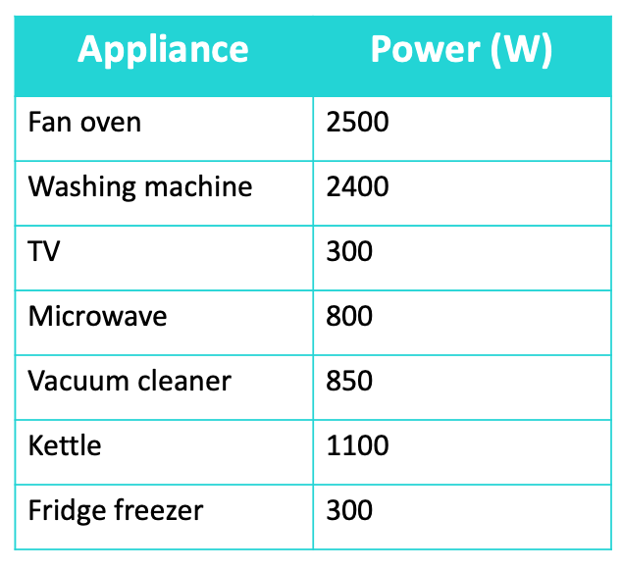
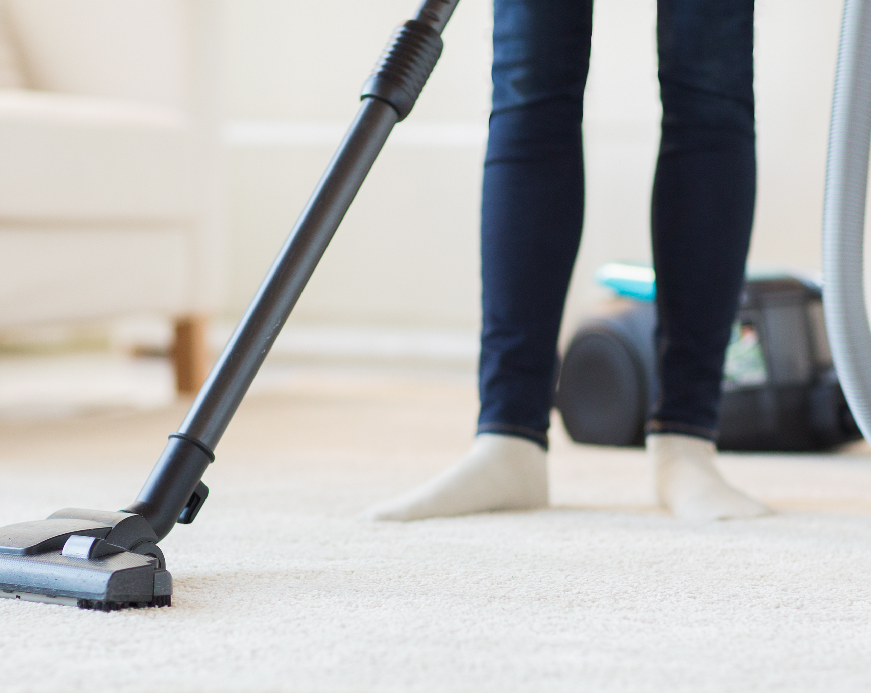
Developing Experts All rights reserved © 2021

