Slide 1
Mission Assignment: Explain how sound travels
KS3-18-03
Build a passive speaker
You are going to build a passive speaker. A passive speaker does not require a power source; instead, it channels sound waves into the same spot to create the effect of increasing volume.
Your design should include a slot to put a mobile telephone and an opening to allow the sound out. The rest of the design is entirely up to you!
Things to Consider
Shape The shape is very important as this will determine where the sound waves travel. Consider how they will move from the source to the opening | Materials The materials can affect how the sound travels. Sound may be absorbed by some materials and reflected by others. Sound may pass straight through certain thin materials.
1. Draw a labelled diagram of your design in the space below.
Developing Experts Copyright 2023 All Rights Reserved

Slide 2
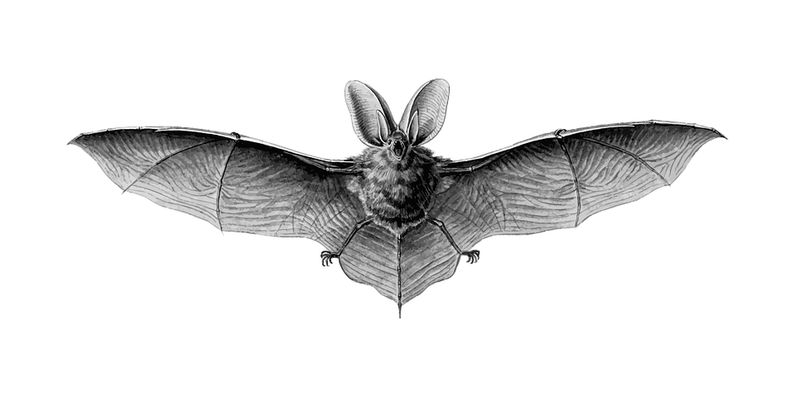
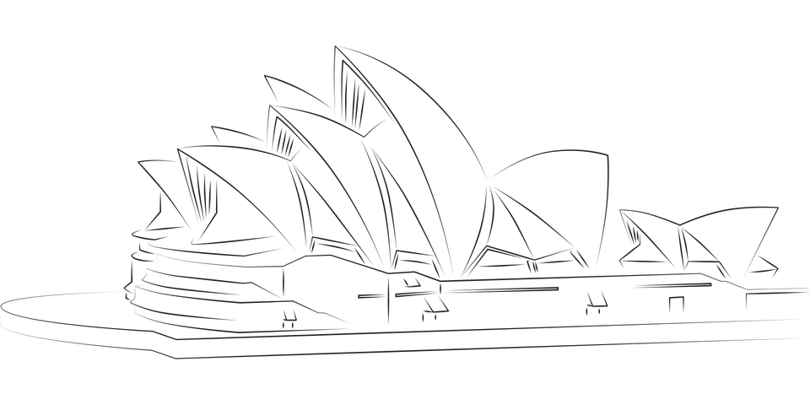
Mission Assignment: Explain how sound travels
KS3-18-03
Build a passive speaker
2. Give an example of a problem you had in the building/designing process and how you overcame it.
_______________________________________________________________________________________________________________________________________________________________________________________________________________________________________________________________________________________________________________________________________________________________________________________________________________________________
3. Describe your design and explain how you think it works.
_______________________________________________________________________________________________________________________________________________________________________________________________________________________________________________________________________________________________________________________________________________________________________________________________________________________________
4. If you had more time and resources, how would you improve your design?
_______________________________________________________________________________________________________________________________________________________________________________________________________________________________________________________________________________________________________________________________________________________________________________________________________________________________
Challenge: Suggest some examples of objects, buildings or animals that are shaped to channel sound in a particular direction. Below are some pictures to help you.
_____________________________________________________________________________________________________________________________________________________________________________________________________________________________________________________________________________________________________________________________________________________________________________________________________________________________________________________________________________________________________________________________________________________________________________________________________
Developing Experts Copyright 2023 All Rights Reserved

Slide 3
Mission Assignment: Explain how sound travels ANSWERS
KS3-18-03
Build a passive speaker
2. Give an example of a problem you had in the building/designing process and how you overcame it.
_______________________________________________________________________________________________________________________________________________________________________________________________________________________________________________________________________________________________________________________________________________________________________________________________________________________________
3. Describe your design and explain how you think it works.
_______________________________________________________________________________________________________________________________________________________________________________________________________________________________________________________________________________________________________________________________________________________________________________________________________________________________
4. If you had more time and resources, how would you improve your design?
_______________________________________________________________________________________________________________________________________________________________________________________________________________________________________________________________________________________________________________________________________________________________________________________________________________________________
Challenge: Suggest some examples of objects, buildings or animals that are shaped to channel sound in a particular direction. Below are some pictures to help you.
_____________________________________________________________________________________________________________________________________________________________________________________________________________________________________________________________________________________________________________________________________________________________________________________________________________________________________________________________________________________________________________________________________________________________________________________________________
A megaphone is a cone-shaped device that is used to amplify sound and direct it towards a specific location. The wide end helps to amplify and direct the sound in a specific direction. Bats use echolocation to navigate and locate prey. The shape of a bat's ears and face help to focus and direct these sound waves, allowing the bat to accurately locate and track its prey. The Sydney Opera House is an iconic building known for its unique design. The building's roof consists of a series of interlocking shell-like structures that help to focus and direct sound towards the audience, creating an acoustically rich and immersive environment for performances.
Developing Experts Copyright 2023 All Rights Reserved

