Slide 1
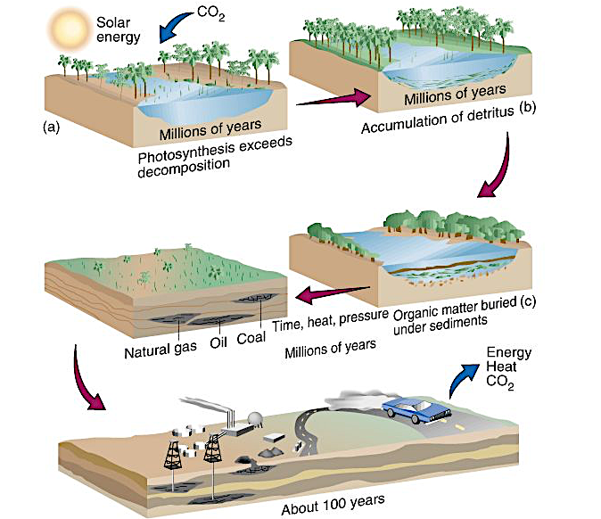
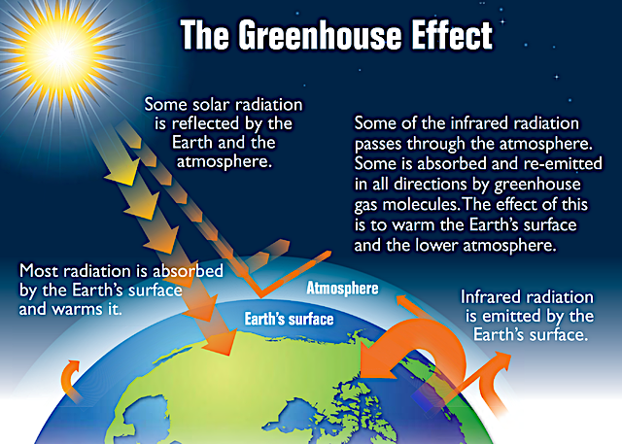
Fossil fuels - hydrocarbons
Coal, oil and gas have powered the world since the 1700’s as the first form of fuel mined on an industrial scale and powered the early steam engines that drove the industrial revolution and early transport. Crude oil was originally refined as kerosene for heating, lighting and cooking whilst petroleum was viewed as a by-product of that process. Eventually, one hundred years ago, the refinements of the internal combustion engine found a use for petrol. This fuel has driven the revolution towards national and personal transport.
Fossil fuels have formed from simple organisms like plankton, algae, and trees that lived 250-500 million years ago. These life-forms were composed of the basic building-blocks of life – hydrogen and carbon. As they decomposed, they became compressed and subject to rapid burial in the sediments that formed rocks over many millions of years. Pockets of methane gas from the decomposition formed above deposits of thick brown oil. Petrified forests laid down coal seams. These three resources are non-renewable, release CO2 when burnt and are declining after 300 years of over-exploitation.
Gravitational
field strength
10N/kg
When the sun’s radiation is reflected back from the earth, the gases from fossil fuels - essentially carbon dioxide - absorb some of that radiation and then act as a blanket around the planet, trapping heat within it. This has led to significant temperature increases across the earth, which has dramatically affected weather patterns. Climate change is now a global problem that must be reversed. Governments across the world are working together to stop the use of fossil fuels to avert climate change.

Slide 2
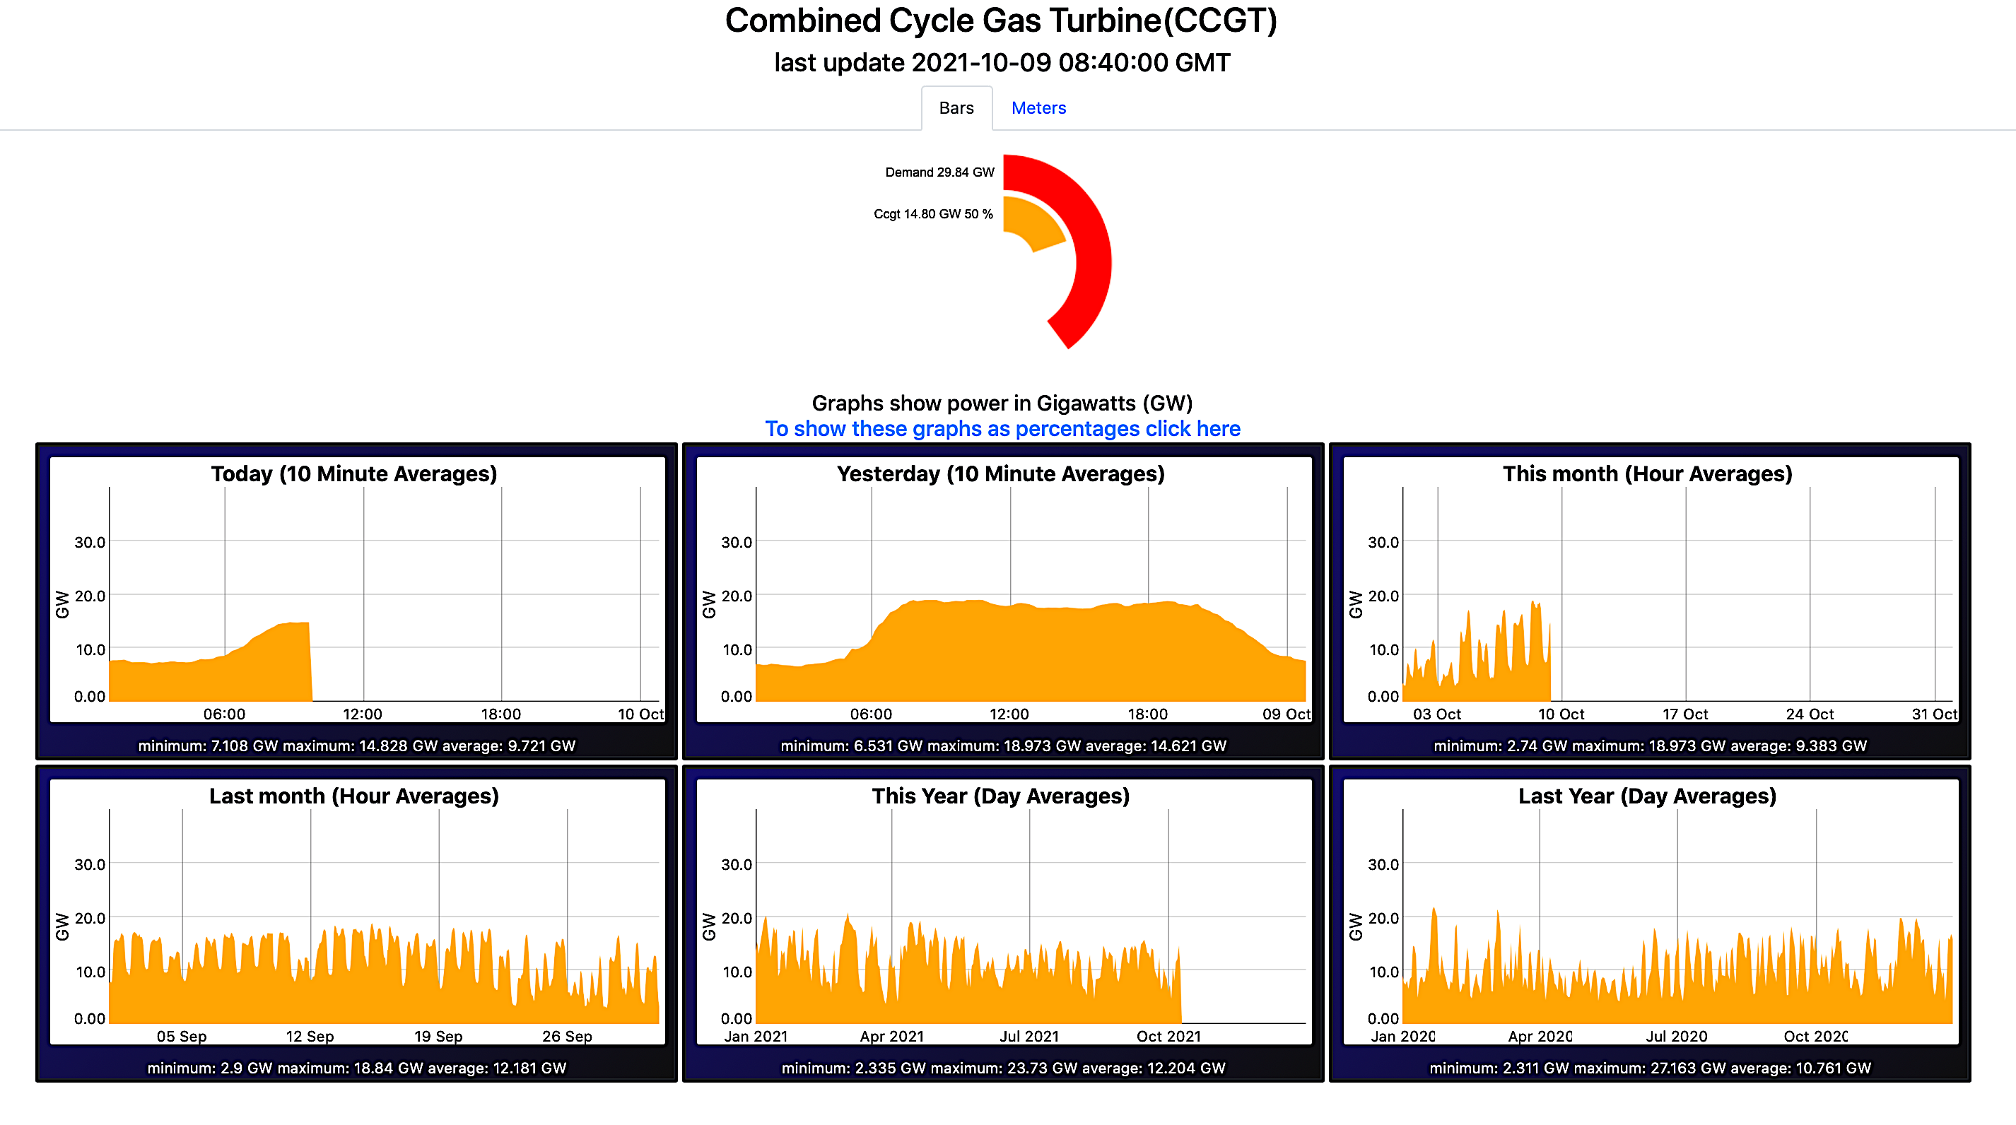
Energy demand
According to the data above, the present energy demand is 29.84Gw and 50% of that is being supplied through CCGT – Combined Cycle Gas Turbines. Why are we using so much fossil fuels to meet half of our demand for energy and not renewable sources of energy? _________________________________________________________________________________________________________________________________________________________________________________________________________________________________________________________________________
On the graph for yesterday, why is there more demand for power between 6.00hrs and 21.00hrs? ______________________________________________________________________________________________________________________________________________________

Slide 3
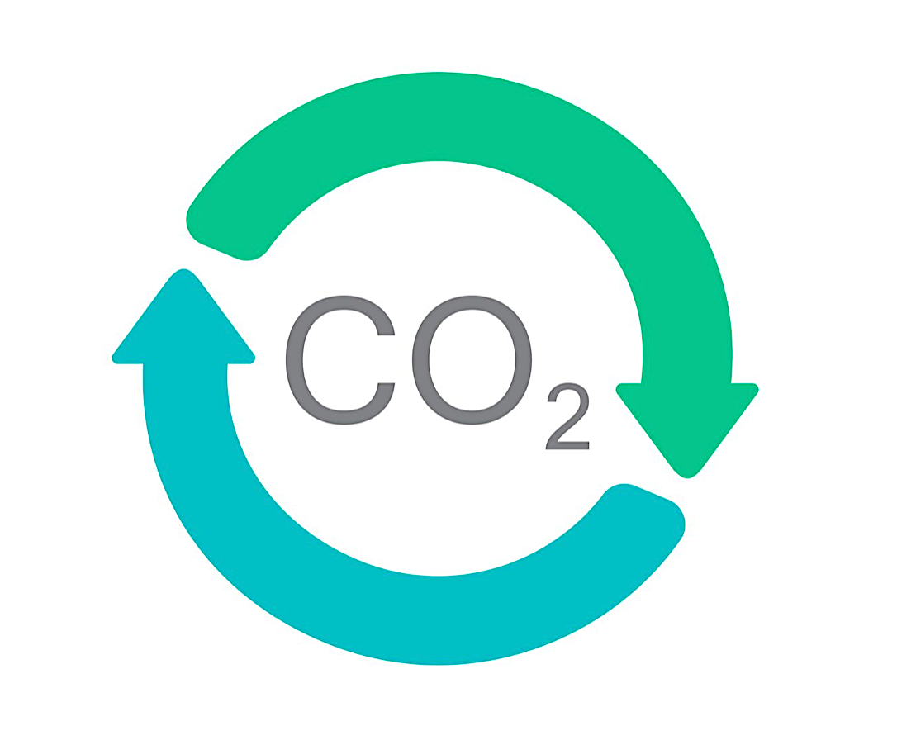
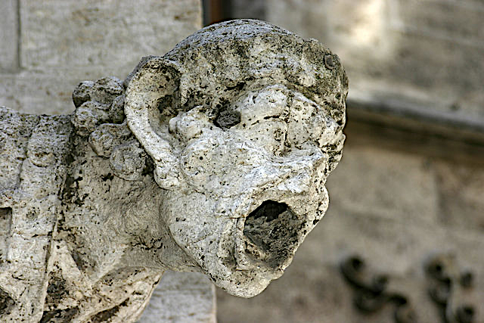
Energy & the environment
State and explain the advantages and disadvantages of using non- renewable energy resources. ______________________________________________________________________________________________________________________________________________________________________________________________________________________________________________________________________________________________________________________________________________________________________________________________________________________________________________________________________________________________________
Carbon capture technology is being used to offset the carbon dioxide produced by fossil fuels. (a) Explain what carbon capture is. (b) give two examples of carbon capture. __________________________________________________________________________________________________________________________________________________________________________
Acid rain is caused by sulphur dioxide released from burning fossil fuels. Give an example of the environmental damages caused by acid rain. ______________________________________________________________________________________

Slide 4
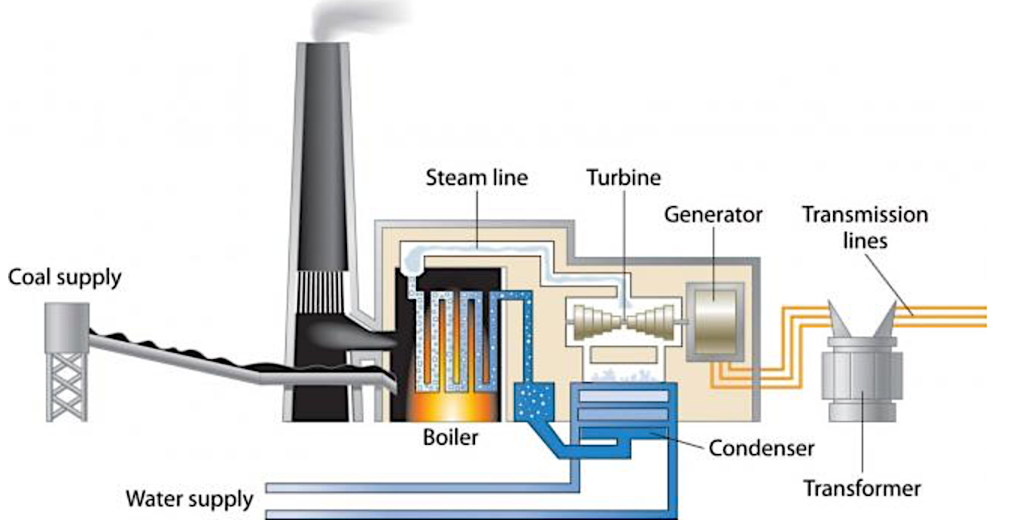
Coal-fired power station
Steam
Transformer
Generator
Condenser
HVAC Lines
Turbine
Component | Function

