Slide 1
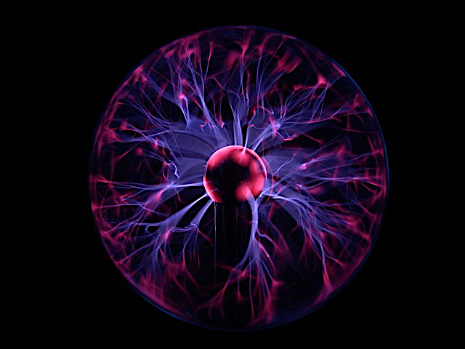
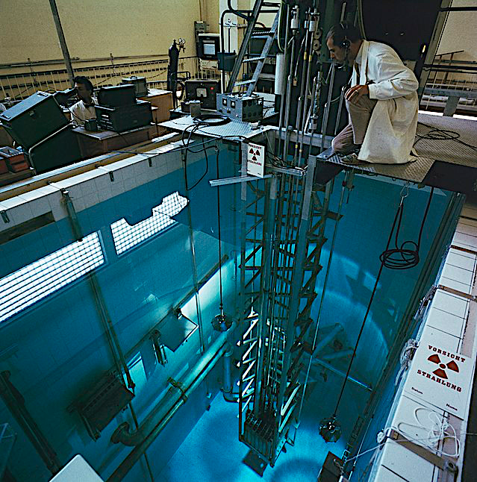
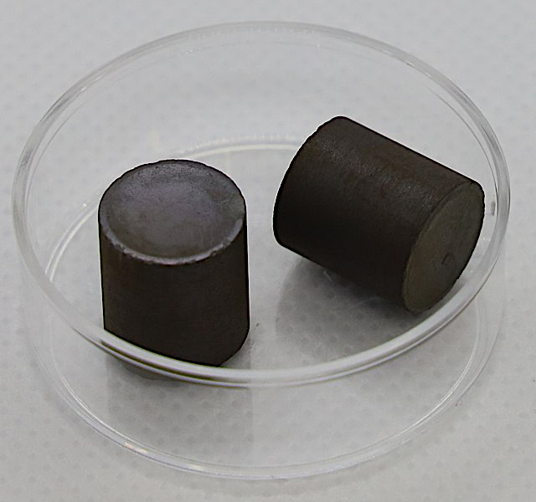
The power of the atom
Nuclear fission occurs when a large unstable nucleus of a uranium atom is bombarded by a neutron. This causes the nucleus to split and release other neutrons that then bombard other nuclei, causing them to split. The splitting of these nuclei releases vast amounts of energy. The growth in the chain reaction is very rapid. In each of the 2 million uranium pellets that are held in the reactor core, there are 5 million fission reactions per second. These many million reactions produce enormous quantities of thermal energy. The hot water from a pressurised nuclear reactor is at 300°celsius.
The moderator and the control rods
The reactor pool is just water. The water slows the reactions down so that the process can be controlled.
Another mechanism to control the reaction is the use of control rods – to soak up the excess neutrons being produced by the fission reactions.
The blue colour – Cherenkov Radiation – is due to radiation particles travelling faster than the speed of light.
Gravitational
field strength
10N/kg
Uranium dioxide
The pellets of uranium are 1cm in size and held in fuel rods in the reactor core. Uranium is a plentiful metal - as common as tin, it can even be found in seawater.
It is the instability of the uranium atom that creates the radioactivity – thermal energy. The problem of disposal of radioactive waste is solved by deep burial in sealed bunkers.

Slide 2
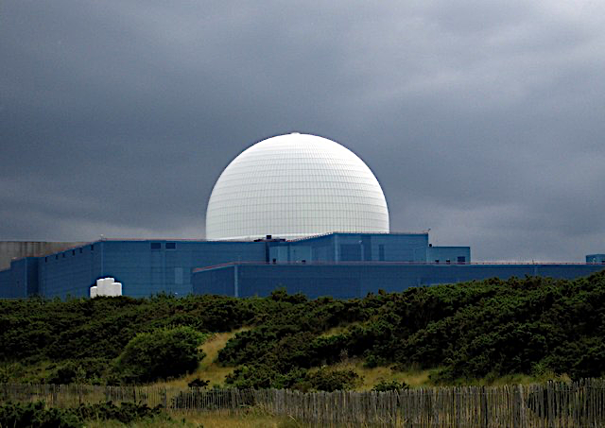
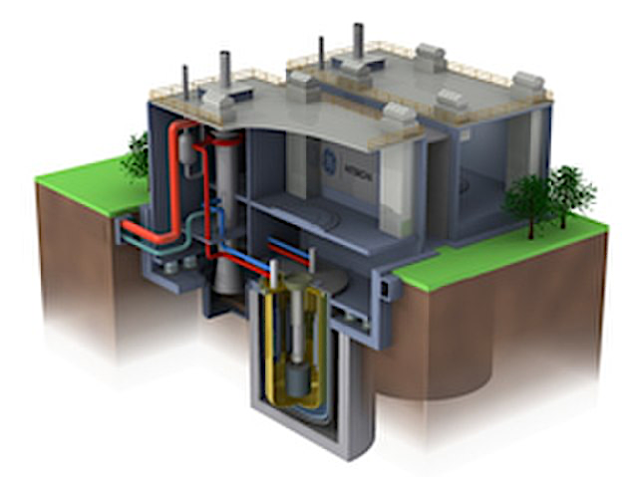
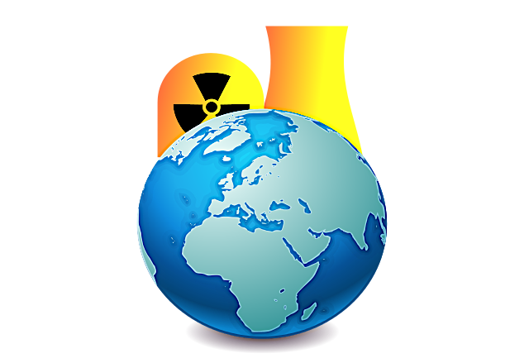
Practice
Nuclear power stations generate 10% of the world’s power. Uranium 235 is used as a fuel. Name another substance that is used. _____________________________________________________________________________________________
Why is nuclear energy defined as a low carbon resource? ________________________________________________________________________________________________________________________________________________________________________
Comparing energy produced from nuclear fission and wind, (a) which source is the more consistent, and why? (b) which source can respond to changes in demand day-to-day, and why? ______________________________________________________________________________________________________________________________________________________________________________________________
Inside a nuclear power station, water is heated to make steam. Explain how electricity is generated by the power station. ____________________________________________________________________________________________________________________________________________________________________________________________________________________________

Slide 3
Compare the resources
Research the various energy resources online. Make a table of advantages and disadvantages to help to inform a group discussion.
Resource | Advantages | Disadvantages
Nuclear
Fossil Fuels
Solar
Wind
Hydro
Geothermal
Biomass

