Slide 1

Mission Assignment: Explore different types of vegetable
EYFS-02-02
Draw the items that fit in these groups
fruit
vegetable
orange
green
Are there any which belong in more than one group?
2
Developing Experts Copyright 2024 All Rights Reserved

Slide 2
Mission Assignment: Explore different types of vegetable
EYFS-02-02
Draw or write the different ways you sorted your items
3
Developing Experts Copyright 2024 All Rights Reserved

Slide 3
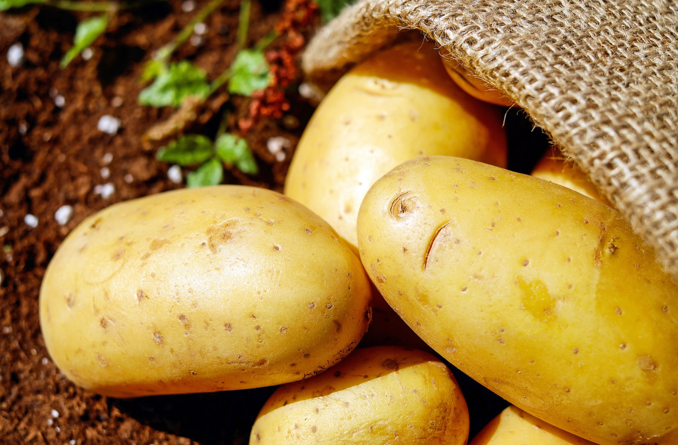
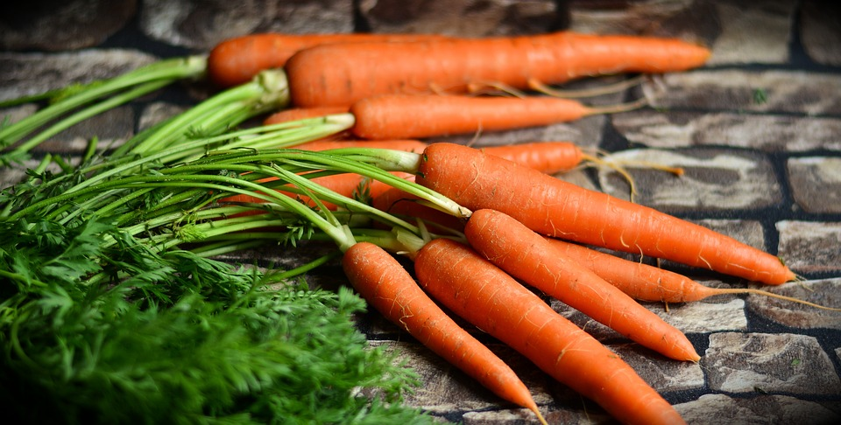
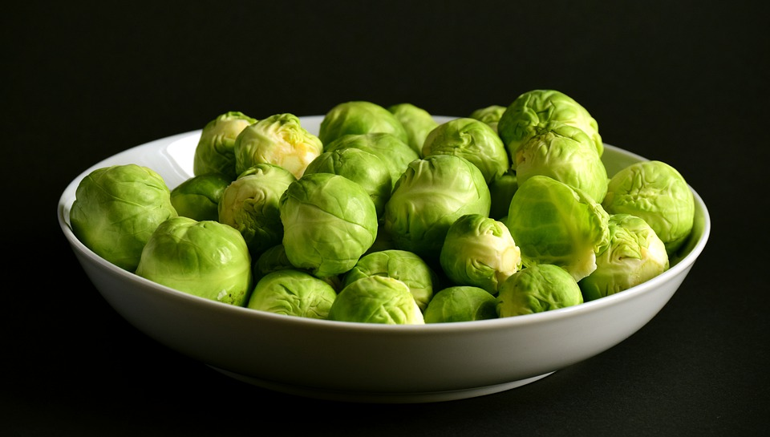
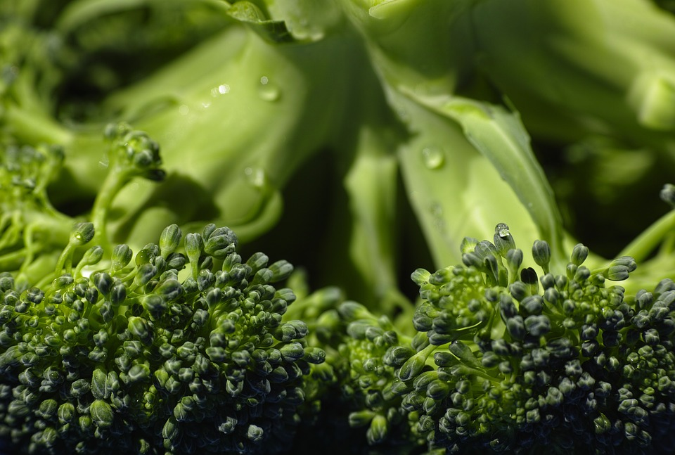
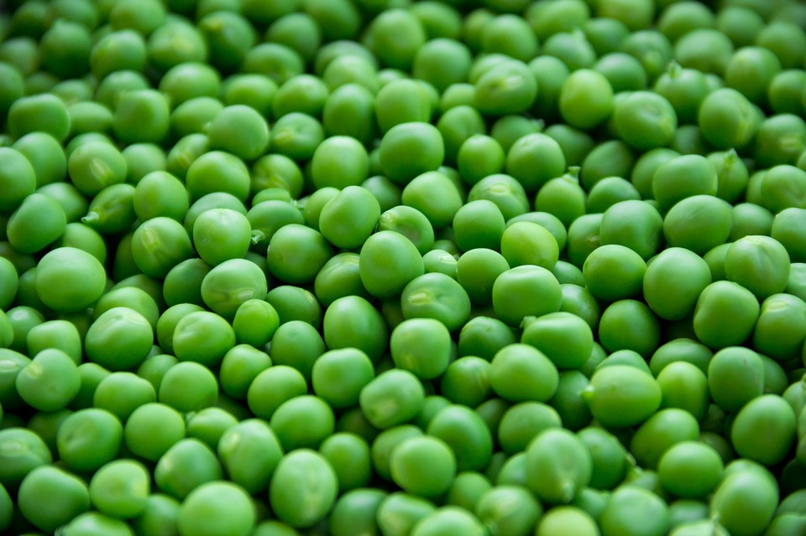
Mission Assignment: Explore different types of vegetable
EYFS-02-02
Label each vegetable by drawing a line from the word to the correct picture
peas
peas
peas
carrots
carrots
carrots
potato
potato
potato
sprouts
sprouts
sprouts
broccoli
broccoli
broccoli
2
Developing Experts Copyright 2024 All Rights Reserved

