Slide 1
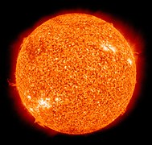
The Sun is powered by fusion reactions.
Each second more than 500 million tonnes of hydrogen fuse together to make helium and generates 400-million-million-million-million joules of energy per second.
Currently, we use fission reactions to generate energy in nuclear reactors.
Developing Experts All rights reserved © 2021

Slide 2
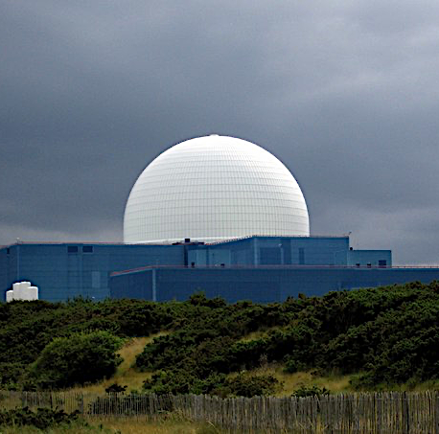
Explore nuclear energy
Describe how a nuclear power plant generates electricity.
Explain why nuclear power is important in electricity generation.
Discuss the advantages and disadvantages of using nuclear power to generate electricity.

Slide 3
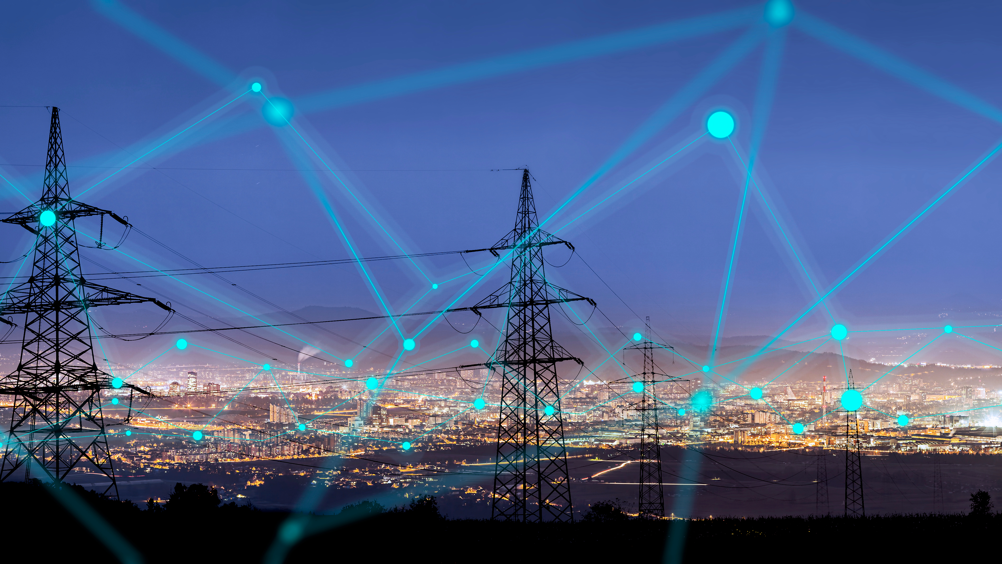
The UK has 9 nuclear reactors that together generate 5 GW of power into the UK grid.
Nuclear is a vital part of the energy mix in the UK.

Slide 4
Nuclear power is generated by splitting a large atomic nuclei of elements such as uranium.
This process is known as nuclear fission.
Fission also produces neutrons that can initiate further fission reactions. We call this a nuclear chain reaction.
Developing Experts All rights reserved © 2021

Slide 5
Inside a nuclear power station, nuclear chain reactions are carefully controlled by control rods.
Nuclear fission generates heat in the reactor that is used to turn water into steam. This steam drives a turbine that generates electricity.
This energy makes its way into homes and offices via the National Grid.
Developing Experts All rights reserved © 2021

Slide 6
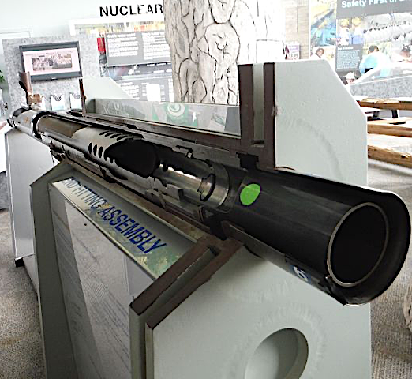
A nuclear fuel rod contains uranium pellets.
These rods are grouped together and suspended in the reactor core.
A neutron moderator slows down the neutrons, making fission reactions more likely. Moderators include water and graphite (carbon).
Developing Experts All rights reserved © 2021

Slide 7
The blue glow of a nuclear reactor is caused by Cherenkov radiation.
Control rods control the chain reaction and can be lowered further into the reactor to decrease its power output.
Control rods in = low power
Control rods out = high power

Slide 8
Nuclear energy: the pros and cons:
Pros -
Zero carbon emissions
Nuclear fuel produces one million times more energy than fossils fuels per kilogram of fuel
Nuclear is incredibly reliable compared to many renewables. It does not depend on the Sun shining (like solar power) or the wind blowing (like wind power)
Cons -
New power stations are expensive to build
Produces nuclear waste that must be reprocessed or stored for thousands of years
In the event of a natural disaster like a tsunami or an act of war there can be nuclear accidents
Developing Experts All rights reserved © 2021

Slide 9
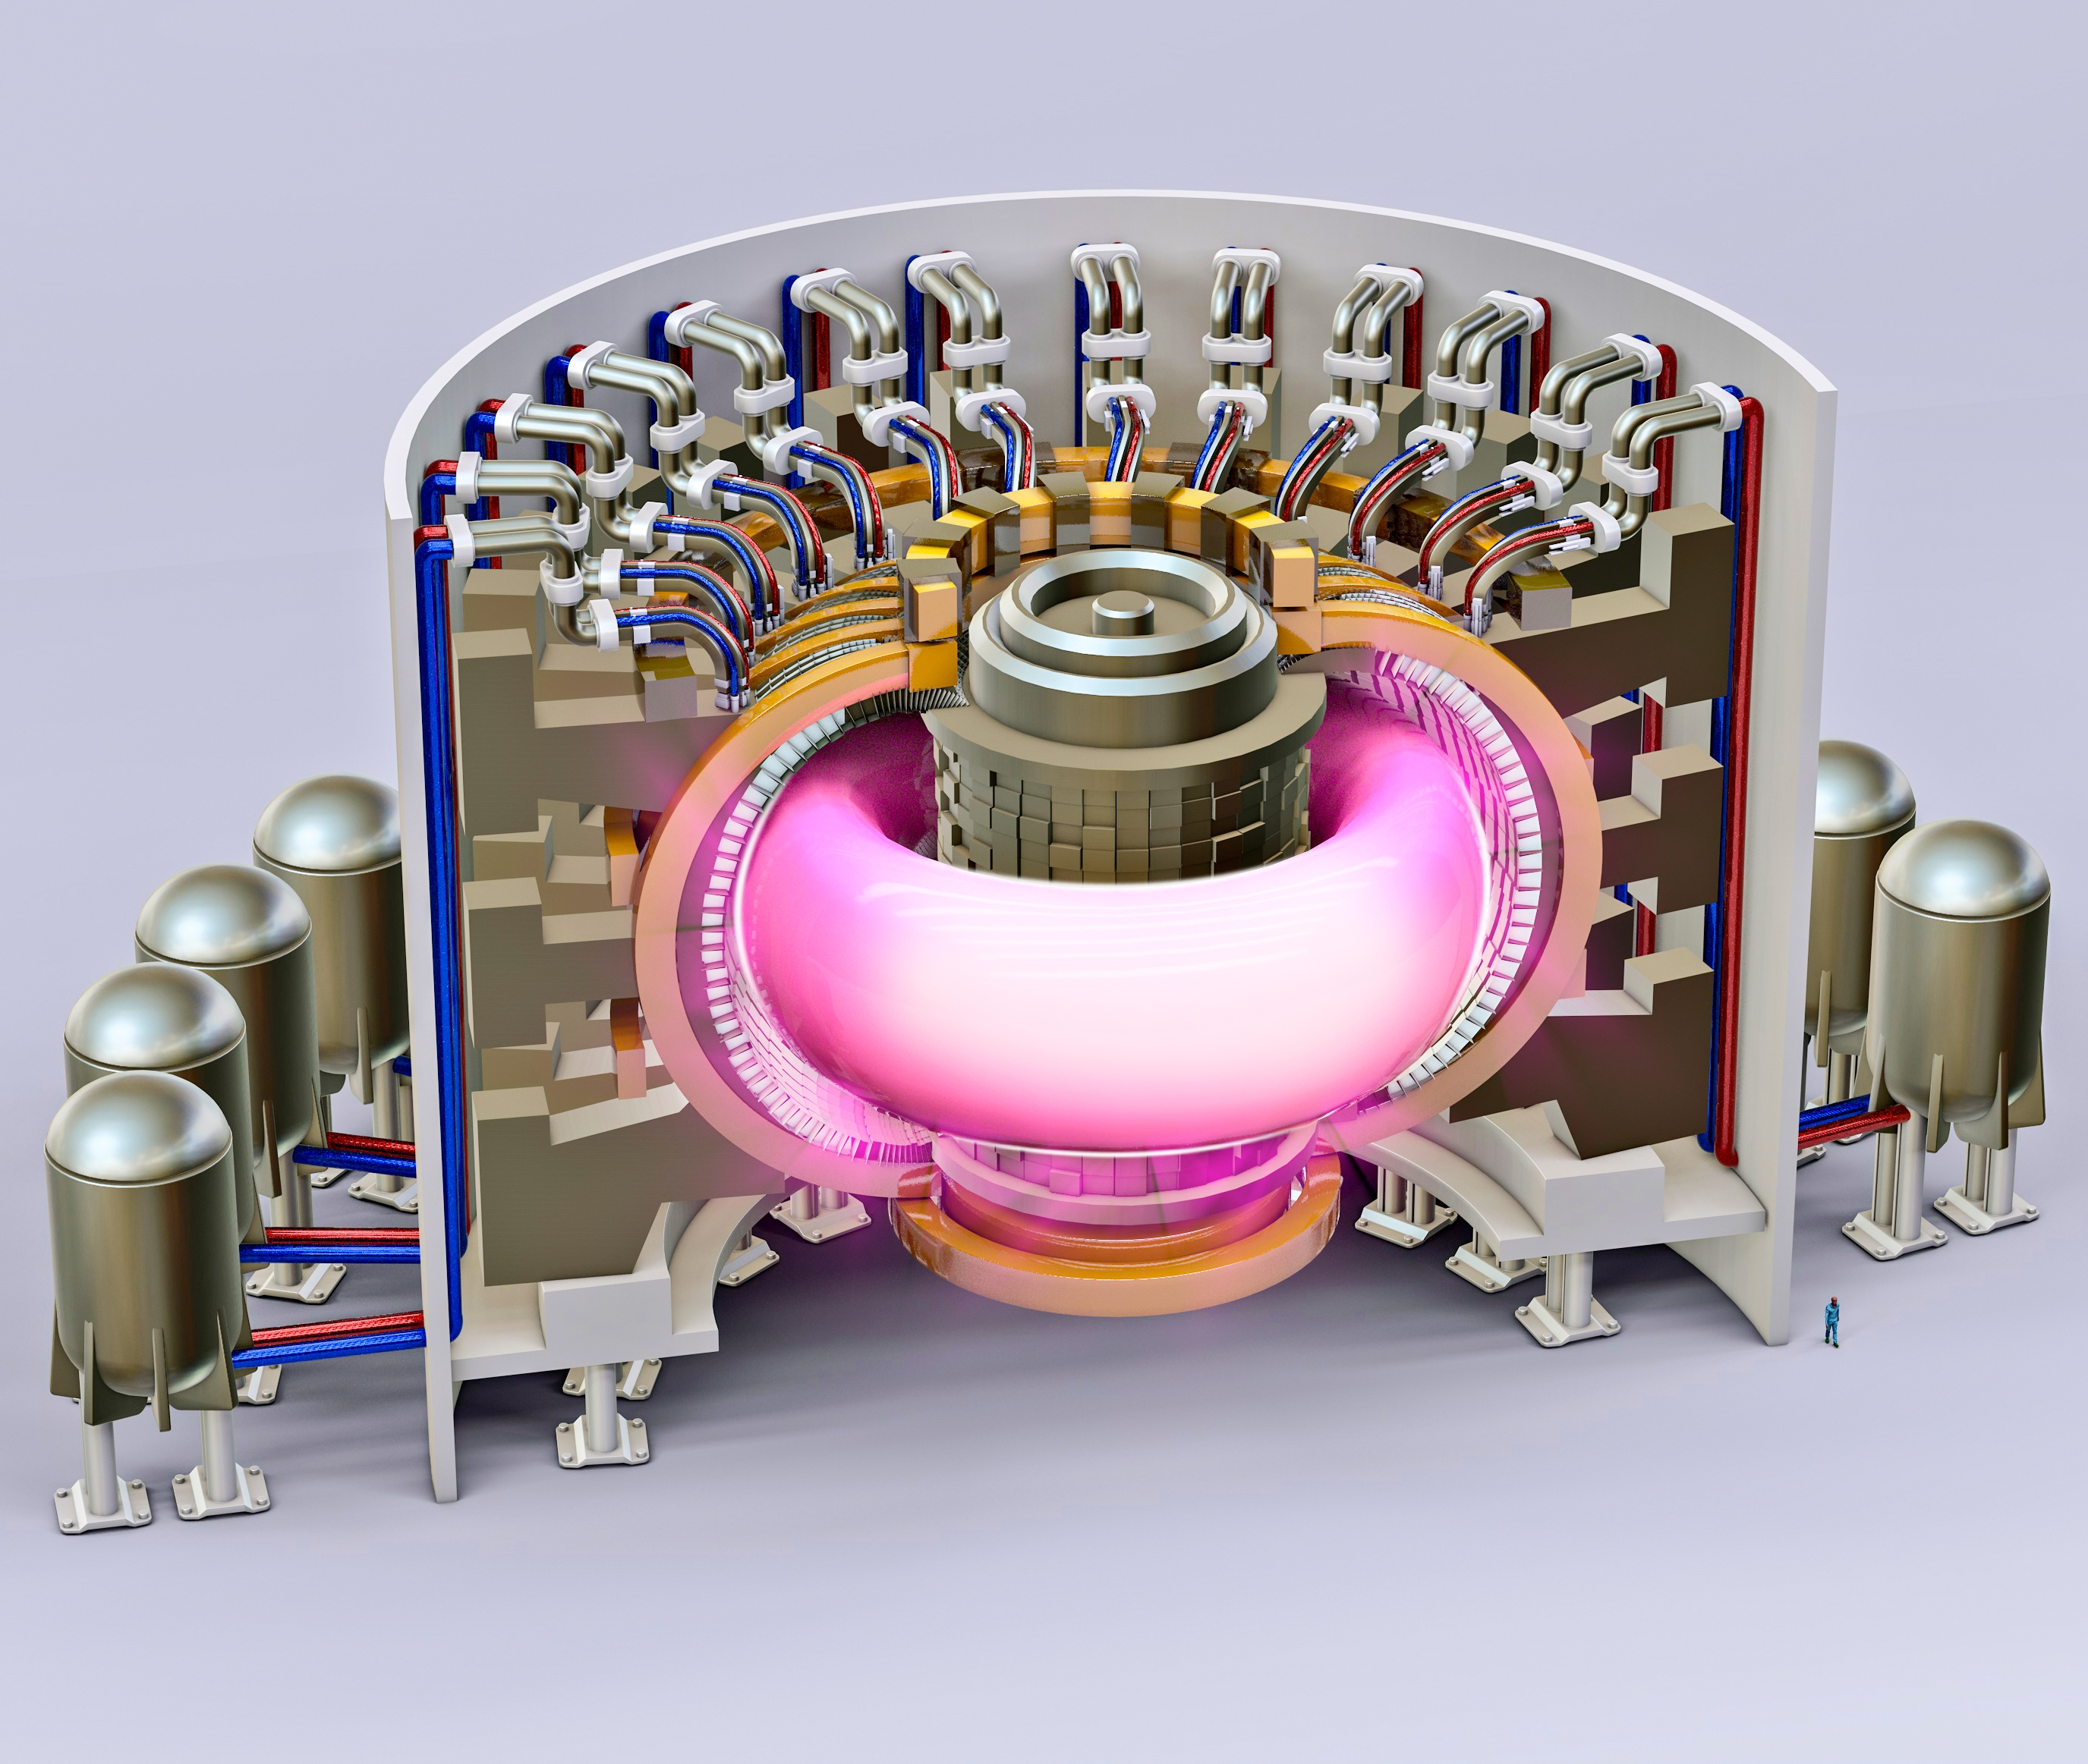
The ITER experiment in France is a prototype fusion reactor.
Dozens of countries around the world are working together to make fusion power a reality.
The test reactor will be switched on in 2025.
Developing Experts All rights reserved © 2021

