Slide 1
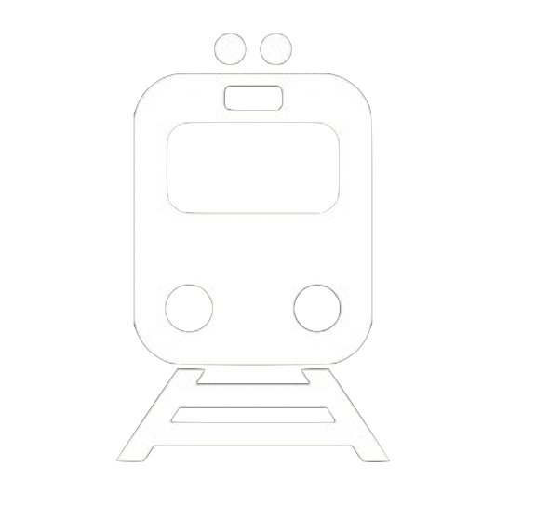
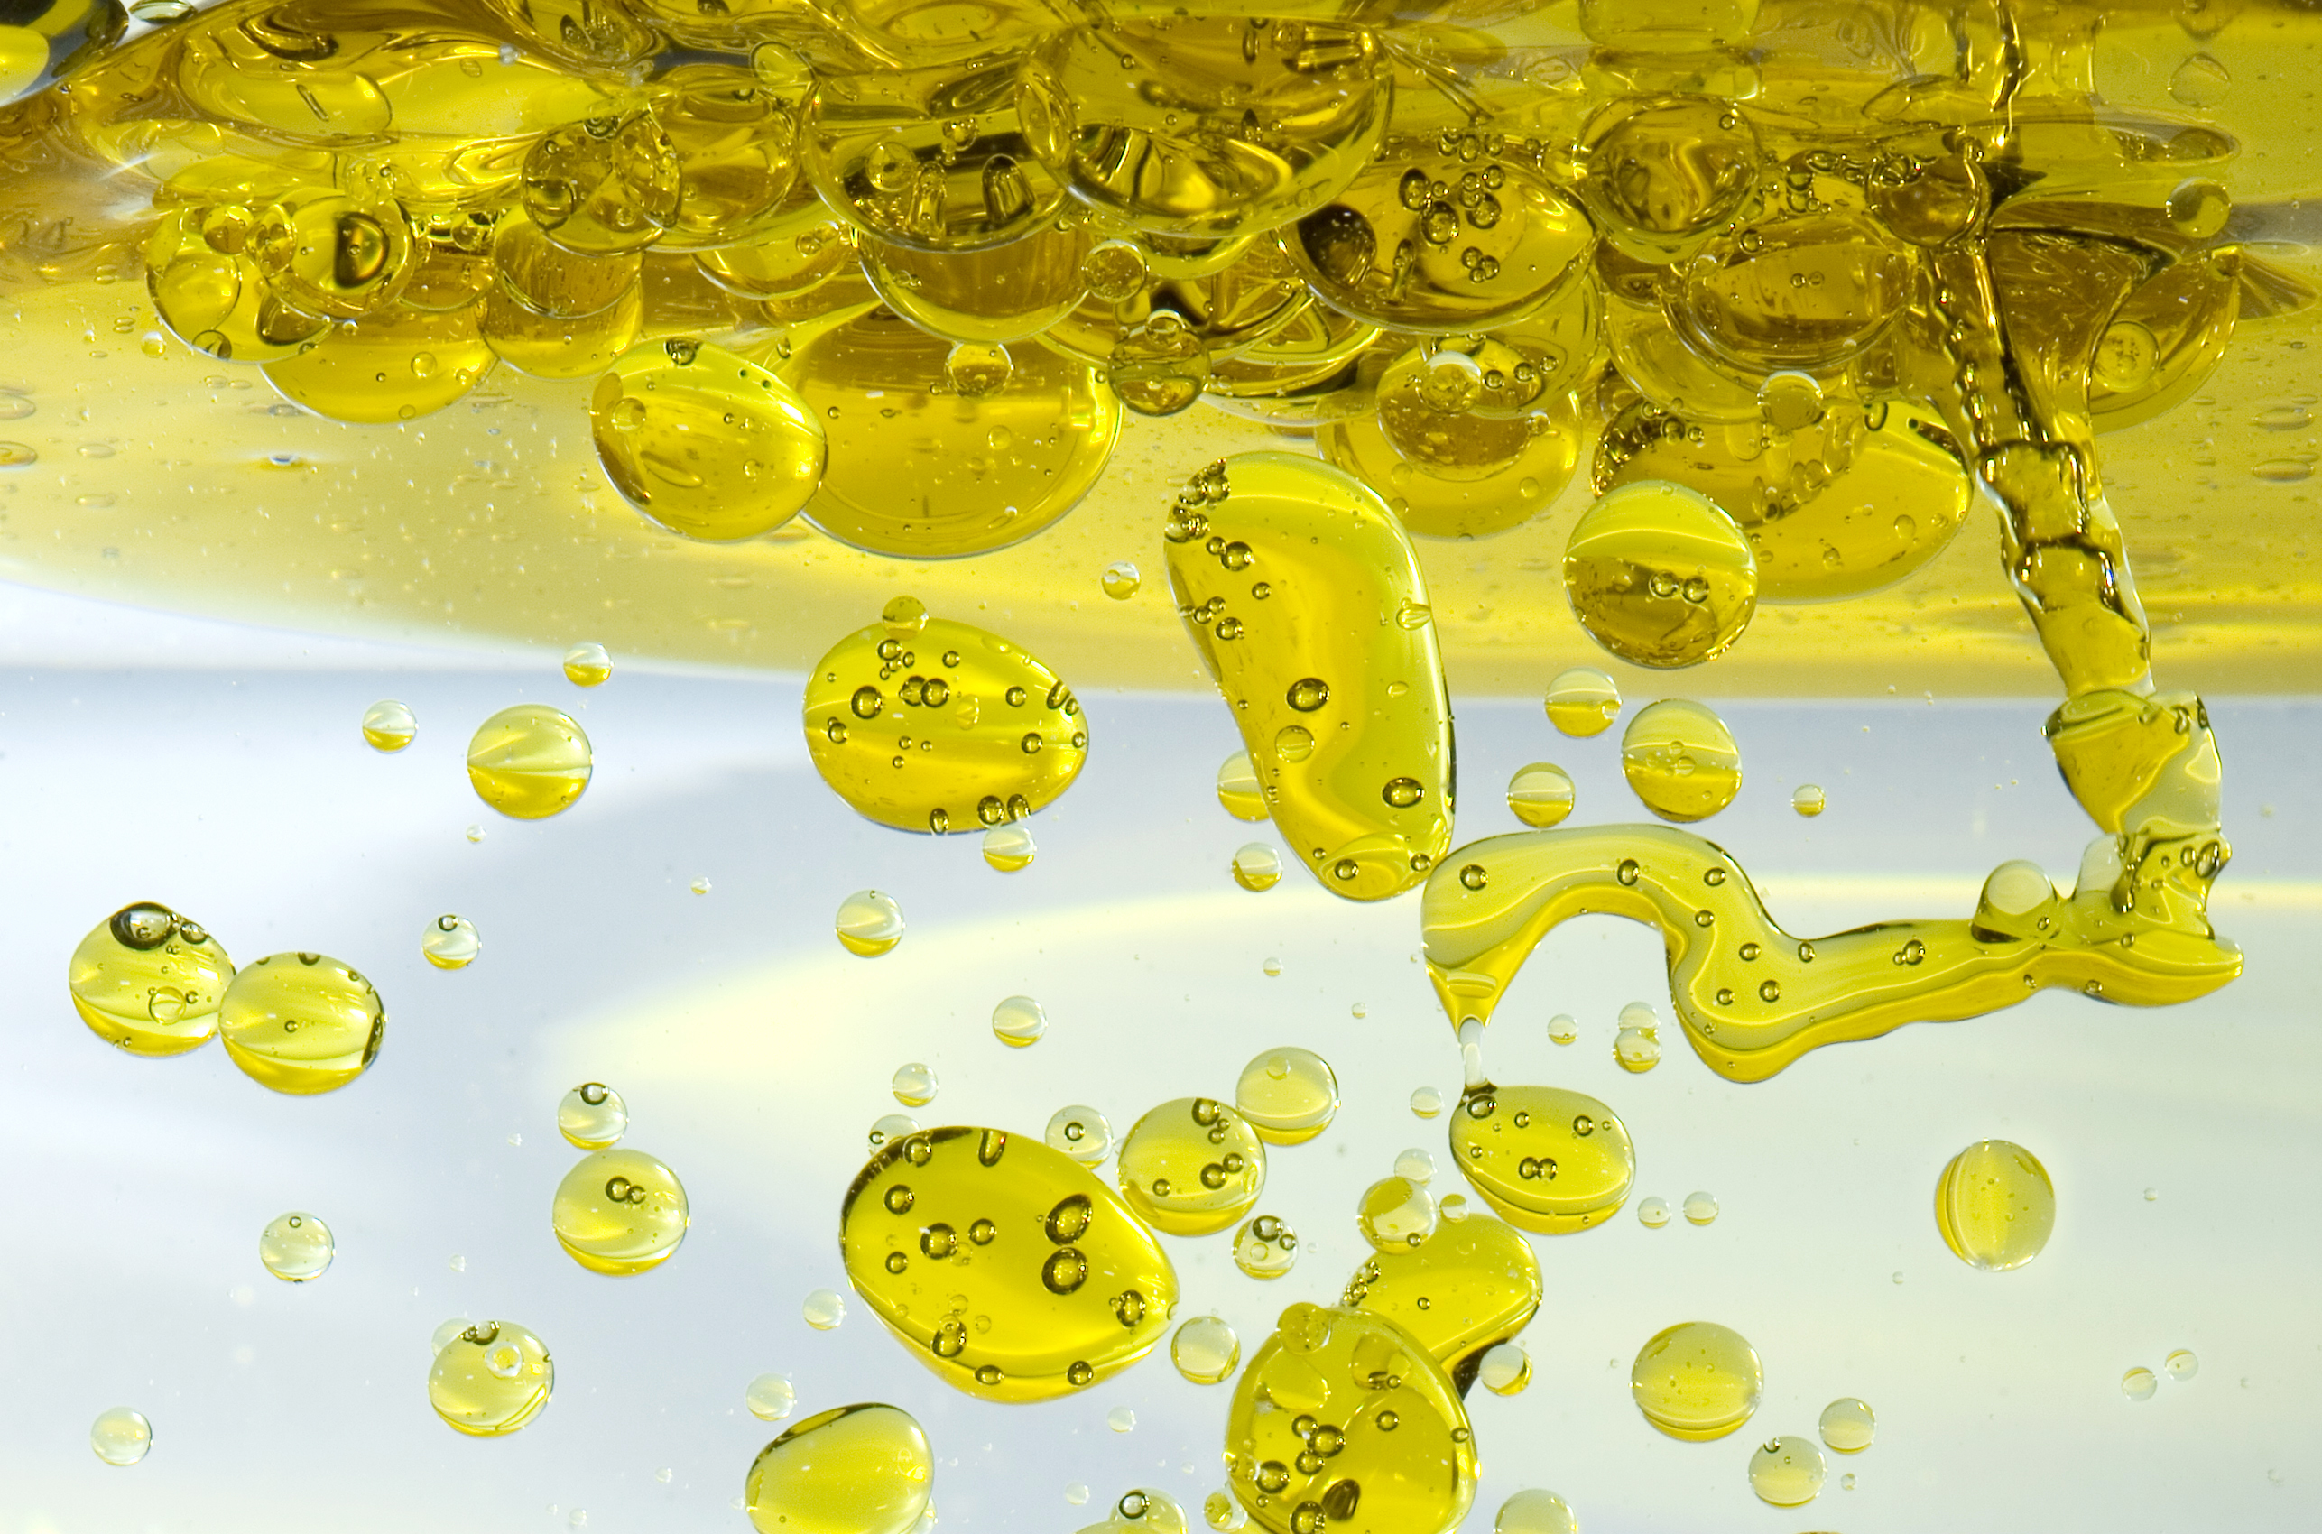
Mission Assignment: Discover how Grease is dealt with in Water
MA Code: N22.KS3.05
Investigate how oil and water behave when mixed
Equipment
Glass jam jars
Jug of water
Vegetable oil
Dishwashing detergent
Food colouring
Small container
Syringes or pipettes
Cloth
Table Salt
Method
Pour one cup of water into your glass jam jar.
Pour half a cup of vegetable oil on top of the water in the jar.
Stop and observe. Does the oil mix with the water? Screw the lid onto the jar and shake it. Can you make the oil and water mix? Is the vegetable oil more or less dense than the water?
Stretch
If you would like to see a different reaction, try pouring a teaspoon of salt into the mixture and watch what happens.
Mix a generous squirt of dishwashing detergent with some food colouring in the separate small container.
Using a syringe squirt some coloured detergent into your oil and water filled jar.
Watch what happens, you should see a lava lamp like affect with bubbles of colour falling through the mixture. Repeat this progress as many times as you like.
To consider:
How will you dispose of these liquids without polluting?
Developing Experts Copyright 2022 All Right Reserved

