Slide 1
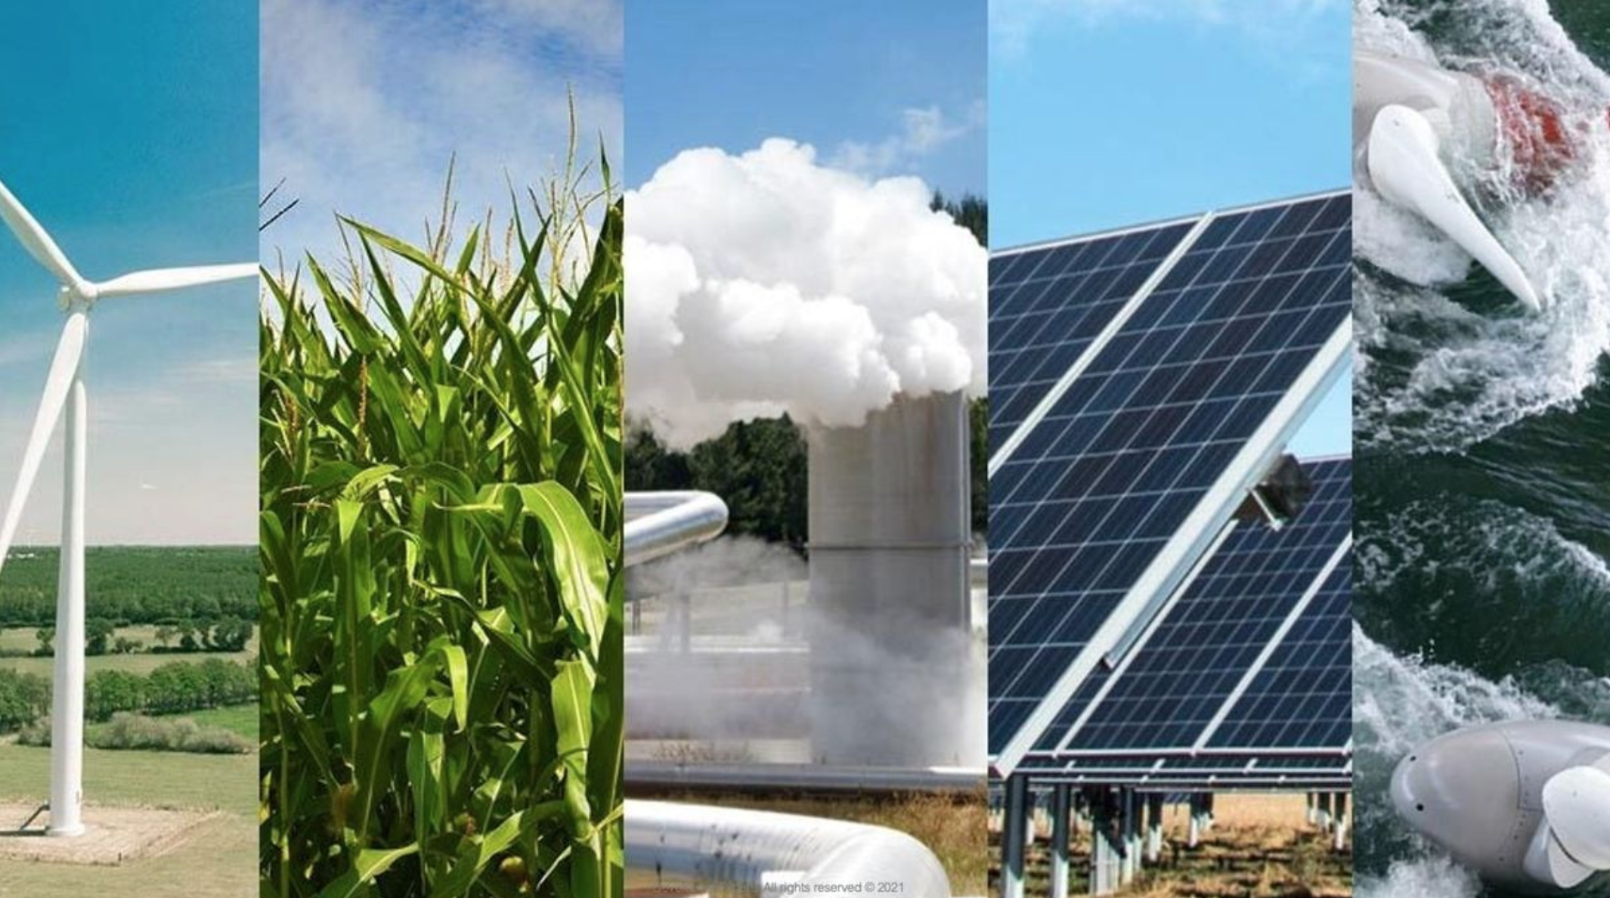
Developing Experts All rights reserved © 2021

Slide 2
Energy Resource
Wind
Biofuel
Geothermal
Hydroelectric
Solar
Disadvantages
Expensive to set up and wind does not always blow
Expensive and uses lots of land
Very expensive to set up and only works in certain places.
Expensive to set up and output could be affected by drought
Not always sunny and output does not always outweigh initial cost to set up

Slide 3
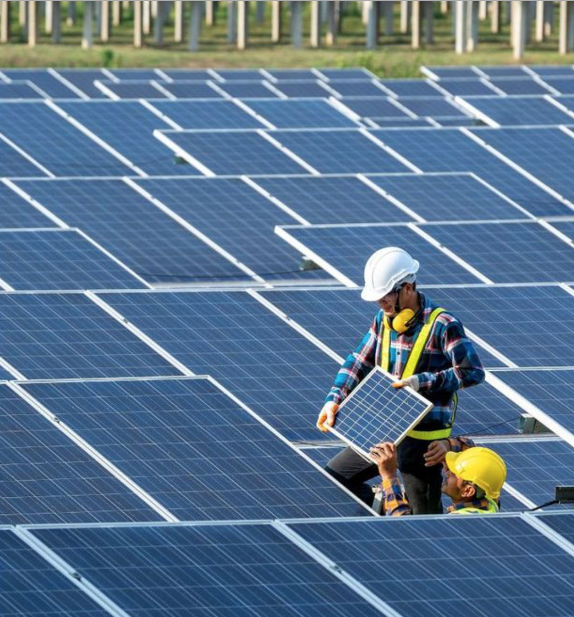
Explore renewable energy resources
Define a renewable energy resource.
Name some renewable energy resources.
Describe the environmental impact of using some renewable energy resources.
Compare renewable and non-renewable energy resources.
Evaluate the scientific, environmental, social, ethical and economic considerations when using renewable energy resources.
Developing Experts All rights reserved © 2021

Slide 5
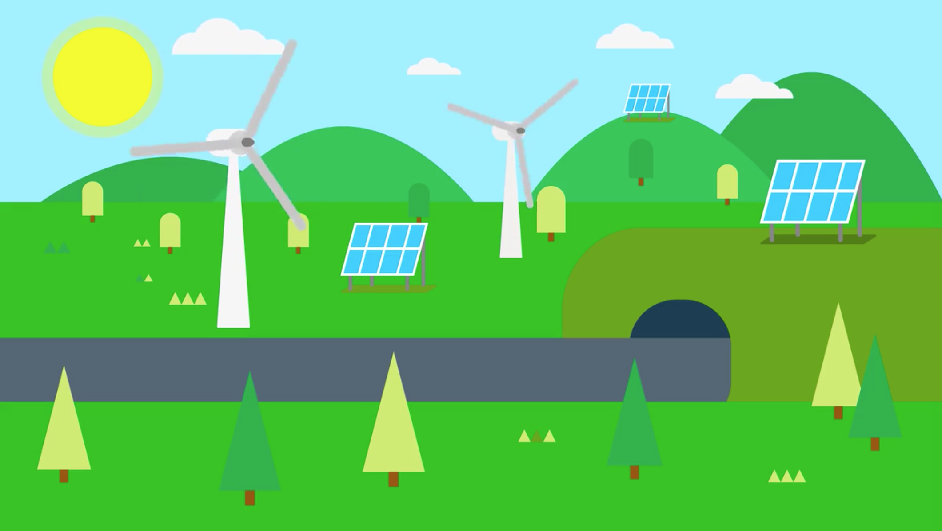

Slide 6
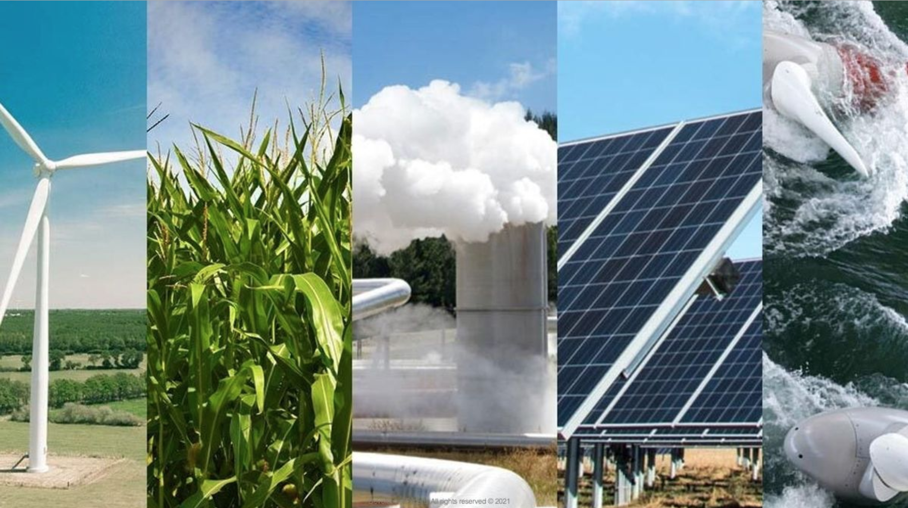

Slide 7
They’ll never run out; they are constantly being replenished.
Once a renewable energy source is in place, they do not add any carbon dioxide to the atmosphere; they do not contribute to climate change.

Slide 8
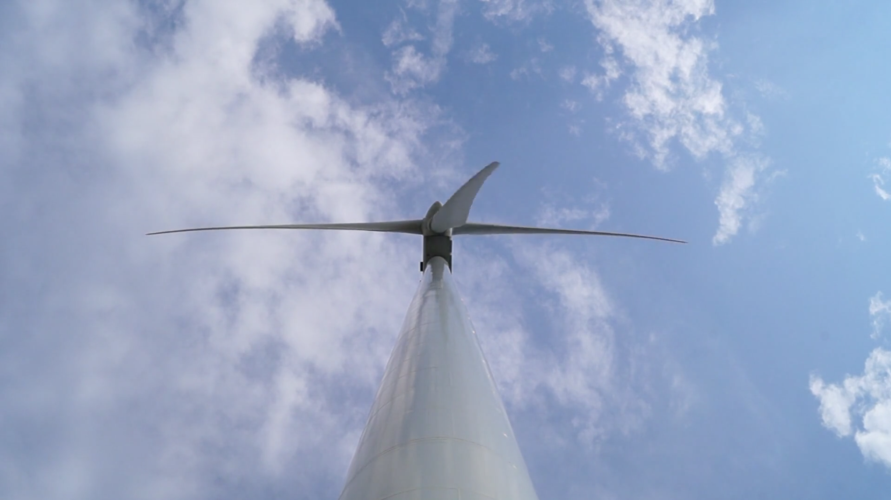

Slide 9
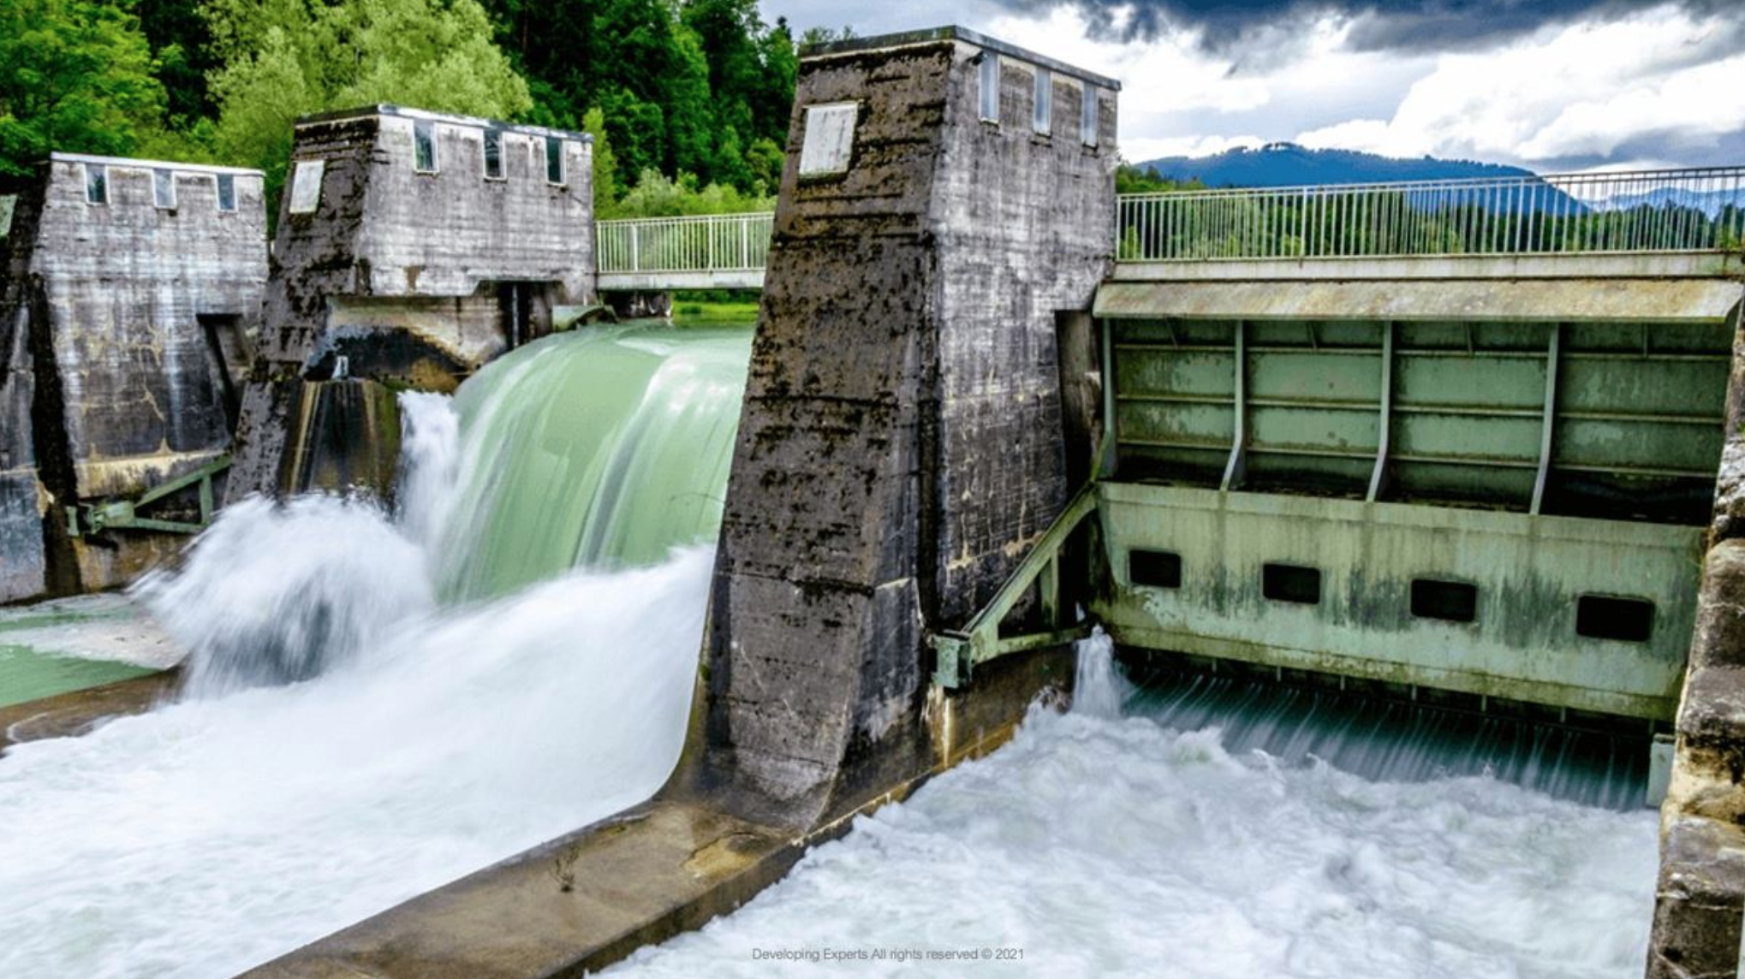

Slide 10
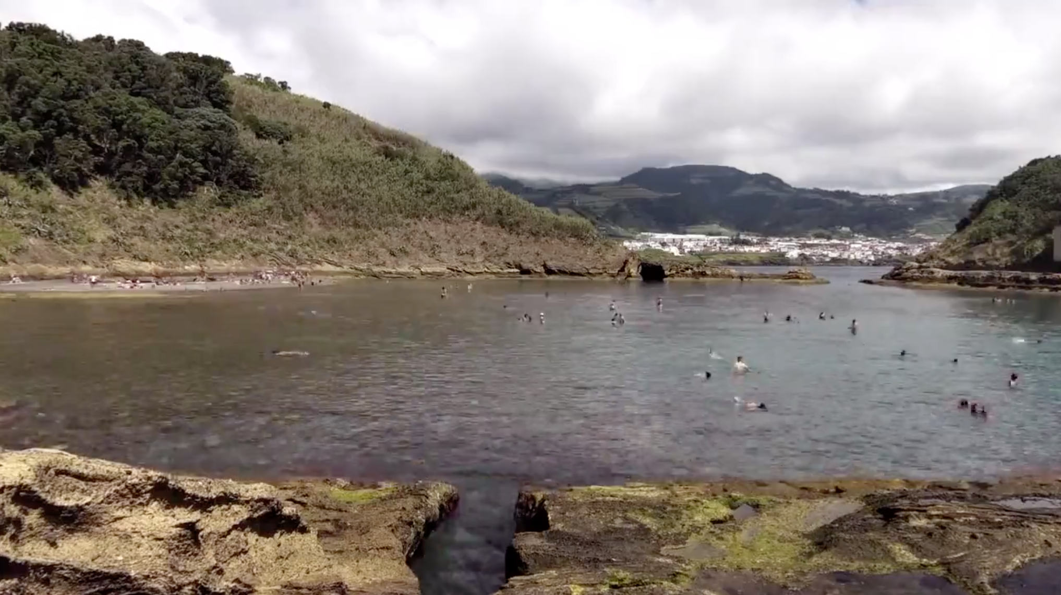

Slide 11
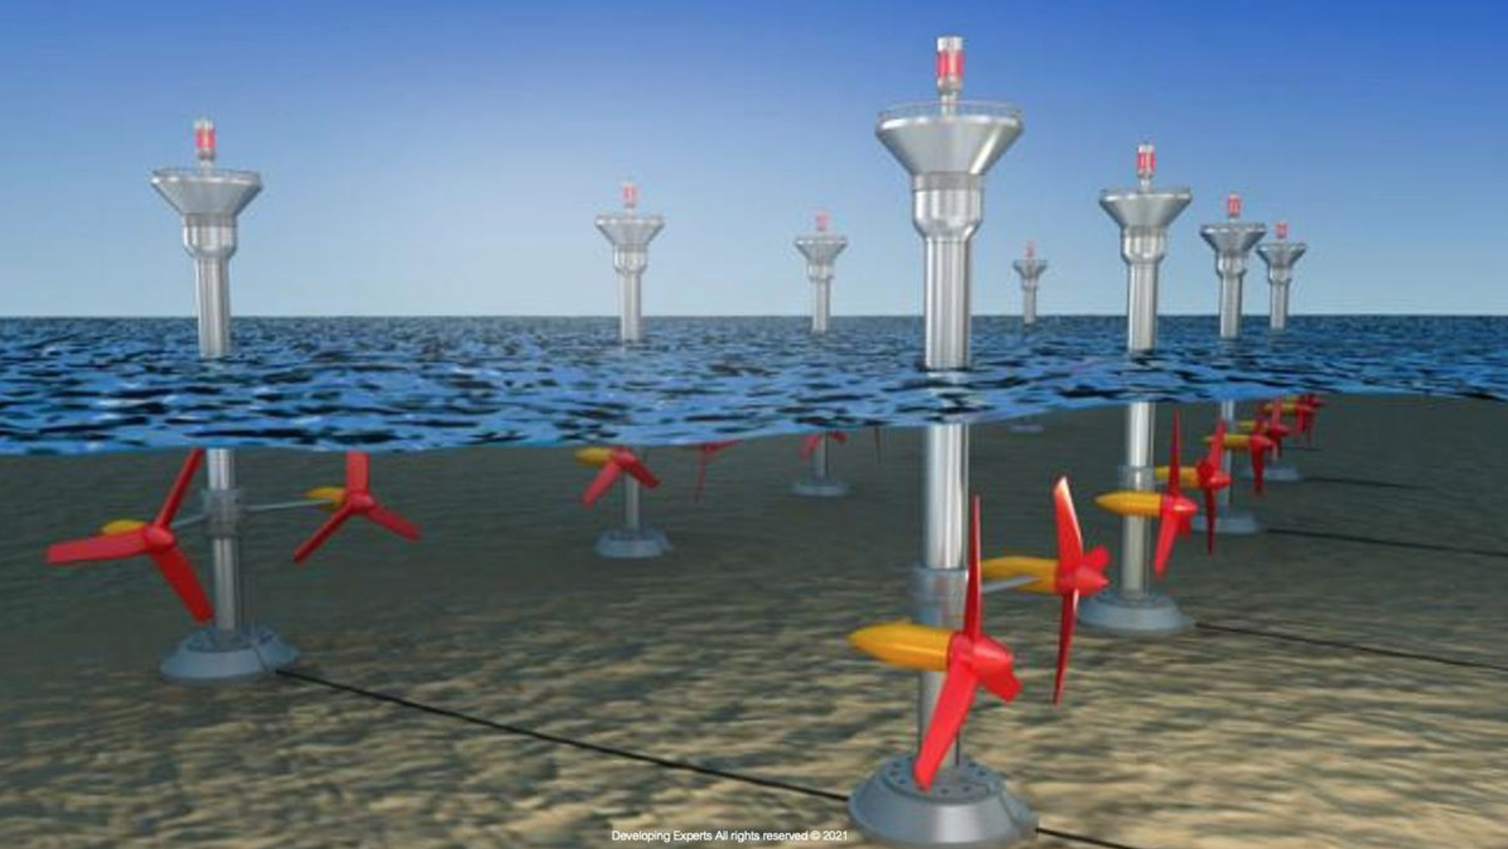

Slide 12
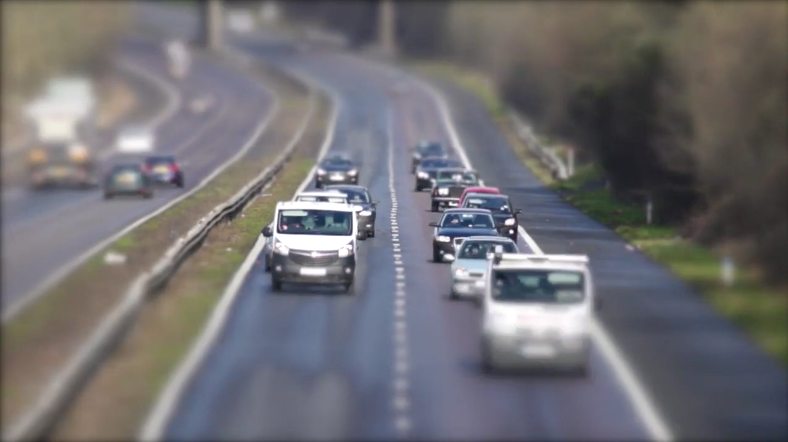

Slide 13
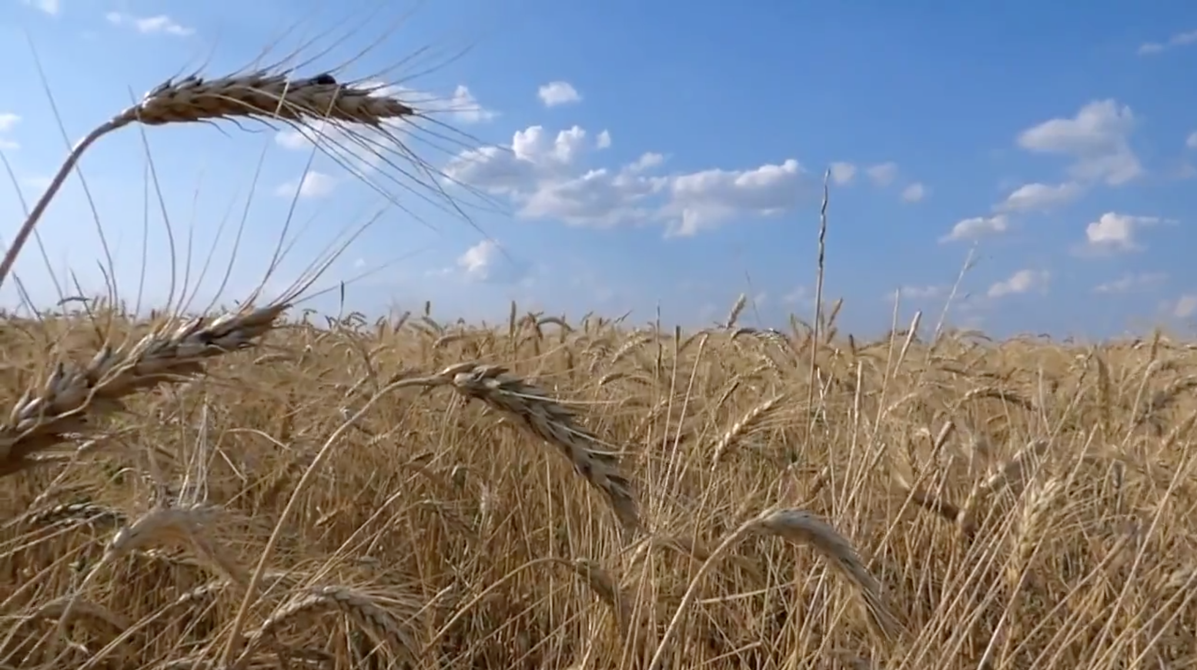

Slide 14
