Slide 1
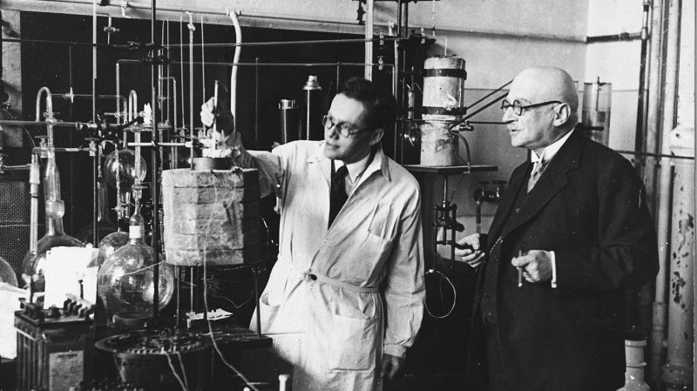
Why do some argue that the Harber process is fundamentally the most important invention of all time?
Developing Experts All rights reserved © 2021

Slide 2
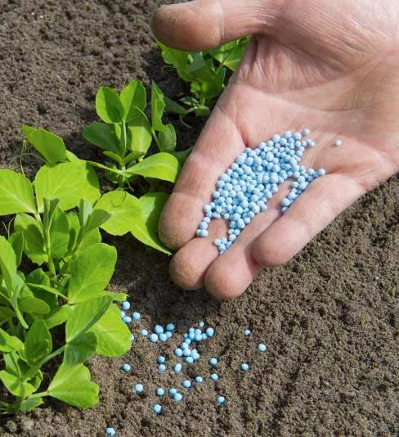
Explore making fertilisers in the lab and in industry
State the elements in NPK fertilizers.
Describe how the compounds and NPK fertilizers are produced.
Compare the industrial production of fertilizers with their production in a lab.
Developing Experts All rights reserved © 2021

Slide 3
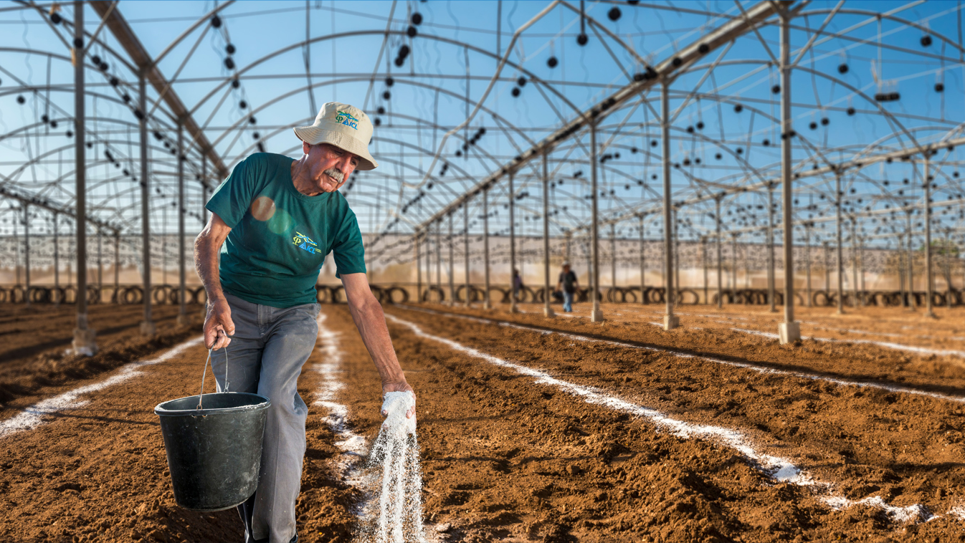
NPK fertilisers contain compounds of nitrogen, phosphorus, and potassium.
Developing Experts All rights reserved © 2021

Slide 4
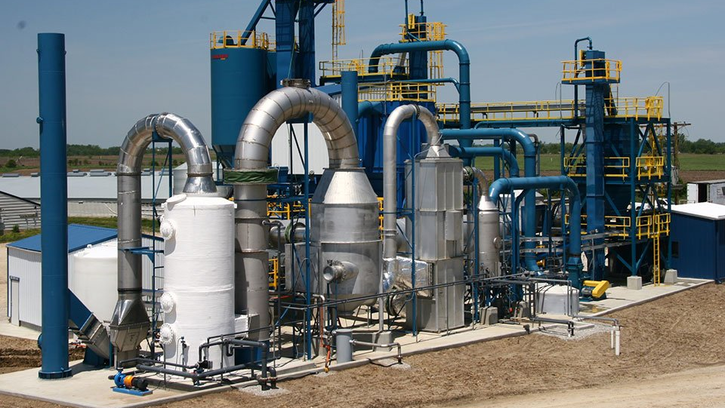
Developing Experts All rights reserved © 2021

Slide 5
NPK fertilisers is ammonium nitrate its formula is NH4NO3.
To make this, we use ammonia which is produced by the Harber process.
Developing Experts All rights reserved © 2021

Slide 6
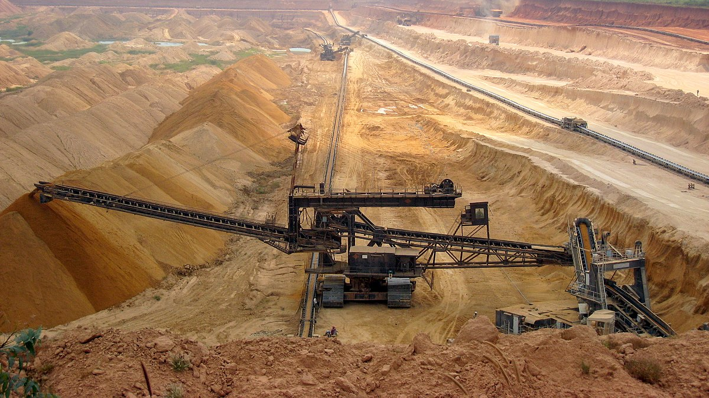
Developing Experts All rights reserved © 2021

Slide 7
Treating phosphate rock with nitric acid produces phosphoric acid and calcium nitrate.
Phosphoric acid contains phosphorus, but we cannot add this directly to plants, so we neutralise it with ammonia.
This produces ammonium phosphate and that can be used in NPK fertiliser.
Developing Experts All rights reserved © 2021

Slide 8
If we treat phosphate rock with sulfuric acid, then we make a mixture of calcium phosphate and calcium sulfate.
This mixture is called single super phosphate.
This can use this in NPK fertilisers.
Developing Experts All rights reserved © 2021

Slide 9
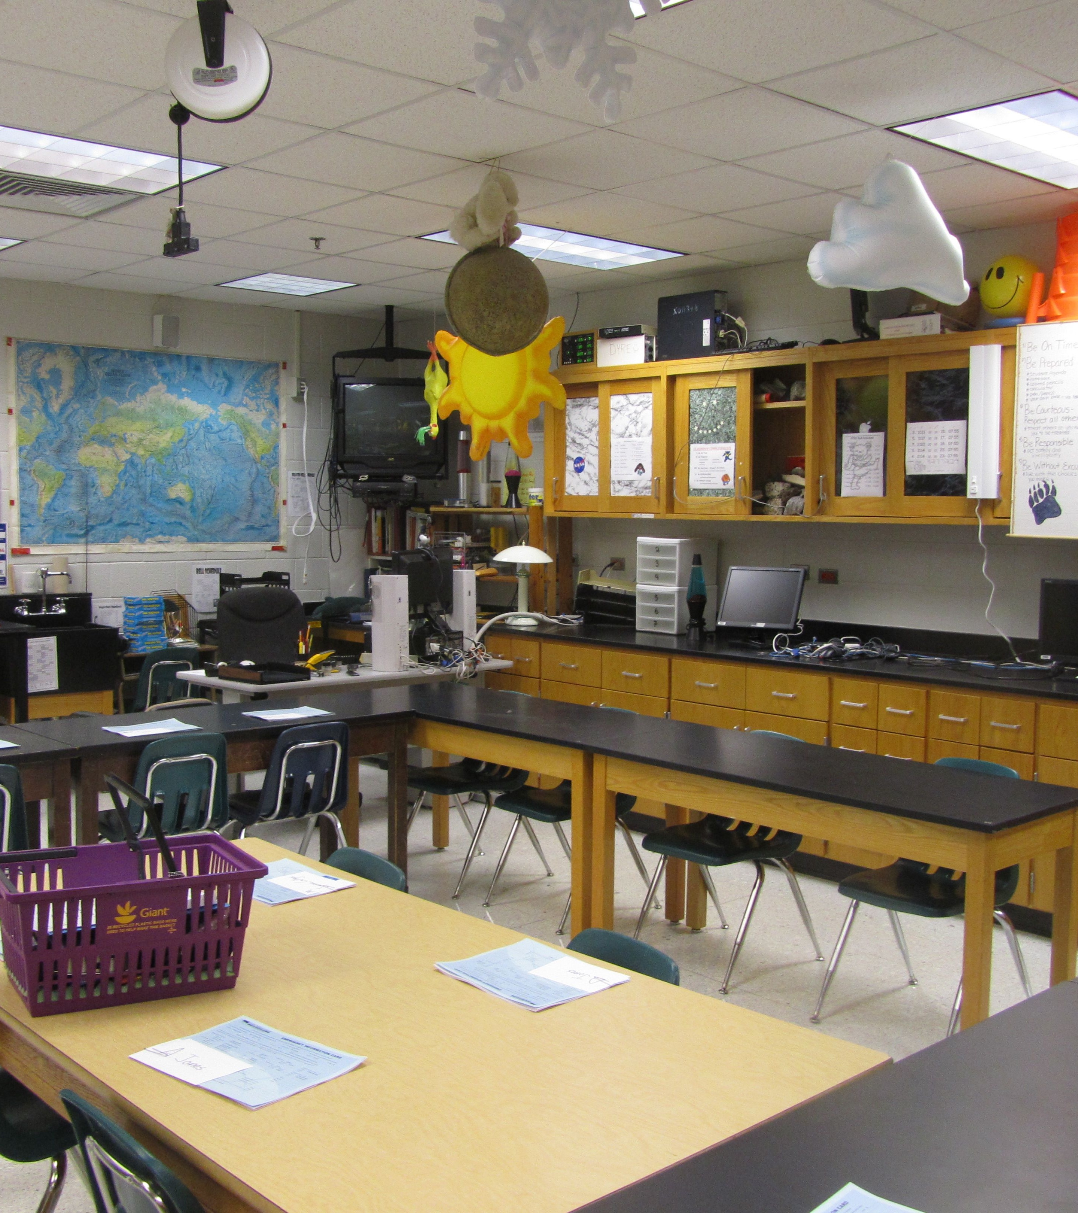
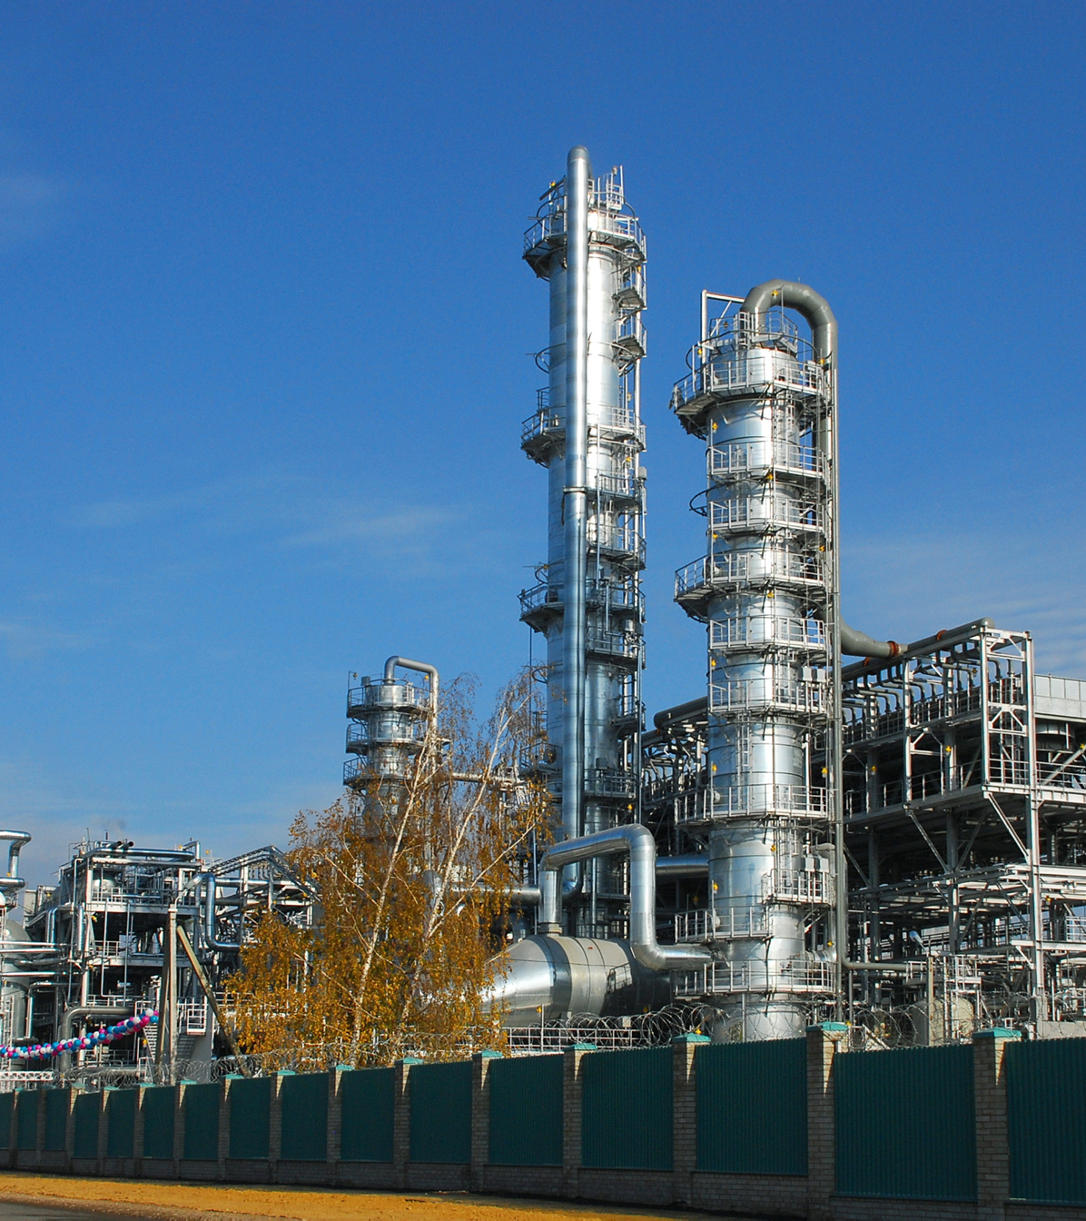
School Lab
We would use dilute solutions of ammonia on nitric acid, that's to make them safe to work with.
Industry
The ammonia would be used as a gas and the nitric acid will be concentrated.
This is much more dangerous, as the reactions very exothermic.
This means that the heat produced has to be safely removed. This heat is then used in later stages.
Developing Experts All rights reserved © 2021

Slide 10
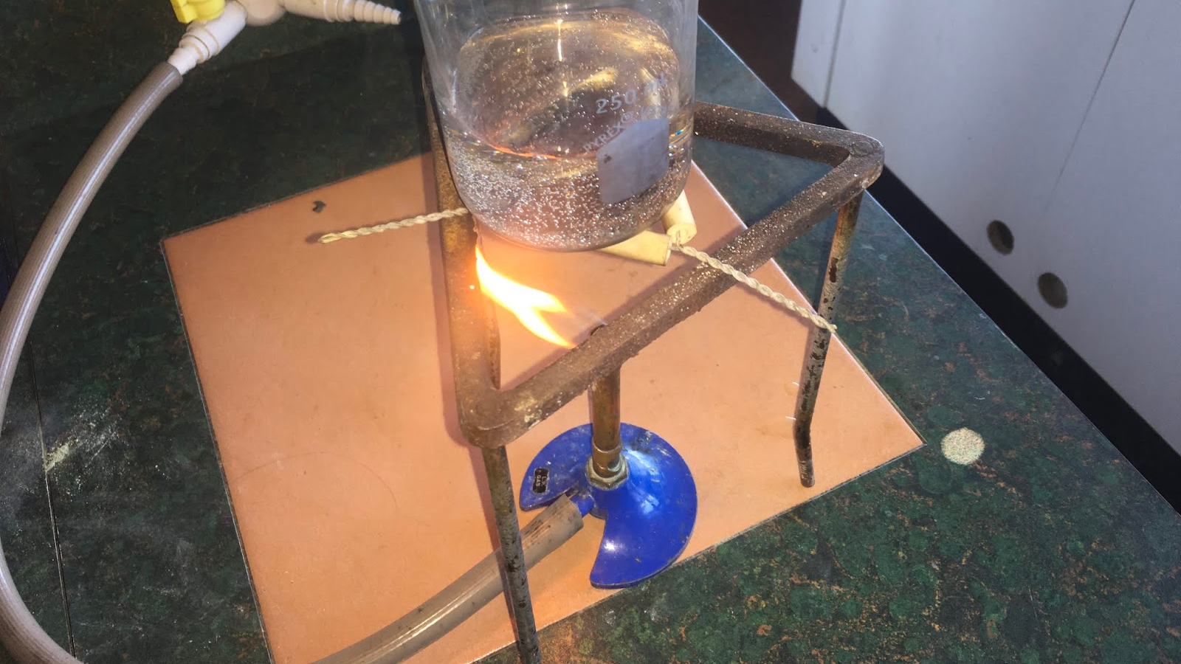
In the lab we can only produce a small amount of ammonium nitrate in one go. This is called a batch process.
Developing Experts All rights reserved © 2021

