Slide 1
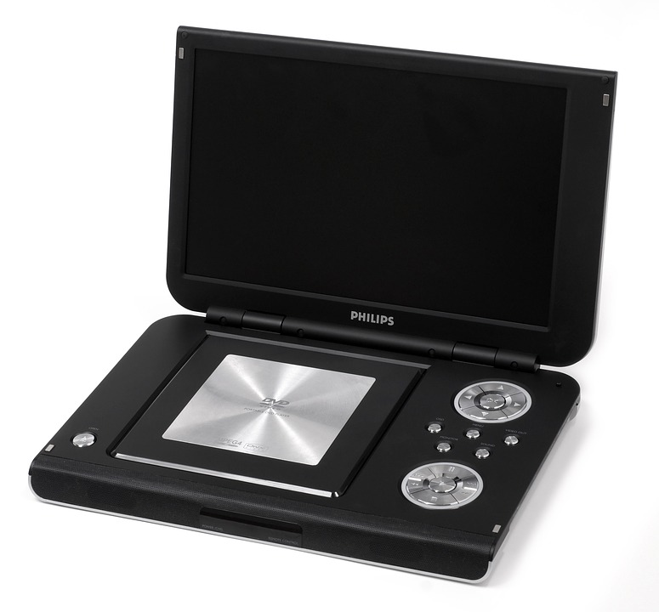
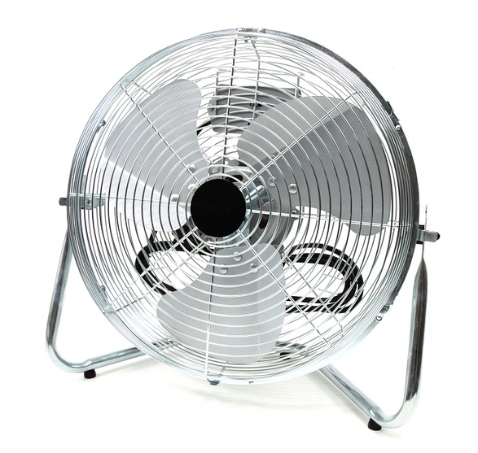
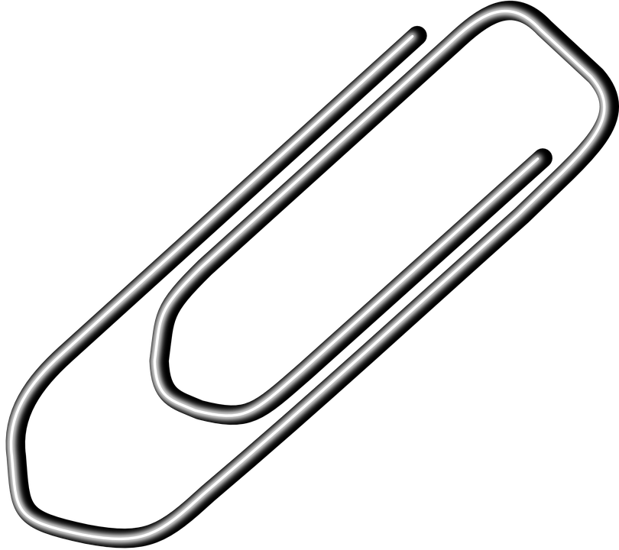
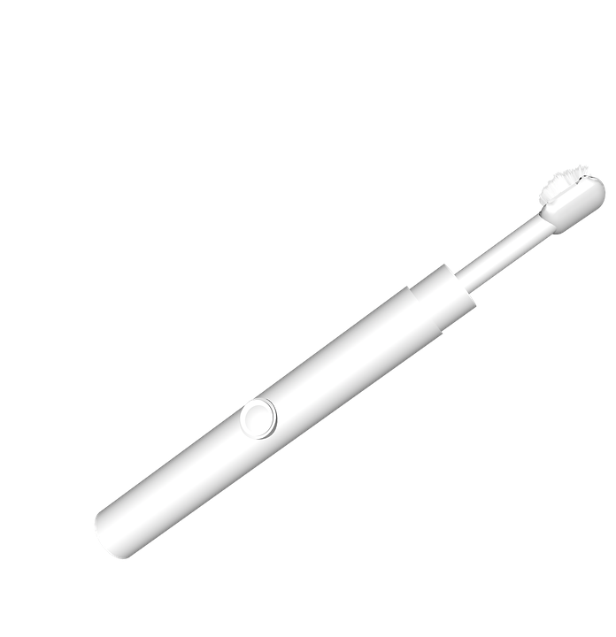
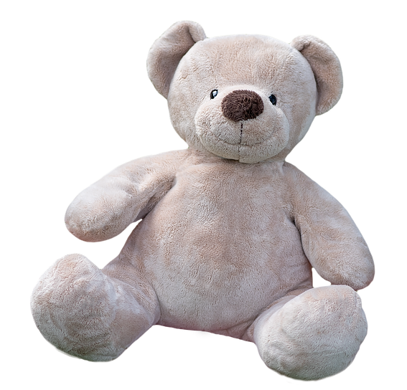
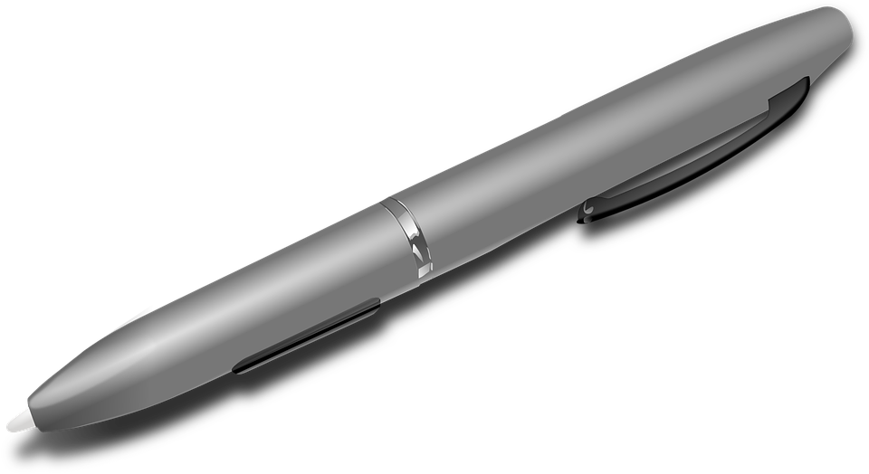
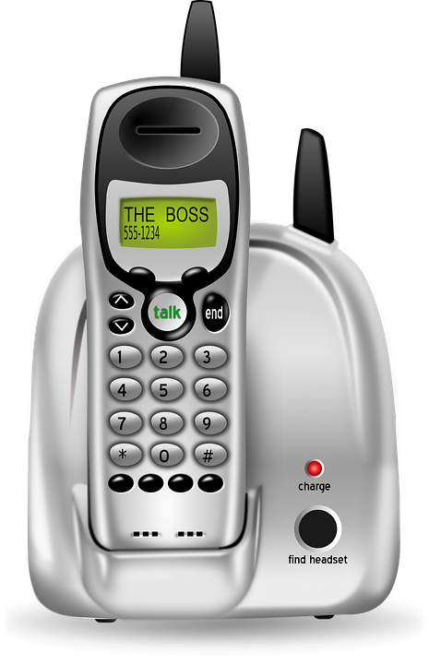
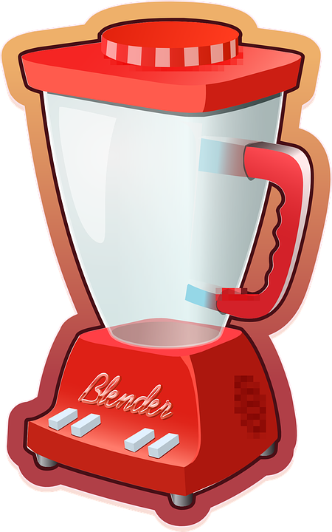
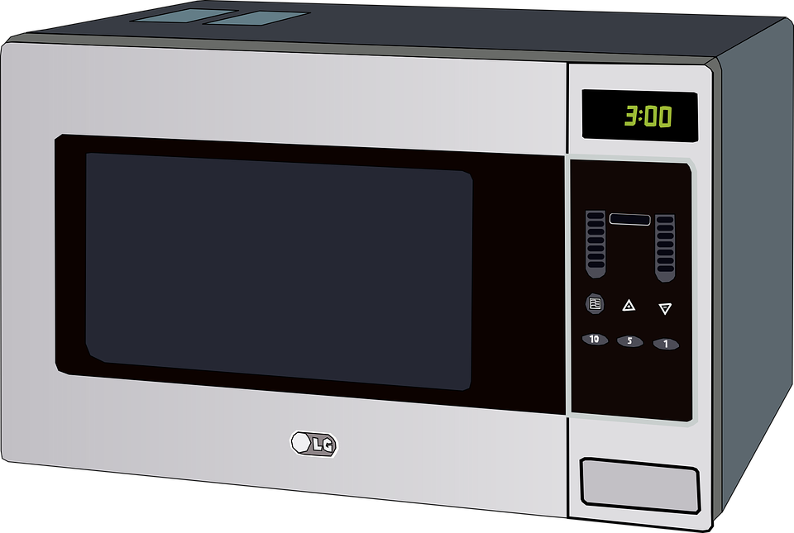
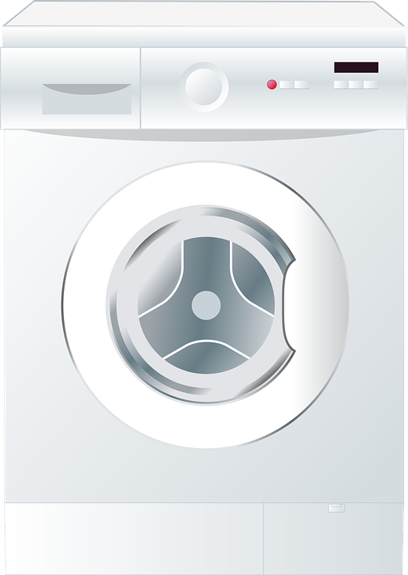
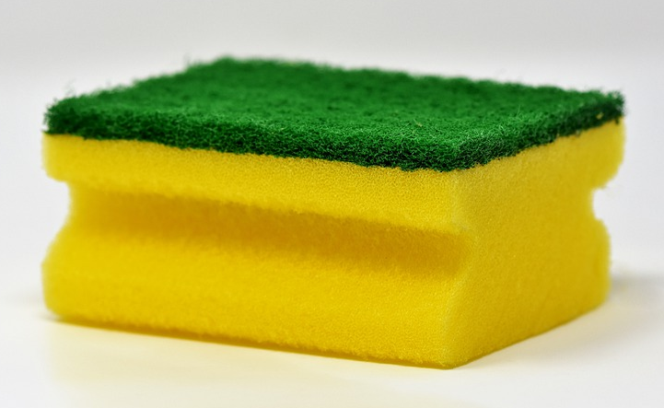
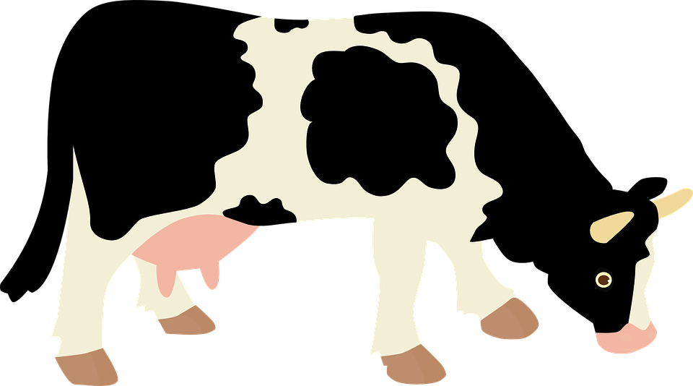
Magnets are found in lots of every objects.
Circle the objects below that contain a magnet.
books | DVD player | fan | paperclip
teddy bear | electric toothbrush | pen | screw
phone | blender | whiteboard | clock
lamp | microphone | microwave | headphones
washing machine | sponge | hammer | cow
Hint: objects that contain a motor, make sounds or record sounds contain a magnet.

Slide 2
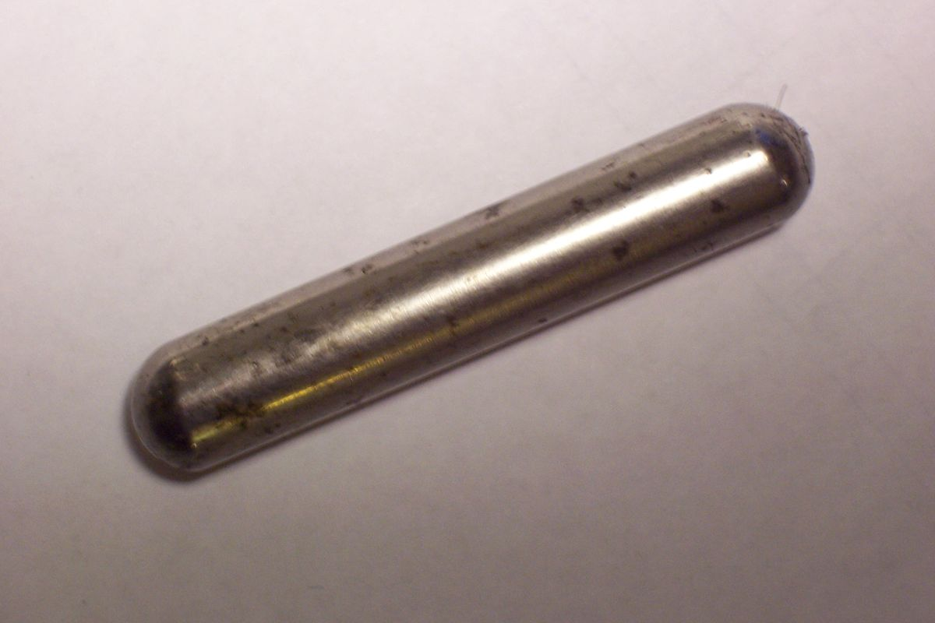
Read the passage about “cow magnets” and answer the questions.
Cows love to eat grass. Sometimes the grass has small bits of metal hidden in it and the cows eat the metal by mistake.
The metal bits can harm the cows. So, farmers can feed the cows a special magnet called a “cow magnet”.
This attracts the metal bits into one place, so they don’t harm the cow.
What do cows love to eat?
____________________________________________
What might the cows eat by mistake?
____________________________________________
Who looks after the cows?
____________________________________________
How do the farmers give the cow the magnet?
____________________________________________
What does a “cow magnet” do?
____________________________________________
a cow magnet
Stretch:
Describe what life would be like without magnets.
Challenge:
Write 4 things you use magnets for.

Slide 3
Magnets are found in lots of every objects.
Circle the objects below that contain a magnet.
ANSWERS
books | DVD player | fan | paperclip
teddy bear | electric toothbrush | pen | screw
phone | blender | whiteboard | clock
lamp | microphone | microwave | headphones
washing machine | sponge | hammer | cow
Non-magnetic
Magnetic not a magnet
Non-magnetic
Non-magnetic
Magnetic not a magnet
Magnetic not a magnet
Magnetic not a magnet
Non-magnetic
Magnetic not a magnet
See page 2
Hint: objects that contain a motor, make sounds or record sounds contain a magnet.

