Slide 1
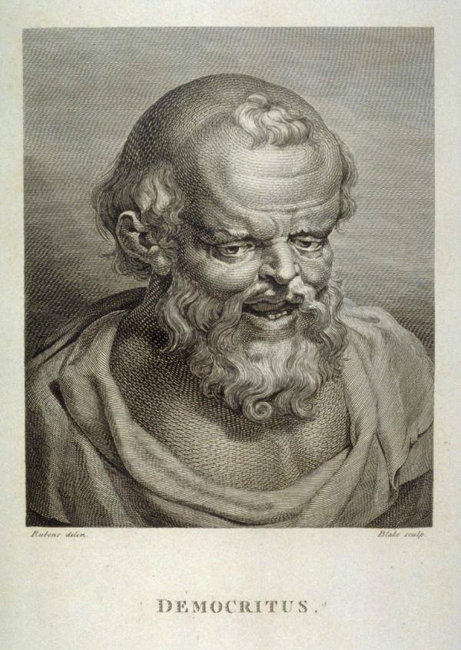
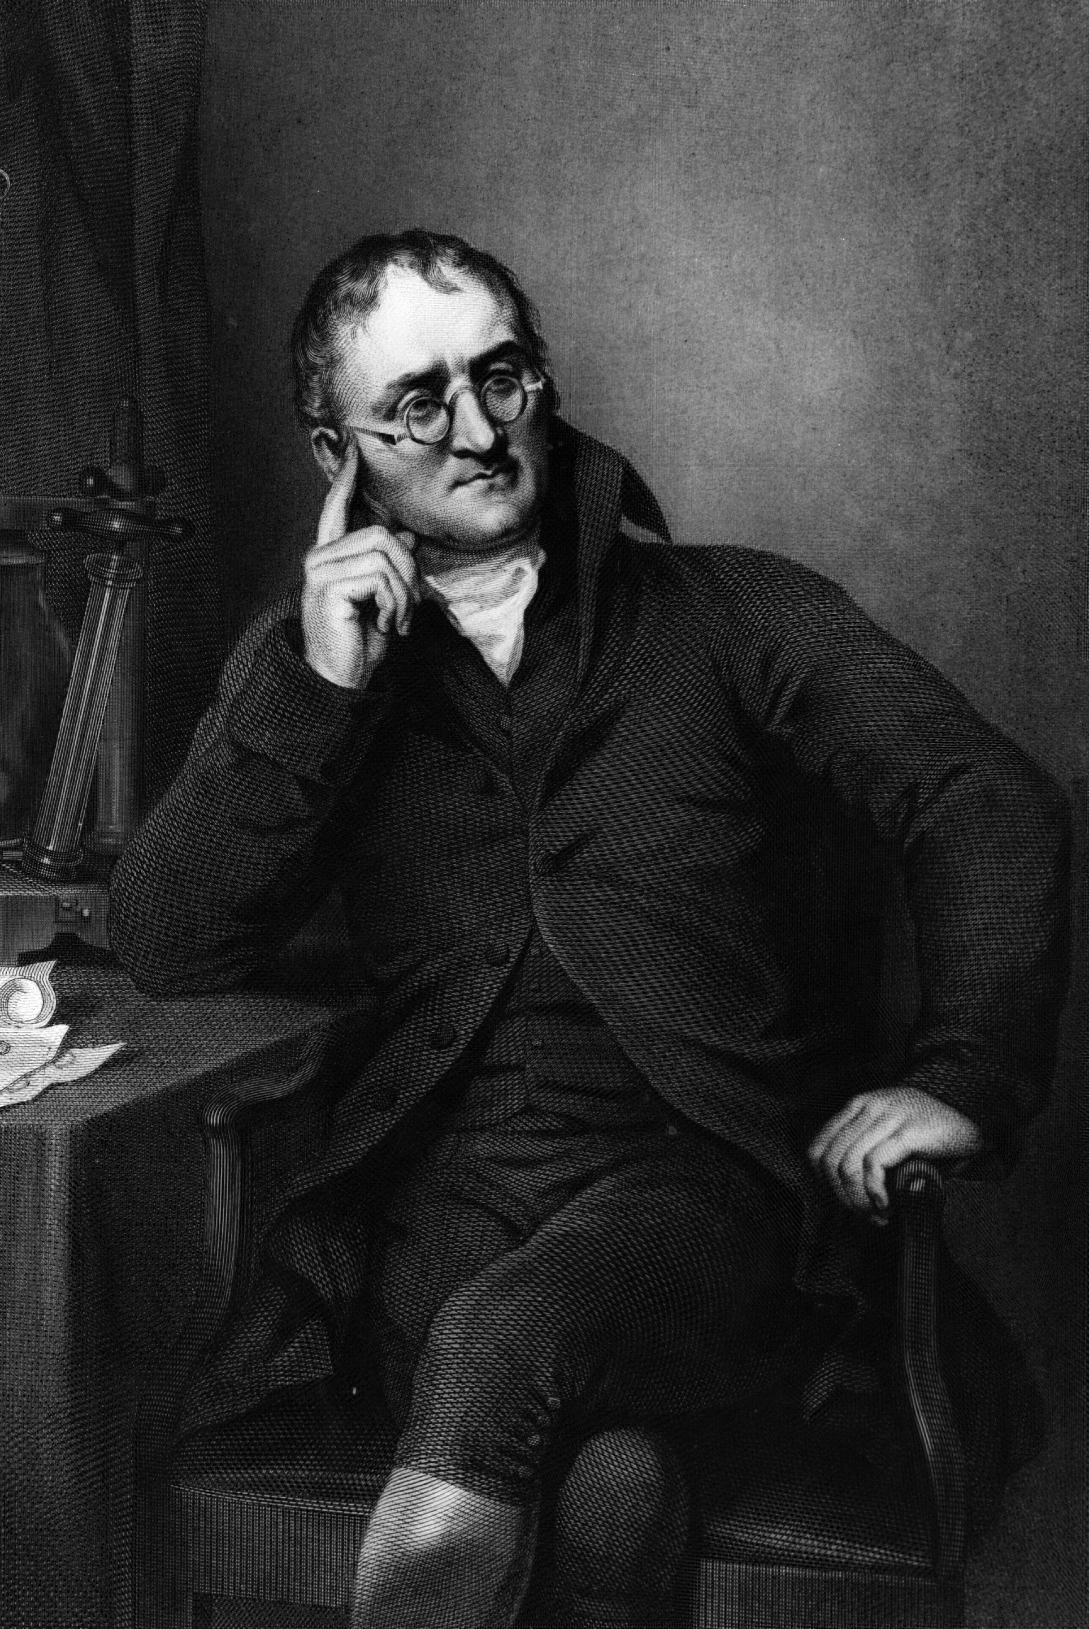
Describe how ideas about the atom have changed
Mission Assignment:
Code: N21_01_04
History of the Atom
Read the descriptions of the atoms and produce a physical model to represent them.
 | Democritus ~ 500BC
Description | Democritus’s theory was everything is composed of "atoms", which are physically indivisible. Between atoms, there is empty space. Atoms are indestructible, and have always been and always will be in motion. There is an infinite number of atoms and of kinds of atoms, which differ in shape and size.
Evidence | No evidence given. Democritus was a philosopher. There was no scientific method of testing at this time.
 | John Dalton ~ 1800
Description | Elements are made of extremely small particles called atoms. Atoms of a given element are identical in size, mass and other properties; atoms of different elements differ in size, mass and other properties. Atoms cannot be subdivided, created or destroyed. Atoms of different elements combine in simple whole-number ratios to form chemical compounds. In chemical reactions, atoms are combined, separated or rearranged.
Evidence | Dalton worked with pressures and weights of different gases and his experiments led him to believe that the different gases' properties depended on tiny particles with varying weights. Dalton was the first to attempt a table of atomic weights.
Developing Experts Copyright 2022 All Right Reserved

Slide 2
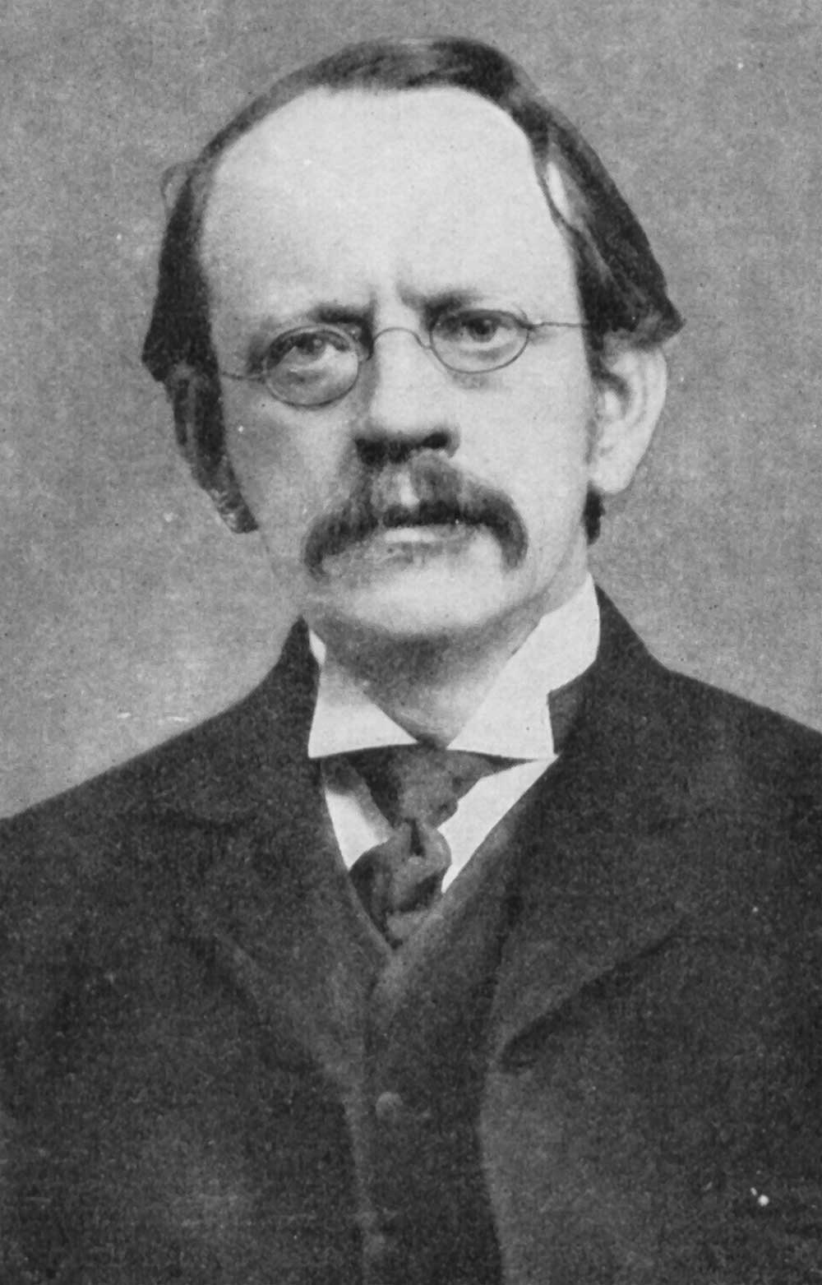
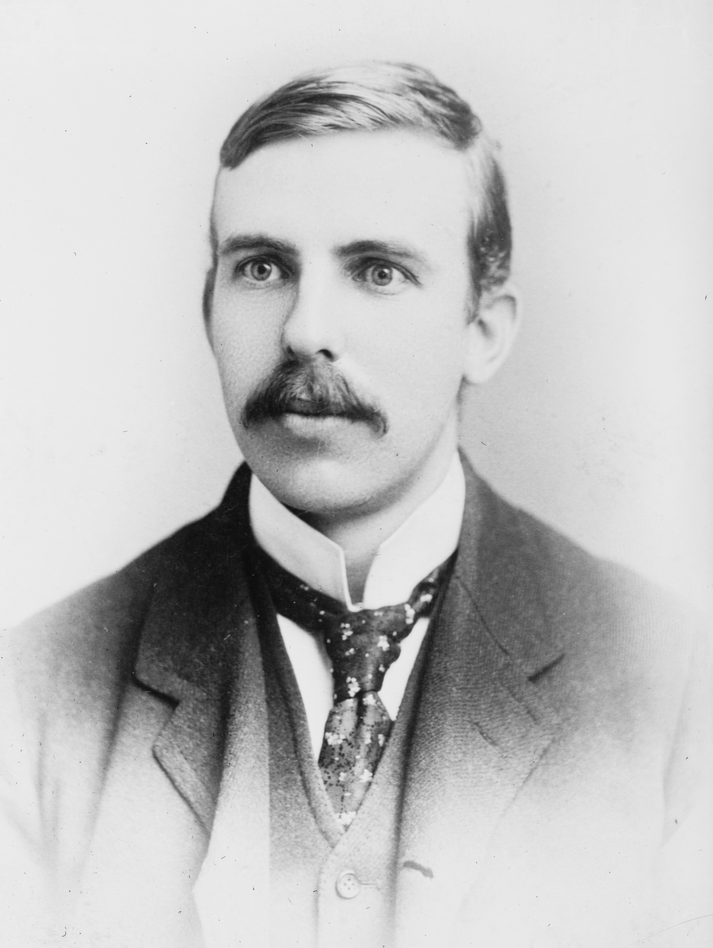
Describe how ideas about the atom have changed
Mission Assignment:
Code: N21_01_04
History of the Atom
Stretch Yourself
Read through the descriptions of these modern descriptions of the atom and try to make a physical model to visualise them.
 | J. J. Thomson - 1904
Description | Thomson is probably best known for the discovery of the electron (a negatively charge subatomic particle). He then described the atom as like plum pudding (a traditional English dessert). His atomic model was a large ball of positive charge, with free moving electrons throughout.
Evidence | Electrons could be isolated and stripped off materials, leaving a large positively object. This model does not suggest the existence of an atomic nucleus.
 | Earnest Rutherford - 1911
Description | Rutherford proposed the idea of an atom with a small, dense, positively charge nucleus. This is now a widely accepted model of the atom. A small nucleus with shells (layers) of electrons orbiting around the nucleus.
Evidence | Rutherford fired alpha particles (small positively charged particles) at a thin sheet of gold leaf, (only about 30 atoms thick). He observed 99% passed straight through, the remainder deflected with a small potion bouncing straight back. He concluded the nucleus must be small and the atom largely empty space. If all the mass is in the nucleus it must be very dense. As alpha particles are deflected they must be positively charged.
Developing Experts Copyright 2022 All Right Reserved

