Slide 1
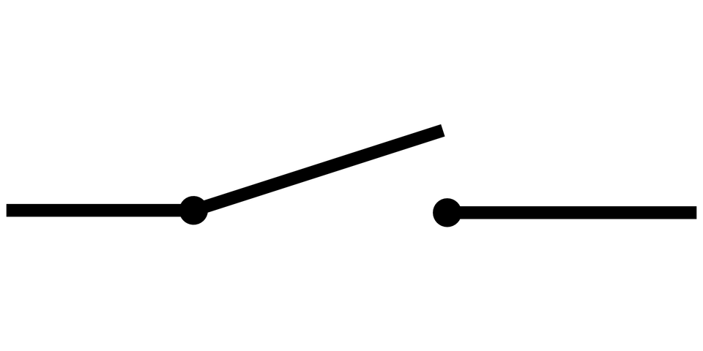
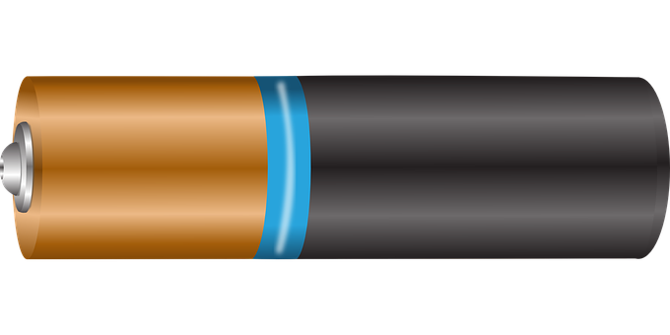
Investigate which materials reduce the
volume of a buzzer most effectively.
You will need:
A simple circuit containing a battery, a buzzer & a switch.
Samples of materials including; sponge, paper, corrugated card, cloth, foil etc. These should be cut to the same size and be able to cover the top and sides of the buzzer.
You may want a quiet area where you won’t be disturbed or disturb others, as this experiment can be distracting.
Instructions:
Close the switch to test how loud the buzzer is, then switch it off again.
Place one of your materials on top of the buzzer. You may want to hold down the material or secure it with sticky tack/tape.
Close the switch and test the loudness the buzzer. Give this a volume score between 1-10 (1 is absolute silence, 10 is the same as the buzzer with no material).
Repeat steps 2-3, replacing the material each time.
When you have tested all the materials, write them out in order from the most to the least absorbing.
Material | Sponge | Paper | Corrugated card | Cloth | Foil
Volume score /10
Most Absorbing |  |  |  | Least Absorbing

Slide 2
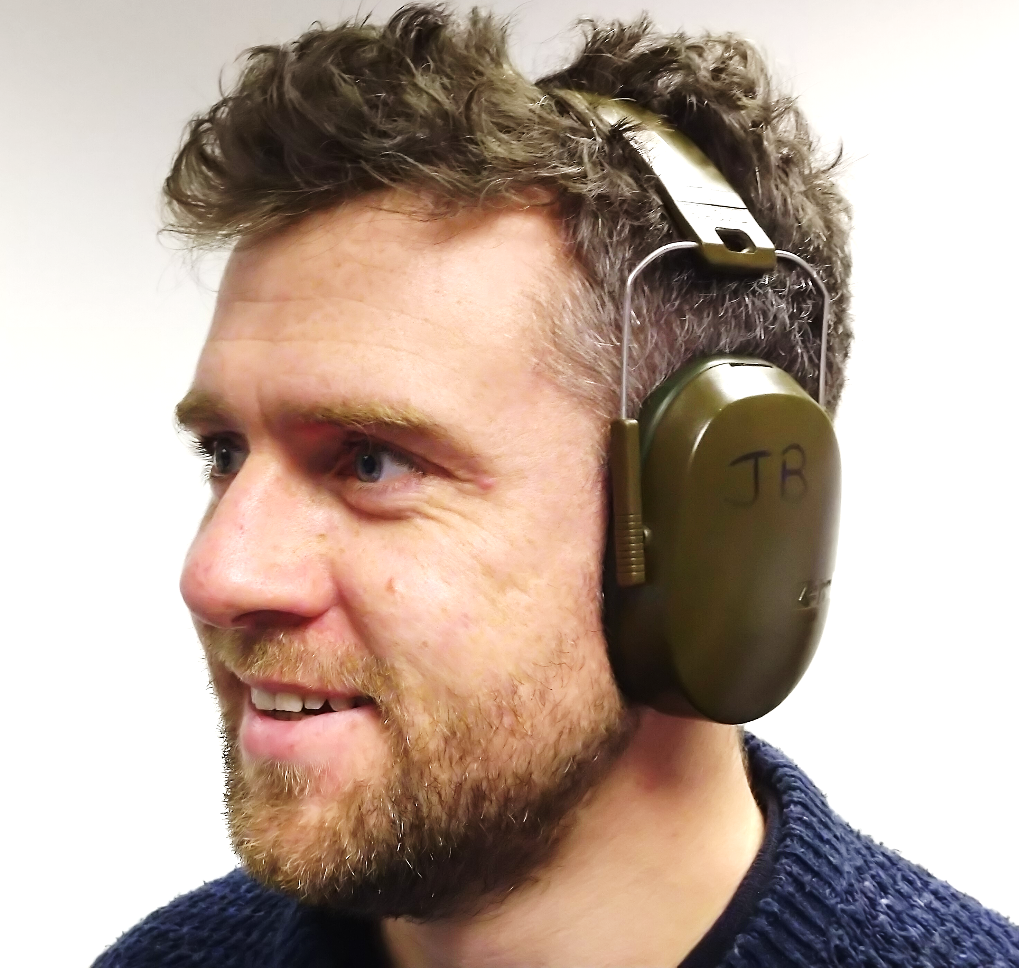
Which of your materials reduced the noise most effectively?
__________________________
Explain why you think this material reduced noise the most.
_____________________________________________________________________________________________________________________________________________________________________
_______________________________________________________
Ear defenders are worn to protect hearing in loud environments. Could the material from the previous question be used to make ear defenders? Explain your idea.
_________________________________________ _________________________________________ _________________________________________ _________________________________________
Which of your materials reduced the noise least effectively?
__________________________
Explain why you think this material reduced noise the least.
_____________________________________________________________________________________________________________________________________________________________________
A student says, “we could test the materials by using them to cover and block our ears”. Why is this a bad idea? ___________________________________________________________________________________________________________________________________________________________________________________________________________________________________________________________________________________

