Slide 1


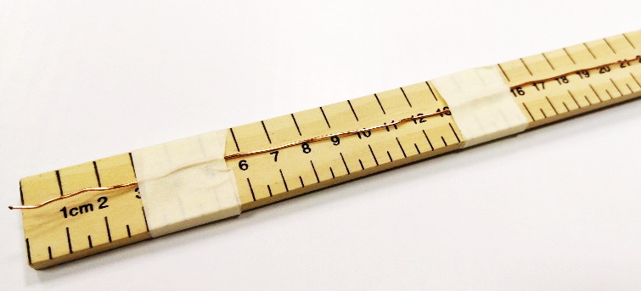
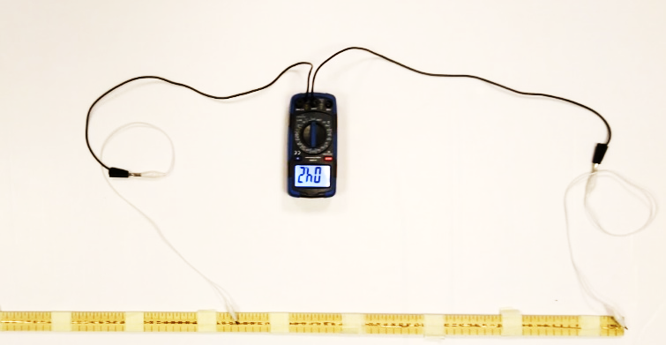
Mission Assignment: Explain the causes and effects of electrical resistance
KS3-22-04
In this experiment, you will be measuring the resistance of a wire when you change the length. There are three possible methods, depending on the equipment you have available.
Equipment
Meter ruler with a thin uninsulated wire secured to it with masking tape (copper or constantan)
Connecting wires
Crocodile clips
Ohmmeter
Method 1 - Ohmmeter
This is the simplest method and requires no power source.
Connect the 0cm end-mounted wire to the ohmmeter.
Place the other connecting wire from the ohmmeter on the mounted wire at the 20cm mark. Press firmly or grip with the crocodile clips, as the wire may have a layer of oxidised metal on it preventing electrical conduction.
Record the reading from the ohmmeter.
Completely remove the connecting wire from the wire on the ruler to take a second reading and repeat this again for a third reading. The three readings will be averaged when you process your results.
Repeat steps 2-3 placing the connecting wire at different distances along the wire (every 20cm up to 100cm).
Length of wire (cm) | Resistance (Ω)
 | Reading 1 | Reading 2 | Reading 3 | Average
20
40
60
80
100
Developing Experts Copyright 2023 All Rights Reserved

Slide 2
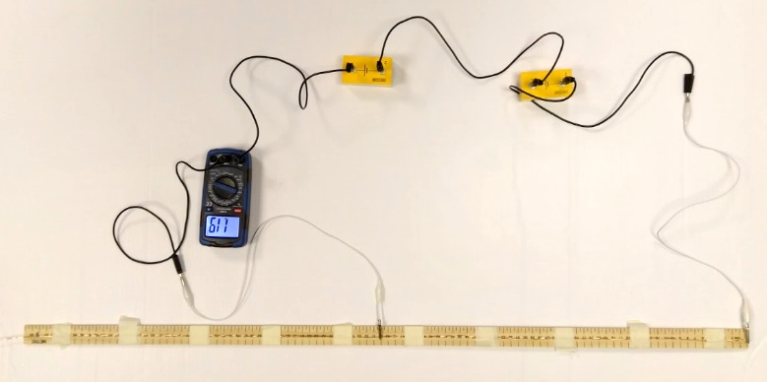
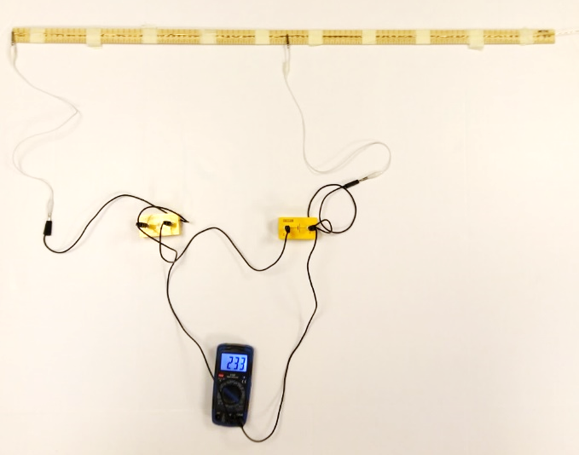
Mission Assignment: Explain the causes and effects of electrical resistance
KS3-22-04
In this experiment, you will be measuring the resistance of a wire when you change the length. There are three possible methods, depending on the equipment you have available.
Equipment
Meter ruler with a thin uninsulated wire mounted to it with masking tape (copper or constantan)
Connecting wires
Crocodile clips
2 cells
Voltmeter & Ammeter
Ammeter
Method 2 - Calculating resistance using a voltmeter and ammeter
Connect the two cells together in series and one end to the 0cm end of the mounted wire.
Using the voltmeter, measure the voltage across the cells. Record this below. If you don’t have access to a voltmeter, you can assume a voltage of 3V. Remember when measuring voltage, you place the voltmeter in parallel with the object you are measuring.
Place the ammeter in a series loop with the cells. Connect this to the connecting wire at the 20cm mark.
Record the reading from the ammeter. Then completely remove the connecting wire from the wire on the ruler to take a second reading and repeat this again for a third reading. The three readings will be averaged when you process your results.
Repeat steps 3-4 placing the connecting wire at different distances along the wire (every 20cm up to 100cm).
To calculate the resistance of the wire, take your value for voltage and divide by your reading for current.
Length of wire (cm) | Current (A) | Resistance (Ω)
20
40
60
80
100
Voltmeter
Developing Experts Copyright 2023 All Rights Reserved

Slide 3
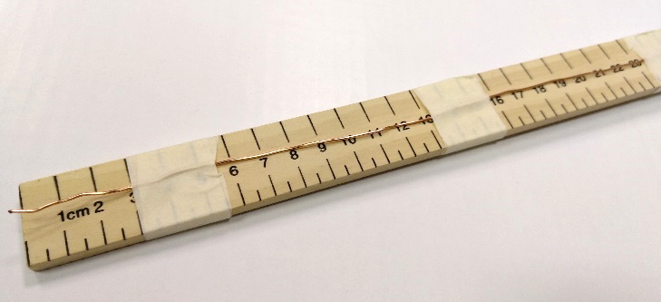
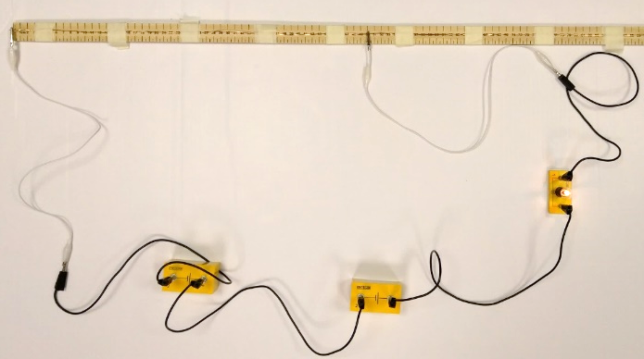
Mission Assignment: Explain the causes and effects of electrical resistance
KS3-22-04
In this experiment, you will be measuring the resistance of a wire when you change the length. There are three possible methods, depending on the equipment you have available.
Equipment
Meter ruler with a thin uninsulated wire mounted to it with masking tape (copper or constantan)
Connecting wires
Crocodile clips
2 cells
1.5V bulb
Method 3 - Brightness of a bulb
This is a qualitative method to observe the change in resistance.
Connect the two cells together in series and one end to the 0cm end of the mounted wire.
Place the bulb in a series loop with the cells and connect the remaining connecting wire to the wire at the 20cm mark.
Describe the brightness of the bulb. You could do this verbally or giving a mark out of 10.
Repeat steps 2-3 placing the connecting wire at different distances along the wire (every 20cm up to 100cm).
Length of wire (cm) | Brightness of Bulb
20
40
60
80
100
What does the brightness of the bulb tell us about the resistance in the wire? ________________________________________________________________________________________________________________________________________________________________________________________________________________________
Developing Experts Copyright 2023 All Rights Reserved

