Slide 1
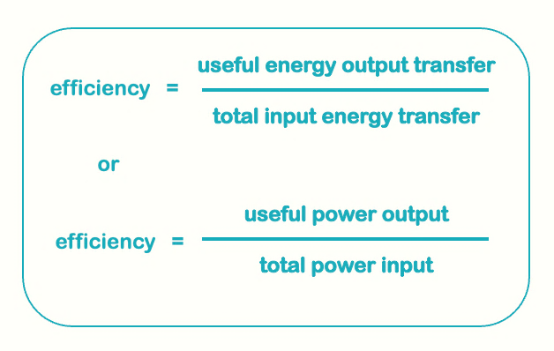
Teacher answers
3000 / 15000 = 0.2 X 100 = 20%
24 kJ = 24000 J
0.45 X 24000 = 10,800 J
Wasted = 24000 - 10800 =. 13,200 J (55%)
102 - 9 = 93 J Eff = 93 / 102 = 0.91 or 91%
Energy cannot be destroyed or created; it can only be transferred between energy stores. Machines involve energy transfer. Give marks for energy lost through dissipation due to friction - heat and sound. Mechanical parts can never be friction-free, and even with lubrication and bearings you cannot completely eradicate friction. That means that no machine can ever be 100% efficient.
Kinetic to electrical
Appliance | Energy in (J) | Useful energy out (J) | Efficiency (%)
A | 100 | 20 | 20
B | 200 | 50 | 25
C | 350 | 280 | 80
D | 2800 | 70 | 2.5
E | 100 | 50 | 50
F | 160 | 40 | 25
G | 45 | 13.5 | 30
H | 28.50 | 30 | 95

