Slide 1
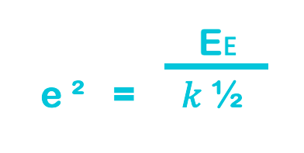
Teacher answers
𝑘 = ½ e ² e ² = 𝑘 ½
0.6 J E𝖤 = ½ 𝑘e ²
0.5 X 7.5 x 0.40 ²
Completed triangle
Joules = J
0.7 m
196 ➗ 400
0.0343 J
E𝖤 = ½ 𝑘e ²
= 0.5 X 14 X 0.07 ²

