Slide 1
Lord Kelvin and kinetic energy
One of Scotland’s most famous scientists, engineers and mathematicians was William Thomson, 1st Baron Kelvin. William had been born in Belfast and moved to Glasgow when his father was appointed as professor of mathematics at the university. At the age of 10, he began his own studies at the university.
He was prolific in his inventions and discoveries. Among other things, the Kelvin Scale of absolute temperature is named after Lord Kelvin. He contributed to the laws of thermodynamics.
He is credited as being the first scientist to coin the term ‘kinetic energy’.
Kinetic energy: the energy an object or particle has by reason of its motion
Kinetic Energy = ½ X Mass X Velocity²
(Joules) (kg) (m/s²)
Eᴷ = ½ MV²
Question:
What is the kinetic energy of a car that travels at a speed of 20 m/s and has a mass of 1500 kg?
Example:
What is the kinetic energy of a car that travels at a speed of 20 m/s and has a mass of 1500 kg?
Kinetic Energy = ½ X Mass X Velocity²
= 0.5 X 1500 X 20²
= 300,000 J = 300 kJ

Slide 2
Practice questions
What is the kinetic energy of a runner with a mass of 62 kg running at a speed of 0.8 m/s?
____________________________________________________________________________________________________________________________________
What is the velocity of a bus travelling through town with a mass of 5040kg and kinetic energy of 493900J?
______________________________________________________________________________________________________________________________
What is the velocity of a hot air balloon with a kinetic energy of 76550J and a mass of 1890kg?
_____________________________________________________________________________________________________________________________________________________________________
Calculate the mass of a wind turbine blade with a kinetic energy of 104040J turning at 6m/s.
__________________________________________________________________________________________________________________________________________________________________________________________________________________

Slide 3
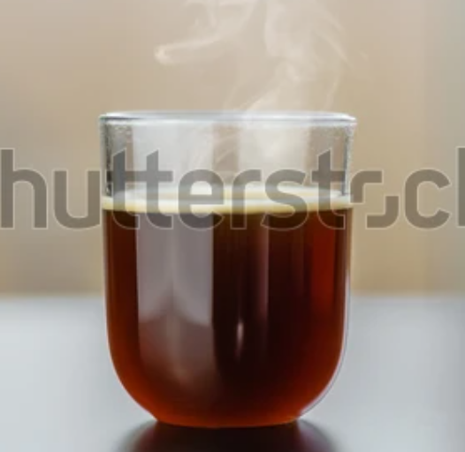
Energy stores
Read the statements in the table and match them with one of these energy stores
Kinetic
Gravitational
Thermal
Elastic
Chemical
Definitions of different energy stores | A - E
Energy stored in an object as a result of its height
A force acting on an object that may cause the shape of the object to change
The energy that an object or particle has because it moves
This energy is stored in the bonds of atoms and molecules
Energy that is contained in a system responsible for its temperature
Notes:
Missing image for thermal. Add image like this one from shutterstock https://www.shutterstock.com/image-photo/fresh-hot-french-pressed-filtered-coffee-1978564127

