Slide 1

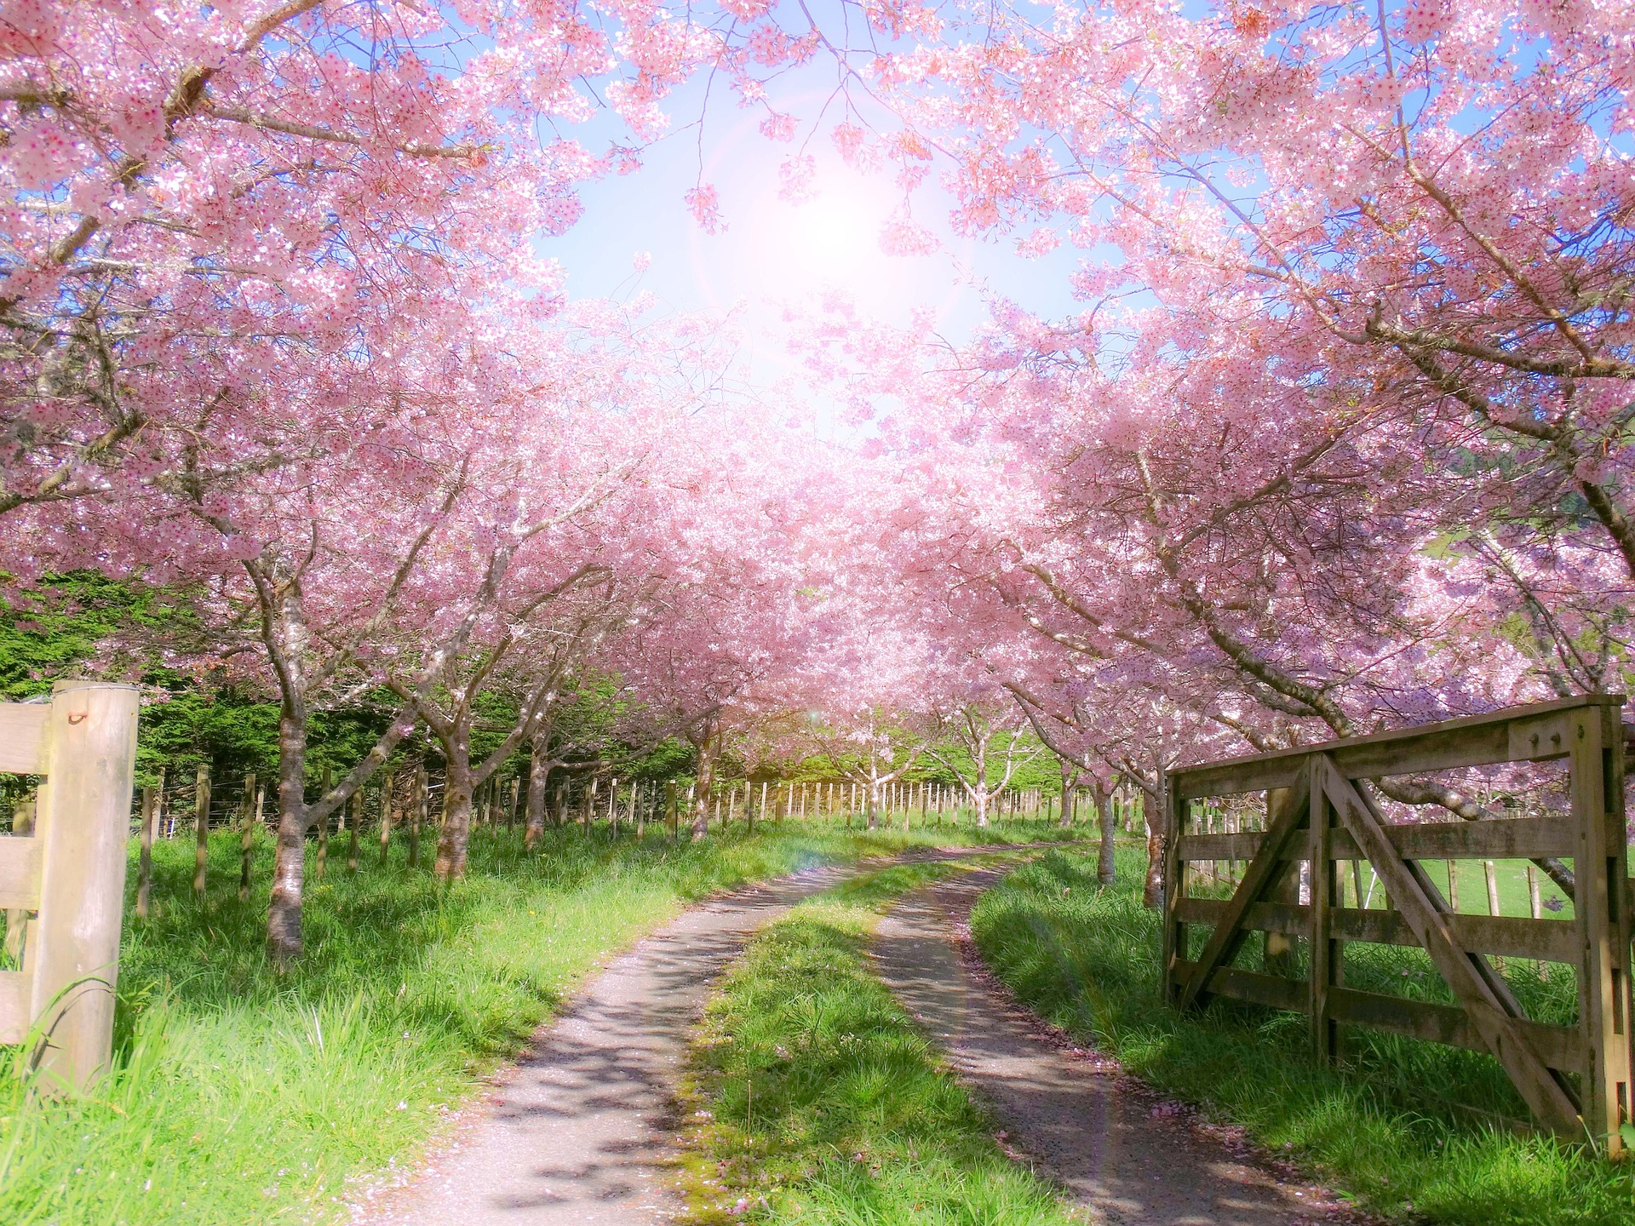

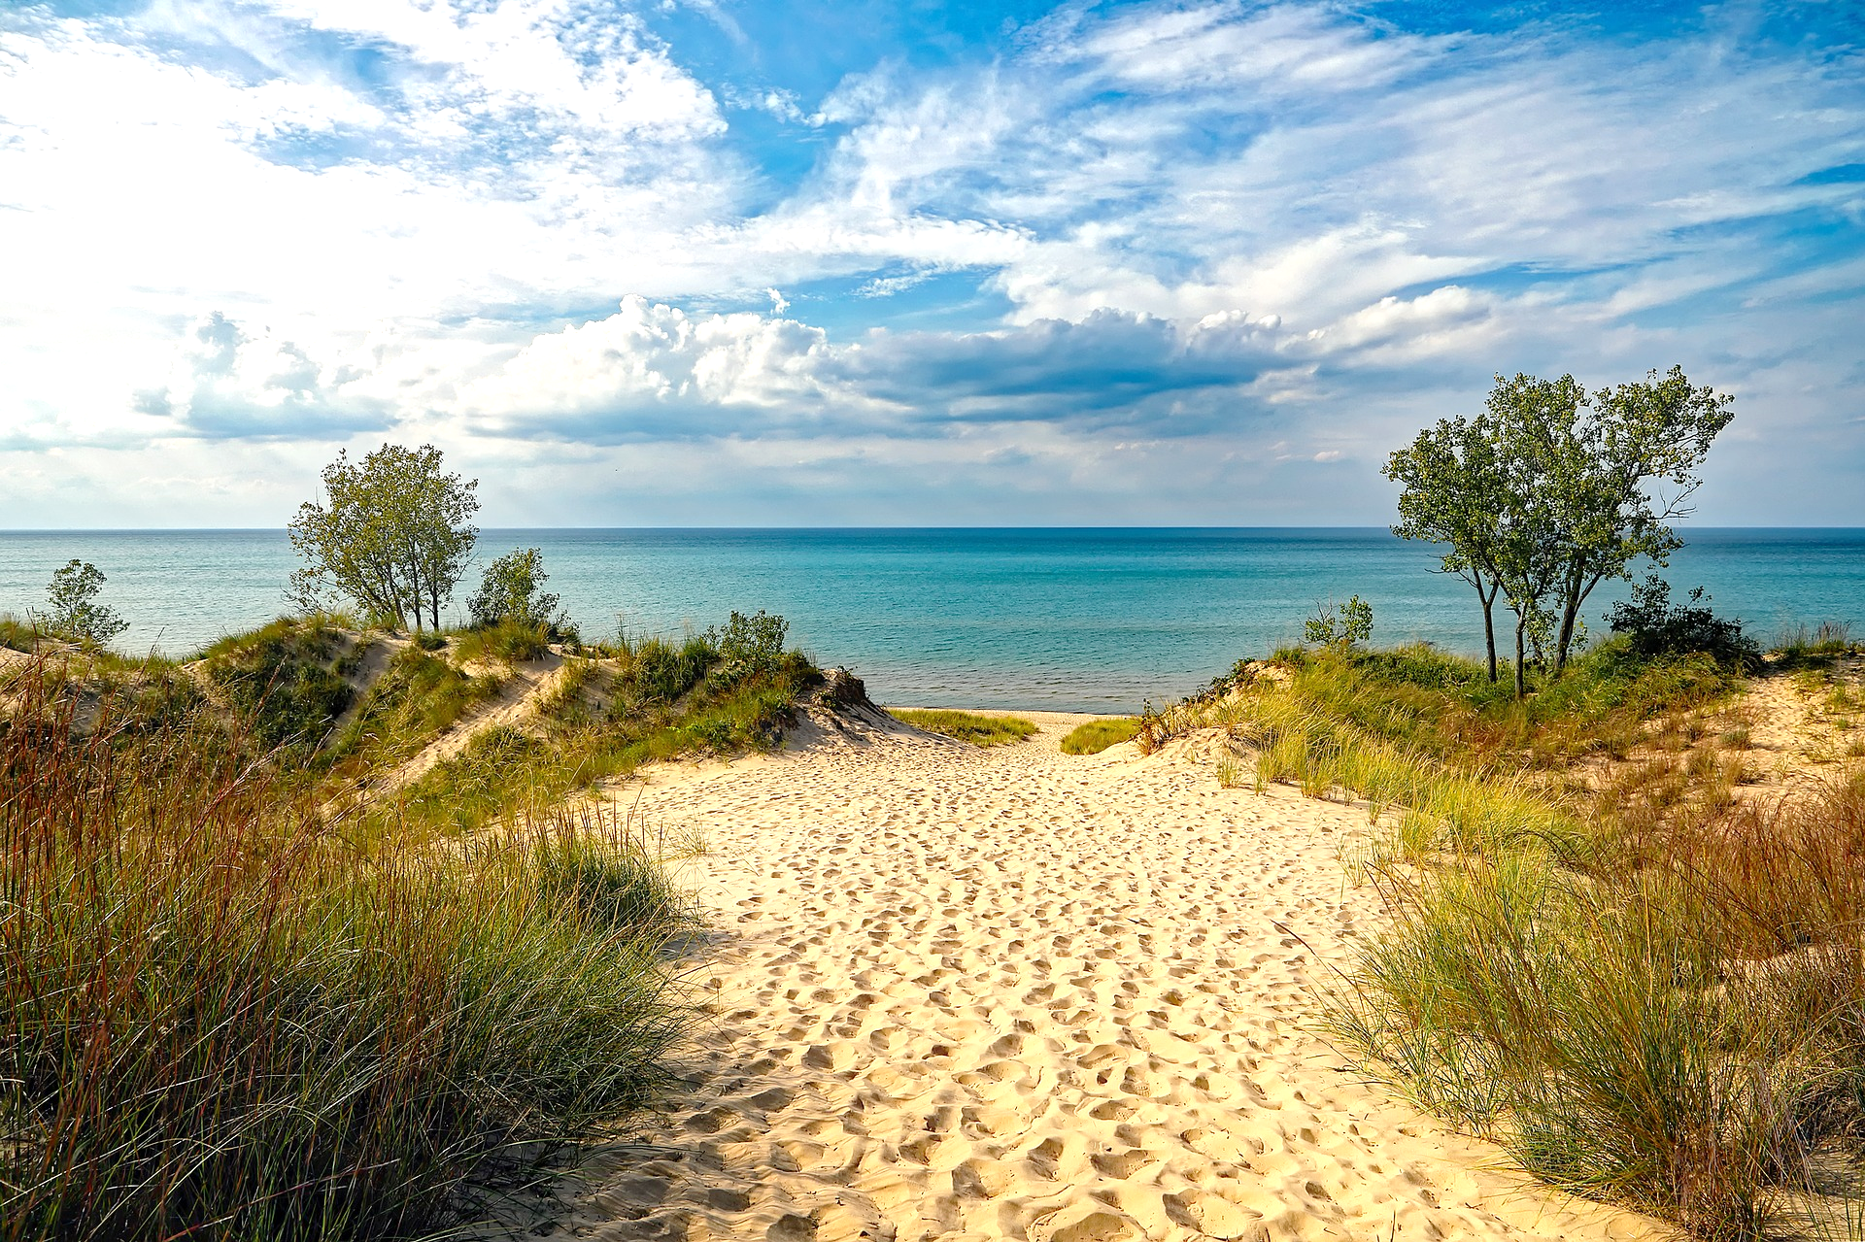
Mission Assignment: Learn about the seasonal changes that happen in spring and summer
EYFS-12-05
Stick an outfit on the person which is suitable for the season they are in.
Spring
Summer
2
Developing Experts Copyright 2024 All Rights Reserved

Slide 2
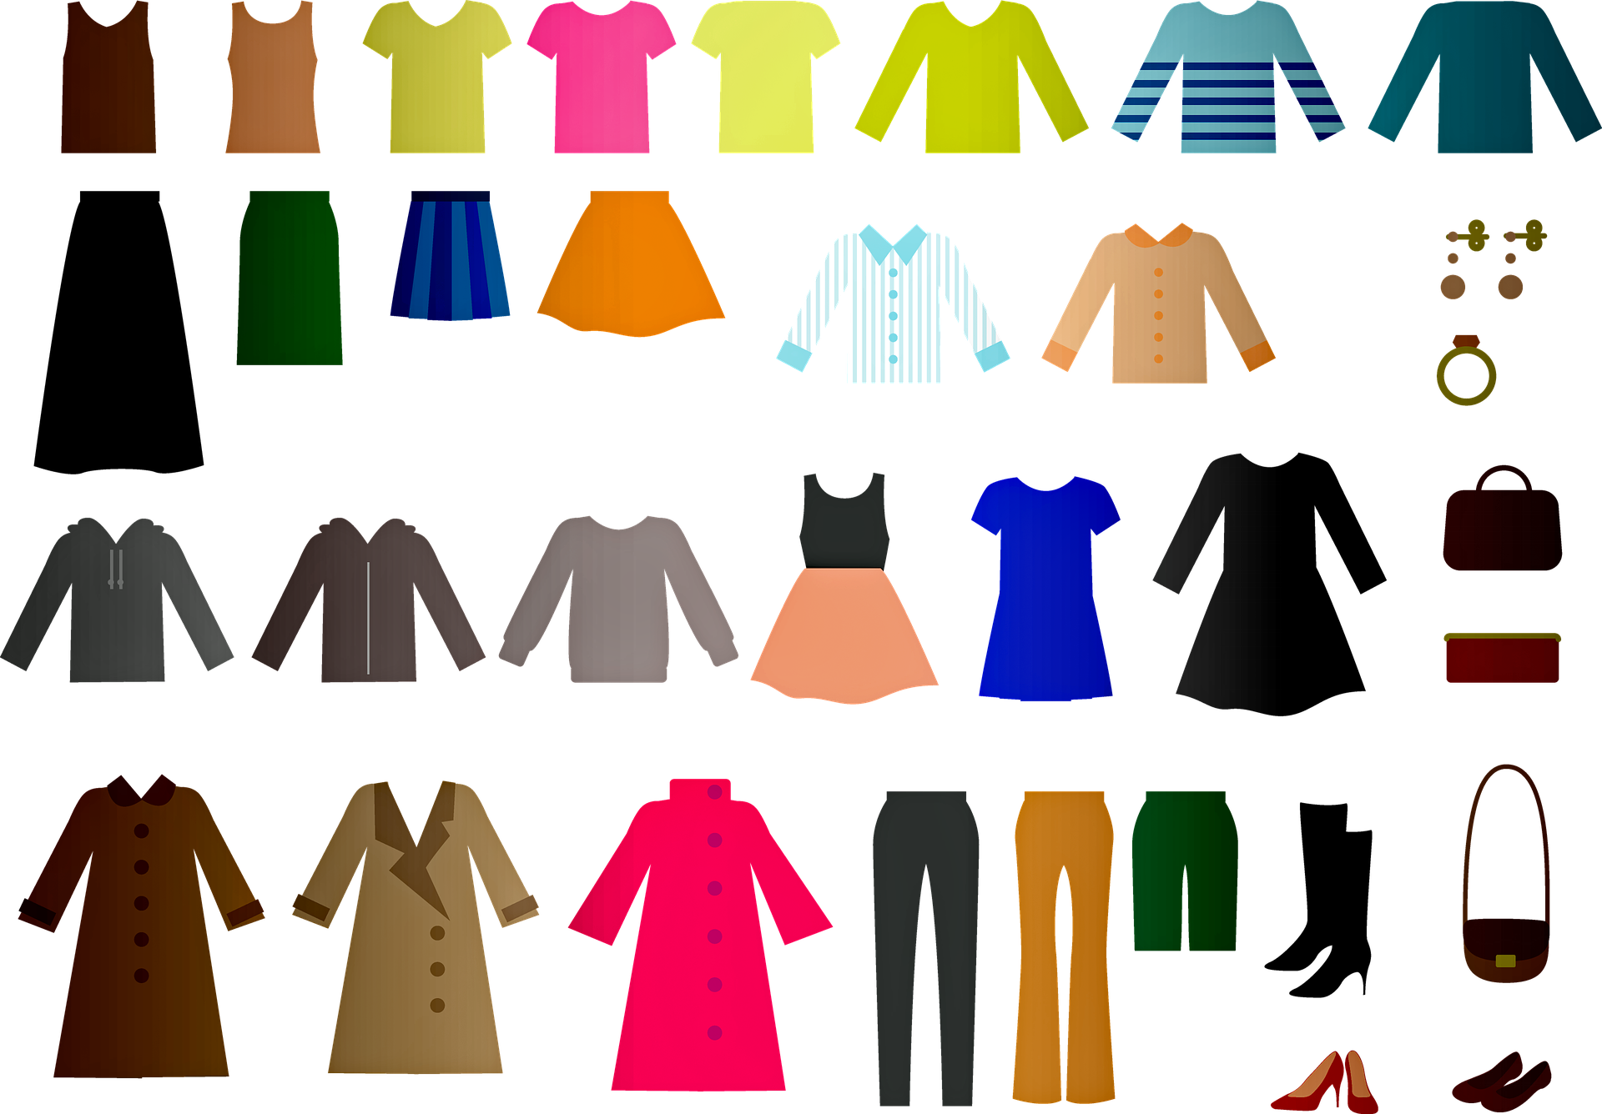
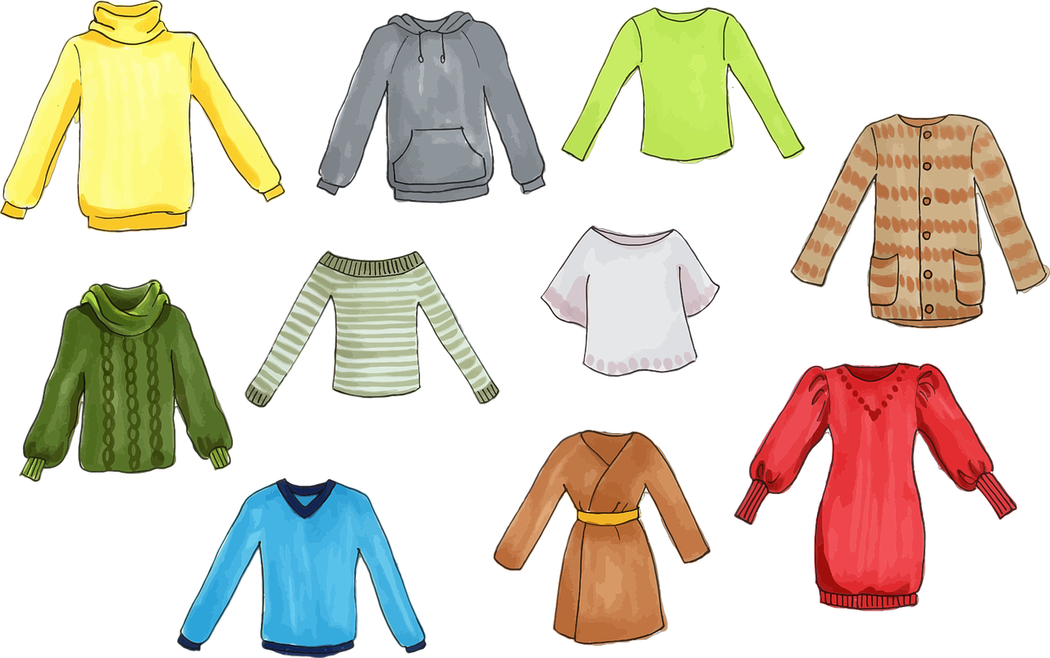
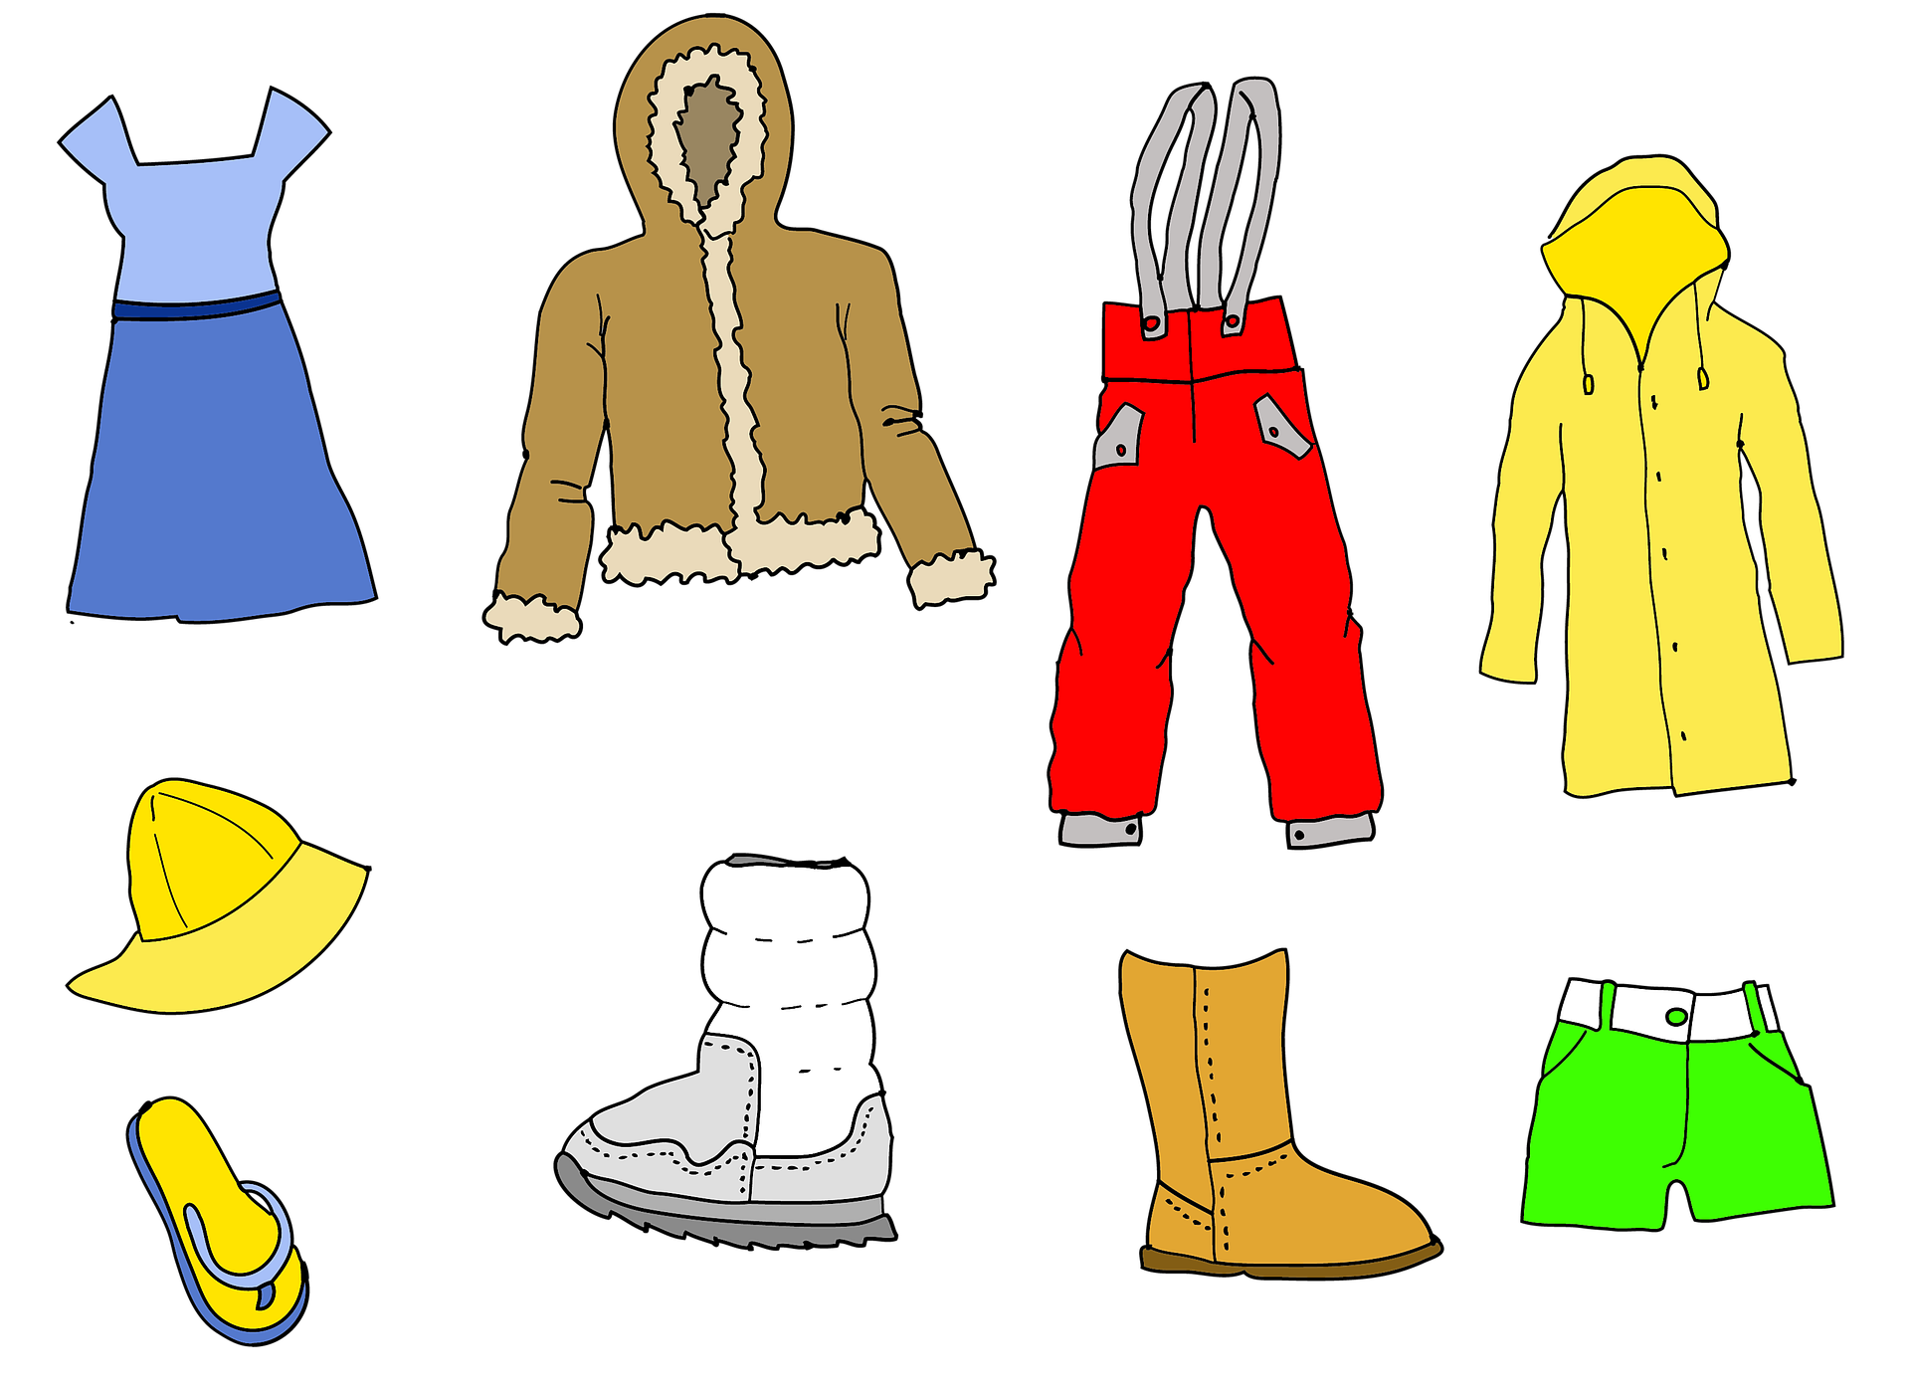
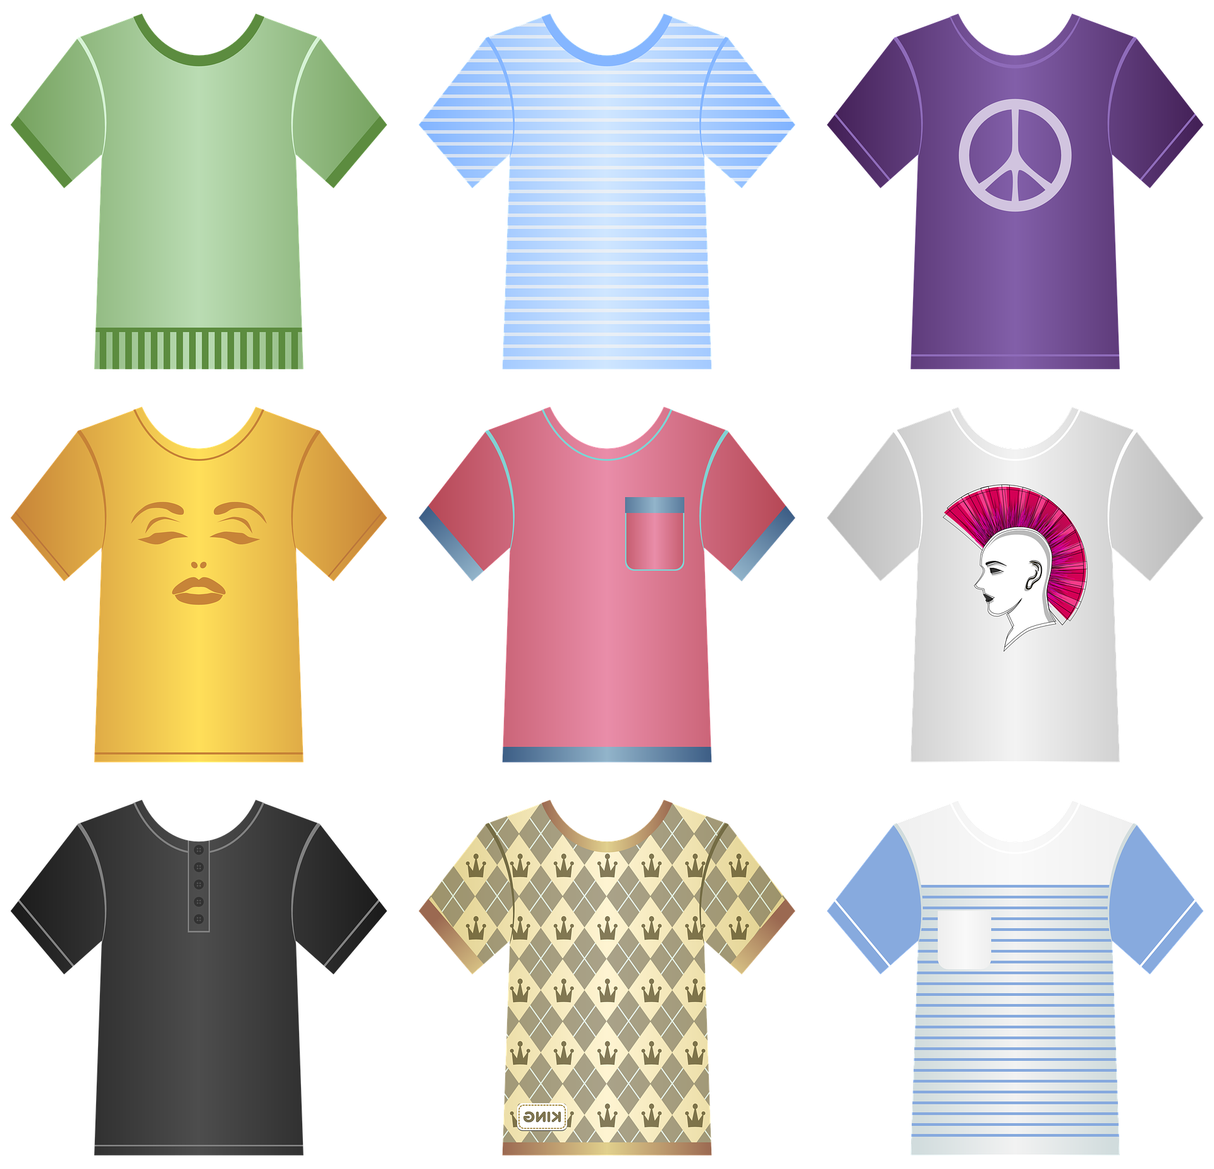

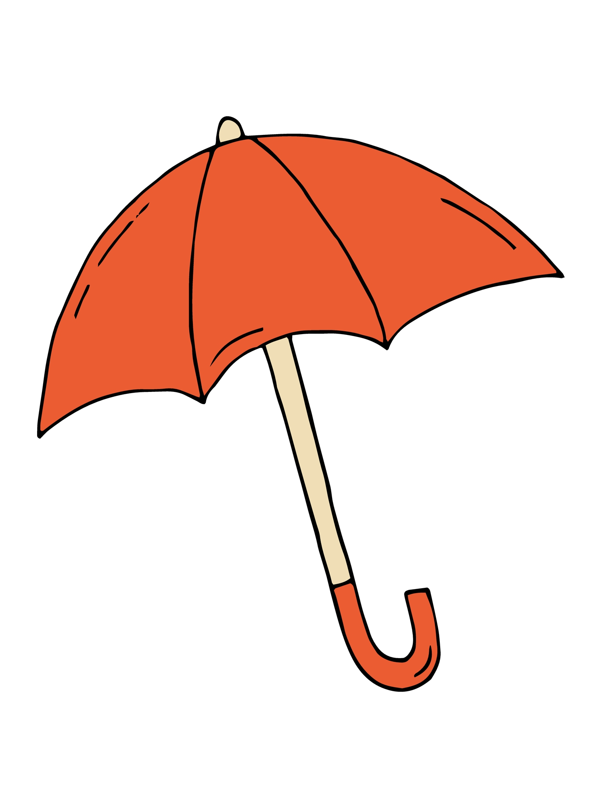
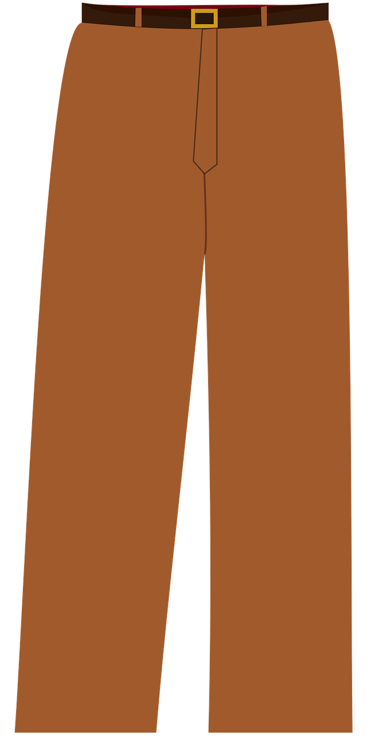
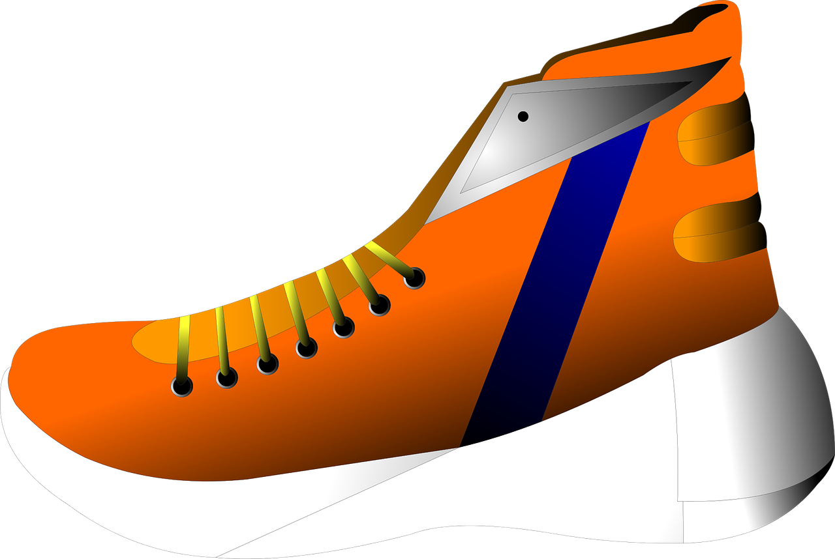
Mission Assignment: Learn about the seasonal changes that happen in spring and summer
EYFS-12-05
Cut out the clothes and use them to dress the people.
2
Developing Experts Copyright 2024 All Rights Reserved

Slide 3
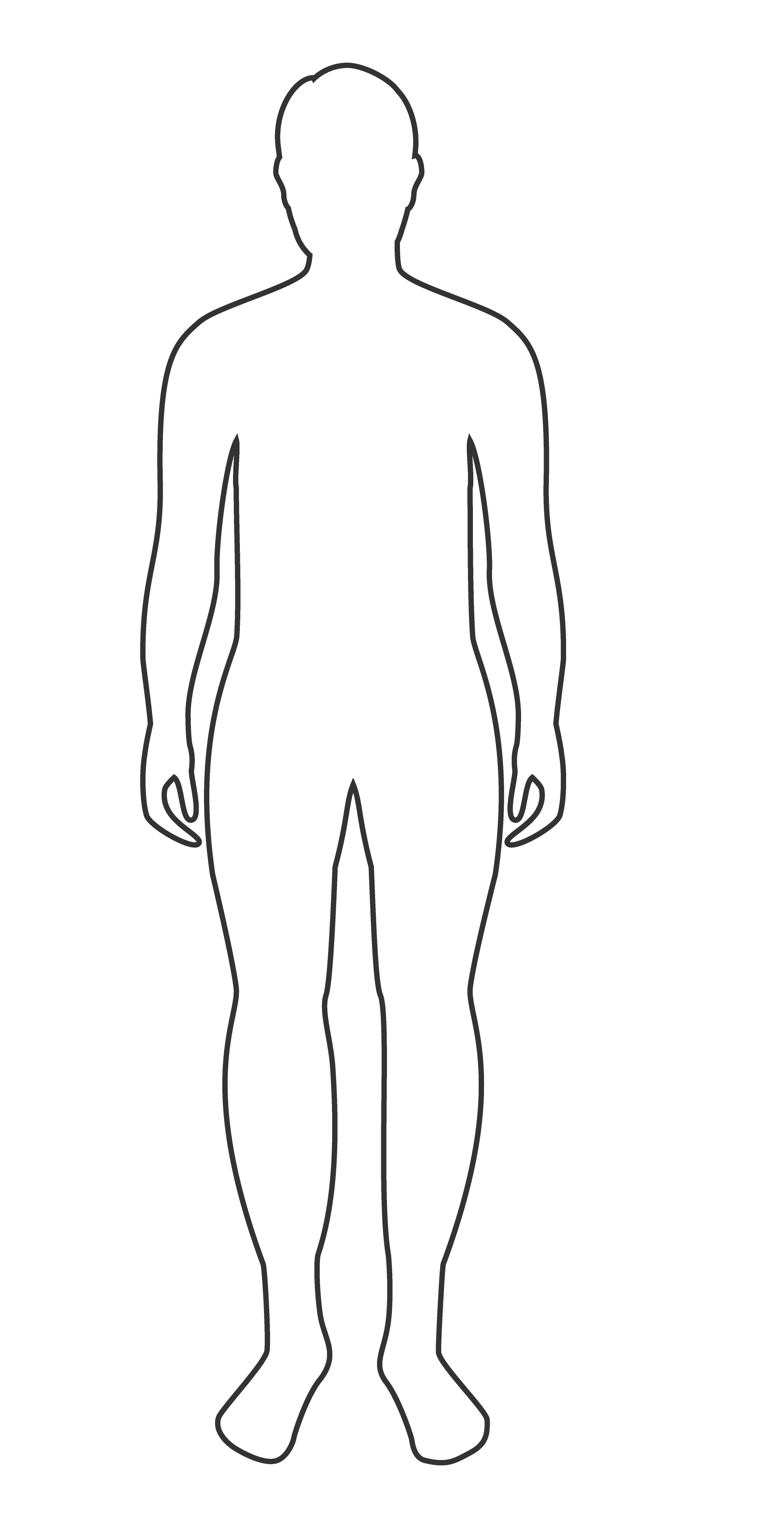
Mission Assignment: Learn about the seasonal changes that happen in spring and summer
EYFS-12-05
Can you design an outfit that would suit all seasons?
3
Developing Experts Copyright 2024 All Rights Reserved

